Slide 1
Shrinking AI to fit your phone —
does messy data make it worse?
Quantisation and data heterogeneity in federated fine-tuning of language models
[Your Name]
FOSE7901 STEM Research Placement · Macquarie University
Mentor: [Mentor name]

Slide 2
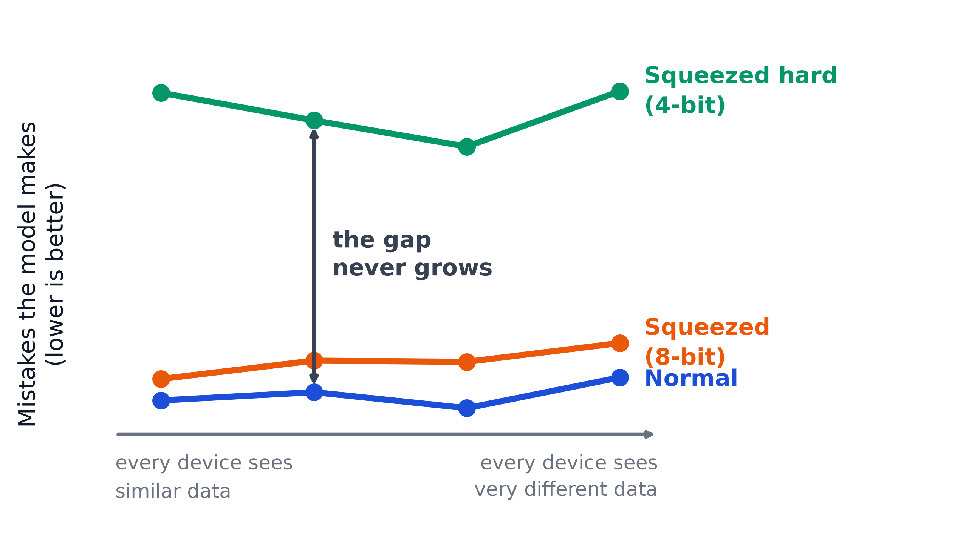
Squeezing the model costs no more when the data gets messy
24 experiments · 34 GPU-hours
8-bit
no measurable loss in quality
but 2.2× slower to train
4-bit
smallest memory footprint
but ~6% more mistakes
So choose how hard to squeeze from your hardware — not from your data.

