Slide 1
Aviation Investment: New Venture Risk Evaluation - Project Presentation
Executive Summary & Problem Restatement
Objective of the Study: To identify the kinds of airplanes that have the least risk for the company's venture to buy and fly airplanes for commercial and private purposes. This study offers recommendations that are actionable for the leader of the New Aviation Division to inform aircraft buying decisions.

Slide 2
Practical Challenge
The company does not have sufficient information on aviation hazards that render the decision-making process on the selection of aircraft to reduce the possibility of accidents, injuries, and economic losses difficult.
Stakeholders
The most immediate stakeholder is the Head of the New Aviation Division. This project will have a direct effect on their strategic buying decisions, allowing them to sidestep initial operational risks and make a safer, more profitable foray into the aviation business.

Slide 3
Key Recommendations
Prioritize Gliders & Powered Parachutes with lowest inherent risk profiles first, especially for initial private/recreational endeavors.
Study Specific Aircraft Models: For commercial airline use, analyze widely utilized aircraft models with low fatality rates and lower destruction ratios.
Implement Robust Operating Safety: Emphasize pilot training, weather, and adherence to flight procedures regardless of aircraft type.

Slide 4
Data Summary and Preparation Overview
Data Source - The research utilizes aviation accident data that has been obtained from the National Transportation Safety Board (NTSB) for accidents occurring from 1948 through 2022.
Relevance - This data is highly relevant since it actually tracks aviation incidents, aircraft types, and outcomes (damage, injuries), which are the very basic determinants of risk in aircraft operations.
Dataset Size:
Original: 88,889 records.
Cleaned: 88,406 records.
Major Features Used:

Slide 5
Cont
Aircraft.Category, Make, Model - Directly identify types of aircraft.
Total.Fatal.Injuries, Aircraft.damage - Measure incident severity and risk.
Event.Year - To examine temporal trends.
Weather.Condition, Broad.phase.of.flight - Give contextual risk factors.

Slide 6
Data Limitations
Lacking flight hours information does not permit the calculation of incident rates (incidents per flight hour), thus our risk assessment is by number of incidents and severity per incident, instead of exposure.
Latitude and Longitude had extraordinary outlier values even after imputation, which would affect geographical analysis if followed up on.

Slide 7
Data Preparation Overview
Initial Cleaning - Changed Event.Date to datetime, and Latitude/Longitude to numeric.
Missing Value Imputation - NaN categorical columns (Air.carrier, Airport.Code, etc.) were imputed with 'Unknown'. This preserves records and shows missing information explicitly.
Injury numbers (Total.Fatal.Injuries, etc.) were filled with 0, assuming missing as zero.
Other numerical (Latitude, Longitude, Number.of.Engines, Total.Uninjured) were filled with their respective medians.
Other categorical columns (Aircraft.damage, Engine.Type, etc.) were imputed with their modes.
Few records with missing values in Location, Country, Make, Model, and Amateur.Built were removed, considering they constituted a very tiny fraction of the whole dataset.
Outcome
A dataset that is complete with no missing values, prepared for rigorous examination.

Slide 8
Findings
Overall Patterns of Aviation Accidents
Aggregate figures of aviation incidents have generally decreased over the past decades. This is indicative of an improved safety environment in aviation.
Relevance: This is a trend that signals that while some risks still exist, the overall safety of the sector is improving, which is a good omen for potential market entrants. Second, this highlights the importance of understanding specific risk factors in this changing environment.

Slide 9
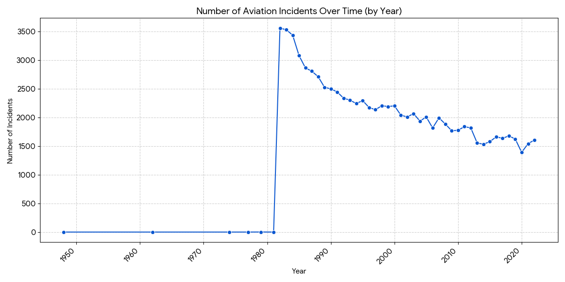
Visualization
Caption: Temporal Trends in Aviation Incidents (by Year). Each point represents the number of incidents noted during a given year. The line depicts the overall trend.

Slide 10
Risk by Aircraft Category - Incident Frequency
Finding
"Airplane" category leads incident tallies, mostly because of their numbers and prevalence of use, representing the overwhelming majority of events recorded. Other types such as "Helicopter" also register high incident tallies.
Implication for Stakeholder
While Airplanes have the most incidents, this does not automatically mean they are most risk because their exposure in operations is also greatest. It does mean, however, that operational processes for Airplanes must be more stringent because of their high involvement rate.

Slide 11
Risk Associated with Aircraft Categories - Severity of Injuries
The study found that :
"Rocket" and "WSFT" (Weight-Shift, assumed to be a type of Ultralight or Powered Parachute) have the highest average fatal injury per incident, despite their fairly low overall incident rates. Conversely, "Airplane" and "Helicopter" display fairly modest average fatal injuries, while "Glider" and "Powered Parachute" have significantly lower mean values.
Implication for Stakeholder
To minimize likely fatalities, categories like Gliders and Powered Parachutes appear to be safer per-incident. That has implications from a reputation and liability management perspective.

Slide 12
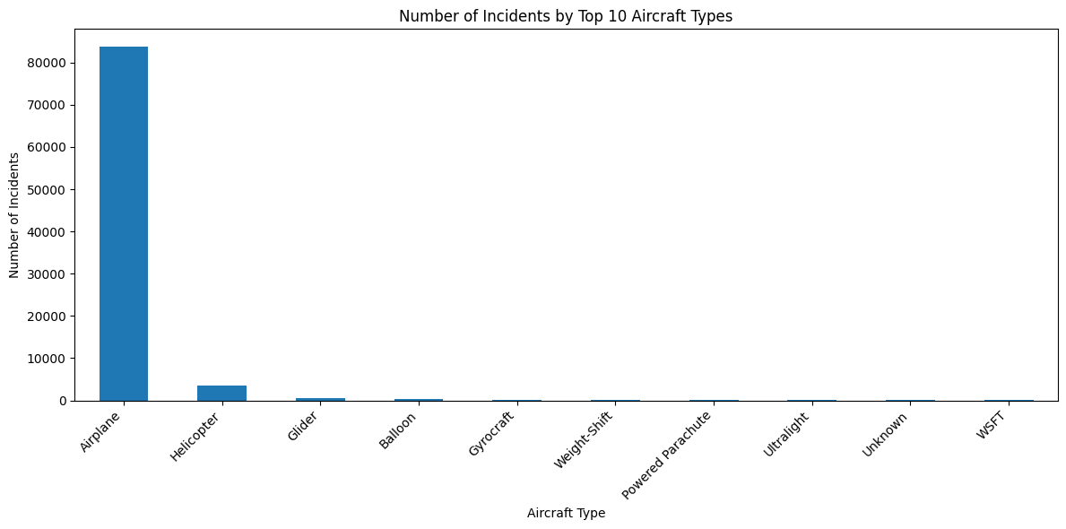
Visualization
number of incidents by air craft type

Slide 13
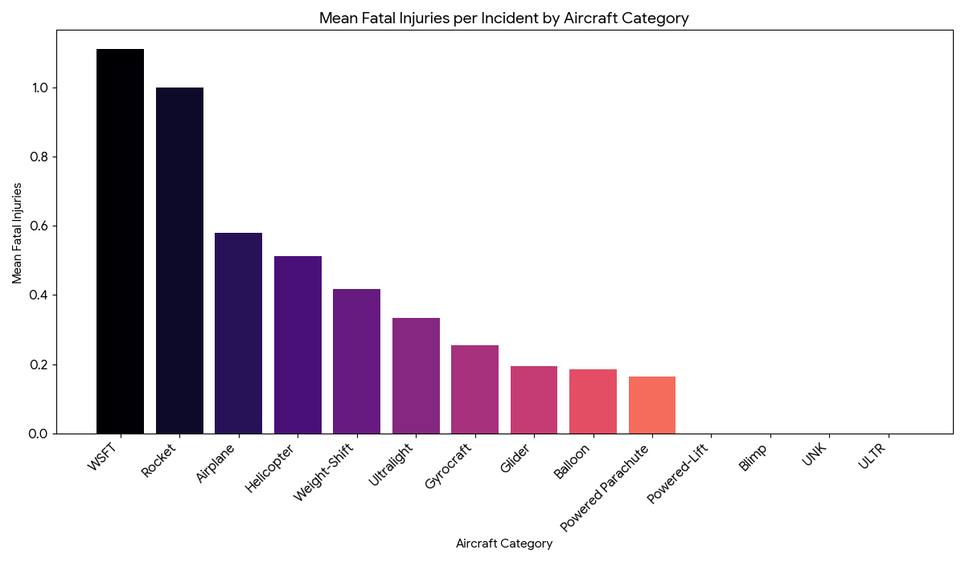
Visualization
Caption: Mean Fatal Injuries per Incident by Aircraft Category. Bars indicate the average number of fatalities for incidents by each aircraft category. Shorter bars represent lower average fatalities.

Slide 14
Risk by Aircraft Classification - Aircraft Damage Severity
The analysis indicates that:
"Rocket" (completely destroyed at 100%), "Blimp" (destroyed at 25%), and "Ultralight" (damaged at 16.67%) demonstrate the highest percentages of 'Destroyed' damage in accidents. Conversely, "Glider," "Weight-Shift," and "Powered Parachute" exhibit lower percentages of aircraft destruction.
Implication for Stakeholder
Minimizing aircraft write-offs is vital in maintaining financial viability. Classes with the lower percentages of destruction represent lower capital risk per incident.

Slide 15
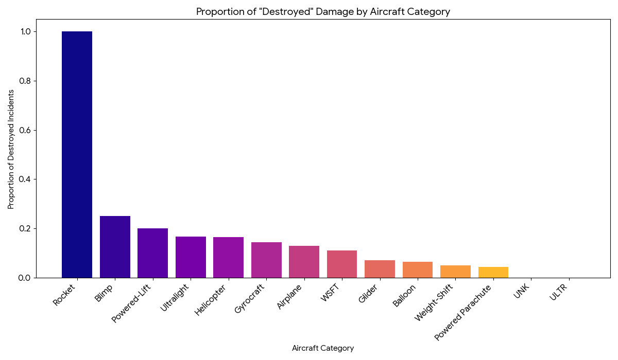
Visualization
Figure: Percent of "Destroyed" Damage by Aircraft Category. The bars are proportional to the proportion of occurrences in each category that involved destruction of the aircraft. Shorter bars indicate a decreased risk of damage.

Slide 16
Comprehensive Analysis: Risk Assessment of Leading Aircraft Manufacturers and Models
Observation:
Within the predominant "Airplane" class, wide variations in risk are observed. For instance, popular models such as the 'Cessna 152' and 'Cessna 172' have moderate rates of fatal injury events. Other models, however, such as the 'Cessna 150M' and 'Beech 35,' have relatively higher average fatal injury cases in the accidents they are involved in, whereas the 'Cessna 172N' and 'Cessna 172P' have lower rates.
Implication for Stakeholder
For business operations that need airplanes, selecting certain models in a category is essential. Model-level analysis can identify lower-risk alternatives. The company should research these models more to determine their particular operational requirements.

Slide 17
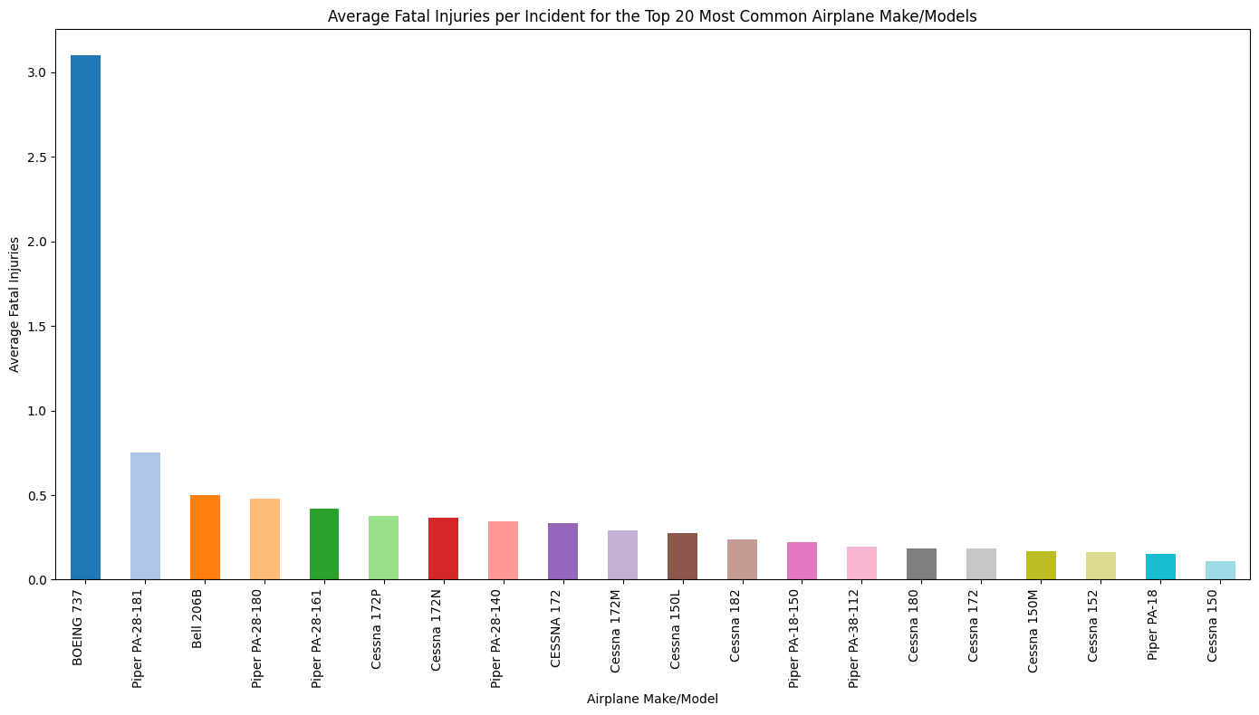
Visualization
Caption: Average Fatal Injuries per Incident for the Top 20 Most Common Airplane Make/Models. Models with shorter bars are those that have fewer fatal injuries per incident.

Slide 18
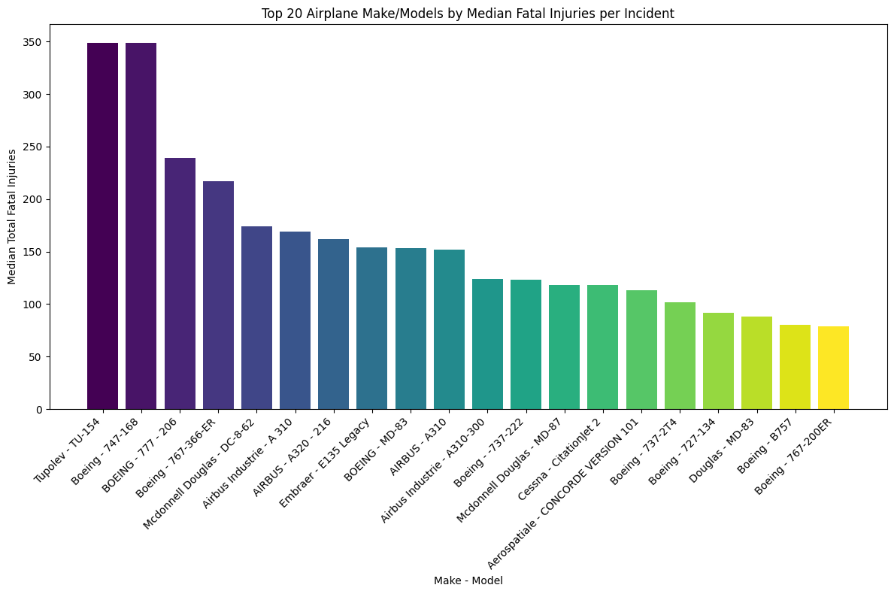
Visualization
Caption: Median Fatal Injuries per Incident for the Top 20 Most Common Airplane Make/Models. Models with shorter bars are those that have fewer fatal injuries per incident.

Slide 19
In-Depth Analysis: Damage Patterns of Leading Aircraft Makes and Models
Findings:
Similar to injury rates, aircraft damage also varies by specific model. Some models, despite being frequent in incidents, can have a lower rate of resulting in 'Destroyed' status. For instance, 'Piper PA-28-140' has relatively low destruction percentage in relation to the frequency of incidents, whereas some older or less common models can have higher percentages.
Implication for Stakeholder
Knowledge of damage propensity drives maintenance, insurance premiums, and ultimate financial risk. Lower destruction rate models indicate higher resilience or less severe incident consequences on average, directly affecting asset value retention.

Slide 20
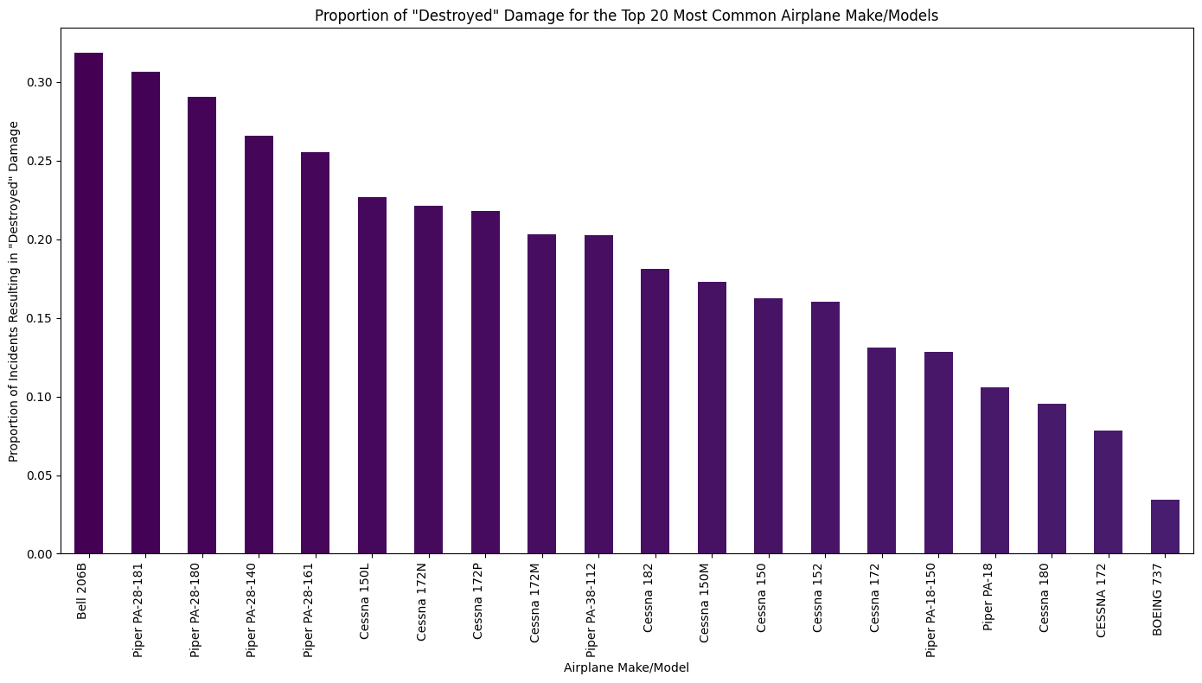
Visualization
Caption: Percent "Destroyed" Damage for Top 20 Most Common Airplane Makes and Models. Short bars indicate those models having a lower likelihood of being destroyed in an accident.

Slide 21
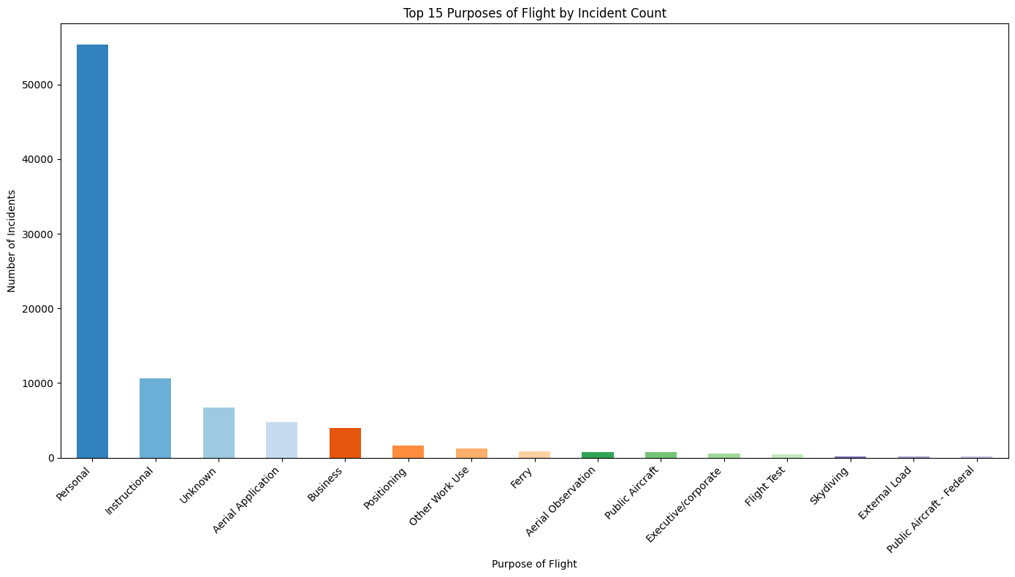
Other visualizations
Top 15 purposes of flight by incident count

Slide 22
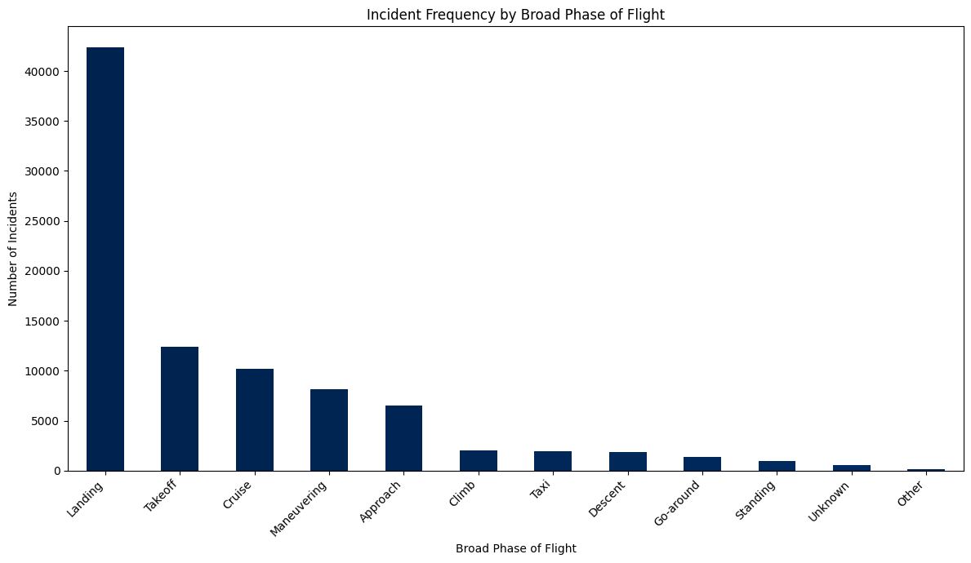
Incident Frequency by Broad Phase of Flight
Visual:

Slide 23
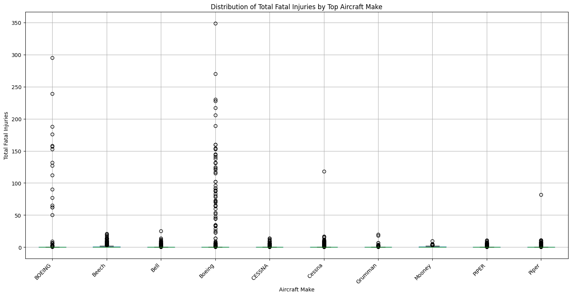
Distribution of Total Fatal Injuries by Top Aircraft Make

Slide 24
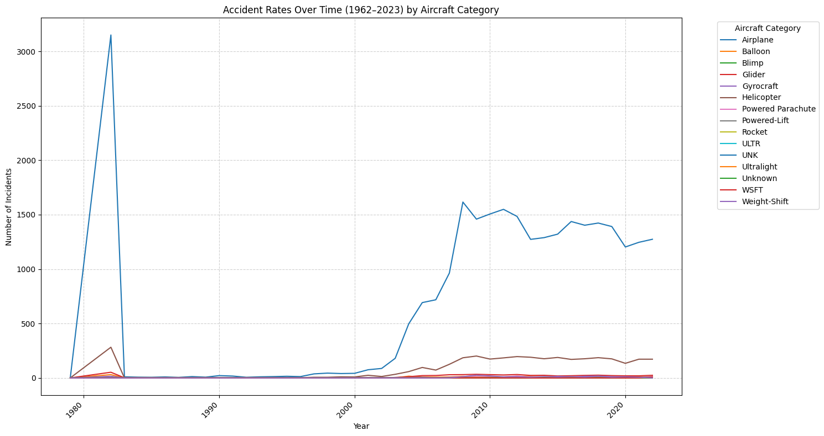
Accident Rates Over Time (1962–2023) by Aircraft Category

Slide 25
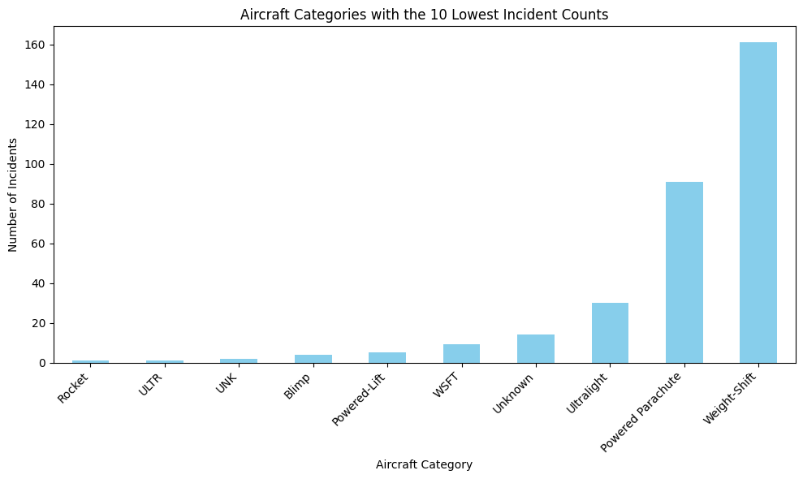
Aircraft Categories with the 10 Lowest Incident Counts
visual:

Slide 26
Recommendations and Practical Tips
Key Recommendations
Diversify Based on Risk Profile for Initial Entry
Minimal Inherent Risk (Private/Recreational Orientation):
Consider Gliders, Powered Parachutes, and Balloons: These categories have the lowest average fatal injuries and lowest wrecked aircraft percentage per accident.
Actionable Insight
As an entry point for recreational or private operations, these aircraft provide a safer gateway with lower liability and economic exposure per incident. The New Aviation Division head should research operating and training systems for these aircraft.

Slide 27
Commercial Operations (Targeted Aircraft Procurement
Prioritize Models of Particular Airplanes: For business, where Airplanes are not optional, target models with fewer mean fatal injuries and destruction rates among high-incident models (e.g., Cessna 172 variants).
Actionable Insight
It is critical that the Head of the New Aviation Division performs additional due diligence on targeted models pinpointed as lower risk within the Airplane category based on their estimated commercial applications, operating expenses, and availability.

Slide 28
General Risk Mitigation Recommendations
Invest in Full Operational Safety Pilot Training & Experience-Emphasize comprehensive pilot training and continuous professional development since human factors are often contributory to incidents.
Weather Awareness - Founded on Weather.Condition, a major cause of incidents, implement rigorous procedures for weather assessment and flight decision-making.
Maintenance Programs - Enact rigorous maintenance protocols exceeding regulatory standards to minimize mechanical failures, irrespective of aircraft type.
Phase of Flight Awareness - Direct training and procedural evaluations on critical phases such as Takeoff and Landing, which are most commonly linked to occurrences of accidents.

Slide 29
Summary and Future Actions Conclusion
Based on our analysis, we offer a data-based framework for determining aircraft risk. No aviation operation is risk-free, but through careful aircraft type and model selection, and by putting in place strong operational safety measures, the company can effectively reduce risks in its new aviation businesses to a minimum.
Implications for Stakeholders
The leadership of the newly created Aviation Division has clear views that will direct early procurement choices, focusing on the purchase of less risky aircraft models and comprehending essential operational considerations.

Slide 30
Next Steps
Thorough Due Diligence - Perform thorough market analysis for prospective aircraft models, review operating costs, and study adherence to regulatory compliance.
Pilot and Operational Training - Develop tailor-made training programs that address the specific risk profiles of chosen aircraft types and their particular operating environments.
Fleet Mix Strategy - Formulate a comprehensive long-term strategy for building a diversified fleet that balances commercial objectives with risk mitigation objectives

