Slide 1
Constrained Delaunay Triangulation
Inna Kats
Daniel Shmuglin
Alexander Vainshtein

Slide 2
Table of content
Delaunay Triangulation
Constrained Delaunay Triangulation
Examples of Constrained Delaunay Triangulation
Applications
Overview of the implemented algorithm
Available algorithms
TODO list
DEMO

Slide 3
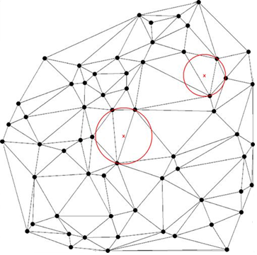
Delaunay Triangulation
DT for a set P of points in a plane is a triangulation such that no point in P is inside the circumcircle of any triangle in DT(P).
DTs maximize the minimum angle of all the angles of the triangles in the triangulation.
The triangulation is named after Boris Delaunay for his work on this topic from 1934
Notes:
Итак – ДТ. Что такое Т? Это соединение данного набора точек линиями, так, что 3 соседние точки образуют треугольник.
ДТ – это Т, которая удовлетворяет уловию Делоне: Окружность, описывающая треугольник, не включает в себя ни одну другу точку Т.
Дополнительное свойство ДТ – она максимизирует наименьший угол среди всех треугольников.
ДТ получила своё имя в честь Д.

Slide 4
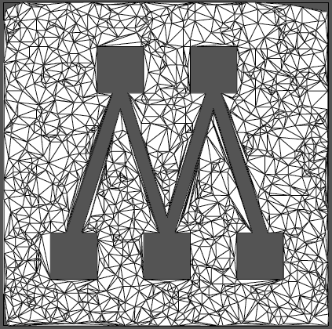
Constrained Delaunay Triangulation
Constrained Delaunay triangulation is a generalization of the Delaunay triangulation that forces certain required segments into the triangulation.
Often a constrained Delaunay triangulation contains edges that do not satisfy the Delaunay condition
Thus a constrained Delaunay triangulation often is not a Delaunay triangulation.
Notes:
Ахлала. Вместе с набором точек мы получаем набор «илюцим», которые требуют, чтобы некоторые точки были соединены (напрямую – была цэла между ними_ в конечной Т. Зачастую в КДТ получаются цлаот, которые лё омдим бэ-критерион Делонэ. Кломар, КДТ не всегда ДТ!

Slide 5
Examples
Delaunay Triangulation
Vs.
Constrained Delaunay Triangulation

Slide 6
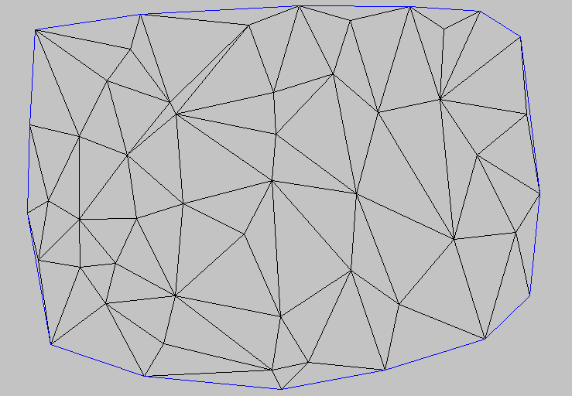
Constrained Delaunay Triangulation
Given a set of points the simple Delaunay Triangulation will look this way
But we want the following segments to present in the triangulation
These intersections point to conflicts with existing triangulation’s edges
These edges should be removed from the triangulation

Slide 7
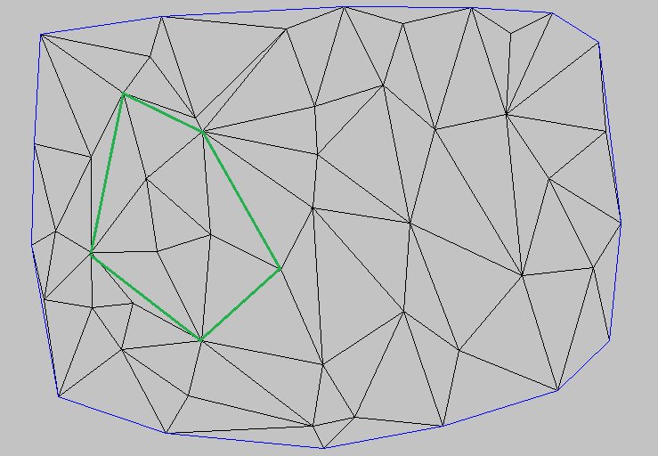
Constrained Delaunay Triangulation
The final Constrained Delaunay Triangulation will look this way

Slide 8
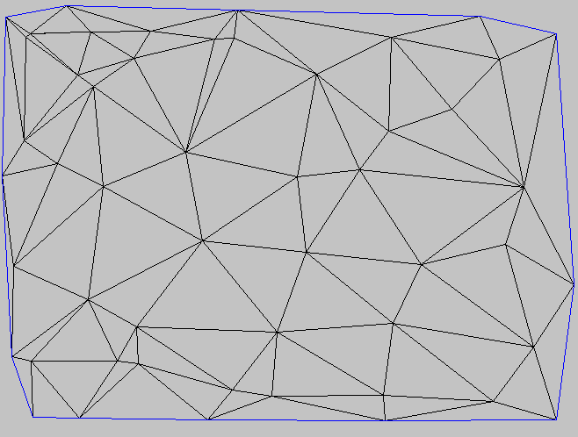
Constrained Delaunay Triangulation more complicated case
Given another set of points it is the corresponding triangulation
We need these segments to exist in the triangulation
These intersections point to conflicts with existing triangulation’s edges
These edges should be removed from the triangulation

Slide 9
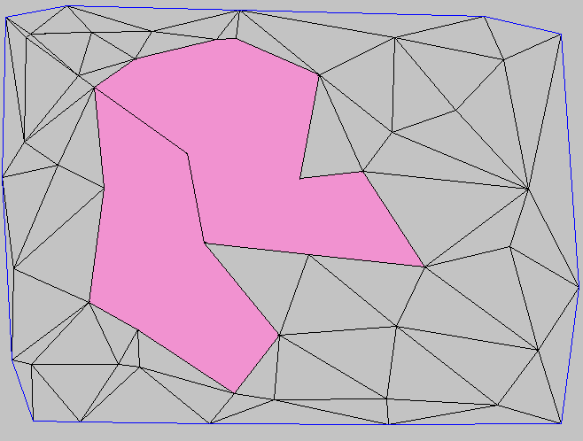
Constrained Delaunay Triangulation
Now we need to rebuild the triangulation inside the colored polygons

Slide 10
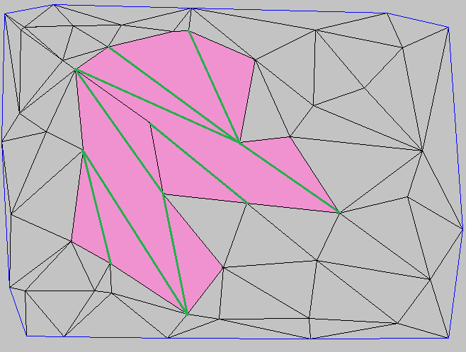
Constrained Delaunay Triangulation
The resulting CDT is looking this way
Note that the resulting triangulation is not Delaunay Triangulation
Lets check this triangle
This is its circumcircle
The red point is inside of this circumcircle

Slide 11
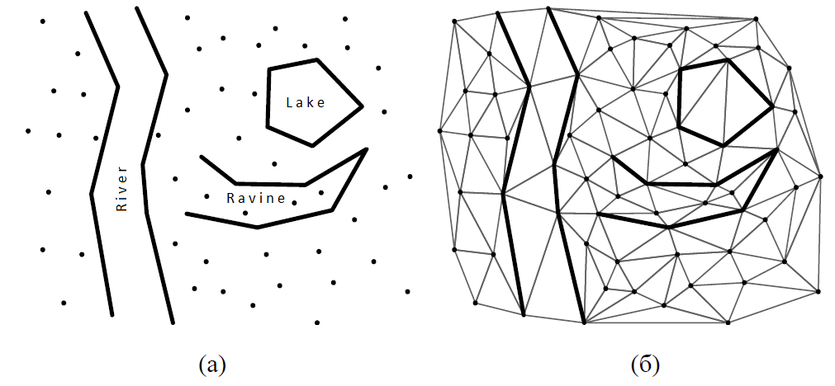
Constrained Delaunay Triangulation Another Example

Slide 12
Constrained Delaunay Triangulation Another Example

Slide 13
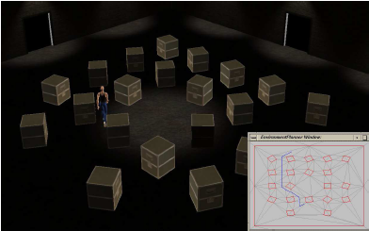
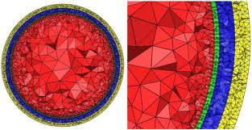
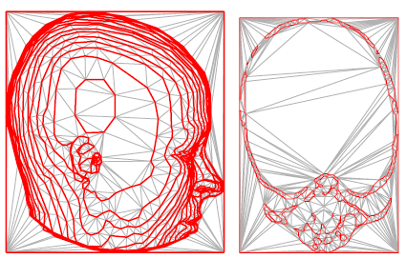
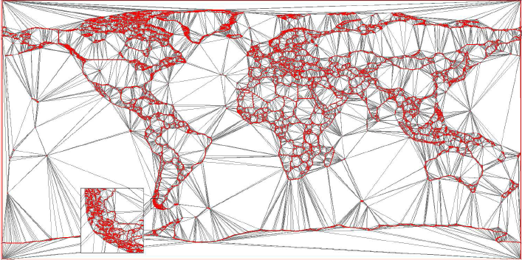
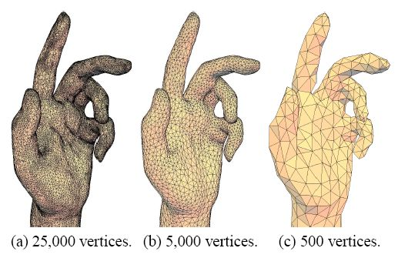
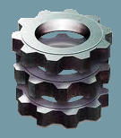
Applications
Path planning
Data Visualization
Shape Reconstruction
GIS
Mesh Generation

Slide 14
Implemented Algorithm
We selected to implement the algorithm described here http://www.geom.uiuc.edu/~samuelp/del_project.html
Algorithm’s input
Set of points
Collection of constraints in the form of a required edge between two points
Algorithm’s output
Constrained Delaunay Triangulation

Slide 15
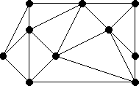
Algorithm description
Given a set of points build the Delaunay Triangulation

Slide 16
Algorithm description
If the collection of the constraints is empty – return current triangulation (we are done!)
Select (and remove) from the constraints collection one constraint AB (i.e. constraint which requires an existence of an edge between points A and B)
If the edge AB exists already in the triangulation, go to step 2
Constraint [P1,P2]
Current constraint [A,B]

Slide 17
Algorithm description
Delete all the triangles which have an edge that intersects the constraint AB in order to adjust for it.
B
A

Slide 18
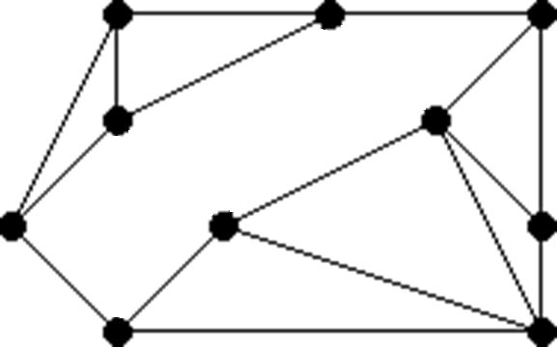
Algorithm description
After deletion of triangles we will have a polygon, within our triangulation, that contains the two points of the constraint.
B
A

Slide 19
Algorithm description
Add the constraint edge.
The addition of the constrained edge cuts the polygon into two pieces
B
A

Slide 20
Algorithm description
Triangulate two pieces generically. After this step we have back a full triangulation (not necessary the Delaunay one!)
Go to step 2 (pick next constraint)

Slide 21
Algorithm’s summary
Given
Build
Set of points
Delaunay Triangulation
Pick one constraint
Delete all triangles having an edge that intersects the constraint
Insert the constrained edge
Build partial triangulation for those polygons
Take two polygons created after triangles deletion and constraint edge insertion
C D T

Slide 22
Available algorithms
CDT using Plane Subdivision - http://www.cescg.org/CESCG-2004/web/Domiter-Vid/
Algorithms based on "Divide and conquer" strategy
L. Paul Chew - http://www.cmlab.csie.ntu.edu.tw/~plokm/htdocs/cmlab/%B1M%C3D/triangulate/Constrained%20Delaunay%20Triangulations.pdf
Sweep-Line algorithms
Shewchuk - constructing higher-dimensional CDT http://www.cs.berkeley.edu/~jrs/papers/cdtj1.pdf
Fortune - http://ect.bell-labs.com/who/sjf/
Incremental algorithms
Marc Vigo Anglada - An improved incremental algorithm for constructing restricted Delaunay Triangulations - http://citeseerx.ist.psu.edu/viewdoc/download?doi=10.1.1.61.3862&rep=rep1&type=pdf

Slide 23
LIVE DEMO

Slide 24
TODO list
Fix bugs
Reintegrate code into Google Code repository
Improve performance
Add more tests
Integrate our GUI into the main solution’s GUI

Slide 25
Q & A

Slide 26
References
Delaunay triangulation http://en.wikipedia.org/wiki/Delaunay_triangulation http://www.s-hull.org/paper/s_hull.pdf
Constrained Delaunay triangulation http://en.wikipedia.org/wiki/Constrained_Delaunay_triangulation http://www.geom.uiuc.edu/~samuelp/del_project.html http://www.cmlab.csie.ntu.edu.tw/~plokm/htdocs/cmlab/%B1M%C3D/triangulate/Constrained%20Delaunay%20Triangulations.pdf http://www.cs.berkeley.edu/~jrs/papers/cdtj1.pdf http://www.cescg.org/CESCG-2004/web/Domiter-Vid/ http://graphics.ucmerced.edu/publications/2003_Chapter_Kallmann.pdf

Slide 27
Thank you!

