Slide 1
Assignment 8 -Build an End-to-End IoT System
Peter Van Vooren, Bryan Tineo
Group 1

Slide 2
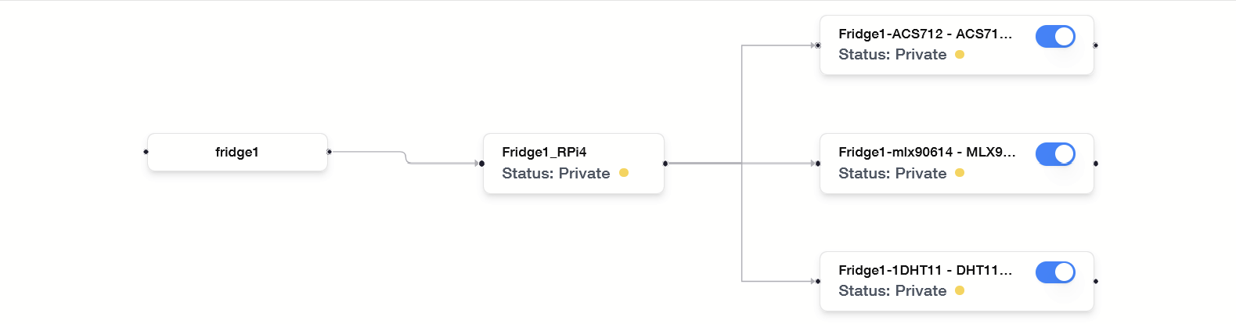
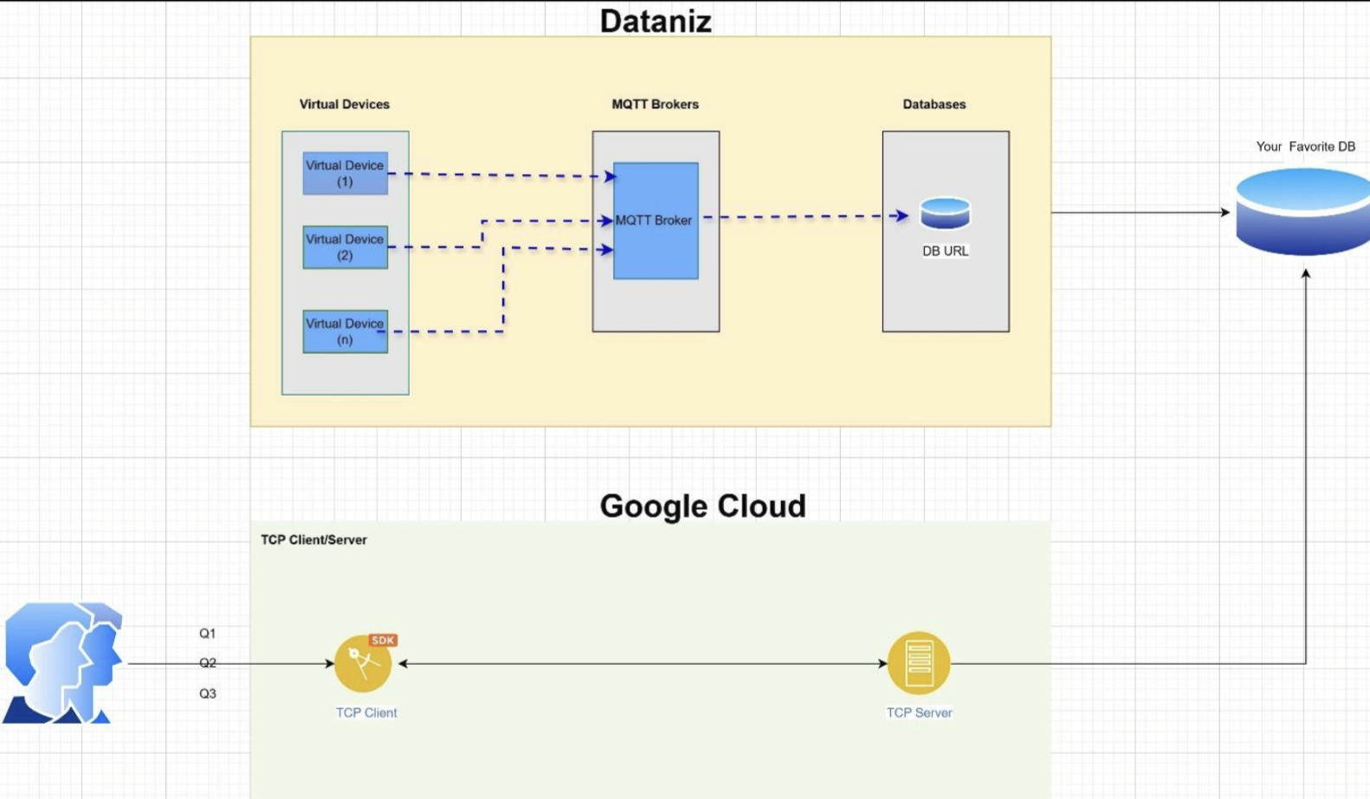
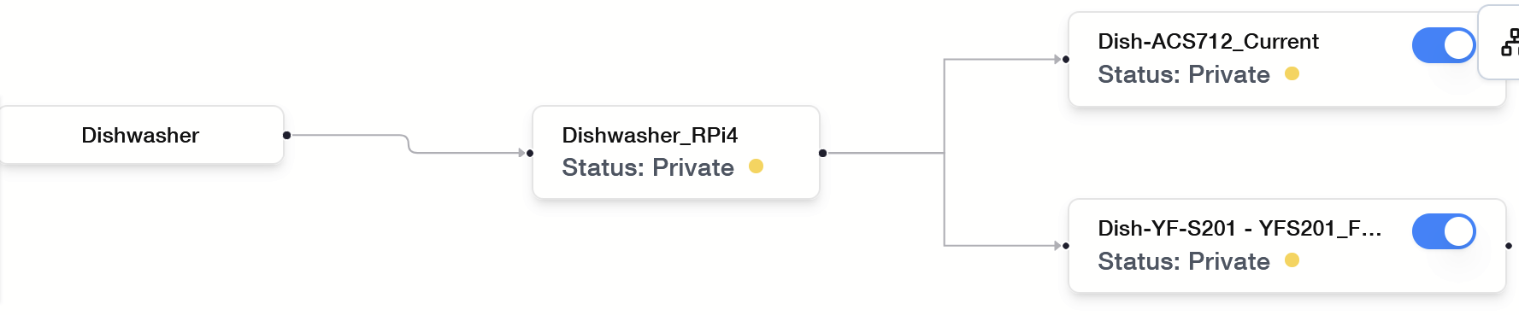
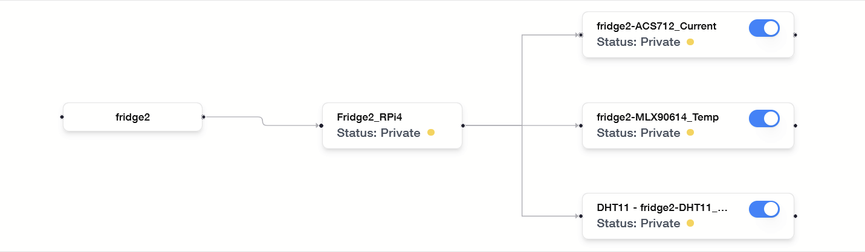
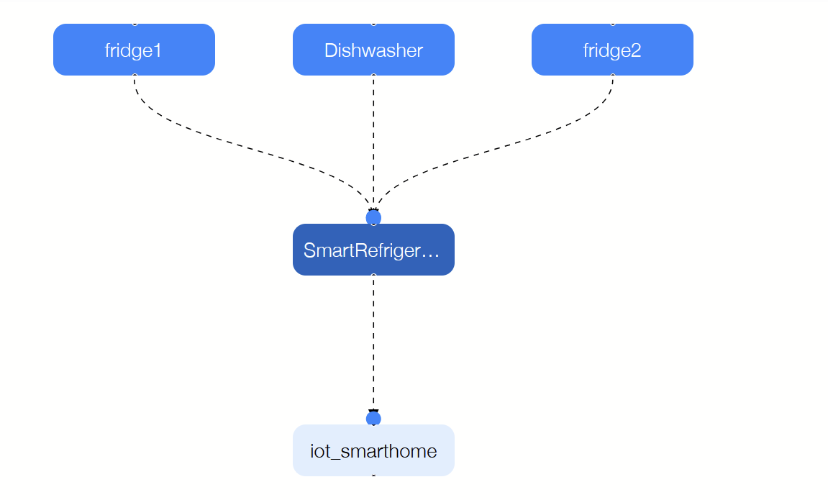
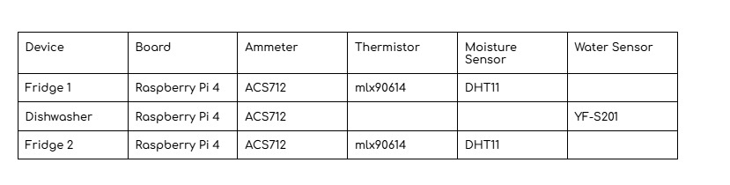
System Functionality

Slide 3
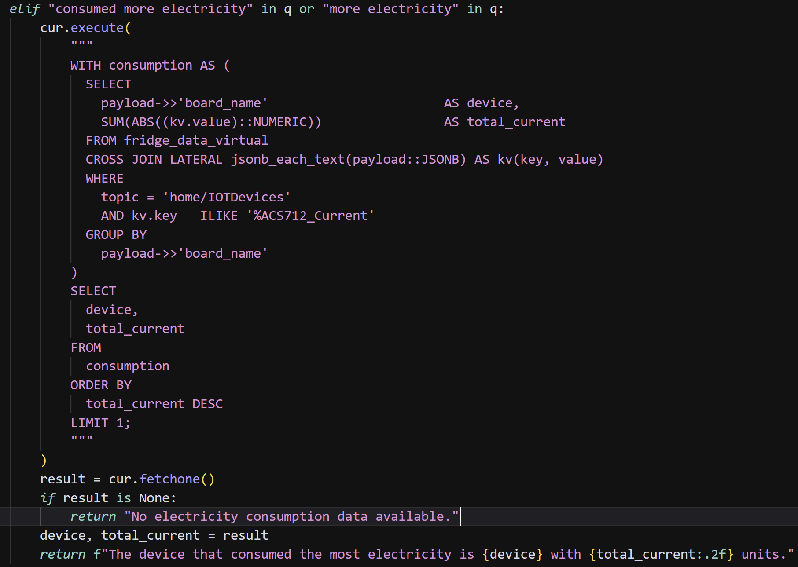
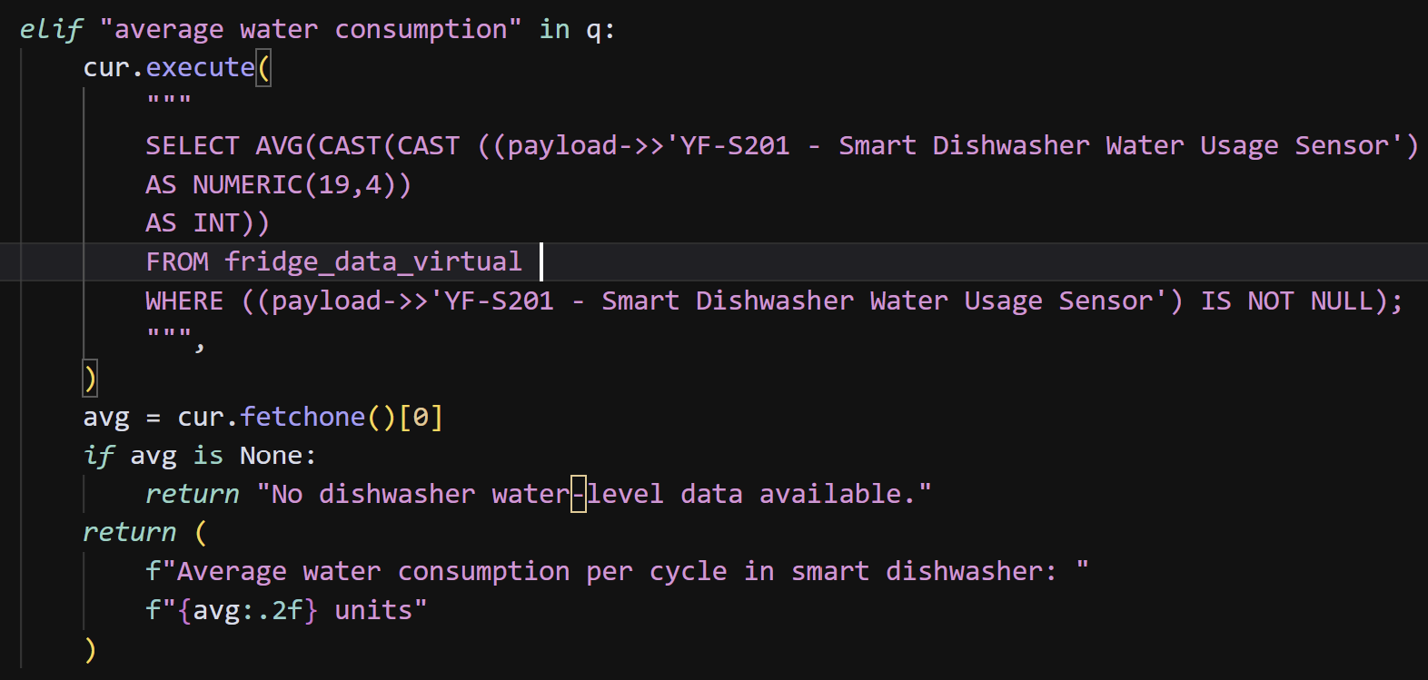
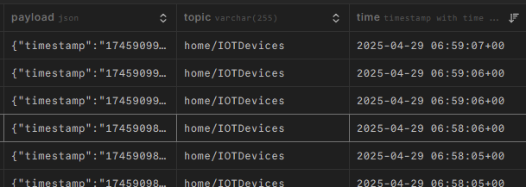
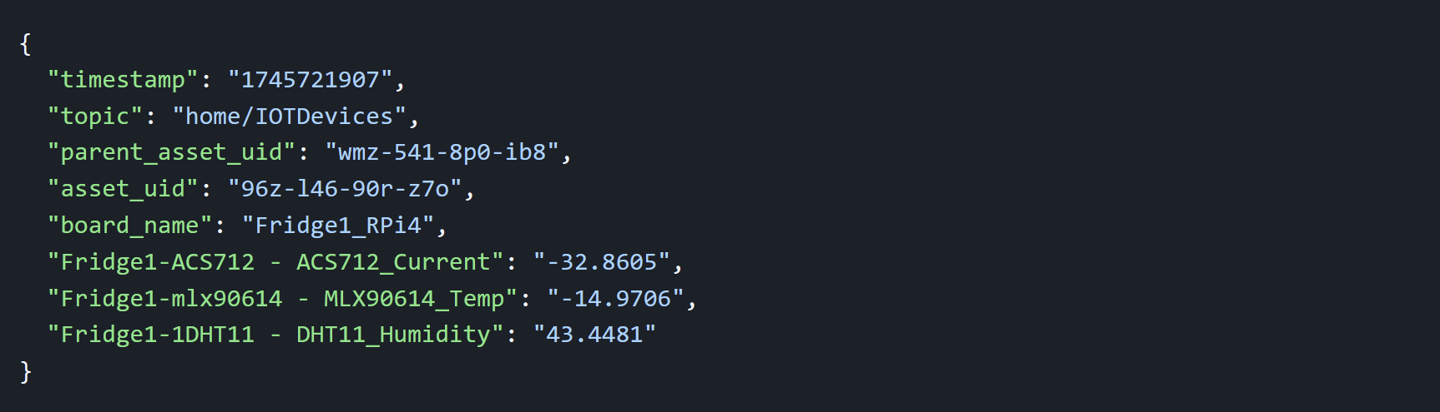
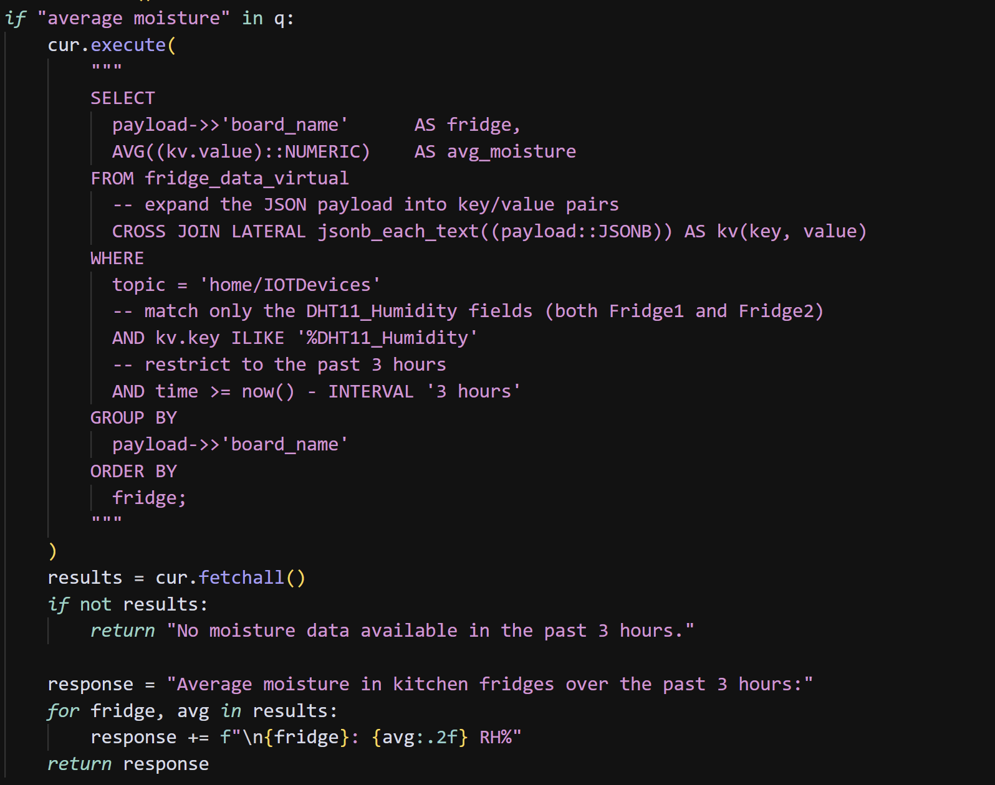
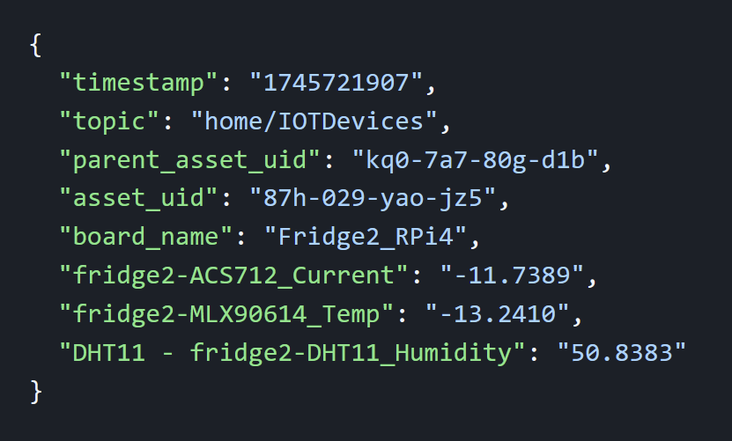
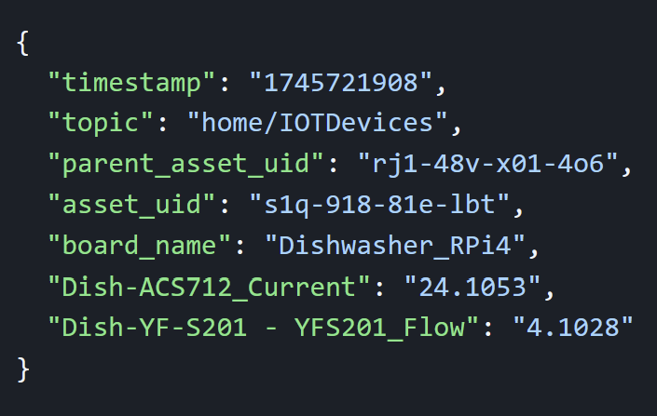
3-Queries
Query 1: Moisture Levels in Kitchen Fridge (per 3 hours)
The kitchen fridge shows a relative humidity (RH%) average of ~53%
Query 2: Water Consumption of Dishwasher (per cycle)
The dishwasher consumes 14.5114 liters (3.8335 gallons) of water per cycle.
Query 3: Electricity Consumption (overall)
Fridge 1: ~17,286 BTU (slightly high consumption)
Fridge 2: ~16,694 BTU (slightly high consumption)
Dishwasher: ~10,814 BTU (consumes within the range of residential level)

Slide 4
Metadata Usage

Slide 5
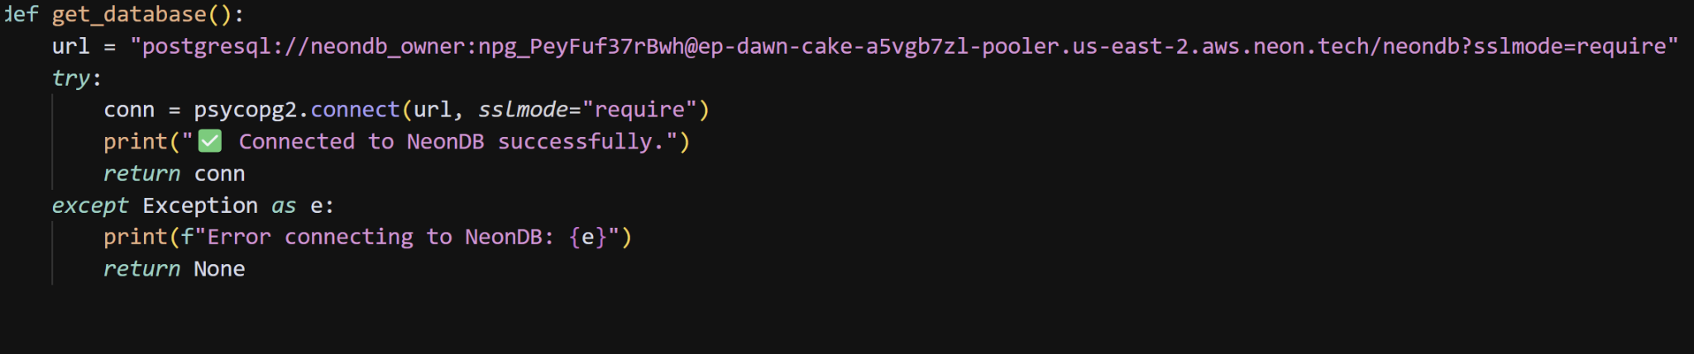
Challenges
Connecting to Neon from python
Figuring out how to unwrap the payload column with SQL
Figuring out how to cast strings into integers for the AVG()
Dynamic Time Handling with SQL query
Structuring into key value pairs the data for faster retrieval of Average moisture

Slide 6

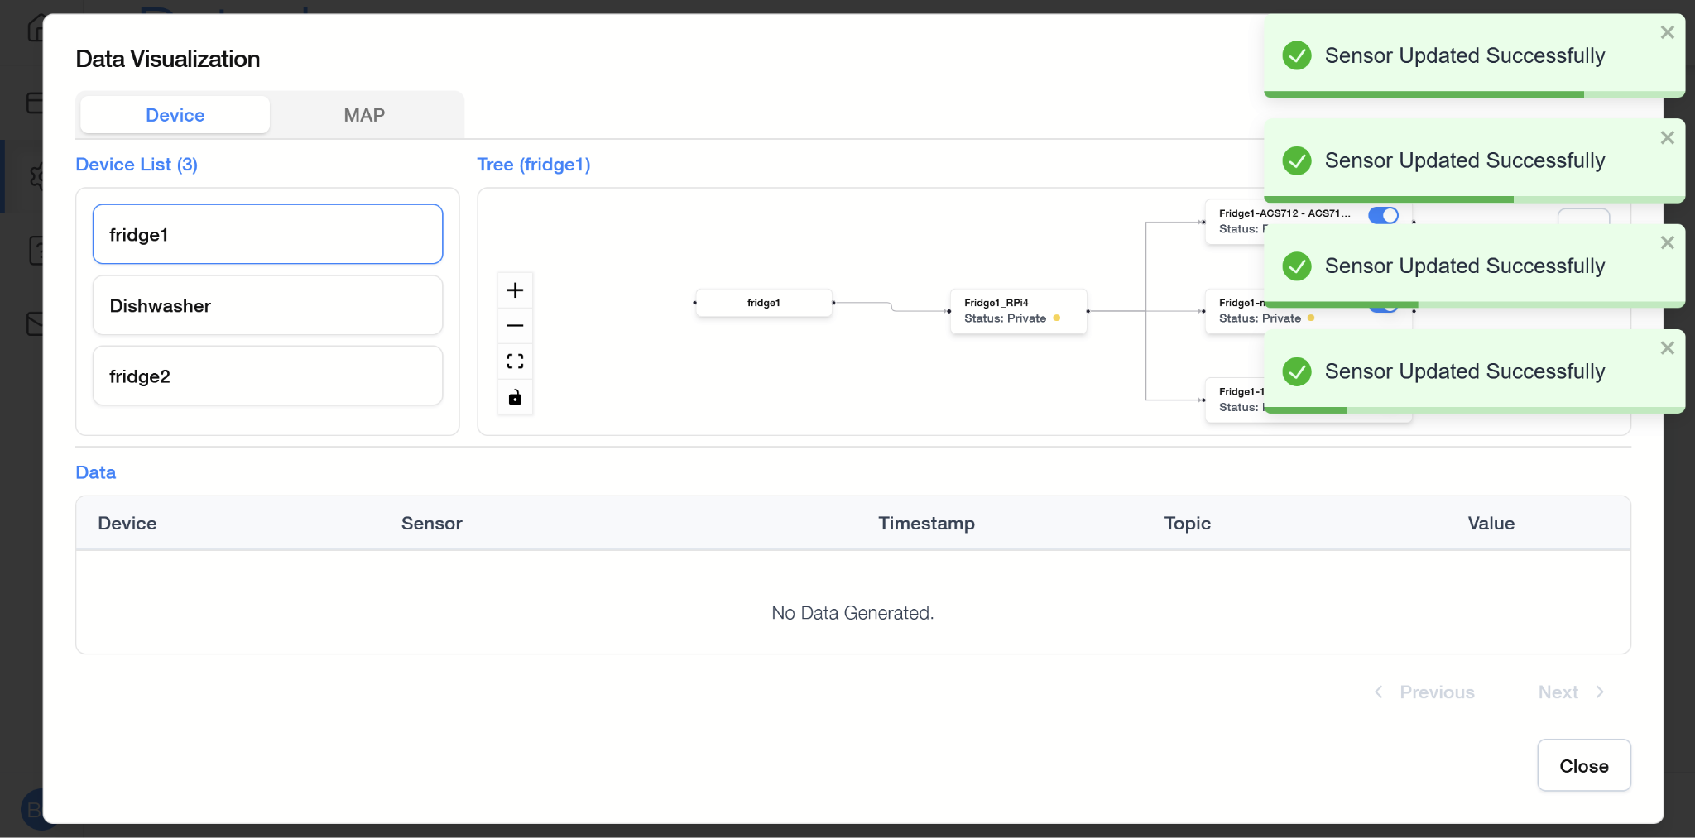
Dataniz Feedback
The notifications for enabling sensors covers the sensors.
I think Dataniz should recommend sensors depending on the projects needs.
Data Display should be able to be modified.
Add more templates for sensors
The UID should be saved on the site
The guide isn’t immediately accessible from the actual creation screen

