Slide 2
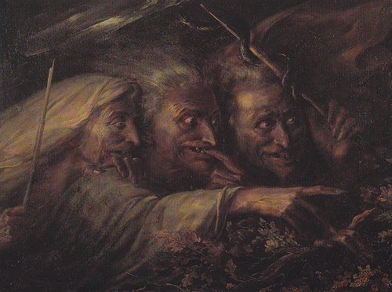
Who?
Witches
Plot?
Planning to meet Macbeth after a battle

Slide 3
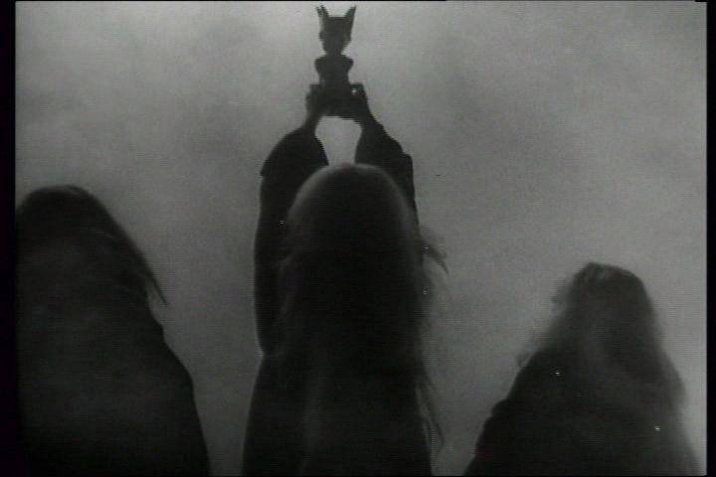
“thunder, lightning or in rain?”
- irony – appearance that it matters but in reality it doesn't
- foreboding Macbeth questioning the meaning of life

Slide 4
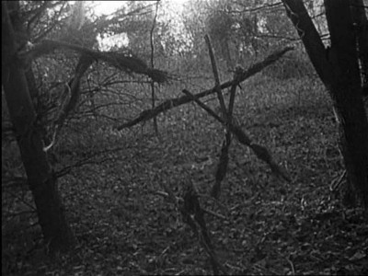
“hurly-burly's done”
- irony & foreboding: witches will start the hurly burly
- text claims the hurly burly will be done but in reality it is only begun

Slide 5
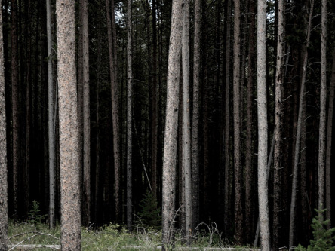

“battle's lost and won”
- paradox – how can you win and lose?
- if you can't tell the difference, what's the point?
- reversal of fortune – winners will become losers
- more irony
- conflict of appearance & reality

Slide 6
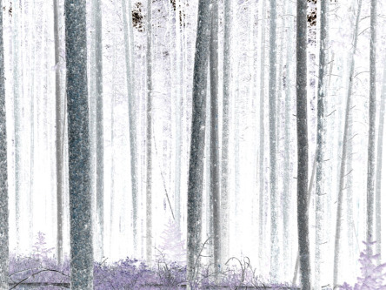
“fair is foul, and foul is fair”
- another paradox
- this time about good and evil
- also, order/disorder & appearance/reality
- if you can't tell the difference between foul and fair, doesn't that make everything foul?

Slide 7
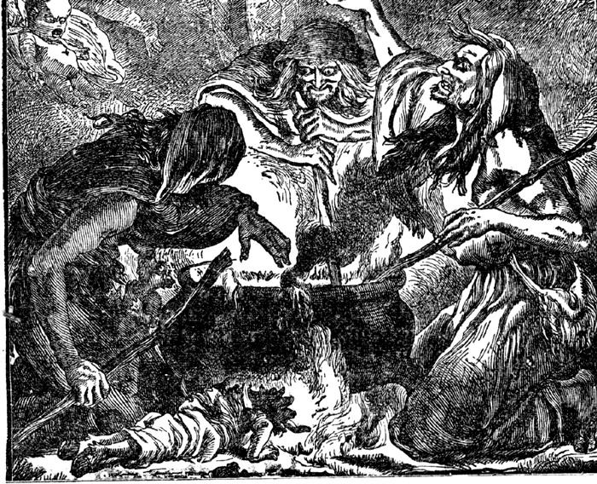
Supernatural
“Hover through the fog and filthy air”
“Graymalkin”
“Paddock”

Slide 8
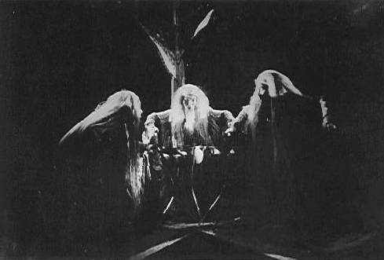
Language supports the subtext
-iambic pentameter - “If I say sooth, I must report they were”
- trochaic tetrameter - “In thunder, lightning or in rain”
- witches language rhymes and is rhythmic making it chant-like, ritualistic, hypnotic, even dream-like – supernatural
- contrast of language also reflects the reversals discussed and emphasizes the difference with ordinary people.

Slide 9
