Slide 1
Action Settings: 1
Mouse over -> Hyperlink to Slide 2

Slide 2

Action Settings: 2
Mouse click -> Run program -> calc
NOTE: Environment (system) variable PATH includes needed path

Slide 3

Action Settings: 3
Mouse click -> Hyperlink to URL

Slide 4

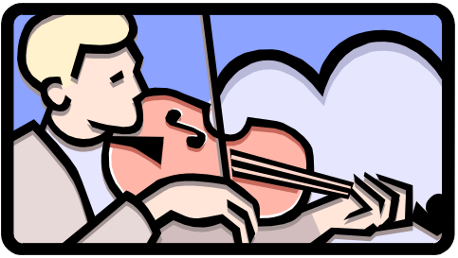
Action Settings: 4
Highlight
Mouse click -> Show Object
Mouse click -> Play sound
Highlight click

Slide 5
Action Settings: 5
Mouse click -> Run Macro -> message box
End Show

