Slide 1
Notes:
Welcome!

Slide 2
Disaster 101
Insert your name and
date of training
Notes:
(Have Script for PW DP Disaster 101 in hand.)
Welcome!
I am … (Introduce yourself, and this slide up through introductions.)
As a PW Disaster Preparedness Trainer you will have this PowerPoint to work with when you are training presbytery and congregation members to make their disaster preparation plans. So consider this just your introduction. You will be seeing all this again as you need to be familiar with it and use it.

Slide 3
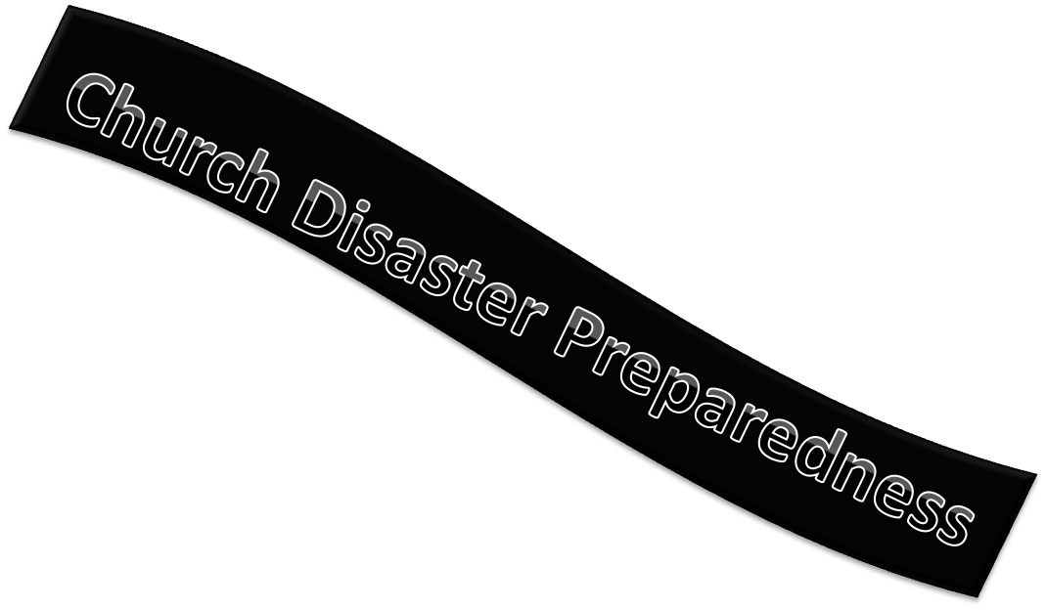
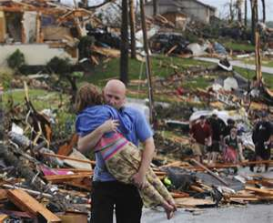
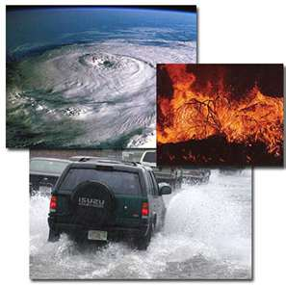
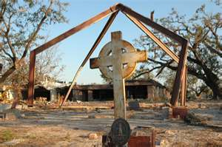
Notes:
Why are we in this Disaster Preparedness endeavor?
It is a presbytery responsibility to support their congregations’ calling to be able to continue operating as a viable worshiping community throughout times of disaster and chaos; preparation is essential for that to be possible.
Presbyterians come to disaster preparedness and recovery ministry through our understanding of Scripture and our theological perspective that affirm the church having a special concern for the poor, the powerless, and those most vulnerable. Some biblical and Presbyterian themes are:
-- God is with us and is present with us in disaster. (Psalm 46: 1-5, 10-11; selected verses in Psalms 69; 86; 121; 130; Light of Christ shining in darkness.)
-- The church is called to respond to those in need. (Mt 25:40) Also, to bear one another’s burdens.
-- The church is called to offer special concern for the poor, the helpless, and those without political influence.
-- Therefore as a congregation, we are called to continue operating as a viable worshiping and functioning community throughout times of disaster and chaos; preparation is essential for that to be possible.
How many of you belong to a church that (Ask for a show of hands):
-- Has a plan for evacuating the sanctuary in case of fire?
-- Has an annual fire drill during worship?
-- Has a telephone tree for calling members in case of an emergency?
How many times lately have you and someone in your congregation talked about that kind of plan? (Ask for a show of hands.) Congratulations to you, your session and your congregation if even one of those three is in place! Today we are here to talk about that kind of plan -- and much, much more.
Another question, does your presbytery have a presbytery disaster committee. “How many of your presbyteries have such a committee?” Wonderful! If you don’t already have one, please talk to one of us at a break about how to get one started.
Disaster preparedness is very serious work—but we don’t intend to take ourselves too seriously. So you are hereby given permission, even the requirement – to laugh and have a good time as we talk together.
Our goal for this part of the presentation is to define and describe disaster, to lay some groundwork for why we do disaster preparedness, and to acquaint you with the roles that you, your congregation, your presbytery, and PDA play in disaster ministry.

Slide 4
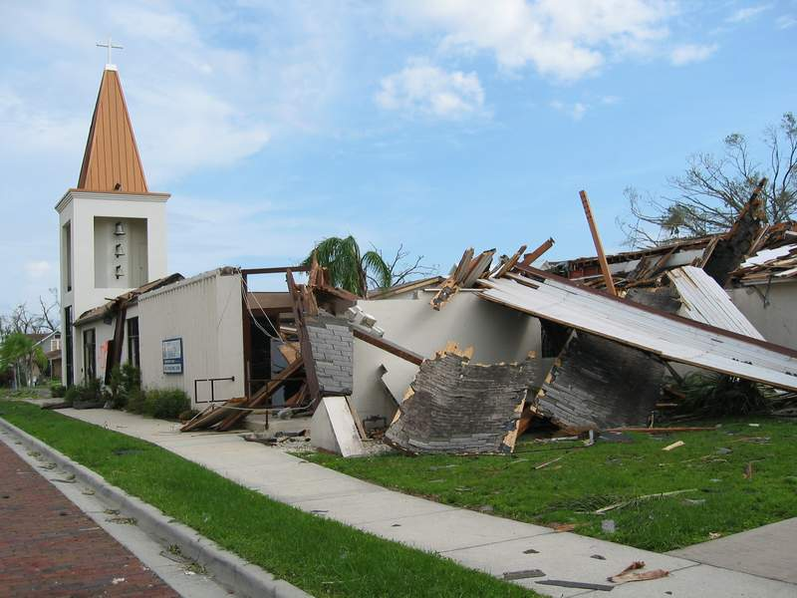
Notes:
“Is this an emergency or a disaster?” (Just gather their ideas at this point.) We don’t know from this picture alone. To determine if the crisis is an emergency or a disaster we have to assess the situation, usually quickly. We need to know the initial assessment to know how to begin to respond.

Slide 5
The difference between disaster and emergency
  An emergency is an event we can cope with ourselves
  A disaster overwhelms local resources
Notes:
A disaster is different from an emergency. Here is the difference. We prepare and have resources to deal with an emergency. “Name some resources your town has to prepare for emergency?” (Perhaps people will name hospitals, fire stations, police departments, and first responders.) You’re right: our municipalities and counties provide basic emergency equipment and personnel. EMS is even named Emergency Medical Services! When there are the resources to deal with the crisis this is an emergency and emergency response.
So when the crisis demands more than our local resources, we call that a disaster. 9/11 was a disaster. So were Katrina and the Newtown elementary school shootings. The local agencies had to call outsiders for help in those cases. The event that overwhelms local resources is what we call a disaster. Disasters impact everyone in the affected area and beyond.
Both emergencies and disasters are crises, and may be traumatic events depending on the physical and emotional impacts of either. Disasters impact everyone in the affected area and beyond.

Slide 6

Who Is Impacted?
First Responders
Family & Close Friends
Bereaved, Injured, or Lost Property
Those Who Serve
Faith, Business &
Government Groups
Community at Large
…in Short, Everybody
Notes:
(Show ripple slide of emotional impact on everyone in the community.)
(This slide is layered so that when PowerPoint is in Slide Show mode under View, the words come onto the slide. Mostly they speak for themselves. This is not a lengthy section because the slides give the message. Move through the slideshow, a few seconds for each new ripple. It’s good to practice before presenting because it takes two clicks of remote to get words and arrow up.)
Disasters impact everyone in the affected area plus the rest of the community.
How big is the community impacted by this disaster? Just how far do the ripples go?
The impact reaches much farther than the immediate survivors. How far?
(Trainer can use any example that fits. If you have a local disaster that is a great choice.)
One example is 9/11. In that disaster, 3,000 people died and 4,000 people were injured. That’s 7,000 people. How many people do you think were impacted? (Ask for responses.)
12,000,000 Americans reported to doctors physical and psychological problems because of their reactions to the 9/11 attacks. This is clearly more than the immediate survivors, the families of those injured or dead, and the first responders.
The latest disaster in your community may have dredged up people’s memories of prior events, even very different life events, such as abuse, car or train accident, or anything that has left its mark on the person. Disaster preparation is a way for people to have a sense of control. Preparation reduces the chaos.

Slide 7
All disasters are local
All disasters are unique
Notes:
We say that all disasters are local and all disasters are unique. Note that yes, it takes outside resources to handle a disaster yet the local folks are most important in the response and they affect the ultimate outcomes. This is another reason why disaster preparation is most important.

Slide 8
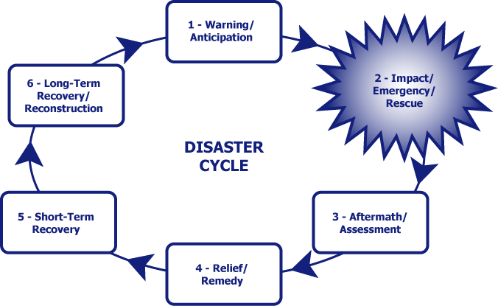
Disaster Cycle
Notes:
There’s a predictable lifecycle of a disaster. (Show slide of “The Disaster Cycle,” the 6-part elliptical disaster cycle. Take your time.)
Briefly, here’s what we have: There are many diagrams of the disaster cycle…this is one of them. It shows 6 stages –
1: Warning/Anticipation: At this point, we may get news that there could be a problem. With a hurricane, we may have 5-7 days to anticipate and prepare; with a tornado, we may anticipate for an hour or so and have 5-15 minutes to “prepare”; with a fire, earthquake or an active shooter, we may have no advance news and no time to anticipate or prepare.
2: Impact/Emergency/Rescue: This stage may include high drama, TV coverage, 1st responder bravery, rescue and sheltering. With a hurricane, we may have high winds for half a day, heavy rain for a day (or so) and a state of emergency and rescue for days afterward. With a tornado, we may have a few seconds of impact and days of emergency and rescue. With a fire or an active shooter, the impact is instantaneous; the emergency and rescue may require days. 1st responders and the news media come in. (But an aside here: neighbors do a lot of the rescuing and 1st response.)
3: Aftermath/Assessment: Government and agency assessors, such as Red Cross and FEMA, may come in and tell us how bad things are. The news media are present. Volunteers may begin to swarm.
4: Relief/Remedy: Helping agencies arrive. They set up shelters, feeding stations, and distribution of clothing, cleaning supplies, and the like. People’s needs hopefully are met temporarily so that no one should be un-housed or unfed.
5. Short-Term Recovery: Helping agencies and local community agencies find a more stable housing and feeding solution for families and individuals.
6. Long-Term Recovery: Community agencies and faith-based organizations gather themselves and their funds together to meet unmet needs of people who have lost property and are unable to fund their own recovery. Those who don’t have enough insurance or FEMA help may receive some of the funding. They are usually a minority in the community.

Slide 9
Disaster Cycle
7 – Mitigation - 0
Notes:
6.5 Mitigation: Sometimes there are changes made as in building code changes following a disaster. We can call this “lessons learned” and these can be incorporated into disaster plans.

Slide 10
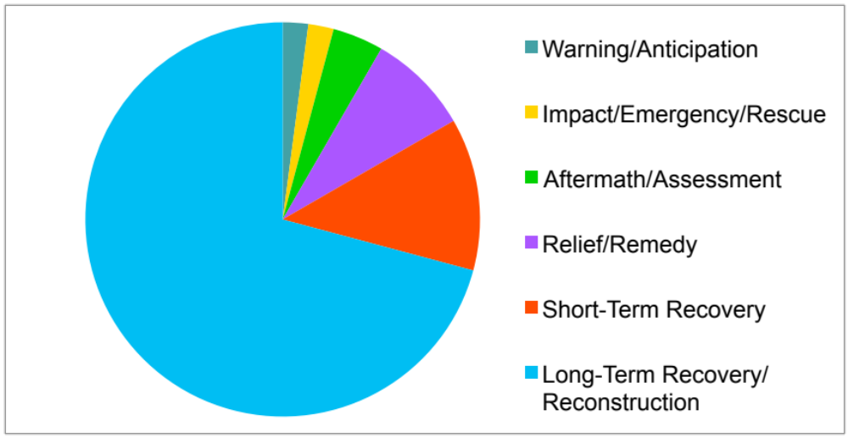
The Recovery Clock
Notes:
(Disaster Cycle Pie Chart) This is a chart that shows the stages of disaster in terms of time. Long-term recovery takes a long time! For a rough estimate of the time, multiply the days of emergency/rescue by 10 to get short-term recovery duration. Our operational definition of short–term recovery is when the blue tarps are up. Then multiply the short–term recovery number by 10 to get long-term recovery duration. Our operational definition of long-term recovery is when the National Guard has departed and FEMA has stopped picking up fallen trees. After Katrina emergency and rescue took about a month (30 days). 10 times that = 300 days or nearly a year to get people into temporary housing (some more than that). 10 times that is 3000 days, or 8 ¼ years. From 2005 to 2015 = 10 years, and New Orleans is still rebuilding…. From PDA the last of the funds for Katrina were spent in 2014.

Slide 11

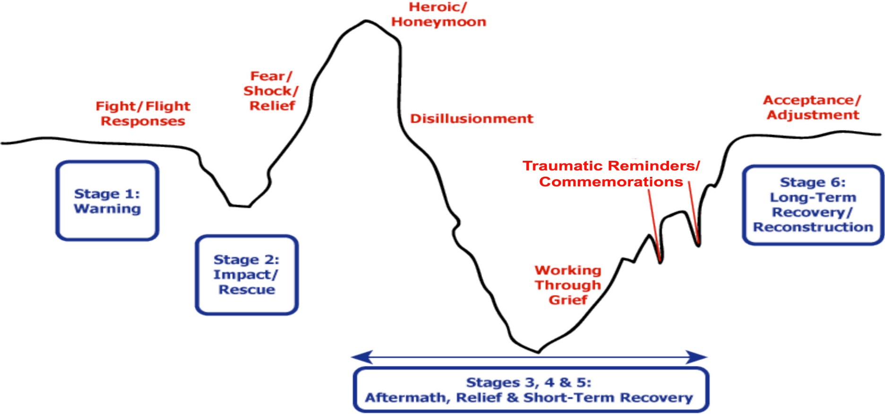
Notes:
Another phenomenon to keep in mind is the Emotional Impact of Crisis. Take a moment to look at the trajectory and the key points.
Immediately after a disaster there is an emotional high for both individuals and a community – there is a “can do” spirit that insists we can and will get through this. While this is essential at the time, and ultimately true, the frustrations of recovery stretch on far longer than anyone would have been willing to admit in the first days after the disaster.
Even if they use the term “years of recovery”, few people actually internalize that reality. The depth of the disaster gradually sinks in and discouragement occurs. That’s the low point on the curve.
Individuals and the community continue working through the grief, and the process begins to improve again. This is not a straight uphill progress, however. There will be traumatic reminders: similar disasters, nearby or far away; annual or other reminders, which can either be signs of hope or occasions of frustration as it appears that the world has forgotten what the community has suffered. People’s progress on this journey is not continuous; people can cycle back and forth from one emotion to another. The first anniversary and subsequent anniversaries are important to acknowledge and help the individuals and community in their recovery.

Slide 12
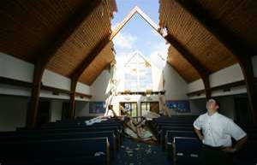
Maintain Your Mission
To enable the body of Jesus Christ to continue to function in a viable way before, during and after disaster.
Notes:
The mission of disaster ministry at all levels is to enable…. (Read the slide.)
Just a couple of thoughts on that – we will have more information about how to do that later on.
-- The survival of the church after a disaster often depends on how quickly the church can meet as an organized unit after the event.
-- The loss of several services in a row may make it very difficult for the church to retain its identity.
-- A high priority must therefore be to resume worship. God With Us worship and church school resources are available for use immediately after disaster.
-- Find an alternative site for worship and offices

Slide 13
PDA Contacts
PDA web Page www.pcusa.org/pda
Jim Kirk, Associate for Disaster Response (U.S.) jim.kirk@pcusa.org
Beth Snyder, National Program Assistant
beth.snyder@pcusa.org
National Call Center - 502-938-9018
PDA.CallCenter@pcusa.org
Notes:
Questions about disaster preparedness training go to Beth Snyder.
If a presbytery or a congregation needs national PDA assistance after disaster, it is accessed through the presbytery’s executive or designee.
Pastors or church leadership are to make contact with the Executive Presbyter and encourage him/her to contact PDA by contacting Jim Kirk, Associate for Disaster Response (U.S.).

Slide 14
Notes:
We are at the end of Disaster 101.
Questions?
If you have questions other than disaster basics, please add them to the parking lot question area.

