Slide 2
Disaster Preparedness
Insert your name and date of training
Notes:
An effective response to a disaster depends on prior planning. A disaster plan won’t eliminate the chaos after a disaster, but it will reduce the chaos. A disaster plan can sometimes prevent an emergency from becoming a disaster.

Slide 3
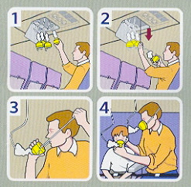
This is a disaster plan.
Notes:
So here is a brief and simple disaster plan. When the flight attendant gives safety briefing, that’s a disaster plan.

Slide 4
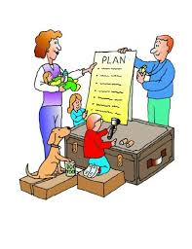
Individual/Family Preparedness
Notes:
You can instruct disaster preparation top-down, presbytery to individuals and families or bottom-up, individuals and families up to presbytery. In either direction the congregation is in the middle.
Here we are going bottom-up beginning with individuals and families. Our rationale is that we cannot function effectively in a disaster unless our own safety and family needs are met. Here are few essentials of family preparation.
Know what emergencies or disasters are most likely to occur in your community.
Have a family disaster plan and have practiced it.
Have an emergency preparedness kit.
Be sure that at least one member of your household is trained in first aid and CPR/AED.
We aren’t going to spend a lot of time in this training talking about family preparedness. There are easily accessible and understandable plans and checklists available online at FEMA – ready.gov and the Red Cross. Those links will be in the resources information we will give you later on.
What we want you to take away from this information is that Family Preparation is essential to reducing the chaos of a disaster. There is a plethora of information on disaster preparedness online. Start with FEMA at Ready.gov or with the Red Cross.

Slide 5
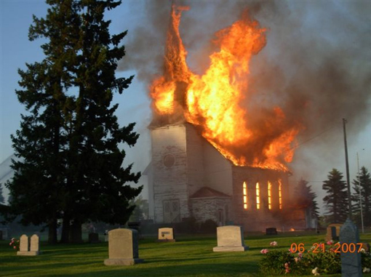
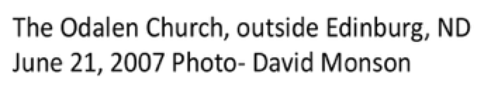
What do you wish you had done last week?
What do you do now?
Notes:
The first step in the basics of disaster preparation is get beyond the denial and other concerns to establish the perceived need for disaster preparation. This is no small matter and will take time and persistent communication.
Identifying a strategy is useful. Then identify the persons interested and willing to “wade into the waters” of disaster prep.
Second time - after referring back from Slide 6
But a church fire can happen anywhere and is the most likely event that having a disaster plan can mitigate.

Slide 6
Congregation Disaster Plan
Is our congregation willing to prepare ourselves and our facilities for the eventuality of a disaster?
Notes:
This is the big question! Is the congregation willing? It is sometimes a hard-sell in places that don’t have frequent disasters. It’s probably a lot easier to convince a congregation in Moore, OK or South Florida that they need a disaster plan than in the Shenandoah Valley or Northern Maine.( Click back to slide 5) But a church fire can happen anywhere and is the most likely event that having a disaster plan can mitigate.
Prayer for clarity in discernment and guidance as to who and when to ask is essential. Think about how to go into the life of the congregation with this question. The session, pastors, PW, committees, staff, and key members all need to be considered. So who is first on the list?

Slide 7
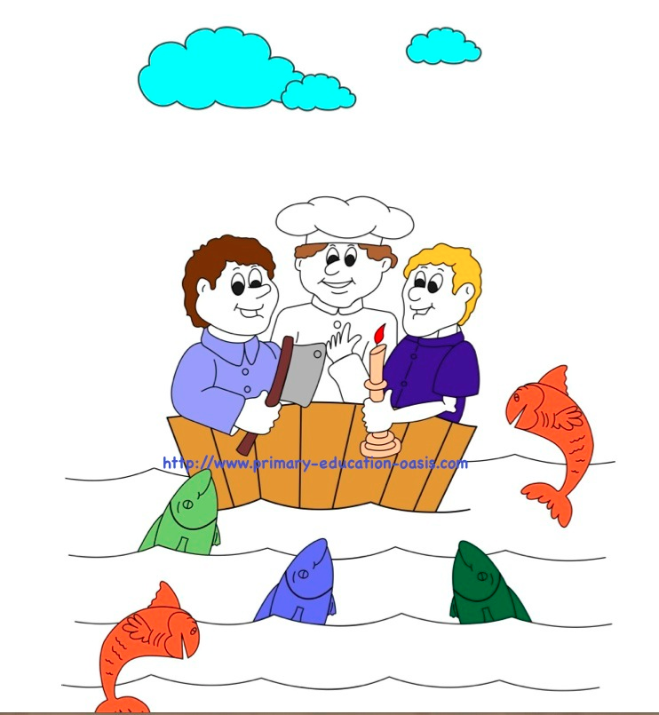
People to Recruit
for Your Disaster Team
One with a passion for disaster ministry
One who likes to keep notes
One with persistence
Notes:
Here are some key people to have on your Disaster Team. (Read Slide) Now - Take a few minutes to make a list of members of the congregation who may have an interest in a disaster plan.
Possible groups might include property committee, first responders, medical personnel, military or former military, weather geeks, ham radio operators.
Allow 5 minutes or so for this list making.

Slide 8
Congregation Disaster Plan
Create a small task force of key people according to your congregation’s culture and tradition.
Notes:
What is the appropriate decision making process to establish a Disaster Preparation Task Force in this congregation? Follow the usual procedures for your church to create a task force.
Now that there is the beginning of a Disaster Preparation Task Force in this congregation, what do we do? Decide the first priorities and the time line for these.

Slide 9
What are the Possibilities?
A basic plan includes:
Plan for continuation of the ministry of the church
Have an evacuation plan
Plan to care for vulnerable members
Review and update insurance coverage
Notes:
These are minimum essentials -
As a body of Christ each congregation is called to continue operating as a viable worshiping, functioning community in times of disaster and chaos. The future of each congregation is in the “how” the congregation handles the disaster.
Have and practice an evacuation plan….which would be different if you have a pre-school, for Sunday worship and Sunday School, or if the building is occupied by only a secretary and the pastor.
Plan to care for vulnerable members – who is elderly and living alone, a single mother with several small children, a disabled member or someone who is ill. Who knows who these people are and how to check on them?
Review insurance coverage.

Slide 10
Ensure continued ministry of the church
Continue regular worship services
Protect church records
Communication plan
Notes:
Again, we are called to continue operating as a viable worshiping, functioning community in times of disaster and chaos. These are the critical elements in fulfilling that mission. The way in which a congregations navigates a disaster’s direct hit impacts the future life of the congregation. How do you make sense of this statement? (Ask for short responses.)

Slide 11
Where to start?
Task force should ask more questions.
Refer to:
Congregational Preparedness Questions
Congregational Preparedness Checklist
Notes:
So where do you start……by asking lots of questions. HAND OUT Congregational Preparedness Questions
and Congregational Preparedness Checklist and take time to review them and think about them. Are there questions at this point?
(Give time for participants to go through these lists. Allow up to fifteen minutes. Let then know they can mark in their copies as they will have access to all the materials in this presentation. )

Slide 12
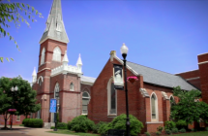
Review other church plans
Photo by Shaun Gulang
Notes:
Later look at an existing congregation disaster preparation plan, FPC Winchester, VA. We aren’t going to elaborate on that plan now, but note that the final structure of the disaster response team in the Session of the church with the responsibility for implementing the plan related to the ministry of a particular session member. For example, Property Management will always have a seat on the Session. The person may change but the seat of responsibility is always there.

Slide 13

Mid Council Preparation
Does your presbytery
have a disaster plan?
Is the plan up-to-date?
Notes:
Now let’s go up a level in the planning to the presbytery disaster preparedness plan. If there is a presbytery plan it should be listed on the presbytery website. Add this to your list! We will give you access to presbytery disaster preparedness and response plans.
I suggest that each of you from the same presbytery decide who will take on the task to check with your presbytery about the existence of a presbytery disaster preparedness plan.
Presbytery of Arkansas’s plan has a great mission statement to consider:
Understanding that God’s love extends to all peoples, and realizing that God’s call may take us beyond these bounds, the Presbytery of Arkansas has created a Disaster Preparedness Response Committee (DPRC) whose mission it is to coordinate relief, response, and assistance to communities adversely affected by disaster in Arkansas, and coordinating the Presbytery’s response to disasters outside of Arkansas.

Slide 14
What does a presbytery disaster plan include?
Designated Disaster Preparedness/Response Team
Plan for response to a disaster event
Communication plan
Notes:
With all you are learning it is obvious that communication and connections are needed and yet often are “a disaster” in a disaster. Also disasters do not usually hit during Monday-Friday office hours. So you can see the essential need for a presbytery disaster preparedness plan. A plan in action would have the EP and staff having alternative phone numbers for each congregation’s pastors and clerk of session, etc. And each congregation’s pastors, clerk of session, and disaster preparation task force, and media spokes person to have alternative phone numbers for the EP and presbytery staff.

Slide 15
Next Steps
Plan for
Congregations
Presbytery facilities
Educating the presbytery and congregations
Notes:
These are things that the Presbytery plan needs to consider.

Slide 16
Where to Start
Initiate contact with presbytery council
Propose a disaster planning task force
Ask questions
Notes:
Where do you start – in the same way that you start with a church plan.
Initiate contact with the Presbytery Council
Follow the steps that the presbytery uses to establish a task force.
Ask questions. Take a look at the Presbytery Questions – it is very similar to the Congregational Preparedness Questions…

Slide 17
Ensure continued operation of presbytery
Chain of responsibility
Security of documents
Plan to notify PDA
Inventory of disaster response resources
Notes:
Like with our churches, the goal is to ensure the continued operation of the presbytery. One of the elements of that is understanding the chain of responsibility. When there is a disaster in a presbytery, the invitation to PDA must come from the Presbytery Exec or whoever is acting in that capacity. If the Exec isn’t available, the Stated Clerk or Moderator of Presbytery can request PDA’s assistance.
It is also VERY important that PDA have the cell phone number of the Presbytery Exec….remember Disasters rarely happen during office hours. .And often PDA imitates the call to a presbytery when there has been a disaster.

Slide 18
PDA Contacts
PDA web Page www.pcusa.org/pda
Jim Kirk, Associate for Disaster Response (U.S.) jim.kirk@pcusa.org
Beth Snyder, Associate for Program Administration beth.snyder@pcusa.org
Eden Roberts, National Call Center – 866-732-6121 PDA.callcenter@pcusa.org
Notes:
Read the slide.
Mention that www.pcusa.org/pda is PDA’s main website and that there is also a PW “quiet page.” It contains tools, resources, etc. that can be used to teach disaster preparation. We’ll discuss some of these this afternoon.

Slide 20
David Monson

