Slide 1
Action Settings: 1
Mouse over -> Hyperlink to Slide 2

Slide 2

Action Settings: 2
Mouse over -> Run program -> calc
NOTE: Environment (system) variable PATH includes needed path

Slide 3

Action Settings: 3
Mouse over -> Hyperlink to URL

Slide 4

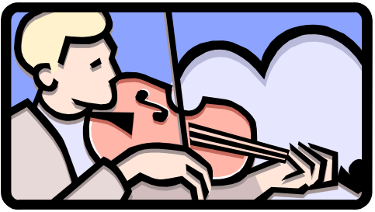
Action Settings: 4
Highlight
Mouse over -> Show Object
Mouse over -> Play sound
Highlight when mouse over

Slide 5
Action Settings: 5
Mouse over -> Run Macro -> message box
End Show

