Slide 1
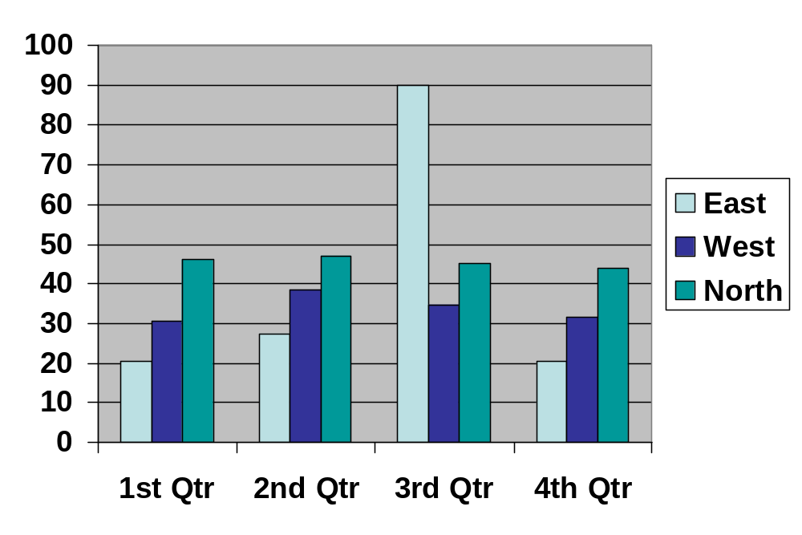
Testcase_ID | FFC30EP1_PPT_GRCHART0010(Clustered Column)
Sub-Function | FFC\FFC with MS office\Interoperability Support Enhancement Phase I\Graphic Chart\Chart Type\Column
TestPoint | Clustered Column
Example:

