Slide 1
PHY 905 Final Project: Application of Genetic Algorithms to Optimizing Paths in the Traveling Salesman Problem
Steve Hughey
May 5, 2015

Slide 2

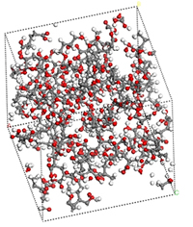

Overview
Traveling Salesman Problem (TSP)
Approaches to solving TSP
Genetic Algorithms
Genetic Algorithm for solving TSP
Conclusion
Sales
http://www.buzzpirates.com/2008/11/billy-mays-you-sir-are-on-notice/
“Miniaturized Linear Stochastic Dipole Antenna”
Protein folding
http://cearl.ee.psu.edu/Projects/Project3-3.htm
http://brainz.org/15-real-world-applications-genetic-algorithms/

Slide 3
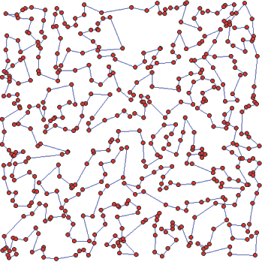

Traveling Salesman Problem
Mathematically, TSP amounts to finding the shortest path through an undirected weighted graph which visits each vertex exactly once
Brute force solution:
compute every possible
path and select the
shortest one
Brute force complexity:
O(n!) (yikes!)
TSP is a classic example of an NP-hard problem
Additional constraints can be imposed, such as bottlenecks, etc.
Very important problem in transportation and delivery logistics
We consider the circuitous tour case
Example illustration of a solution to a TSP

Slide 4
Traveling Salesman Problem
Alternative methods to solving TSP include:
Branch-and-bound algorithms (a variant is the current record holder: 85.9k cities)
  Recursively subdivide candidate solutions into disjoint segments and discard costly segments from the search
Greedy algorithms/nearest neighbors
  Go boldly in the direction of the nearest unvisited town and never reconsider your choice
Ant colony optimization
  Travelers (“ants”) deposit “pheromones” on each edge, shortest path is fortified with more “pheromones” before next iteration
Genetic algorithms, used in this presentation

Slide 5
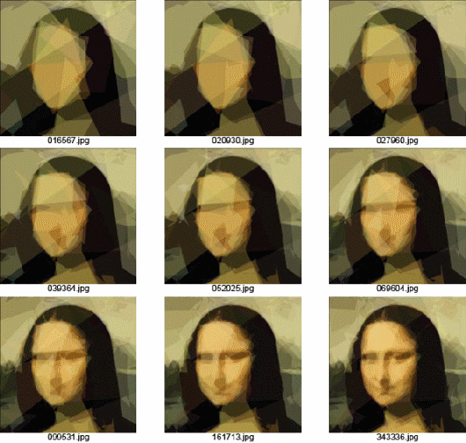
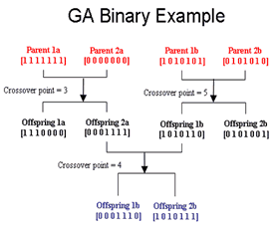
Genetic Algorithms
GA are somewhat problem-agnostic – can be applied to many optimization problems
Significant research effort to develop optimization techniques which draw upon natural processes, e.g. GA, artificial neural networks, machine learning, etc.
GA are often used in engineering design applications
  Complex antenna topologies
  Aerodynamic flow for aircraft, cars, etc.
GA require only a cost/”fitness” function and “chromosome” representation of seach space
http://nxt.ncat.edu/genetic.html
http://www.puremango.co.uk/2011/03/genetic-algorithm-examples/

Slide 6
Genetic Algorithms
Basic idea of genetic algorithms (GA):
  Retain the characteristics of low-cost candidate solutions and explore surrounding candidates by means of evolutionary modifications to the candidate population
Common selection techniques include:
  Roulette: probabilistic selection weighted by fitness
  Tournament selection: selected states win NCAA-style fitness comparison tournament
Mating: splice two candidate solutions together at randomized position to create “child” candidates
Mutation: Probablistic alteration of candidate solution – bit flipping (binary), entry swapping, etc.
Basic GA steps
Initial population
Selection
Mutation
Mating
Final Population
N_{generations} times
(or stopping criterion reached)

Slide 7

Genetic Algorithms in Python
DEAP (Distributed Evolutionary Algorithms in Python) package provides evolutionary algorithm building blocks
Highly flexible framework
Allows custom functions for population creation, evaluating cost/fitness, mating, mutation, etc.
Multi-objective optimization
Parallelization of cost/fitness function evaluation
DEAP, NumPy, matplotlib, and matplotlib's Basemap package for plotting geographical map data were used for this project

Slide 8
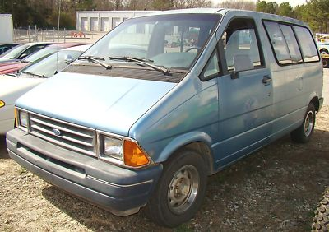

Traveling Salesman Problem: Example
The 14-member bluegrass Bon Jovi cover band, Ban Jovi, is embarking on a tour to promote its new album, A Fiddle Bit of Soul, and also to evade the pursuit of Jon Bon Jovi's legal team
In order to publicize their music, they have decided to tour the 40 largest cities in the contiguous US in their 1987 Ford Aerostar van
Due to time and financial constraints, the
overall driving distance should be minimized
Left: Two of the 14 members of Ban Jovi
Right: 1987 Ford Aerostar

Slide 9
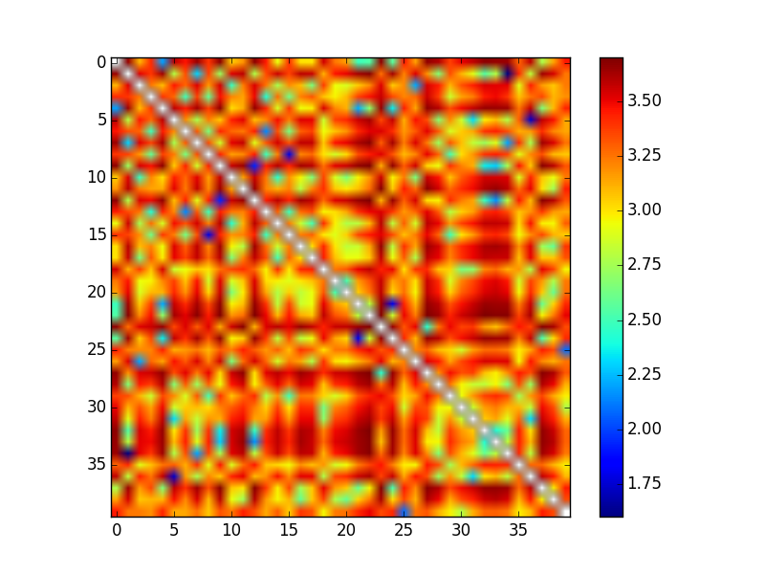
Traveling Salesman Problem: Example
The band gets together and creates a distance matrix which holds the shortest driving distance between each pair of cities, as given by Google Maps API
With 40 cities, there are 40! = 8.1591528e+47 possible paths
An exact solution is not tractable on the computers available to the band members
Some sort of approximation approach will be required: GA
ID+city lat/lon
[0 ] New York City, New York (40.664274,-73.938500)
[1 ] Los Angeles, California (34.019394,-118.410825)
[2 ] Chicago, Illinois (41.837551,-87.681844)
[3 ] Houston, Texas (29.780472,-95.386342)
[4 ] Philadelphia, Pennsylvania (40.009375,-75.133346)
[5 ] Phoenix, Arizona (33.572162,-112.087966)
[6 ] San Antonio, Texas (29.472403,-98.525142)
[7 ] San Diego, California (32.815300,-117.134993)
[8 ] Dallas, Texas (32.794176,-96.765503)
[9 ] San Jose, California (37.296867,-121.819306)
[10] Indianapolis, Indiana (39.777995,-86.145838)
[11] Jacksonville, Florida (30.337019,-81.661302)
[12] San Francisco, California (37.759881,-122.437392)
[13] Austin, Texas (30.307182,-97.755996)
[14] Columbus, Ohio (39.984799,-82.985044)
[15] Fort Worth, Texas (32.779542,-97.346335)
[16] Charlotte, North Carolina (35.208707,-80.830739)
[17] Detroit, Michigan (42.383038,-83.102237)
[18] El Paso, Texas (31.848360,-106.426979)
[19] Memphis, Tennessee (35.103543,-89.978498)
[20] Nashville, Tennessee (36.169129,-86.784790)
[21] Baltimore, Maryland (39.300213,-76.610516)
[22] Boston, Massachusetts (42.331960,-71.020173)
[23] Seattle, Washington (47.620499,-122.350876)
[24] Washington, District of Columbia (38.904148,-77.017094)
[25] Denver, Colorado (39.761849,-104.880625)
[26] Milwaukee, Wisconsin (43.063348,-87.966695)
[27] Portland, Oregon (45.536951,-122.649971)
[28] Las Vegas, Nevada (36.227712,-115.264045)
[29] Oklahoma City, Oklahoma (35.467079,-97.513656)
[30] Albuquerque, New Mexico (35.105552,-106.647388)
[31] Tucson, Arizona (32.154289,-110.871062)
[32] Fresno, California (36.782674,-119.794492)
[33] Sacramento, California (38.566592,-121.468632)
[34] Long Beach, California (33.809102,-118.155327)
[35] Kansas City, Missouri (39.125212,-94.551136)
[36] Mesa, Arizona (33.401926,-111.717379)
[37] Virginia Beach, Virginia (36.779322,-76.024020)
[38] Atlanta, Georgia (33.762909,-84.422674)
[39] Colorado Springs, Colorado (38.867255,-104.760749)
Distance between each city (km), log scale
Cities ordered by population
(city data obtained from Mathematica)

Slide 10



Traveling Salesman Problem: Example
Mary, the best of the 3 fiddle players, decides to write a GA in Python using DEAP to solve the problem
Tennessee Joe (9 of the band members are named Joe, so they differentiate themselves by their home states), the backup banjo player/yodeler, decides to copy Mary's idea, but represents the path using a different set of chromosomes
Indisputably the worst of the 6 dulcimer players, Alabama Joe #2 (4/9 of the Joes are from Alabama), thinks he is clever, so he writes a program to compute the distance of all possible paths and choose the shortest route

Slide 11
Traveling Salesman Problem: Example
Chromosome Representation of a path
Philadelphia, PA
Fort Worth, TX
Charlotte, NC
Dallas, TX
Seattle, WA
4
8
15
16
23
4
8
29
8
...
Mutation/breeding and tournament selection
8
15
8
15
29
8
15
3
13
15
16
15
3
“What are you lookin' at? You got a problem with my code? Just give her a few more minutes to finish up. You'll see.”
16
23
3
13
Dallas, TX
Austin, TX
Houston, TX
Fort Worth, TX
Oklahoma City, OK
Edges have a notion of length
Mary
Tennessee Joe
Alabama Joe #2

Slide 12
Traveling Salesman Problem: Example
Mary represents the candidate paths using permutations of the integers 0-39
Computing the length of a path using her representation is cheap
Mating and mutation operations amount to permuting the path integer set, preserving the circuit
Parameters:
  Population: 200
  # Generations: 1000
  Tournament size: 4
  Crossover probability: 0.8
  Mutation rate: 0.2(0.05)
Tennessee Joe's representation is more costly than Mary's
Mutation and mating operations must preserve the complete circuit, requiring operations on Mary's representation
Parameters:
  Population: 200
  # Generations: 1000
  Tournament size: 3
  Crossover probability: 0.8
  Mutation probability: 0.2(0.05)
“Just you wait. My code is gonna blow you and your fancy-pants algorithms and what not straight out of the water.”
Mary
Tennessee Joe
Alabama Joe #2

Slide 13
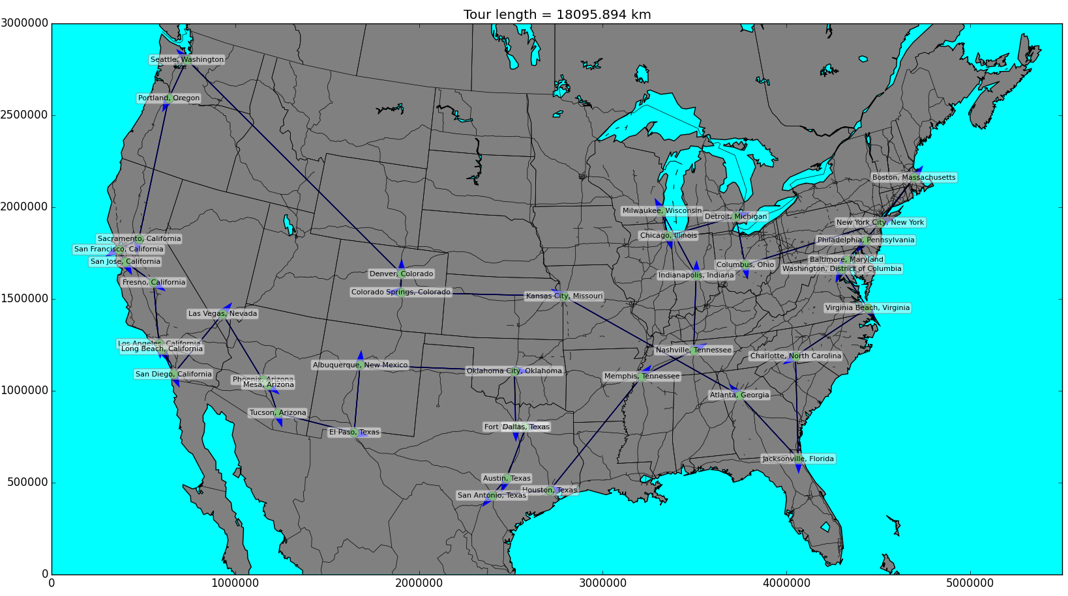
Traveling Salesman Problem: Example
Mary's sequence-based approach seems to have yielded a reasonably good solution to the problem, in under 5 minutes!
Tour distance ~ 18096 km

Slide 14
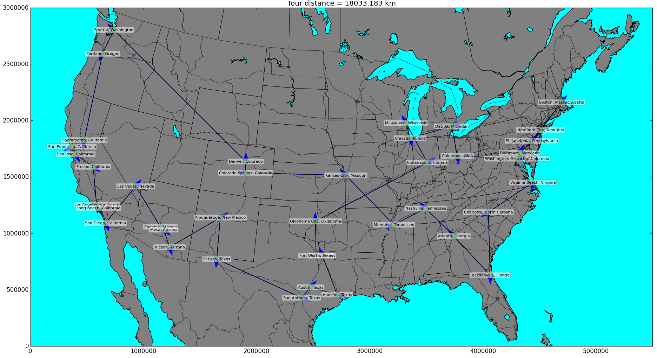
Traveling Salesman Problem: Example
Tennessee Joe's program yielded a very similar solution, only 60km shorter
Tour distance ~ 18033 km

Slide 15
Traveling Salesman Problem: Example
The selected examples were the shortest paths generated by their respective approaches over a number of runs using randomized initial populations
Both the sequence-based and the edge-based algorithms appeared to converge to some kind of minimum (hopefully global)
Obtaining these minimal distances required some tweaking of the algorithm settings, namely tournament size, population size, and number of generations
Above a certain number of generations (~500), there appeared to be no gain in the currently optimal path
Most of the route is identical except through the Midwest

Slide 16
Traveling Salesman Problem: Conclusion
The band decided to head off on Tennessee Joe's path, playing every venue they could book in each city
Upon completion of the tour, the members realized that gas alone had cost them well over $12,000
In order to pay off debt and to hire a lawyer to fend off Bon Jovi's legal team, the members of Ban Jovi decided to sell their instruments and use their knowledge of GA to go work on Wall Street
...say, whatever happened to Alabama Joe #2? He never made it into the van….

Slide 17



Traveling Salesman Problem: Conclusion
BRUTE_FORCE.EXE
Running… STILL...

Slide 18
Questions?

