Slide 1
Is there a reference state on Gayini?
Reference-state analysis · Tasks T1, T2 and T6 · 28 July 2026
Every number in this deck is queryable from Gayini_Results.sqlite.

Slide 2
THE BRIEF
What was asked
Since management changed, are the formerly-cropped paddocks becoming more like the conserved paddocks over time? Are they on a trajectory of improvement toward a reference state?
A distance-to-reference design needs
• a reference set that is internally consistent
• a reference set distinguishable from the treated set
• a reference condition that is a plausible target
The design template is Dawson et al. (2016), Macquarie Marshes — same team, same basin, same problem.
The four “No grazing” paddocks were nominated as the reference set. This deck reports what thirty-five years of satellite record says about each of the three requirements, and what follows for the design.
Source: Gayini_project_conversation_history.md §5.3. Template: Dawson et al. 2016, Remote Sensing 8(7), 542.

Slide 3
BEFORE ANY RESULT
One substitution governs everything that follows
Cropping history for Gayini is not recorded anywhere. The paddock table carries five columns reserved for it — cropping_history, land_use_era, irrigation_status, history_source and history_confidence — created deliberately empty when the table was built, and still empty for all 64 paddocks.
The analysis therefore substitutes the grazing treatment layer, which exists, for the land-use history, which does not.
Every contrast in this deck is
not-grazed versus grazed.
It is not conserved versus formerly-cropped.
What that costs. “No grazing” is a management category, not a verified undisturbed state. A paddock in that category may have been cropped, cleared or irrigated before the satellite record begins, and nothing in the data would show it. What follows is what happens when that assumption is tested against thirty-five years of record.
Source: dim_management_zone, built at T1 Gate B. Five RESERVED columns, NULL on 64 of 64 rows.

Slide 4
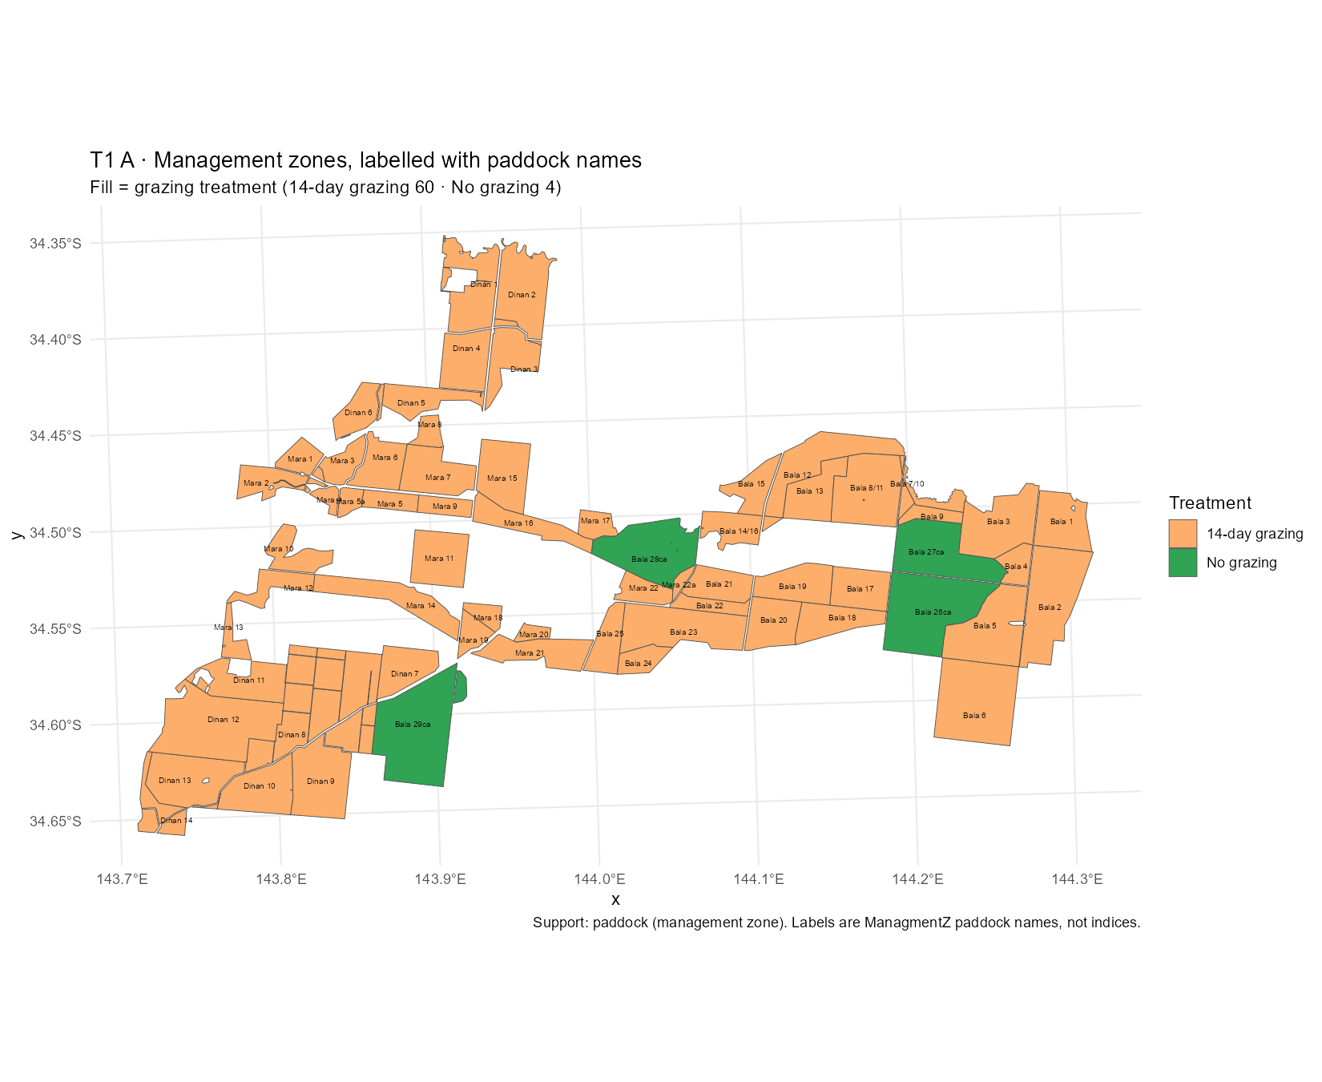
THE PROPERTY
Sixty-four paddocks, four of them ungrazed
What you are looking at
Every management zone on Gayini, filled by grazing treatment and labelled with its paddock name. Orange is 14-day rotational grazing (60 paddocks). Green is no grazing (4 paddocks): Bala 26ca, 27ca, 28ca and 29ca.
All four carry the Bala name, so the reference set is confounded with property block.
But they are not a block on the ground. 26ca and 27ca sit 3.4 km apart in the east. 28ca is 16 km west, surrounded by Mara paddocks. 29ca is 30 km away in the south-west, surrounded by Dinan paddocks.
Reading this map: the shared Bala label is administrative. Whether it also means shared management history is a question for Nari Nari, not something the layer can answer.
Figure T1_A_zone_map_named. Source: management_zones GeoPackage layer joined to dim_management_zone on fid. Support: paddock. Centroid separations computed 28 July, not yet registered.

Slide 5
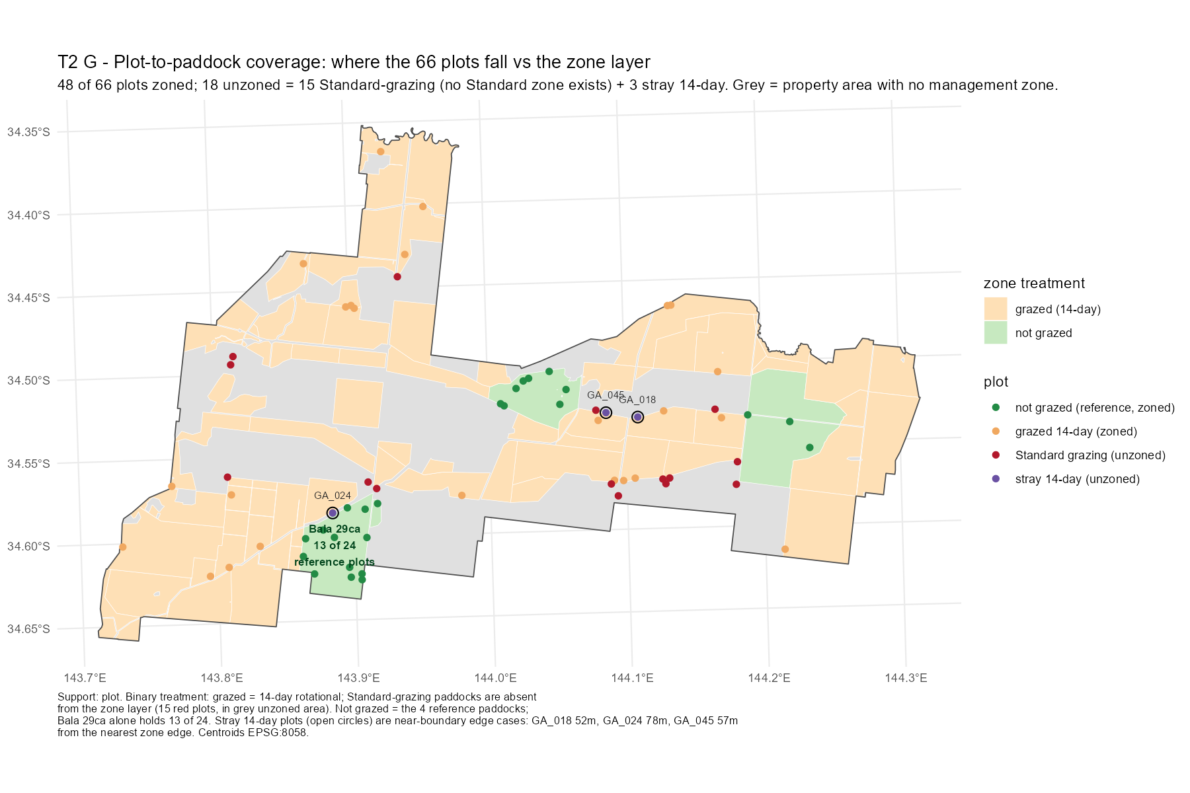
THE MONITORING NETWORK
Where the 66 plots actually fall
Two things this map settles
Bala 29ca alone holds 13 of the 24 reference monitoring plots — 54%. The ground-truth network's picture of “reference condition” is over half one paddock.
All 15 standard-grazing plots fall on grey ground, outside every management zone. Standard grazing has no polygon in the layer, so it has never been measured as a treatment. That is the reason Task T6 exists.
Three 14-day plots sit just outside a zone edge — 52, 57 and 78 m — and are near-boundary cases, not errors.
Reading this map: green dots are reference plots, orange 14-day, red standard grazing; grey fill is property with no management zone at all.
Figure T2_G_plot_paddock_coverage. Source: plot_management_overlay. Support: plot (66 centroids, EPSG:8058).

Slide 6
THE METRIC
What “the floor” means — and what it does not
veg_p05_spatial — used throughout this deck
census veg_p05 — a different number entirely
Take one paddock in one year. Rank every pixel in it by total vegetation cover. The floor is the level at the 5th percentile — the cover carried by the worst-covered 5% of that paddock's ground.
It measures how patchy a paddock is.
Take one pixel across all 35 years. Rank its yearly values. The census floor is the level at the 5th percentile — the cover that pixel holds 95% of the time.
It measures resilience through drought.
These must never appear in the same figure or be compared numerically. One collapses across space, the other across time. The column is named veg_p05_spatial specifically so the difference cannot be lost.
The floor was chosen over the mean because the mean sits high and flat and undersells the flood signal.
Definitions per T2 spec Gate B. veg_p05_spatial lives in fact_zone_veg_annual; census veg_p05 in census_by_zone_stratum.

Slide 7
THE FINDING
Three of the four are indistinguishable from grazed ground
Without Bala 29ca
1.5 – 3.3 pp
is the entire gap between the reference and grazed paddocks, across thirty-five years.
Bala 29ca alone sits 42 pp below at the start of the record and closes to 18 pp.
Reading this chart: zero means identical to the grazed median. Each line is one way of defining the reference set. The green line is the three paddocks other than Bala 29ca — it never leaves a 3 pp band in thirty-five years. The grey line, the set as a whole, only departs from it because the red line drags it down.
Source: v_zone_veg_annual, series_variant = mean_of_seasons. Reference = mean of the paddock values; grazed = median across the 60 14-day paddocks taken within each year, then averaged over the period. Support: pixel, aggregated to paddock. Not stratum-controlled — see slide 18.

Slide 8
TIMING
The gap predates conservation management by thirty years
1988
First year of the satellite record
30 years
1988–92
The reference set already sits 13.1 pp below the grazed median
between the gap appearing and the management that was meant to explain it.
2018–19
Conservation management begins
2019–22
Gap now 5.6 pp — and it has been narrowing since 1988
The convergence predates the intervention too. The gap narrows monotonically from 1988 onward — −13.1, −11.4, −7.9, −5.7, −5.6 pp. Attributing either the gap or its closure to conservation management would be wrong by three decades.
Source: v_zone_veg_annual, five-period split. Support: pixel, aggregated to paddock.

Slide 9
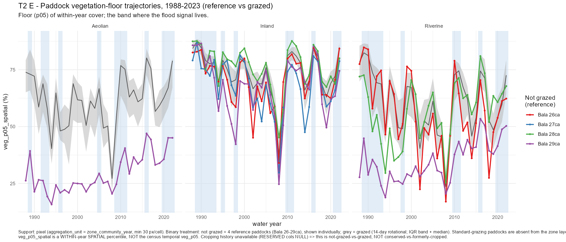
THE RECORD
Thirty-five years, paddock by paddock
Reading this chart: each coloured line is one reference paddock, never pooled. The grey band is the middle half of the 60 grazed paddocks with their median through it, so a reference line inside the band is behaving like ordinary grazed ground. Blue stripes are the wettest years. A paddock spanning several communities appears in each panel it occupies — Bala 29ca reads 29, 67 and 35 across its three, which a single label would hide. In Inland Floodplain all four reference paddocks sit inside the band for the whole record. In Aeolian and Riverine, Bala 29ca is the purple line well below everything else, climbing toward the band over thirty-five years.
Figure T2_E_paddock_trajectories. Source: fact_zone_community_veg_annual, mean_of_seasons, min 30 px/cell. Support: pixel, paddock × community × year.

Slide 10
WHAT KIND OF DIFFERENCE
Same average cover, much patchier ground
Not less vegetated — more uneven
On mean cover the reference paddocks match grazed almost exactly, and in Inland Floodplain sit slightly above.
The whole deficit is in the floor — the worst-covered 5% of ground.
So they carry more bare ground while matching grazed everywhere else.
Reading this chart: both bars are reference minus grazed, so zero means identical. Matching on the average and not on the tail means the cover is distributed differently, not that there is less of it.
Source: v_three_arm_gap_decomposition, community roll-up, all years. Support: pixel. Landsat fractional cover measures cover, not condition.

Slide 11
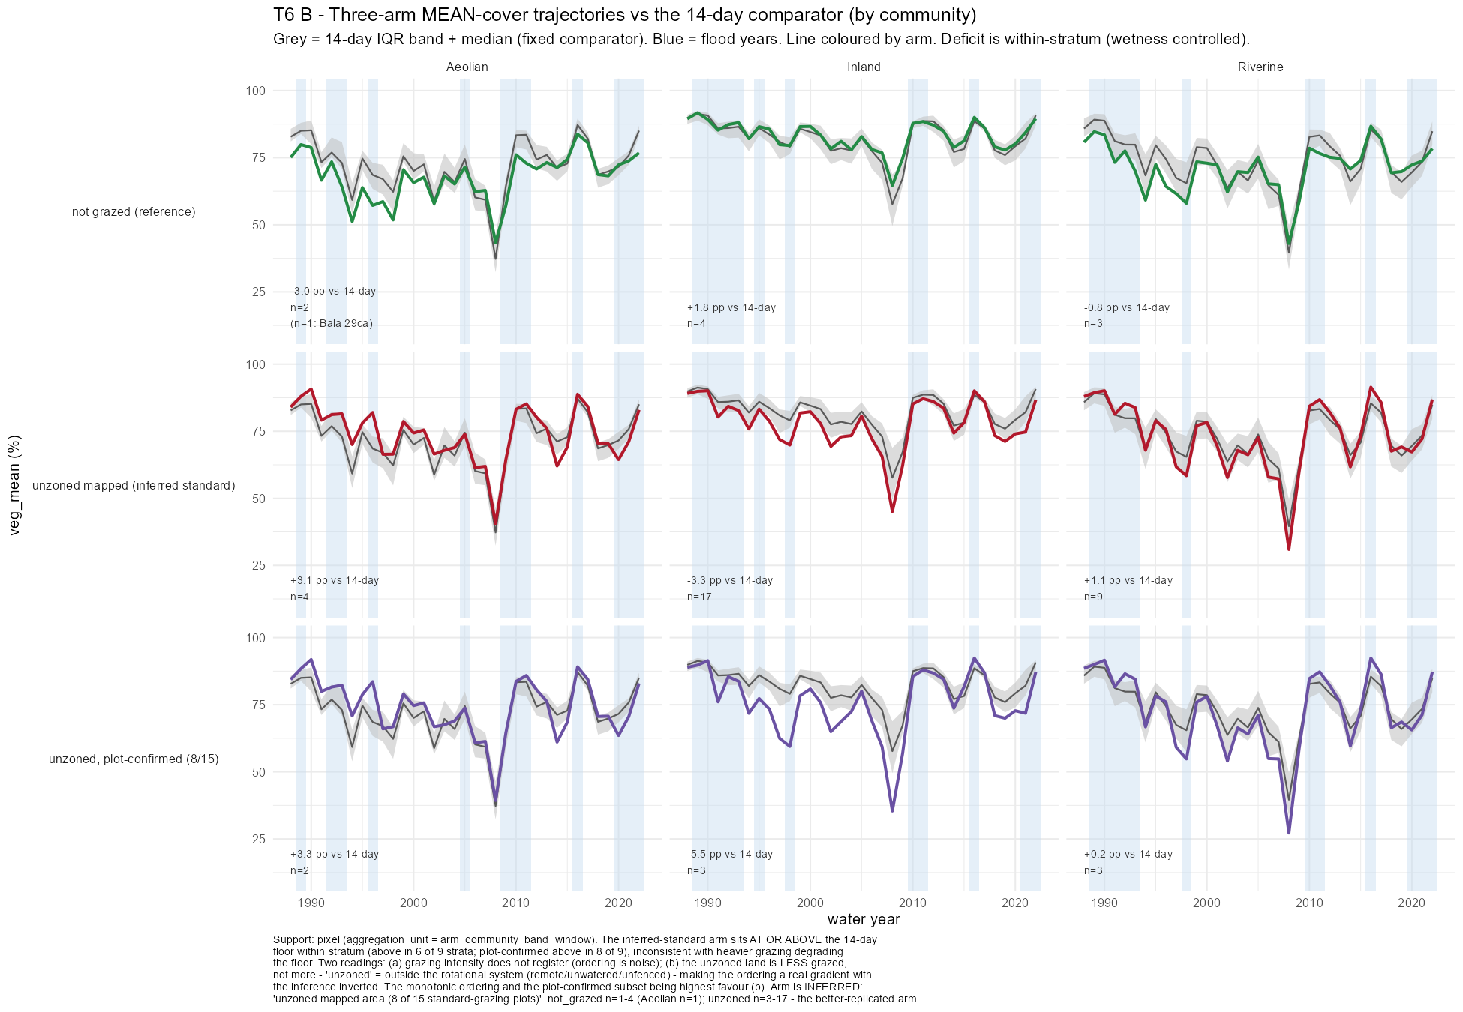
THE SAME CONTRAST, EVERY ARM
On the mean the arms track each other
Reading this chart: mean total cover for each management arm (coloured line) against the middle half of the 14-day grazed paddocks (grey band), by community.
Every arm sits inside or close to the band for the whole record, and the deficits are small — between −5.5 and +3.3 pp.
Compare the next slide, the identical figure for the floor. The arms separate there and not here. That contrast is why the floor was chosen.
Figure T6_B_three_arm_mean. Source: fact_three_arm_stratum_veg_annual. Support: pixel, arm × community × band × year. Deficits are within-stratum, so wetness is controlled.

Slide 12
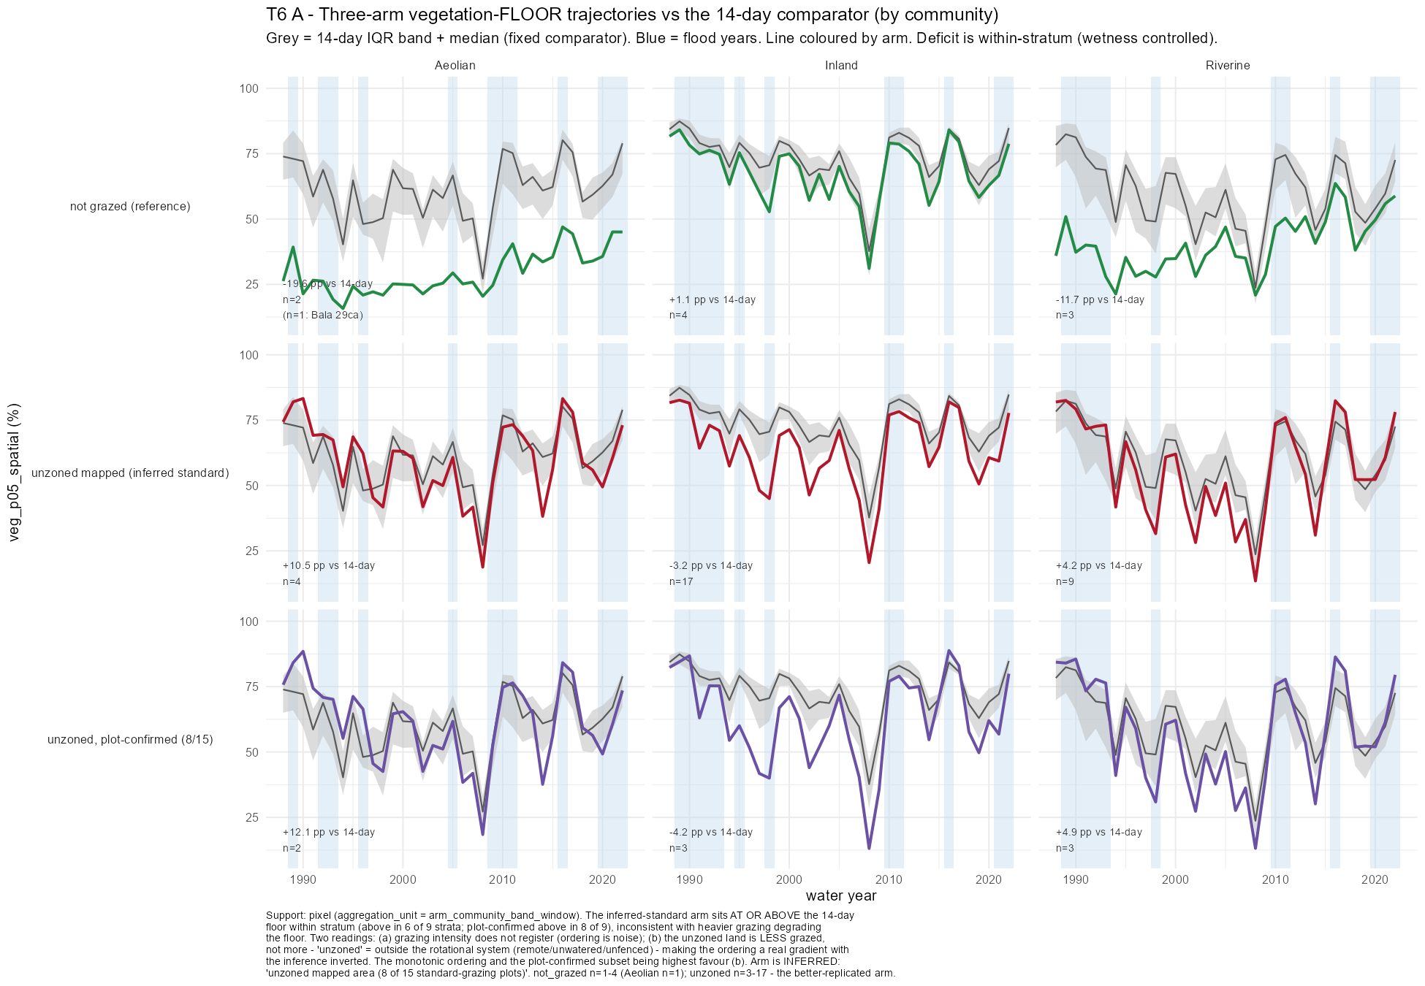
GRAZING INTENSITY
A third arm, and it does not order the way degradation predicts
Reading this chart: the same layout as the previous slide, but for the floor.
Top row: the four ungrazed paddocks. Middle: the whole unzoned area, inferred to be standard grazing. Bottom: only the part of it containing standard-grazing plots.
If heavier grazing degraded the floor, the lower two rows would sit below the grey band. They sit at or above it in 6 of 9 strata, and the plot-confirmed subset in 8 of 9.
The ungrazed row is the one below the band.
Figure T6_A_three_arm_grid. Source: fact_three_arm_stratum_veg_annual. Support: pixel. The unzoned arm is inferred from plot locations (8 of 15 plots), not confirmed.

Slide 13
TWO READINGS
The data cannot choose between them
Reading one
Reading two
Grazing intensity does not register in the floor at all. The ordering between arms is noise, and the floor is set by something else — principally where a paddock sits on the wetness gradient.
If this is right, no management category will separate cleanly on this metric, and the reference-state framing was never going to work.
The unzoned land is grazed less, not more. It sits outside the rotational system because it is remote, unwatered or unfenced — so the ordering is a real gradient with the inference inverted.
If this is right, the floor does respond to grazing pressure, and the arms are simply mislabelled.
One conversation with Nari Nari decides which. Whether the unzoned country is grazed more, less or not at all is a question of fact that no amount of further computation will settle. Both readings are carried here deliberately.
Supporting evidence for both readings: T6_A_three_arm_grid, the monotonic ordering, and the plot-confirmed subset being highest.

Slide 14
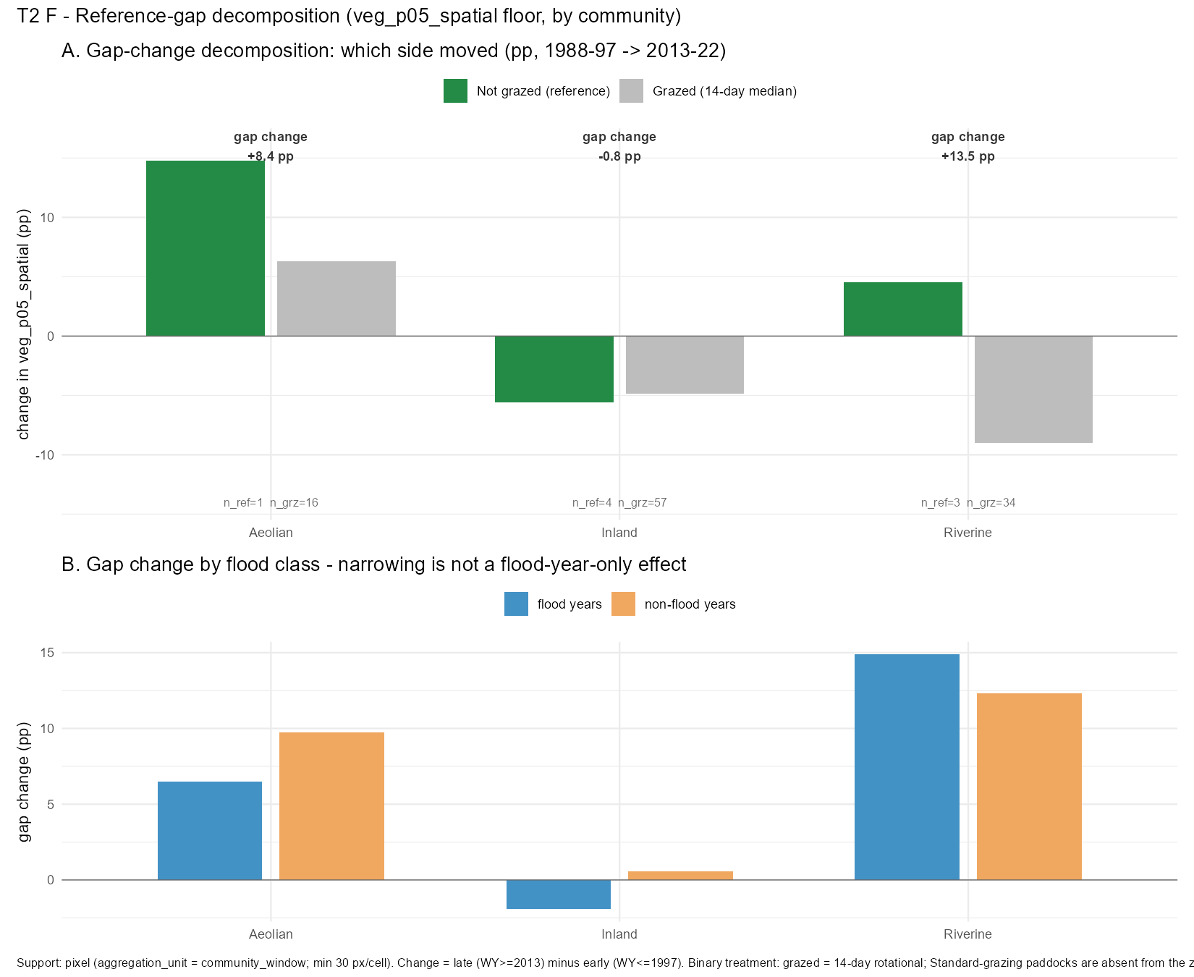
MECHANISM
Which side moved — and it is not just the wet years
Top panel: how much each side moved between 1988–97 and 2013–22. The gap narrowed for a different reason in each community.
Aeolian — the ungrazed side rose (+14.8 against grazed +6.3). Riverine — the grazed side fell (−9.0 against ungrazed +4.5). Inland — both fell together.
Bottom panel: the same split into flood and non-flood years. If the narrowing were only a wet-year effect the orange bars would vanish. They do not.
Figure T2_F_gap_decomposition. Source: fact_reference_gap_decomposition. Support: pixel, community window, min 30 px/cell. Aeolian carries n_ref = 1 (Bala 29ca only).

Slide 15
INTERNAL CONSISTENCY
The reference paddocks disagree with each other
What that means for the design
6 of 9
• In Riverine-high the four reference paddocks span 29.8 to 66.3% floor, while the whole reference-grazed contrast is −2.1 pp. The target is inside the noise.
• A fixed distance-to-reference number would be measuring distance to an arbitrary point inside a 40-point cloud.
• Aeolian has only one reference paddock, so no community-level claim can rest on it at all.
strata where the spread within the reference set is larger than the difference between reference and grazed.
Every Riverine band and every Inland Floodplain band.
Source: within-stratum spread of veg_p05 across the four reference paddocks, from census_by_zone_stratum and v_zone_stratum_contrast_bala_robust. Support: pixel.

Slide 16
THE EARLIER RESULT
The apparent grazing effect was block structure
What changed
Matching on wetness within stratum, the Riverine bands showed a consistent +7.5 to +8.3 pp advantage for ungrazed ground. That looked like a grazing effect.
Restricting the comparison to Bala paddocks and weighting by paddock rather than pixel, it collapses — and reverses in the high band.
93% of the reference pixels behind the original number came from Bala 29ca.
Reading this chart: the gold bars are the result as first computed; the teal bars are the same comparison once the paddocks are treated as the unit rather than the pixels. A result that survives this test is about grazing; one that does not is about which paddocks happen to be in which group.
Source: v_zone_stratum_treatment_contrast and v_zone_stratum_contrast_bala_robust, T1 Gate D. Support: pixel.

Slide 17
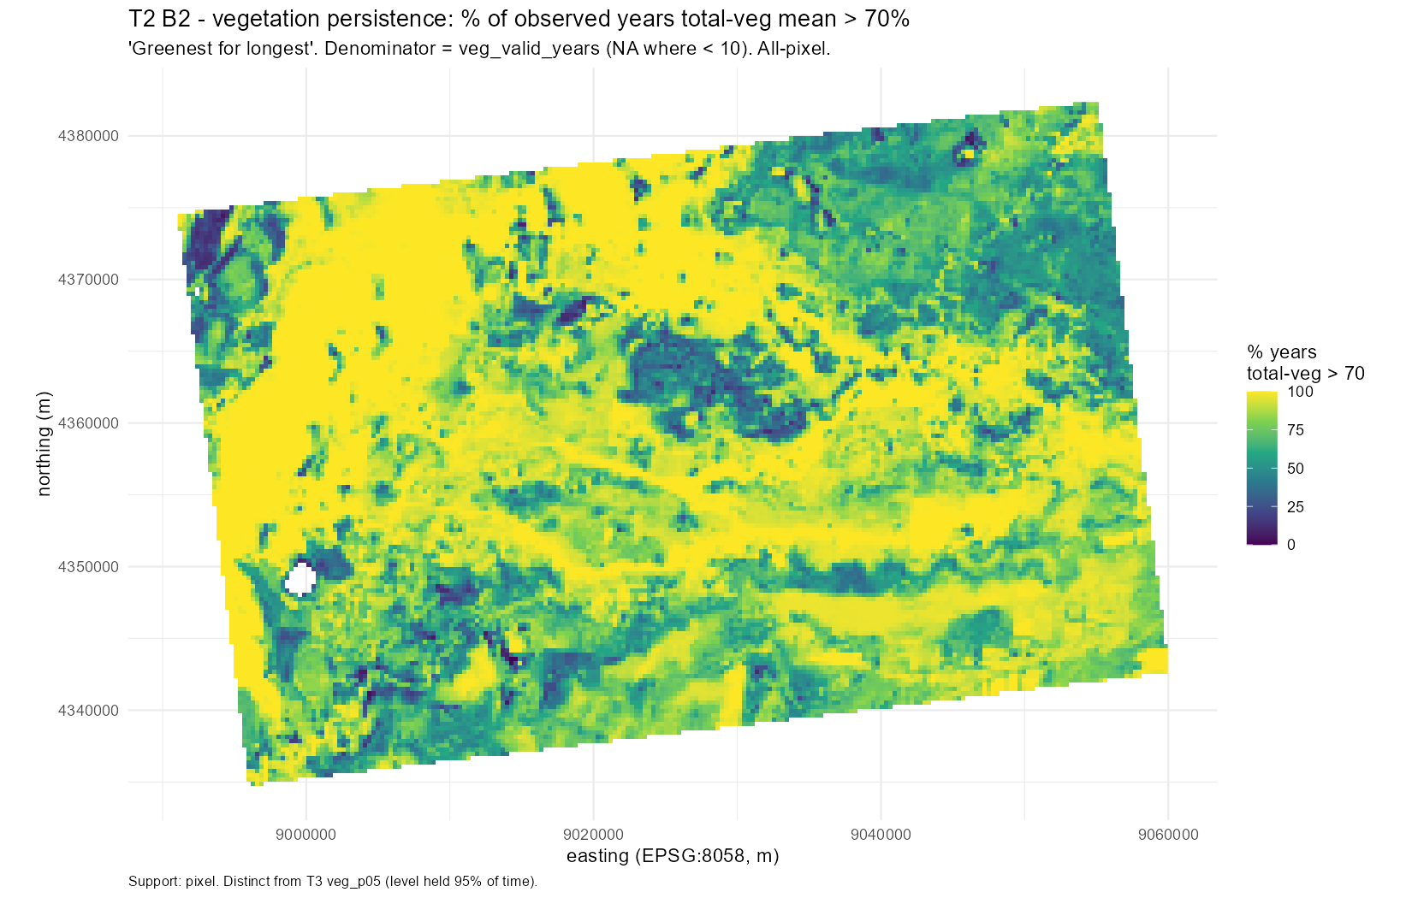
THE WIDER SURFACE
Where the property stays green, regardless of management
What you are looking at
Every pixel on the property, coloured by the share of observed years in which its mean total vegetation exceeded 70%.
Yellow means green nearly every year. Dark blue means rarely.
The pattern is hydrological, not administrative — it follows channels and low ground, and it crosses paddock boundaries without noticing them.
One caution: this is a persistence measure — how often cover was above a threshold — not the floor metric used elsewhere. Shown for spatial context only.
Figure T2_B2_duration_map. Source: veg_persistence_duration_8058, pct_above_70 band. Denominator = veg_valid_years, NA below 10. Support: pixel, all-pixel, EPSG:8058.

Slide 18
THE OPEN PROBLEM
The paddock comparison is not controlled for wetness
Why this matters
Across all 64 paddocks the floor tracks inundation at r = 0.71 — wetness explains about half of it.
Bala 29ca is the fourth-driest paddock on the property: 8.5% mean annual inundation against a grazed median of 28.6%.
Fitting that relationship, a paddock as dry as Bala 29ca would be predicted at about 57% floor. It sits at 40.5%.
What this does to the headline: the −42 pp figure on slide 7 compares one dry paddock against the median of paddocks more than three times wetter. Once wetness is accounted for, the residual is roughly −17 pp. The finding survives — Bala 29ca is genuinely low even for how dry it is — but at about 40% of its stated size. Note that a grazed paddock, Dinan 10, sits at 40.4% on almost the same wetness.
NEW ANALYSIS, computed 28 July 2026, NOT YET REGISTERED. Source: fact_zone_veg_annual joined to dim_management_zone. Needs a proper build before publication. T6 controls this by stratum; T1 reports the flood delta alongside; the slide-7 table does neither.

Slide 19
WHERE THIS LEAVES THE DESIGN
Four ways forward
1
Report it as it stands
“Conserved” is a management category, not a condition state. Three of four are indistinguishable from grazed ground on a 35-year record, and the fourth is an outlier recovering from something that predates the record. Defensible today, no new data.
2
Get the land-use history
If Bala 29ca was cleared or cropped, the whole picture resolves into a recovery trajectory and it becomes the most interesting paddock on the property rather than the most confusing. One email to Ernest.
3
Define reference environmentally
Compare each place to environmentally similar sites rather than to a management category. This is HCAS's premise, and HCAS 3.3 covers 1988–2024 at 90 m annual, matching our span. A redesign.
4
Drop the reference framing
Wetness organises the floor far more strongly than any management category does. That is the finding the data best supports, and the one the client can act on.
Options 1 and 4 are available today. Option 2 is one email. Option 3 is a redesign.
Full reasoning in Gayini_reference_state_methods.md §5–6.

Slide 20
BOUNDS
What this analysis cannot tell you
Cover, not condition
Landsat fractional cover measures how much cover is present — not whether it is native or introduced, nor its structure or health.
Not grazed is not conserved
Cropping history is unrecorded. Every contrast here is not-grazed versus grazed, which is not the comparison the design called for.
Open water sits inside the floor metric
Water reads as low cover and is not masked before the percentile is taken, so wet paddocks carry a tail that may not be vegetation at all.
Not controlled for wetness
Slide 18. T6 controls this by stratum; the headline table does not.
Aeolian rests on one paddock
n = 1 (Bala 29ca). No community-level claim can be built on it.
The third arm is inferred
“Unzoned” is inferred to be standard grazing from plot locations. 8 of 15 standard plots fall on it.
A fifth of the property is unmapped
18,562 ha (21.6%) sits outside the mapped census and has never been in any analysis — including 7 of the 15 standard-grazing plots.
None of these are reasons not to publish. They are the shape of what can be said.
Full register: Gayini_reference_state_results_catalogue.xlsx, Limitations sheet.

Slide 21
WHAT COULD BE DONE NEXT
Six analyses, ordered by value per unit effort
Get the land-use history
no analysis — one email
Whether Bala 29ca is a degraded paddock recovering from clearing. Decisive for the entire framing.
Mask open water before the percentile
one extraction re-run
Whether the reference paddocks' longer tails are sparse vegetation or standing water.
Re-cut the headline at stratum grain
a query, no new extraction
How much of the Bala 29ca gap survives wetness control. Current estimate: about −17 pp of the −42.
Map the floor and the wetness by paddock
two maps from existing tables
Whether the pattern is a management pattern or a hydrological one, visible at a glance.
Regress the floor on wetness, read residuals
established method, public R package
Which paddocks do better or worse than their wetness predicts — a far better management signal than any raw contrast.
Refugia surface against the LiDAR lignum swamp
T3 is specified but not yet built
Whether two independent sensors agree on the same ground, which would weaken the cover-not-condition caveat.
The first two cost nothing and settle the most. The full list of twelve is in the results catalogue.
Gayini_reference_state_results_catalogue.xlsx, Further_analysis sheet.

Slide 22
Three questions would change the answer
ERNEST
Was Bala 29ca ever cleared or cropped?
Decisive. Settles whether the reference set contains a recovering degraded paddock.
NARI NARI
Is the unzoned land grazed more, less, or not at all?
Decides between the two readings of the third arm.
RECORDS
What were the stocking rates, or DSE per hectare?
Whether 14-day and standard grazing differ in intensity at all.
None of them requires more analysis.
T1, T2 and T6 are complete, committed, and reproducible from the database.

