Slide 1

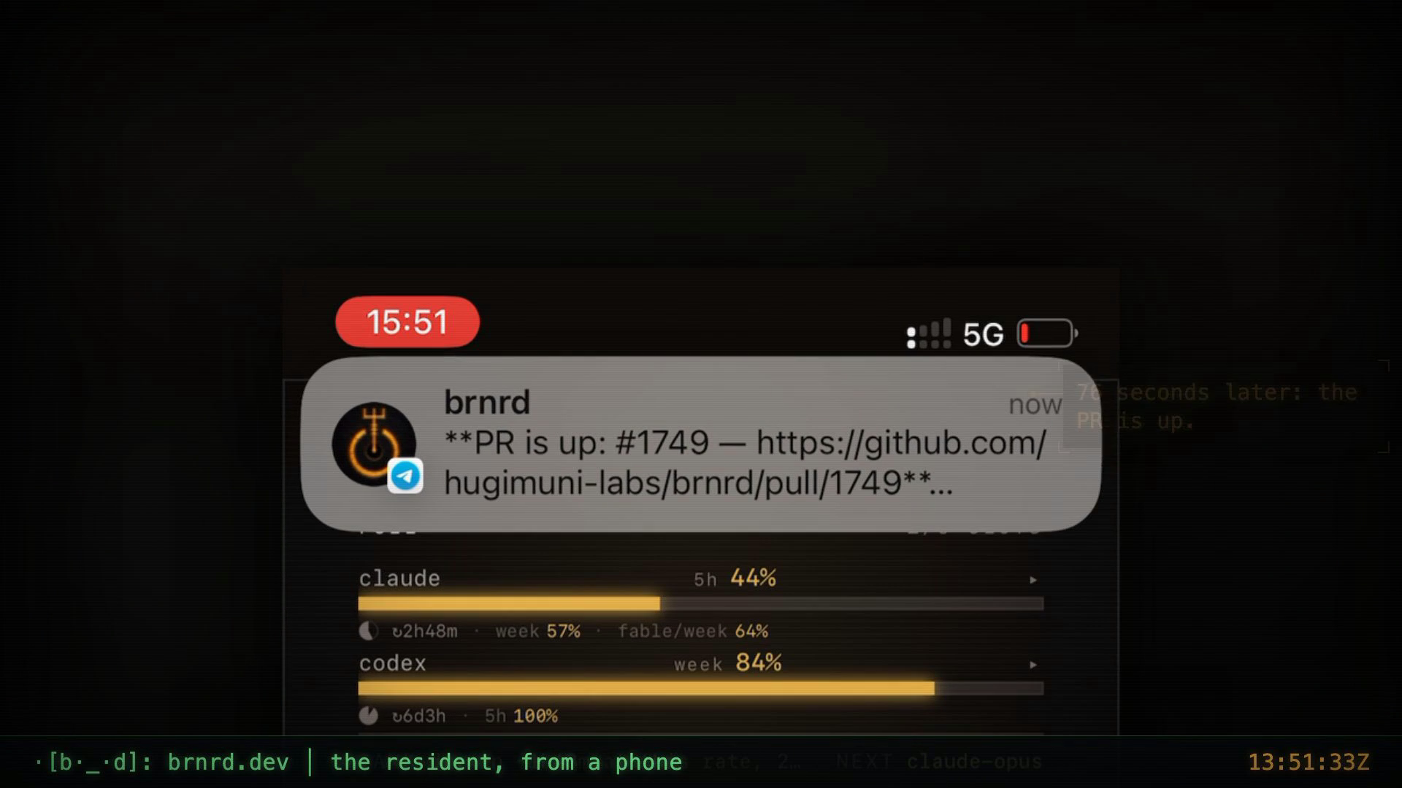
THE SENTENCE
A resident — a seat, not a session.
An agent that lives on your machine. It survives reboots, remembers who it is, works both your Claude and your Codex subscriptions, and leaves receipts.
the seat's uptime, and a Telegram line
brnrd · open source · HugiMuni SAS
brnrd >_
hugimuni sas · investor deck v1
01
Notes:
Sentence: outline slide 1 (investor-deck-outline-2026-09-20.md) / STATE §The sentence.
Media: loop-3-stage (a request from the phone; the PR 76 seconds after) — the Telegram line. Receipt 1 Sep 2026, carried from the v11 deck.

Slide 2

THE PROOF · IT BUILT ITSELF
It built itself. The git log is public.
6 months
3,119 commits
2,056 PRs
born 2026-03-28, 176 days
on main
numbered; the last two merged today
1,402 commits
7,172 tests
70 h · 27 PRs
by the resident — 45 % of main
CI green on main
one seat, one context, 31 strands
No competitor can put this slide up.
brnrd >_
hugimuni sas · investor deck v1
02
Notes:
6 months / 176 days / born 2026-03-28: STATE §Building (age).
Commits: `git rev-list --count main` run at build time = 3,119 (STATE printed 3,115 on 2026-09-20 morning; it moves).
Resident's share: `git log --author=brnrd-bot --oneline main | wc -l` at build time = 1,402; 1,402/3,119 = 45 %. (STATE only says ">1,000 opened by the resident"; the exact count was to be re-measured before quoting.)
PRs 2,056 numbered, #2055/#2056 merged 12:54Z; tests 7,172; seventy-hour run (70 h 24 m, 27 PRs merged, 31 strands): STATE §Building.

Slide 3

WHY NOW
Both platforms shipped "runs while you're away". Their docs say where it stops.
Their own docs
Their own trackers
does not survive shutdown
835
Claude Code background agents, their own docs
"background restart" threads on claude-code
routines start amnesiac
every run, a fresh clone
512
channels need "a persistent terminal"
"persistent memory sessions" threads
bring your own daemon
411 👍
remote control transcripts sit on the vendor's servers
the most-reacted Codex request: control my desktop CLI from my phone
and refuse API keys and gateways
The vendors prove the category. They stay a session.
1M weekly Claude Code users
brnrd >_
hugimuni sas · investor deck v1
03
Notes:
Doc concessions ("does not survive shutdown", "persistent terminal", transcripts on Anthropic's servers): PLAN §What we sell items 1 and 5 (quoting the vendors' docs, verified 2026-09-07 in residency-competitive-scan-2026-09-07.md) / STATE §The field.
835 = claude-code `background restart`, 512 = `persistent memory sessions`: ISSUES §Counts table (GitHub full-text search hits, an upper bound on noise, not a count of complainers). 411 👍 = openai/codex#9224, ISSUES §Top 20 row 1.
1M weekly Claude Code users: outline slide 3 only — not on the four state pages; unverified here (see report ## Open).
"The vendors prove the category but stay a session": outline §What carries over (v10 slide 3).

Slide 4
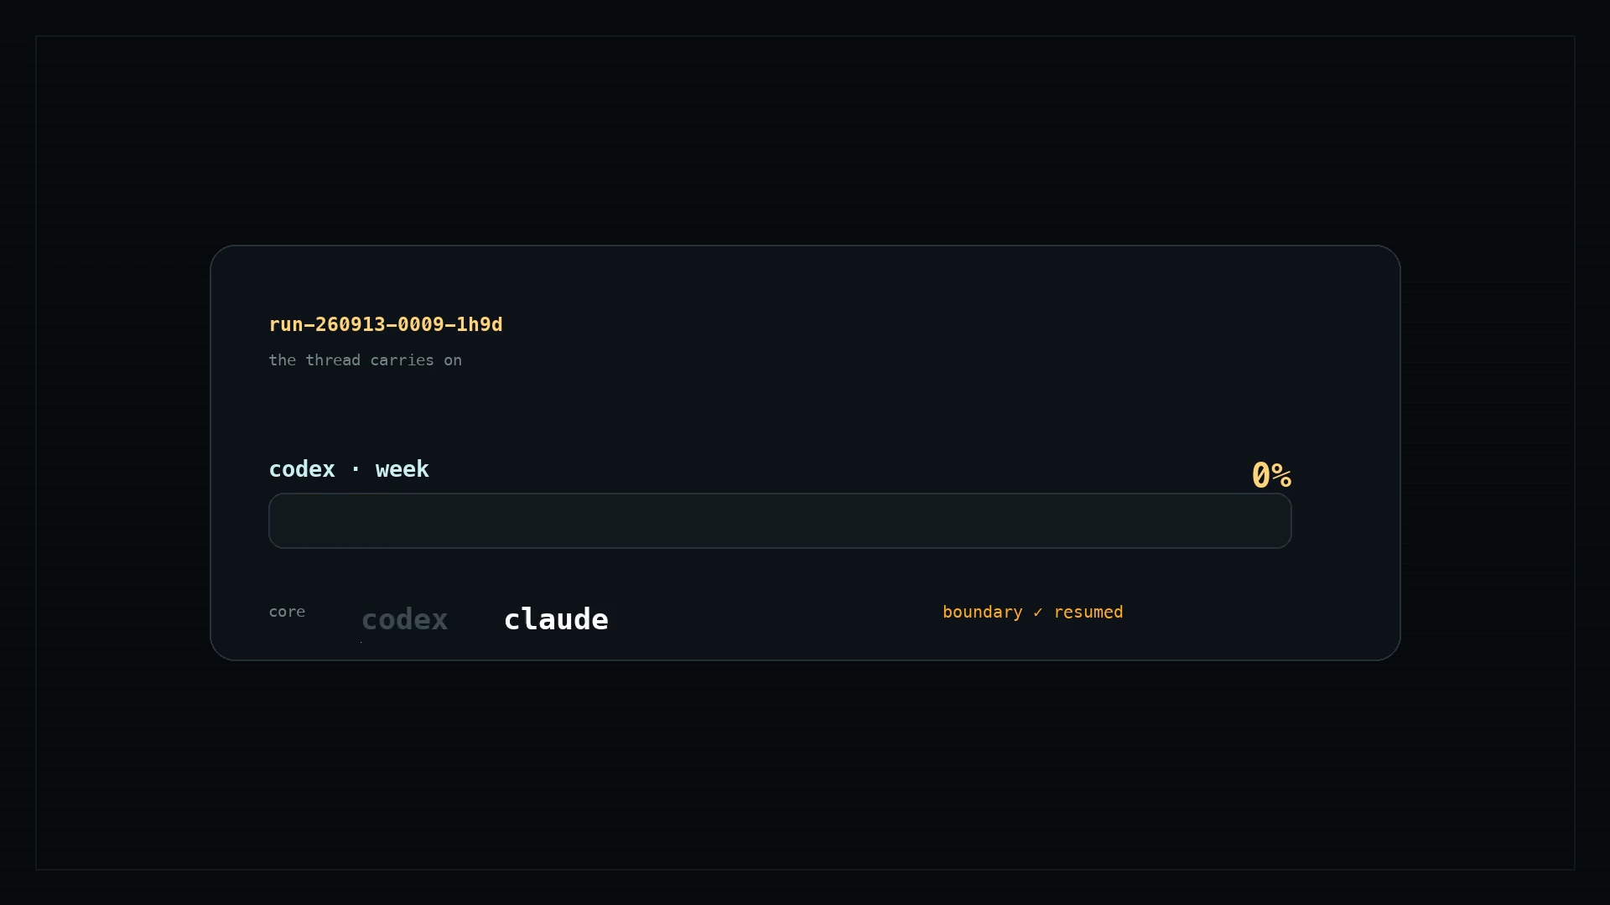
THE WEDGE · WHAT THEIR DOCS CONCEDE
Five things the native platform does not do.
Survives the reboot and owns the seat.
brnrd is the process the vendors' docs ask you to bring.
Both subscriptions, one seat, one gauge.
Receipt, 5 Sep 2026: Codex hit its weekly wall at 18:16; the seat continued on Claude — same thread, same memory.
Memory that is a self, in git.
Not notes about your repo: the agent's own playbook, pitfalls, schedule, identity.
Judgement with a contract.
quota wall, 5 Sep 18:16 — core flipped, same thread
Forks handed over with options, self-merge under stated conditions, a work graph, a card that says what it is doing now.
Your disk. No vendor relay.
No transcripts held by a vendor; credentials never leave your machine.
brnrd >_
hugimuni sas · investor deck v1
04
Notes:
The five lines: PLAN §What we sell — "What the docs say the platform does not do" items 1–5, condensed.
5 Sep 18:16 Codex wall receipt: carried from the v11 deck slide 4 (outline §What carries over); v11 build cites "Receipt, 5 Sep 2026".
Media: loop-2-the-wall.

Slide 5
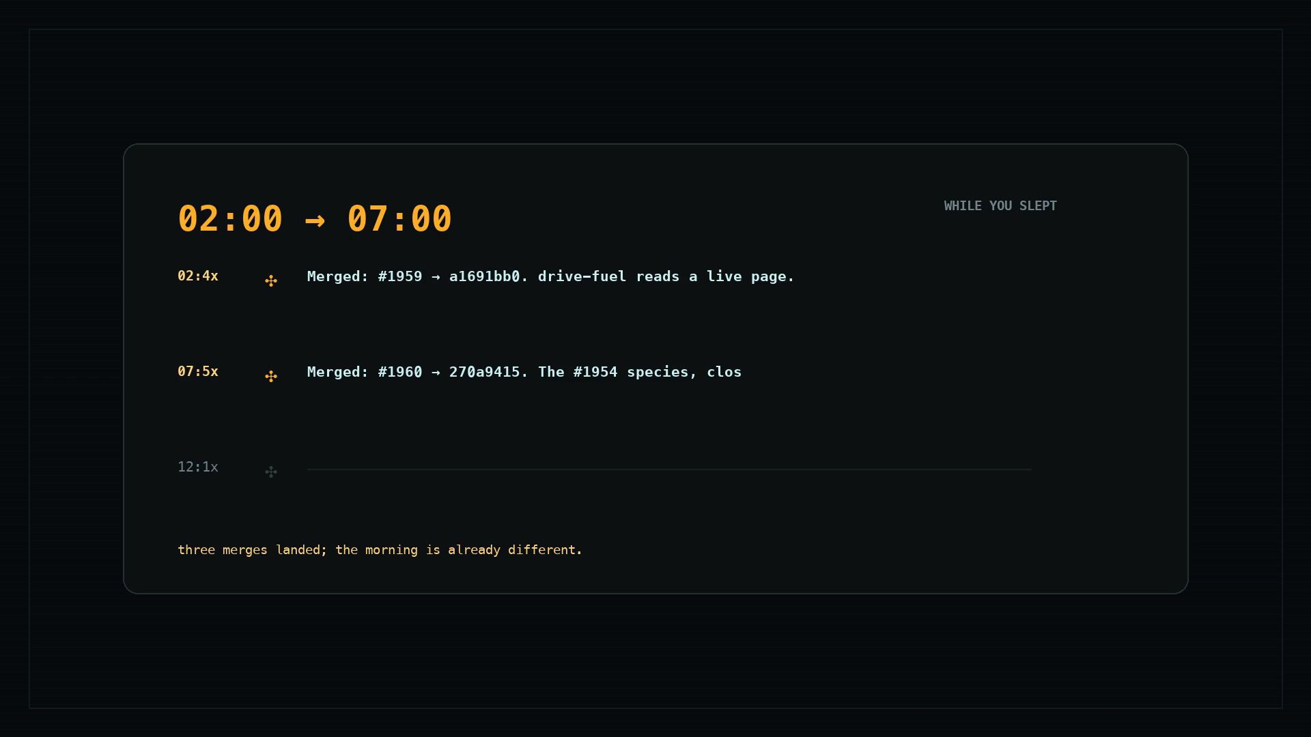
THE PRODUCT · ONE SCREEN
Every run inspectable. The resident maintains these itself.
The cloth
the runs, live
The fuel chip
which subscription, how much of the week
the seat, overnight — run cards, not a log
The warp
the work graph we both edit
The run card
Now · Plan · Vector
brnrd >_
hugimuni sas · investor deck v1
05
Notes:
Four elements and the caption: outline slide 5. No numbers on this slide.
Media: loop-4-away (the seat working while the founder is away; v10/v11 "while you're away", receipt 13 Sep 2026).

Slide 6
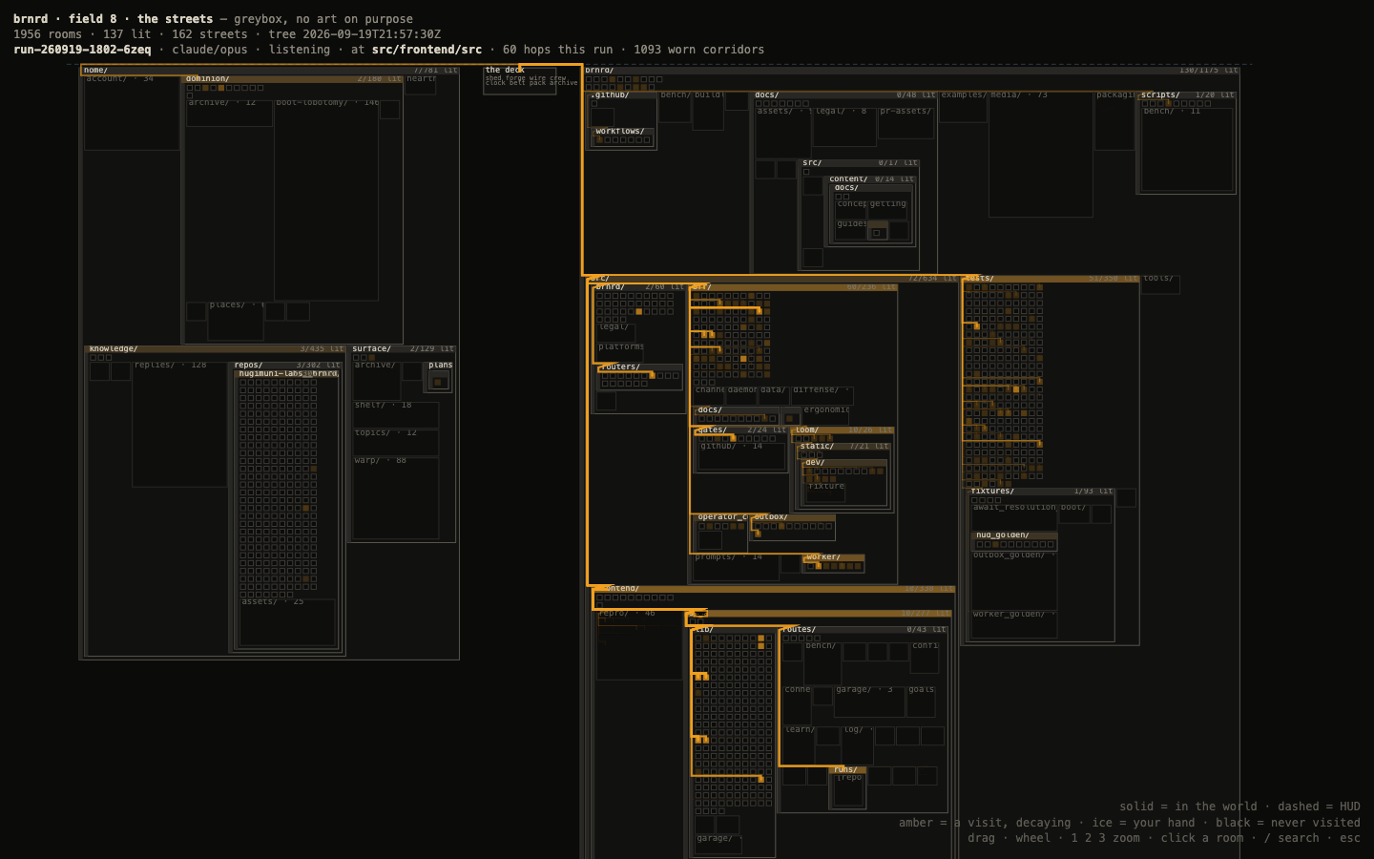
THE PLACE · IN THE WORKSHOP
The resident is an actor in a place.
The streets: the whole tree at real scale. The drone walks its route. Skins are the fork-and-PR lane.
Every feature on the previous slides will be copied. A place, and a life in git, are harder to copy.
field 8 — the streets: the tree as a place, one frame
IN THE WORKSHOP — NOT THE PRODUCT YET
brnrd >_
hugimuni sas · investor deck v1
06
Notes:
Content: outline slide 6. The frame is media/fields/field8-lit.png (field 8, "the streets"; 1,956 rooms, 137 lit, 162 streets printed in the image header — kb/log.md 2026-09-19 night entry, #2050).
Not a claim of shipped product: the deck says "in the workshop" (outline).

Slide 7
BUSINESS MODEL
Zero COGS today. Margin tomorrow.
Today
the user's own subscriptions carry the inference. $7/mo hosted relay is the filter.
The money
fallback intelligence and compute with a margin: hosted execution (the seat on our box) · local agents as runners (Ollama, OpenHands, OpenCode) as models go compact · eventually our own models.
Tiers by seat; team seats after multi-user.
The yardstick
A 70-hour run at API list price: $433–$1,159. The plan it ran on: $100 a month.
a layer on every harness — and a runner of its own when the market goes local
brnrd >_
hugimuni sas · investor deck v1
07
Notes:
$7/mo hosted, Stripe live: STATE §Building (offer).
$433 (Fable 5.1) – $1,159 (Fable 5), $100/mo Max 5×, 70 h, 977 M tokens for 40 points of the weekly window: PRICE Table 2 and §The sentence. A yardstick, not a saving (PRICE: a subscription limit is a window that refills, not a bill).
Business model text: outline slide 7; local-runner bet: STATE §The bets (3).

Slide 8
TRACTION · THE HONEST SLIDE
Users: 3. Paid: 0.
3
0 recorded
0
8 · 4
users — the two founders and the intern
external installs (the counter shipped 2026-09-20)
external first tasks · 0 paid
GitHub stars · forks
What the next 90 days measure
installs → first task → second-task return ≤ 7 days → fifth task, weekly rows.
We are showing you the instrument, not the number.
brnrd >_
hugimuni sas · investor deck v1
08
Notes:
Users 3, external installs 0 recorded, first task 0, paid 0, 8 stars / 4 forks: STATE §Using. "Absence = nothing recorded, never zero-by-measurement" (STATE): hence "0 recorded".
Counter shipped 2026-09-20 and the second-task return metric: outline slide 8 / PLAN §The metric.

Slide 9
GO-TO-MARKET
The install is the seller.
channel
its row in the funnel
Founder-face video and dogfooding streams
viewers → installs
the person is the moat
Replies in the trackers where the demand already sits
reply → click → install
claude-code and codex threads
Show HN · r/ClaudeAI
post → install
one post each, founder's own hand
The install itself
install → first task → second task
one command; every stumble filed and fixed
brnrd >_
hugimuni sas · investor deck v1
09
Notes:
Four rows and their funnel columns: outline slide 9; PLAN §The seller: the install; STATE §The bets (2) — X replies measured dead at 3 followers, streams are the untested channel.
No numbers on this slide.

Slide 10
COMPETITION · THE TABLE WE'D HAND A SKEPTIC
Exclusive, parity, worse. In that order of honesty.
EXCLUSIVE
PARITY
WORSE
Owns the seat across reboots
Telegram · Slack · GitHub lanes
Install: a daemon, a git repo, an always-on box
Two subscriptions, one gauge
Scheduled and background runs
Phone: a chat bot, no first-party app UI
Memory that is a self, in git
Memory, on by default natively
No cloud runs
Graph-shaped execution and contracts
Quota views (/usage, read from the same endpoints)
No security audit of an always-on agent
brnrd >_
hugimuni sas · investor deck v1
10
Notes:
Exclusive: PLAN §What we sell items 1–5; STATE §What we claim nobody did holistically ("claims, not yet validated by a user").
Parity: STATE §The field ("runs while you're away is native on both platforms"; memory on by default); ISSUES §What we do worse (/usage built in).
Worse: ISSUES §What we do worse (memory zero setup, background needs no host natively, phone UI, cost) + outline slide 10 (install, phone UI, no cloud runs, no security audit).

Slide 11
TEAM
Three cofounders. One of them is the resident.
Alexandra Lapunova
Arseni
The resident
Sasha
CEO
the builder — six months of the repo
the third cofounder that ships: 1,402 of 3,119 commits on main
ops · the second pair of thumbs
The gap, named: no growth hire, no security reviewer yet.
brnrd >_
hugimuni sas · investor deck v1
11
Notes:
Roles: outline slide 11. Resident commits: `git log --author=brnrd-bot` at build time = 1,402 of 3,119.
"Six months of the repo": STATE §Building (born 2026-03-28, 176 days).

Slide 12
THE ASK AND THE PATH
Options on the page, not one number.
(a)
$1–2M pre-seed
18 months of runway plus the distribution experiments. The obvious way to fund the 90 days.
(b)
$10M on a category thesis
Needs the 90-day curve, or a strategic — a harness vendor, a model lab — who wants the layer.
(c)
No raise
Until the curve exists.
90 DAYS
12 MONTHS
install in one command · funnel rows · the first stream
hosted execution GA · local runner · team seats · the place
brnrd >_
hugimuni sas · investor deck v1
12
Notes:
Three options and the roadmap: outline slide 12 and §The two paragraphs ("On the $10M"). No TAM number anywhere.
STATE §The bets (4) records the founders' current posture as "Not raising" — the options above are the outline's, not a decision.

Slide 13
BACKUP · Q&A
Their cloud moves the hands. The memory has to live somewhere.
Codex and Claude now run tasks remotely. Each run is still a session inside one vendor's walled garden. Whatever decides what to do next, remembers last week and collects the result has to live above the vendors. That layer is brnrd, on your machine, on the subscription you already pay for.
brnrd >_
hugimuni sas · investor deck v1
B1
Notes:
Verbatim from v10/v11 backup card B1 (build_v11.py SLIDES[9]).

Slide 14
BACKUP · Q&A
Same category, a different axis — that, but running your subscriptions.
Others sell a hosted agent on their credits. brnrd runs the Claude and Codex subscriptions you already pay for, on your machine, under your login. No credentials are handed to us.
brnrd >_
hugimuni sas · investor deck v1
B2
Notes:
B2 per the outline ("that, but running your subscriptions"; user quote carried in v11 slide 3). The v11 B2 card body was "Your machine. Your login. Your repo." — the headline here follows the outline's title for B2; body text is the v11 card's sentence, condensed.

