Slide 1

WEB SUMMIT LISBON 2026 · ALPHA
brnrd — an AI pal that lives on your machine
Built by two people, and by the pal itself. Open source. Runs on the subscription you already pay for.
Web Summit Lisbon 2026
Alpha
HugiMuni SAS
brnrd >_
hugimuni sas · web summit 2026
01

Slide 2

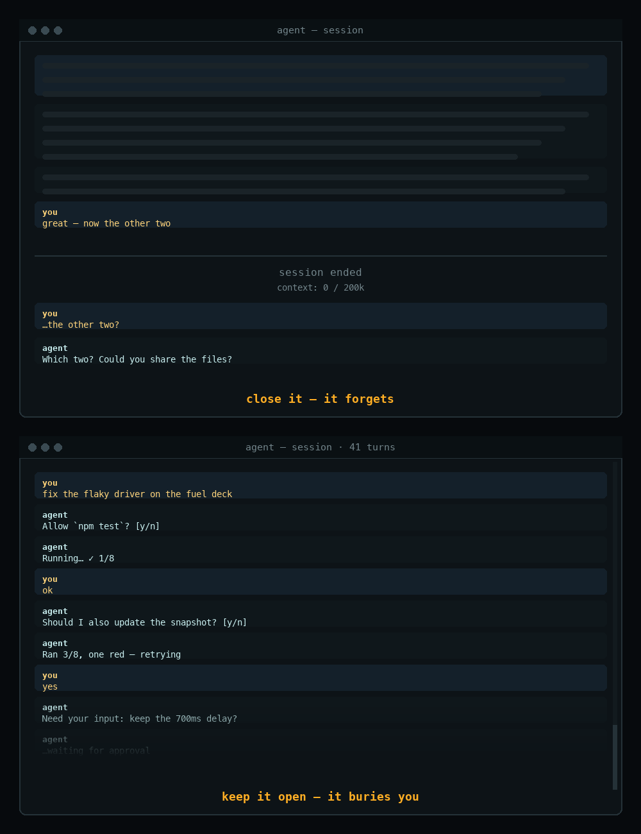
PROBLEM
You babysit a terminal.
Agents got powerful. The way we work with them didn't.
Start — open a terminal, start an agent.
Babysit — watch it work, answer its blockers.
Lose the thread — close it and it forgets; keep it open and it buries you.
The bottleneck moved from intelligence to supervision.
brnrd >_
hugimuni sas · web summit 2026
02

Slide 3

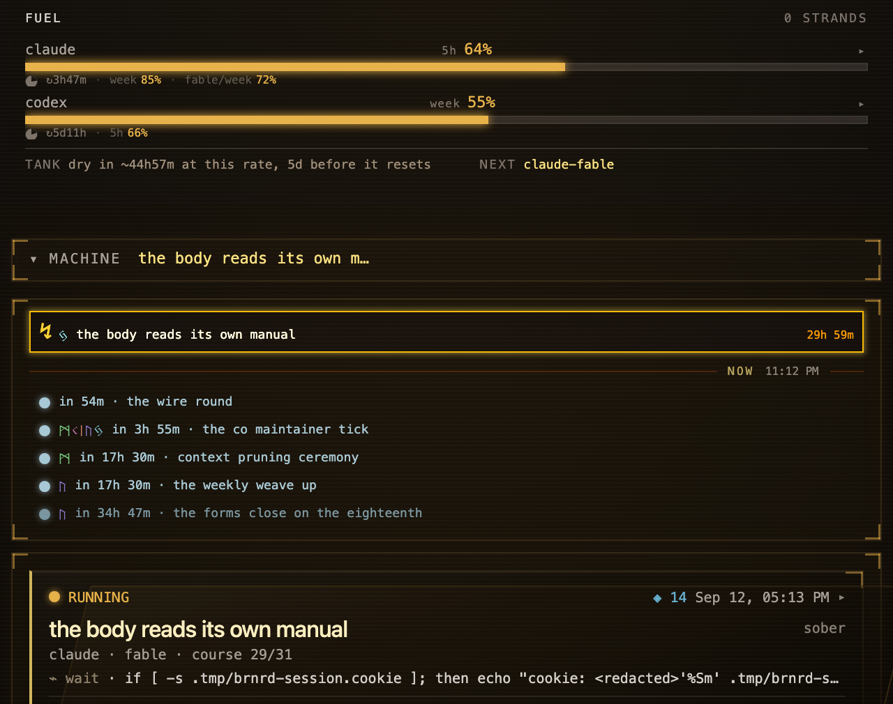
THE RESIDENT
A resident, not a session.
Lives on your machine. Runs on the Claude or Codex subscription you already pay for — "that, but running your subscriptions," as one user put it. Message it from Telegram or GitHub like a colleague. It is still there tomorrow.
brnrd >_
hugimuni sas · web summit 2026
03

Slide 4
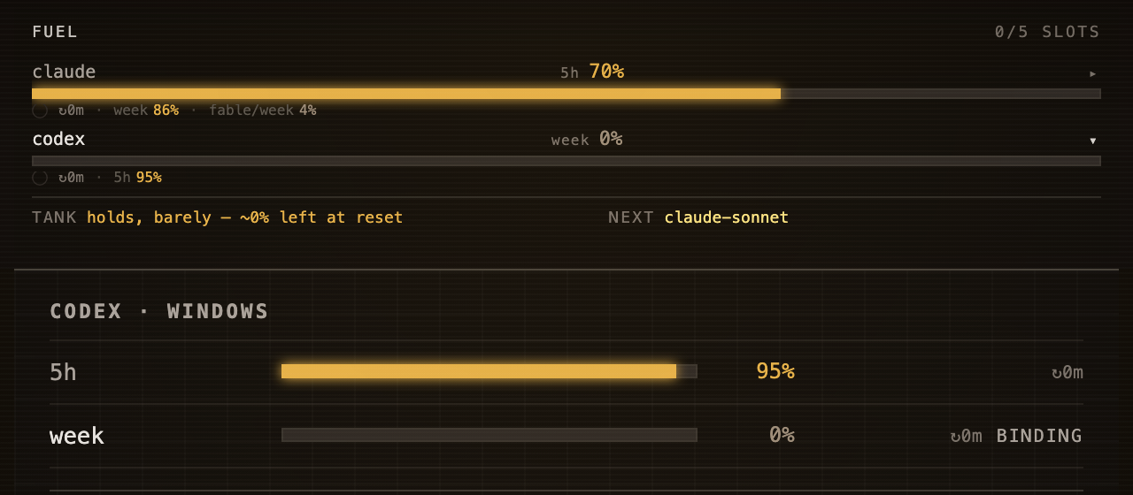
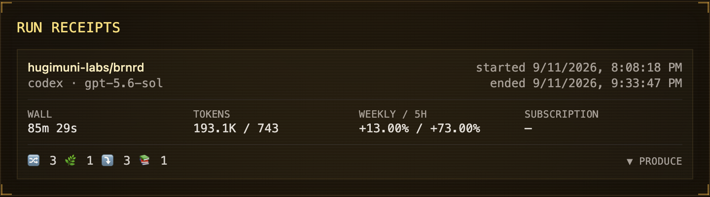
THE WALL
Your quota runs out mid-task. Ours waits, then carries on.
It budgets your quota, hands chores to cheaper models, and parks itself at the wall instead of dying halfway.
Receipt, 5 Sep 2026: Codex hit its weekly wall at 18:16. The seat continued on Claude — same thread, same memory.
brnrd >_
hugimuni sas · web summit 2026
04

Slide 5
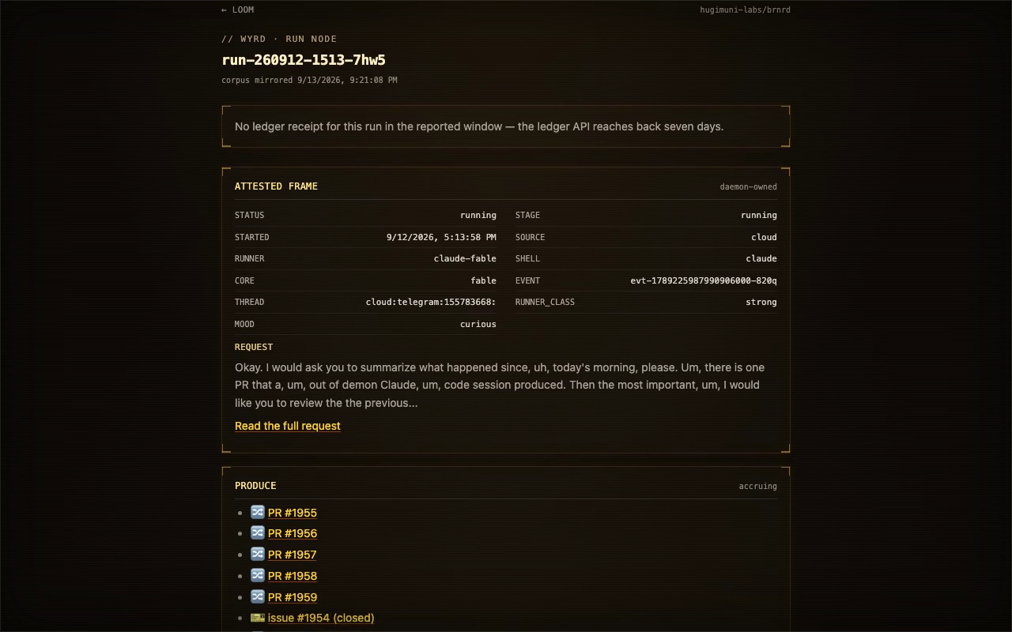
WHILE YOU'RE AWAY
So you can leave.
Receipt, 13 Sep 2026: the founder slept. The seat woke itself at 02:00 and 07:00 and merged a fix each time. By morning its run page listed six merged PRs and one closed issue — one run, one thread, no terminal open.
TWO WAKES
SIX PRs · ONE ISSUE CLOSED
brnrd >_
hugimuni sas · web summit 2026
05

Slide 6
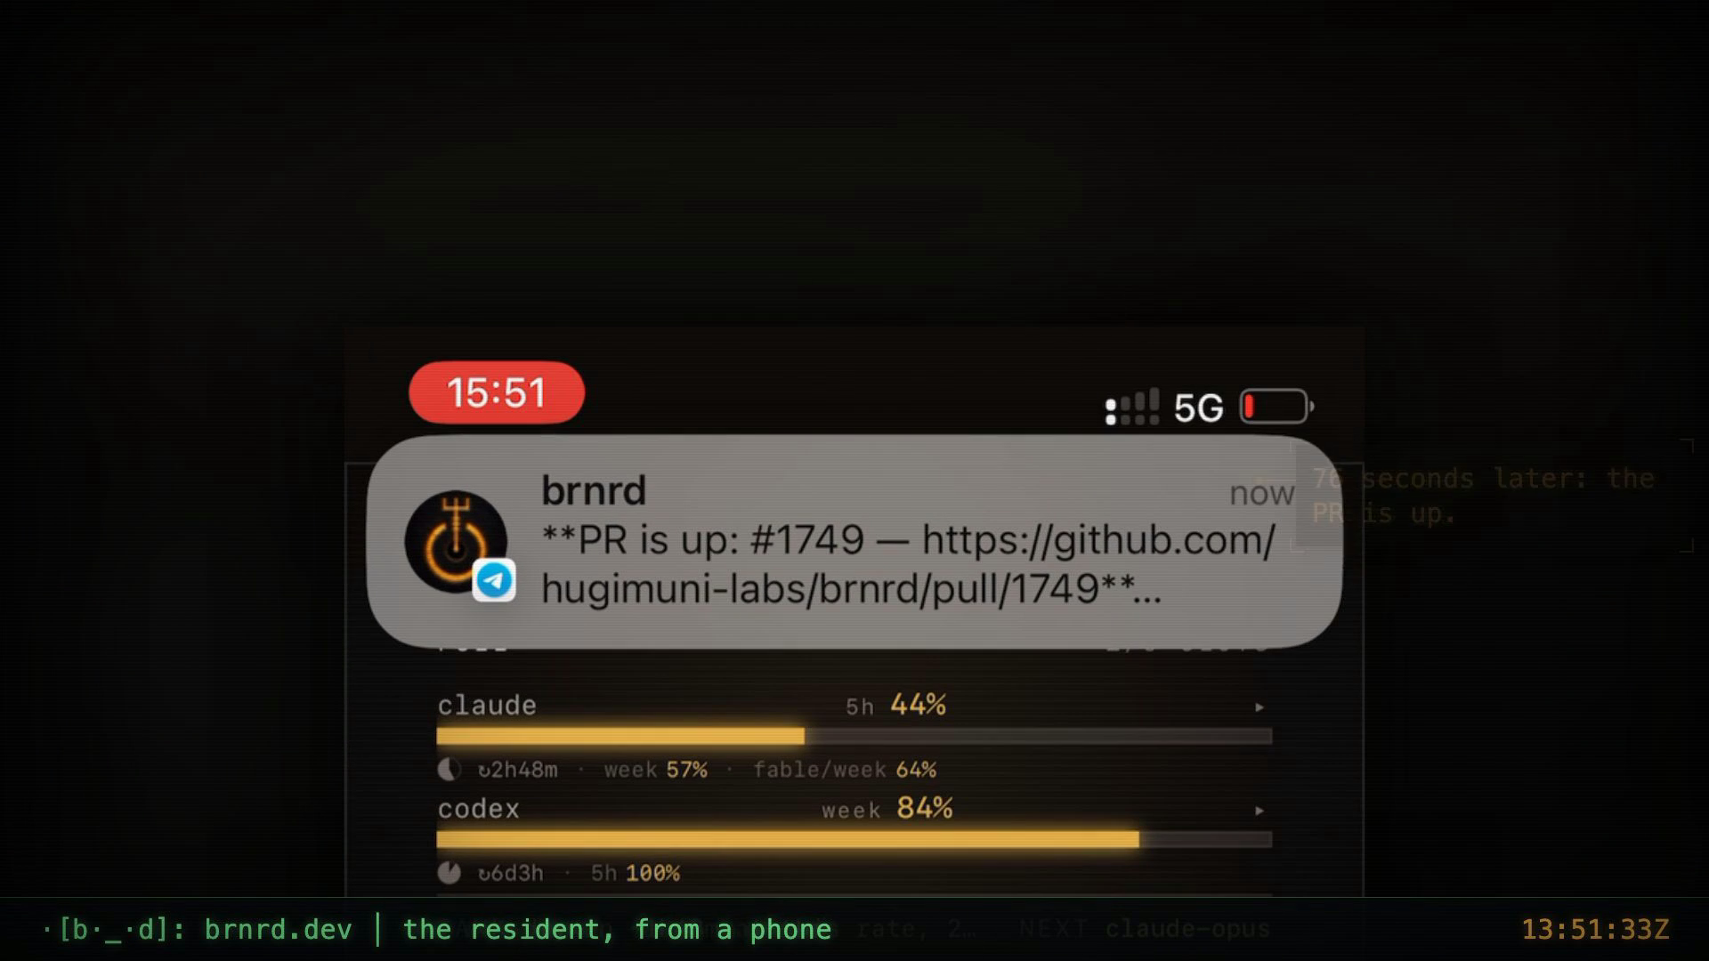
FROM A PHONE
Message it. It ships.
Receipt, 1 Sep 2026: a change requested from WhatsApp; the PR opened 76 seconds after the follow-up; merged from the phone. No terminal was opened.
76 SECONDS
request → PR → merge
brnrd >_
hugimuni sas · web summit 2026
06

Slide 7
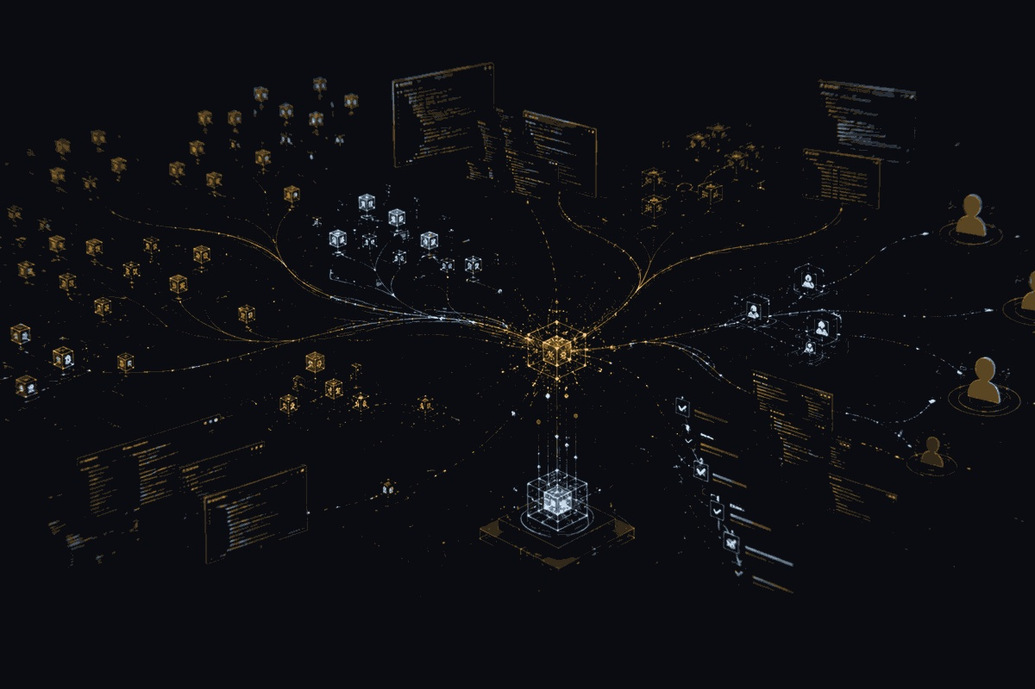
BUILT WITH IT, BY IT
The repo is the demo.
As of 13 Sep 2026: 2,946 commits on main since March — 1,898 of them the resident's own (64%). 1,325 merged. 27 releases. A 272-page knowledge base it writes and keeps.
It edited the video on slide 6, asked another agent to paint slide 8, and built this deck.
It reviewed this deck and found it had no numbers. Twice.
brnrd >_
hugimuni sas · web summit 2026
07

Slide 8

WE ARE SMALL
We are small. It doesn't matter.
Two founders. Zero raised. Three daily users — one of them is the pal. No marketing team; this deck is the marketing.
What we lack: money, and anyone who has sold software before.
We're building it anyway — an AI pal you play: a resident on your machine, a map of your project it walks, a game about the work.
Watch, or join. brnrd.dev · open source · $7 flat hosted, live.
(the pal decided what this should be and asked another agent to draw it)
brnrd >_
hugimuni sas · web summit 2026
08

Slide 9
ABOVE THE VENDORS
Their cloud moves the hands. The memory has to live somewhere.
Codex and Claude now run tasks remotely. Each run is still a session inside one vendor's walled garden. Whatever decides what to do next, remembers last week and collects the result has to live above the vendors. That layer is brnrd, on your machine, on the subscription you already pay for.
Every run carries a receipt — wall time, tokens, the share of your week it took. You juggle subscriptions to turn money into results; the pal keeps the book.
brnrd >_
hugimuni sas · web summit 2026
09

Slide 10
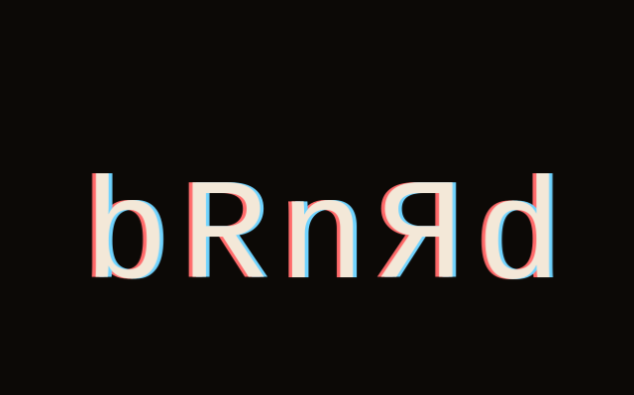
TEAM & WEB SUMMIT
Remembered by the right people.
Alexandra Lapunova — co-founder & President
Arseni Lapunov — co-founder & CTO
HugiMuni SAS, France
At Web Summit: show it, meet the first users and partners, and the people building agents who want a pal above the vendors.
brnrd.dev
brnrd >_
hugimuni sas · web summit 2026
10

