Slide 1
Project 1 Presentation
Group 3 – Hugo, Veda, Rob

Slide 2
Agenda
Overview
Solution Architecture
ELT Techniques Applied
Lessons Learned
Q&A

Slide 3
Overview
Project Context and Objectives
Create data pipeline solution that extract live datasets and load it to a relationship database for specific questions
Access data through ELT techniques to explore correlation of trend, features related to new music releases
Objective
Provide analytic datasets from Spotify API, focusing on new music releases, their associated audio features and popularity
Source Dataset
Spotify API uses a RESTFUL API. Four API calls were used
Get new releases – identify latest releases
Get album tracks – get tracks inside each released album
Get track audio features – fetch audio features associated with each track
Get track details – get details of track including popularity

Slide 4
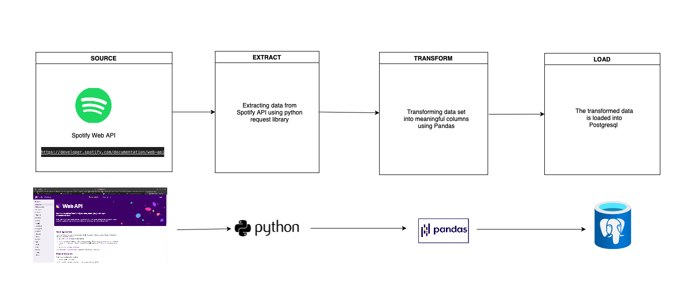
Solution Architecture
Notes:
Python & Pandas was used for:
Extracting the data about artists, songs, albums, new releases. Pipeline is set to run on a regular schedule
Transforming data -> drop unnecessary columns, rename columns.
Load data to our postgres database.
PostgreSQL DBMS was used for storing all our data: artists, songs, ids
AWS RDS was used for hosting and managing our postgres database.
SQL was used for creating views off of the data that is loaded
Docker was used to containerize both pipeline
ECR was used to host our docker container
ECS was used to run the docker container
S3 was used to store the .env file.

Slide 5
ELT Techinque Used
Two Pipelines used
Initially used python pipeline but then added SQL ELT as learning opportunity
Extract
Python approach used full extract directly from source API.
SQL –python to load raw data to “source” database to mimic extract a source database. Used incremental extract based on “new” tracking ids
Load
Data was loaded to both local postgresql and RDS.
Column called “timestamp” was added, to validate incremental extraction
Transform
With Python Pipeline, we able to merge, rename, select data along with extracted data from nested data structures
With SQL Pipelines, we able to run INNER JOIN to combined two datasets, along with queries based on popularity,

Slide 6
ERD Diagram

Slide 7
Limitations and Lessons Learned
O-Auth2.0
Common with API calls, is a two-step authentication. Using our client credentials, the access token was retrieved but for project purposes, we did not get refresh token
Git Pull and Merge
Learned to push changes from respective branches to avoid merge conflicts but also learned to rebase line changes to resolve conflicts
Docker (dotenv)
Due to nature of Docker, will read double quotation marks as part of string
Python vs SQL Transform
Python better for extract and loads, can handle different data types better such as list of dictionaries and nested column headers(album.artist)
SQL much better for transforming, but a lot more difficult for
API Rate Limit
Meant we can only get so much data without hitting the 429 rate limit

Slide 8
Q&A

Slide 9
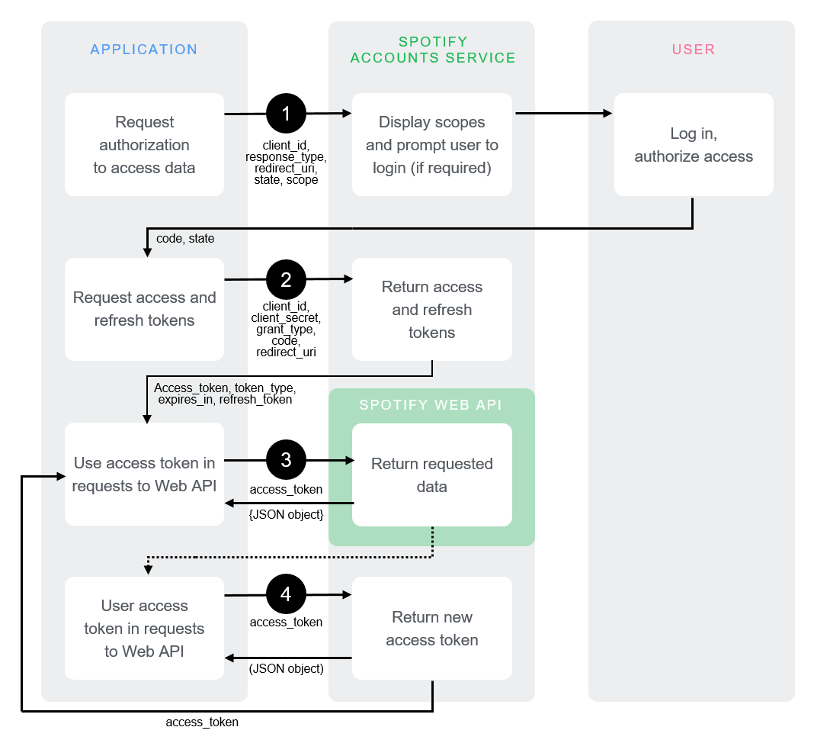
O-Auth 2.0

Slide 10
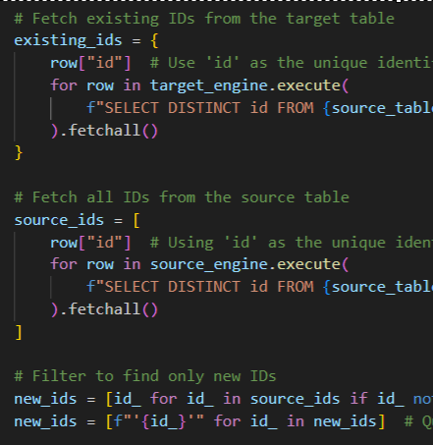
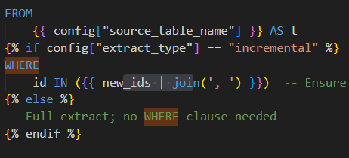
Incremental Extract

Slide 11
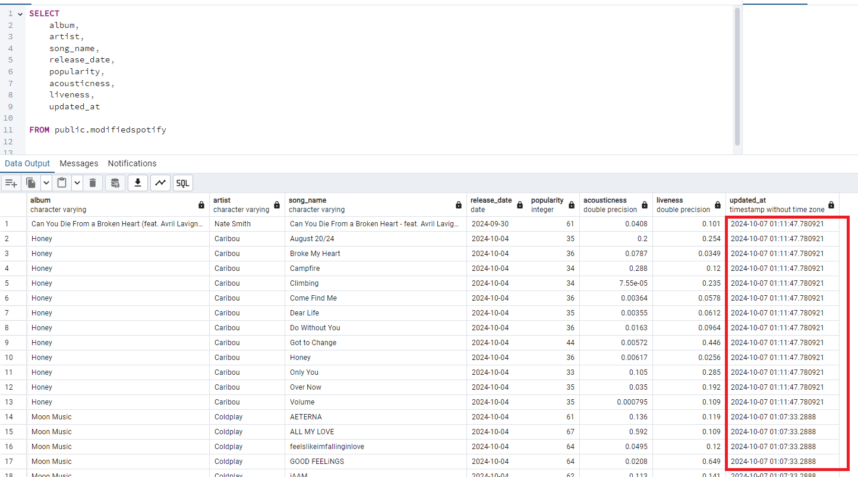
Final Table Sample

