Slide 1
Group 3
Jacob Darling
Austen Erickson
Gretchen Mojica Carrero
Mikaila Steinbrugge
Hugo Vega Hernandez

Slide 2
Outland Adventures
Outland Adventures is an outdoor goods company that allows for its customers to book guided trips with them as well as allowing them to buy or rent any gear that they may need.
They need help to optimize the organization of their supplies and to make sure they are offering what the customers want.

Slide 3
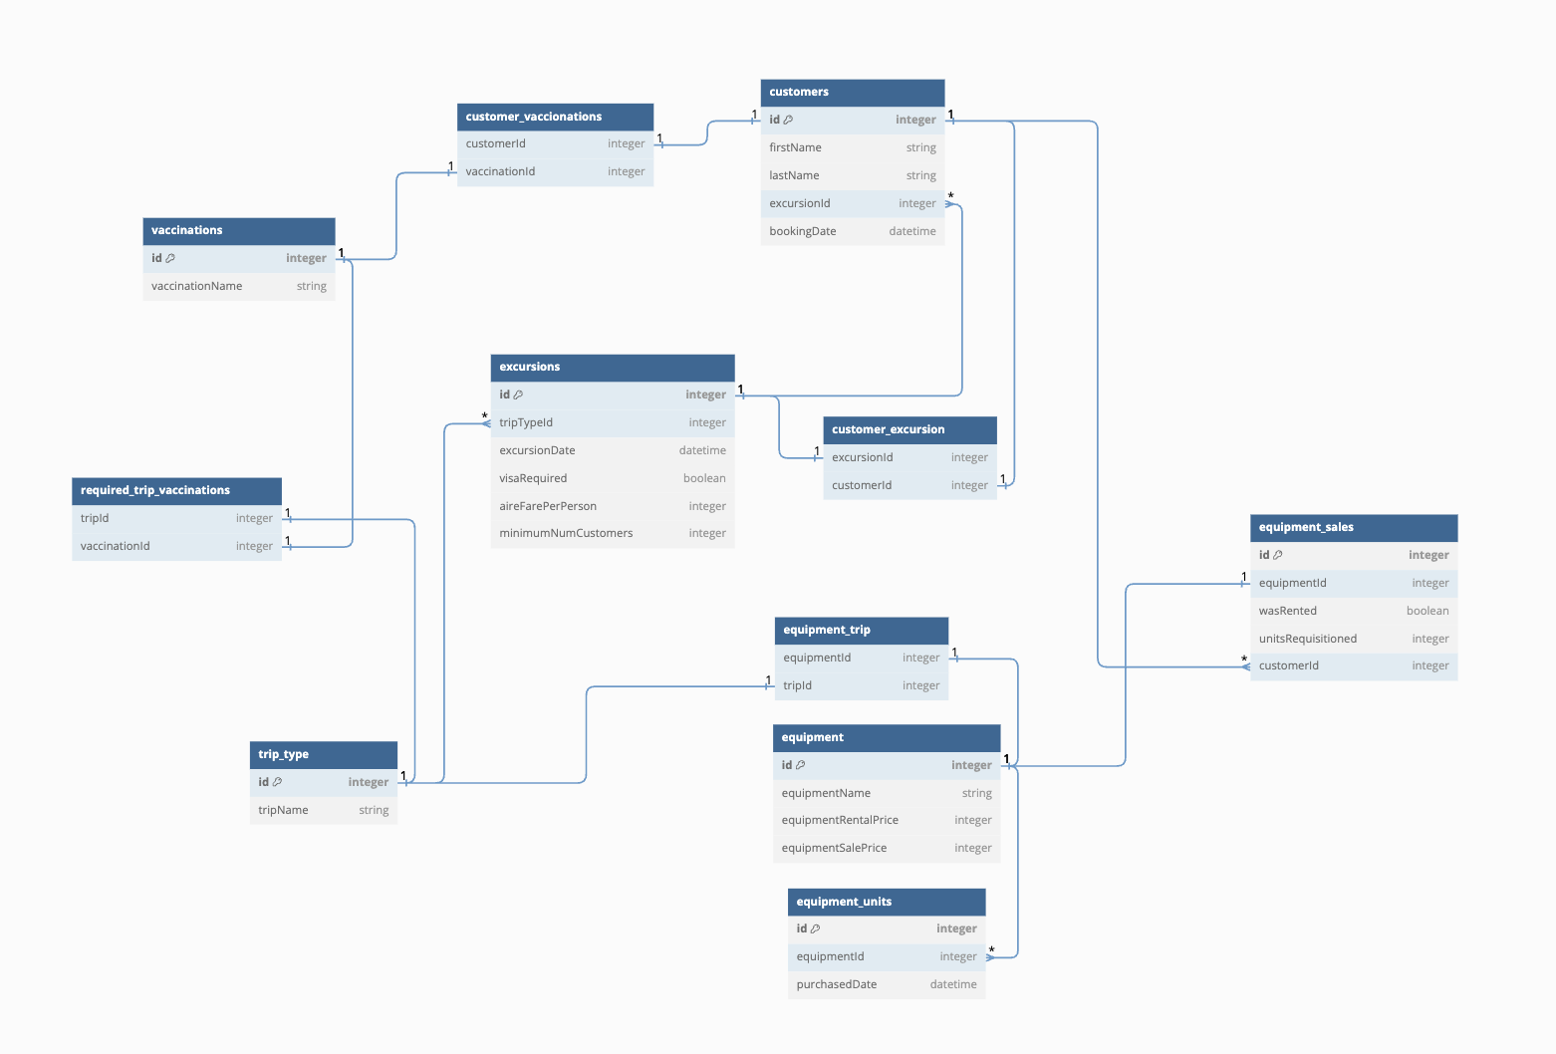
ERD

Slide 4
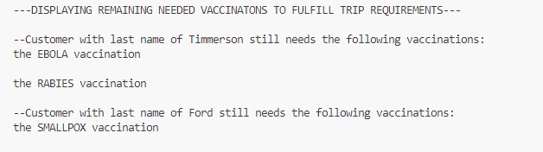
Report 1
This report is to figure out what vaccines are still needed

Slide 5
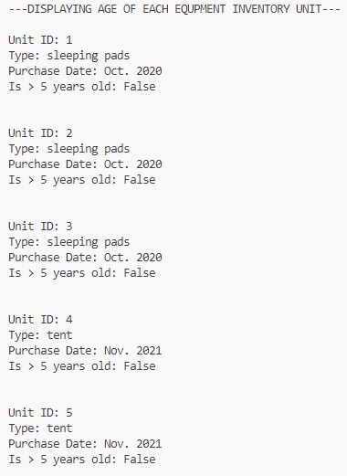
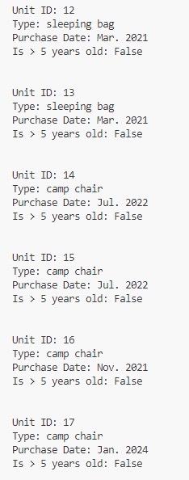
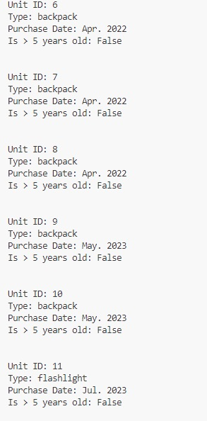
Report 2
This report is to see if there is any merchandise in the inventory that is five years old or older.

Slide 6
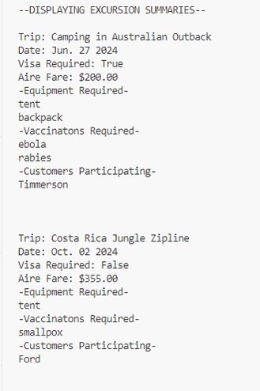
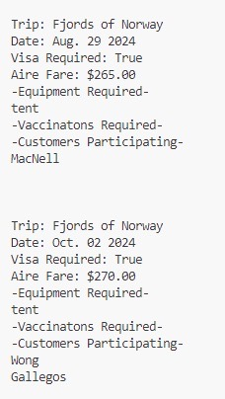
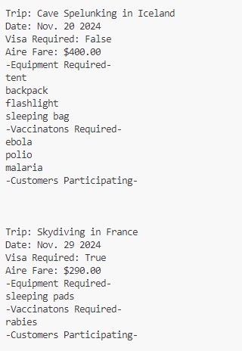
Report 3
This report is to see the summary of past excursions.

Slide 7
Assumptions
A customer will not sign up for overlapping excursions as it is impossible for them to be in two places at once
A customer will either rent or buy equipment, they cannot provide their own equipment (safety reasons?)
Two excursions of the same trip type can happen simultaneously
Dates of customer bookings will be used for analysis of most popular trip types
Transaction types (sale/rental) will be used to determine popularity of renting vs. purchasing.
Purchase date of equipment units for inventory will be used to determine equipment unit age

