Slide 1
The Technology Value Stream by Hugo Vega Hernandez Assignment 1.2 01/06/2025

Slide 2
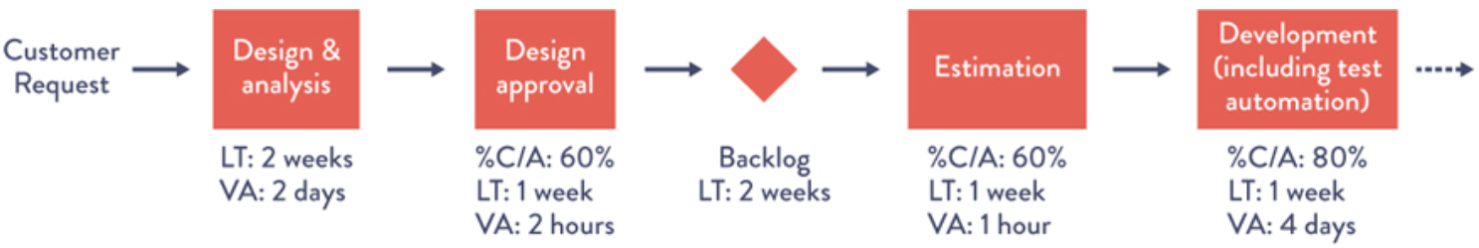
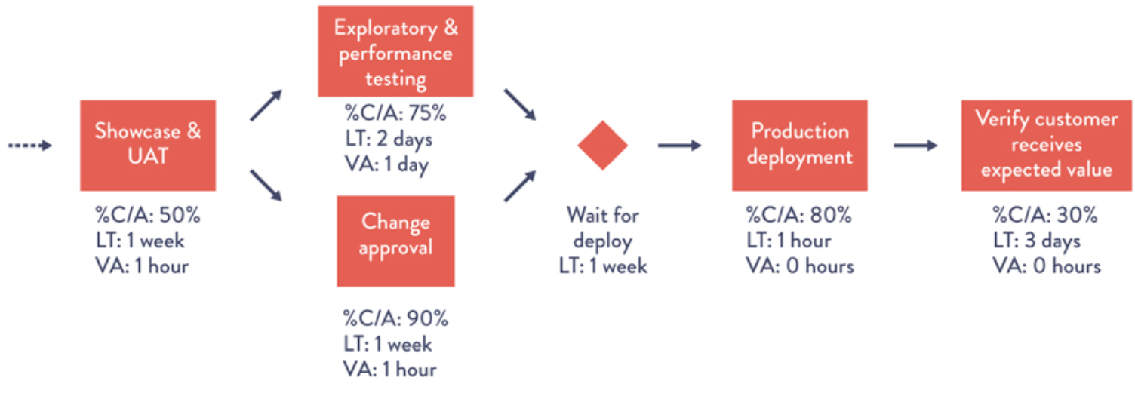
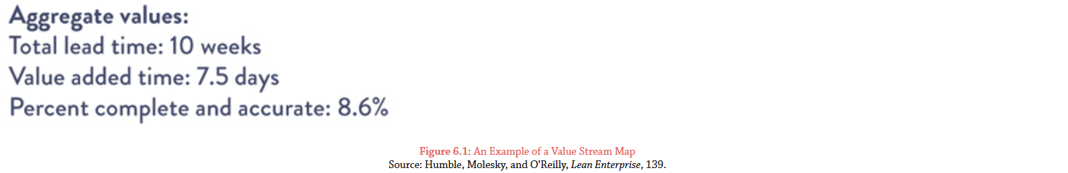
The Technology Value Stream
An Example of a Value Stream Map. (Kim, Humble, Debois, & Wills, n.d.)

Slide 3
Introduction – What is a Technology Value Stream?
Definition: A Technology Value Stream represents all the steps involved in delivering value to the customer through technology, from concept to cash. It encompasses all the activities, processes, and tools used to build and deliver software or technology-based products and services.
Purpose: To identify and eliminate bottlenecks, optimize flow, and accelerate the delivery of value.
Key takeaway: Focus shifts from individual silos to the entire end-to-end process.

Slide 4
Key Components of a Technology Value Stream
Idea/Concept: Where it all begins, identifying market needs and potential solutions.
Development: Designing, coding, testing, and building the product/service.
Testing: Verification and validation of functionality and quality.
Deployment: Releasing the product/service to the end-user.
Operations/Maintenance: Ongoing support, monitoring, and improvements.
Learning/Feedback: Gathering user feedback to inform future iterations.

Slide 5
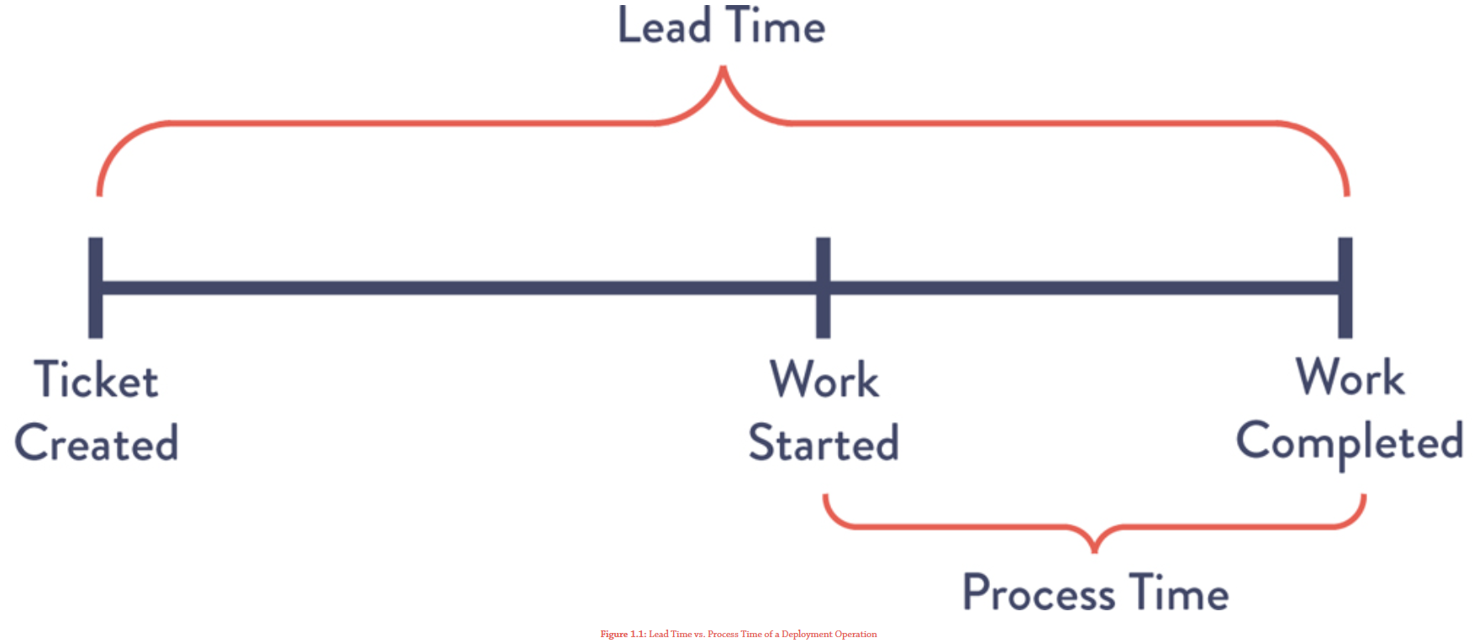
The Importance of Flow
Bottlenecks: Impediments within the Value Stream that slow down the delivery of value (e.g., slow approvals, manual testing, complex deployments).
Lead Time vs. Processing Time: As defined in Project To Product, Lead Time is the total time from request to delivery, while Processing Time is only the time work is actively being done on the request. The difference highlights waste due to wait times and handoffs. (Kim, et al., 2018, p.34)
Lead Time: The overall time taken from concept to delivery – a key metric for Value Stream performance.
Cycle Time: The time taken to complete a specific stage within the Value Stream.
Key takeaway: Optimizing flow minimizes lead time by reducing wait times, increasing value delivery frequency, and improving responsiveness to market changes.

Slide 6
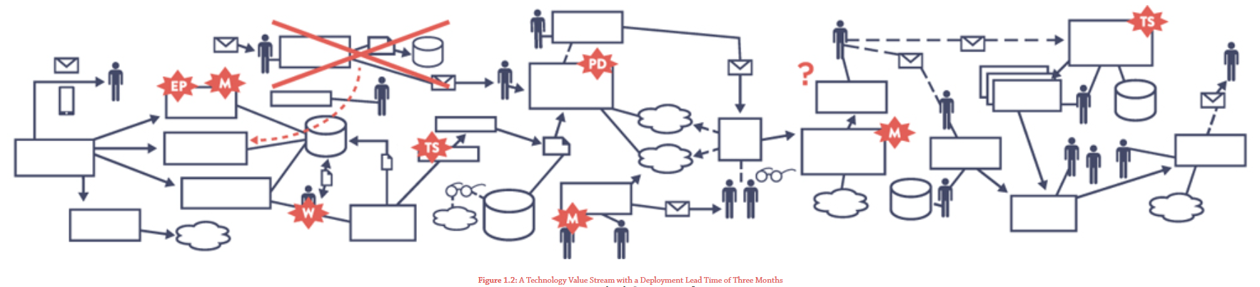
Measuring Value Stream Performance
Lead Time – The "Months" Problem: Traditional project management often leads to deployment lead times measured in months. This long lead time creates significant risk and slows down the feedback loop. (Kim, et al., 2018, p.35)
Key Metrics:
Lead Time: Time taken from request to delivery. Our goal is to dramatically reduce this.
Cycle Time: Time taken to complete a specific stage.
Deployment Frequency: How often releases occur.
Change Fail Rate: Percentage of deployments causing issues.
Mean Time to Recovery (MTTR): Time to resolve production incidents.
Purpose: Data-driven insights help identify areas for improvement and track progress.

Slide 7
Principles of Value Stream Management
Focus on Value: Prioritize activities that directly contribute to customer value.
Flow Optimization: Identify and eliminate bottlenecks to ensure smooth and continuous delivery.
Continuous Improvement: Regularly evaluate and improve the value stream.
Collaboration and Communication: Foster transparency and collaboration across teams.
Automation: Automate repetitive tasks to increase efficiency and reduce errors.

Slide 8
Implementing Value Stream Mapping
Current State Mapping: Visually represent the current state of the Value Stream, including all steps, timelines, and bottlenecks.
Future State Mapping: Envision the ideal state, identifying areas for improvement and optimization.
Implementation Plan: Develop a plan to transition from the current state to the future state.
Image: Example of a simple current state map vs. a future state map showcasing improvements.

Slide 9
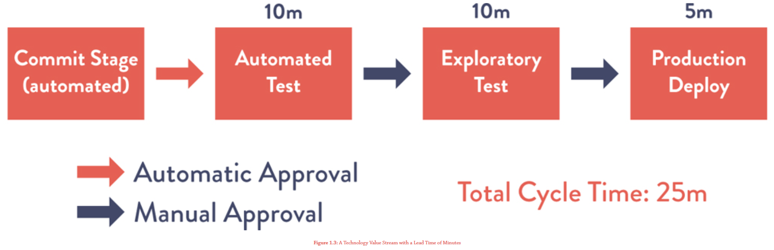
Benefits of Optimizing the Technology Value Stream
Faster Time to Market – The "Minutes" Ideal: DevOps practices, with a focus on automation and continuous delivery, enable us to achieve deployment lead times of minutes, not months. This allows for faster feedback, quicker iterations, and a competitive advantage. (Kim, et al., 2018, p.35)
Improved Quality: Reducing errors and defects through continuous improvement.
Increased Efficiency: Optimizing resources and reducing waste.
Enhanced Customer Satisfaction: Delivering products and services that meet customer needs.
Greater Business Agility: Responding quickly to changing market demands.

Slide 10
Conclusion
Key Takeaways: Value Stream Management is crucial for organizations looking to improve their technology delivery performance. By focusing on flow, continuous improvement, and data-driven decision-making, organizations can achieve faster time to market, improved quality, and greater business agility.
Call to Action: Encourage the audience to begin analyzing their own Technology Value Streams and identify opportunities for improvement.

Slide 11
References
Humble, J., & Farley, D. (2010). Continuous Delivery: Reliable Software Releases through Build, Test, and Deployment Automation. Addison-Wesley Professional.
Kersten, N. (2017). Project to Product: How to Survive and Thrive in the Age of Digital Disruption with the Flow Framework. IT Revolution Press.
Kim, G., Behr, K., & Spafford, G. (2018). Project to Product: How to Survive and Thrive in the Age of Digital Disruption with the Flow Framework. IT Revolution Press.

Slide 12
Questions.

Slide 13
THANK YOU
Hugo Vega Hernandez

