Slide 1
Navigating the Challenges: Barriers to Implementing a Just Culture by Hugo Vega Hernandez Assignment 9.2 02/17/2025

Slide 2

Navigating the Challenges: Barriers to Implementing a Just Culture
Target Audience: Healthcare administrators, safety officers, team leaders, anyone involved in organizational culture change.
Goal: To identify and understand the common hurdles in establishing a just culture so that organizations can proactively address them and increase the likelihood of successful implementation.

Slide 3
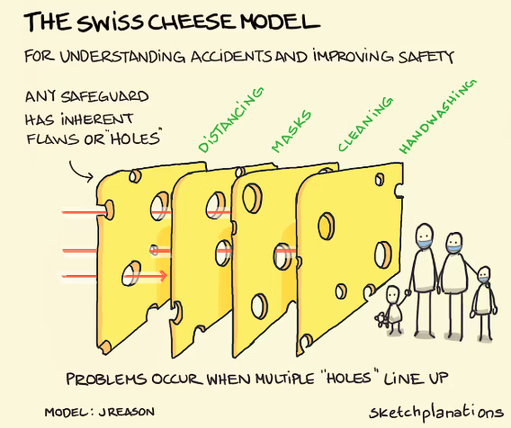
What is a Just Culture?
A culture that encourages reporting errors and near misses without fear of punishment.
Focuses on system improvement rather than individual blame.
Recognizes that errors can result from system failures, human factors, and risky behaviors.
Emphasizes accountability for intentional violations, reckless behavior, and gross negligence.
Defines acceptable and unacceptable behaviors clearly.

Slide 4

Barrier 1: Lack of Leadership Buy-In AND Understanding
Barrier 1: Leadership Skepticism and Misunderstanding
Description: If leaders don't fully understand or support the principles of just culture, implementation will fail. They may revert to blame-focused approaches in times of crisis.
Details:
Lack of Understanding: Not grasping the difference between human error, at-risk behavior, and reckless behavior.
Fear of Accountability: Leaders worry that a just culture will make them appear "soft" on errors or that it will shield incompetent employees.
Resistance to Change: Entrenched leadership styles resistant to adopting new paradigms.
Consequences: Inconsistent application of principles, lack of trust, and employees remaining silent.

Slide 5

Barrier 2: Fear of Retribution AND Blame
Barrier 2: The Enduring Fear of Retribution
Description: Even with stated policies, a deep-seated fear of punishment, reprisal, or career damage can prevent employees from reporting incidents.
Details:
Past Experiences: Previous negative experiences with reporting incidents (e.g., being unfairly blamed or disciplined).
Peer Pressure: A culture of silence enforced by colleagues who fear rocking the boat.
Lack of Confidentiality: Concerns that reports will not be kept confidential and will lead to negative consequences.
Consequences: Underreporting of errors, delayed intervention, continued unsafe practices.

Slide 6
Barrier 3: Inconsistent Application of Principles
Barrier 3: Inconsistent Application and Perceived Unfairness
Description: If just culture principles are not applied fairly and consistently across all levels of the organization, trust will erode quickly.
Details:
Favoritism/Bias: Perception that some individuals or groups are treated differently.
Situational Inconsistency: Applying just culture principles leniently in some cases but harshly in others without clear justification.
Lack of Transparency: Failure to clearly communicate the rationale behind decisions related to errors and near misses.
Consequences: Distrust, resentment, erosion of the reporting culture, perception of hypocrisy.

Slide 7

Barrier 4: Insufficient Training AND Education
Barrier 4: Insufficient Training and Education
Description: Without adequate training, employees and managers may not fully understand the principles of just culture or how to apply them in practice.
Details:
Lack of Awareness: Employees are unaware of the organization's commitment to just culture.
Lack of Skills: Managers lack the skills to investigate incidents effectively, conduct fair investigations, and provide constructive feedback.
Lack of Tools: Absence of proper tools and templates for incident reporting and analysis.
Consequences: Misapplication of principles, ineffective investigations, continued blaming behavior.

Slide 8
Barrier 5: Complex Systems AND Poor Communication
Barrier 5: System Complexity and Communication Breakdowns
Description: Overly complex systems, poor communication channels, and inadequate documentation can contribute to errors and make it difficult to identify root causes.
Details:
System Design Flaws: Poorly designed processes, inadequate resources, and confusing workflows.
Communication Silos: Lack of communication and collaboration between different departments or teams.
Inadequate Documentation: Poorly written policies, procedures, and training materials.
Consequences: Increased likelihood of errors, difficulty in identifying system-level failures, and a culture of "workarounds."

Slide 9

Barrier 6: Resistance to Change AND Entrenched Culture
Barrier 6: Overcoming Deep-Rooted Cultural Resistance
Description: Changing a deeply ingrained culture of blame and punishment can be a significant challenge, especially in organizations with a long history of hierarchical structures and top-down management.
Details:
Cultural Inertia: Resistance to new ideas and a preference for maintaining the status quo.
Skepticism About Management: Lack of trust in management's commitment to change.
Fear of Loss of Control: Managers may feel threatened by the shift in power dynamics.
Consequences: Slow progress, cynicism, and a return to old behaviors.

Slide 10

Strategies to Overcome Barriers
Strategies to Overcome the Barriers
Secure Strong Leadership Commitment: Educate leaders, involve them in the process, and hold them accountable.
Provide Comprehensive Training: Train all employees on just culture principles, incident reporting, and investigation techniques.
Promote Transparency and Communication: Communicate openly about incidents, investigations, and lessons learned.
Ensure Fair and Consistent Application: Develop clear guidelines for applying just culture principles and ensure that they are followed consistently.
Foster a Culture of Trust and Respect: Create a safe environment where employees feel comfortable speaking up.
Regularly evaluate the just culture program: Conduct periodic audits to assess the effectiveness of the just culture program and identify areas for improvement.

Slide 11
Conclusion
Conclusion: Building a Sustainable Just Culture
Implementing a just culture is a complex process that requires ongoing effort and commitment.
By addressing the common barriers proactively, organizations can create a safer, more learning-oriented environment.
The benefits of a just culture include:
Increased reporting of errors
Improved patient safety
Enhanced employee morale
Greater organizational resilience
Call to action: Encourage the audience to reflect on the barriers discussed and to consider how they can contribute to building a just culture in their own organizations.

Slide 12
References:
TestGorilla (Accessed 02/17/2025) 7 Organizational Culture Change Examples. URL: https://www.testgorilla.com/blog/organizational-culture-change-examples/
ClickUp (Accessed 02/17/2025) How to Build a Positive Company Culture (with Examples) (Published 06/26/2024) URL: https://clickup.com/blog/company-culture-examples/
The Great Game of Business Homepage (Accessed 02/17/2025) Workplace Culture. URL: https://www.greatgame.com/the-fundamentals/workplace-culture
The National Patient Safety Foundation (NPSF) – Now the Institute for Healthcare Improvement (IHI).
The Agency for Healthcare Research and Quality (AHRQ).
Professional journals related to healthcare quality, safety, and risk management (e.g., BMJ Quality & Safety, Journal of Patient Safety).

Slide 13
Questions.

Slide 14
THANK YOU
Hugo Vega Hernandez

