Slide 1
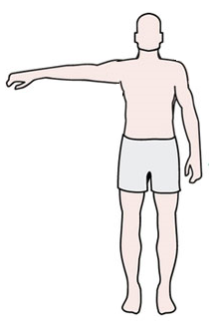
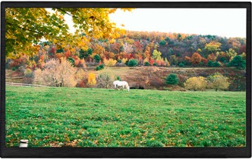
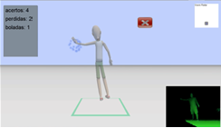







Health Monitoring System
HGM Client
Motion
Control
Game
Rendering
User
Post
Biomechanical Signal
Processing
& Statistical
Analysis
User
Database
HGM Server
Healthcare
Professional

Slide 2
Collect raw data from
Foot Sensor
Identify the begin and the of the user gait cycles
Start
Normalize and Scale each gait cycle
Yes
Identified
gait
cycles?
No
Gait Signal Processing
Extract Principal Components
Select the three more distinguish Principal Components
Split Training Data and Test Data
Measure Euclidean Distance Between Test and Training Data
Project Training Data into Eigenspace
Statistical Analysis with PCA
Check classifier performance
End

