Slide 1
Parallel Transport Unfolding:
A Connection-based Manifold Learning Approach
Woringer Paul
Bouigeon Hugo

Slide 2
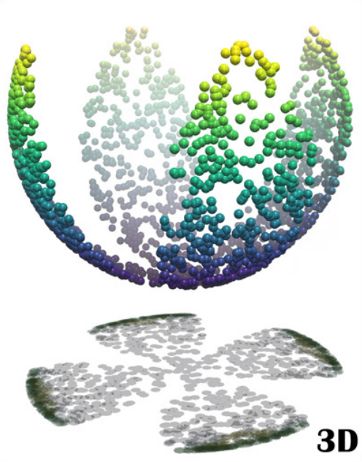
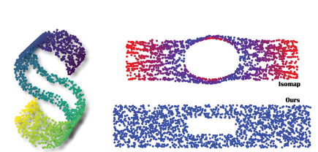
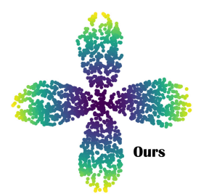
A non linear dimensionality reduction technique
Representing D dimensional data in d dimensions
An improvement to the previous isomap method
Quasi-isometric

Slide 3

Summary
Proximity Graph
Tangent space computation
Parallel Transport
Unfolding for distance calculations
Multidimensional Scaling

Slide 4

Proximity Graph
Using knn, we create a graph out of the pointset, connecting close points to one another.
$k = 4d$

Slide 5
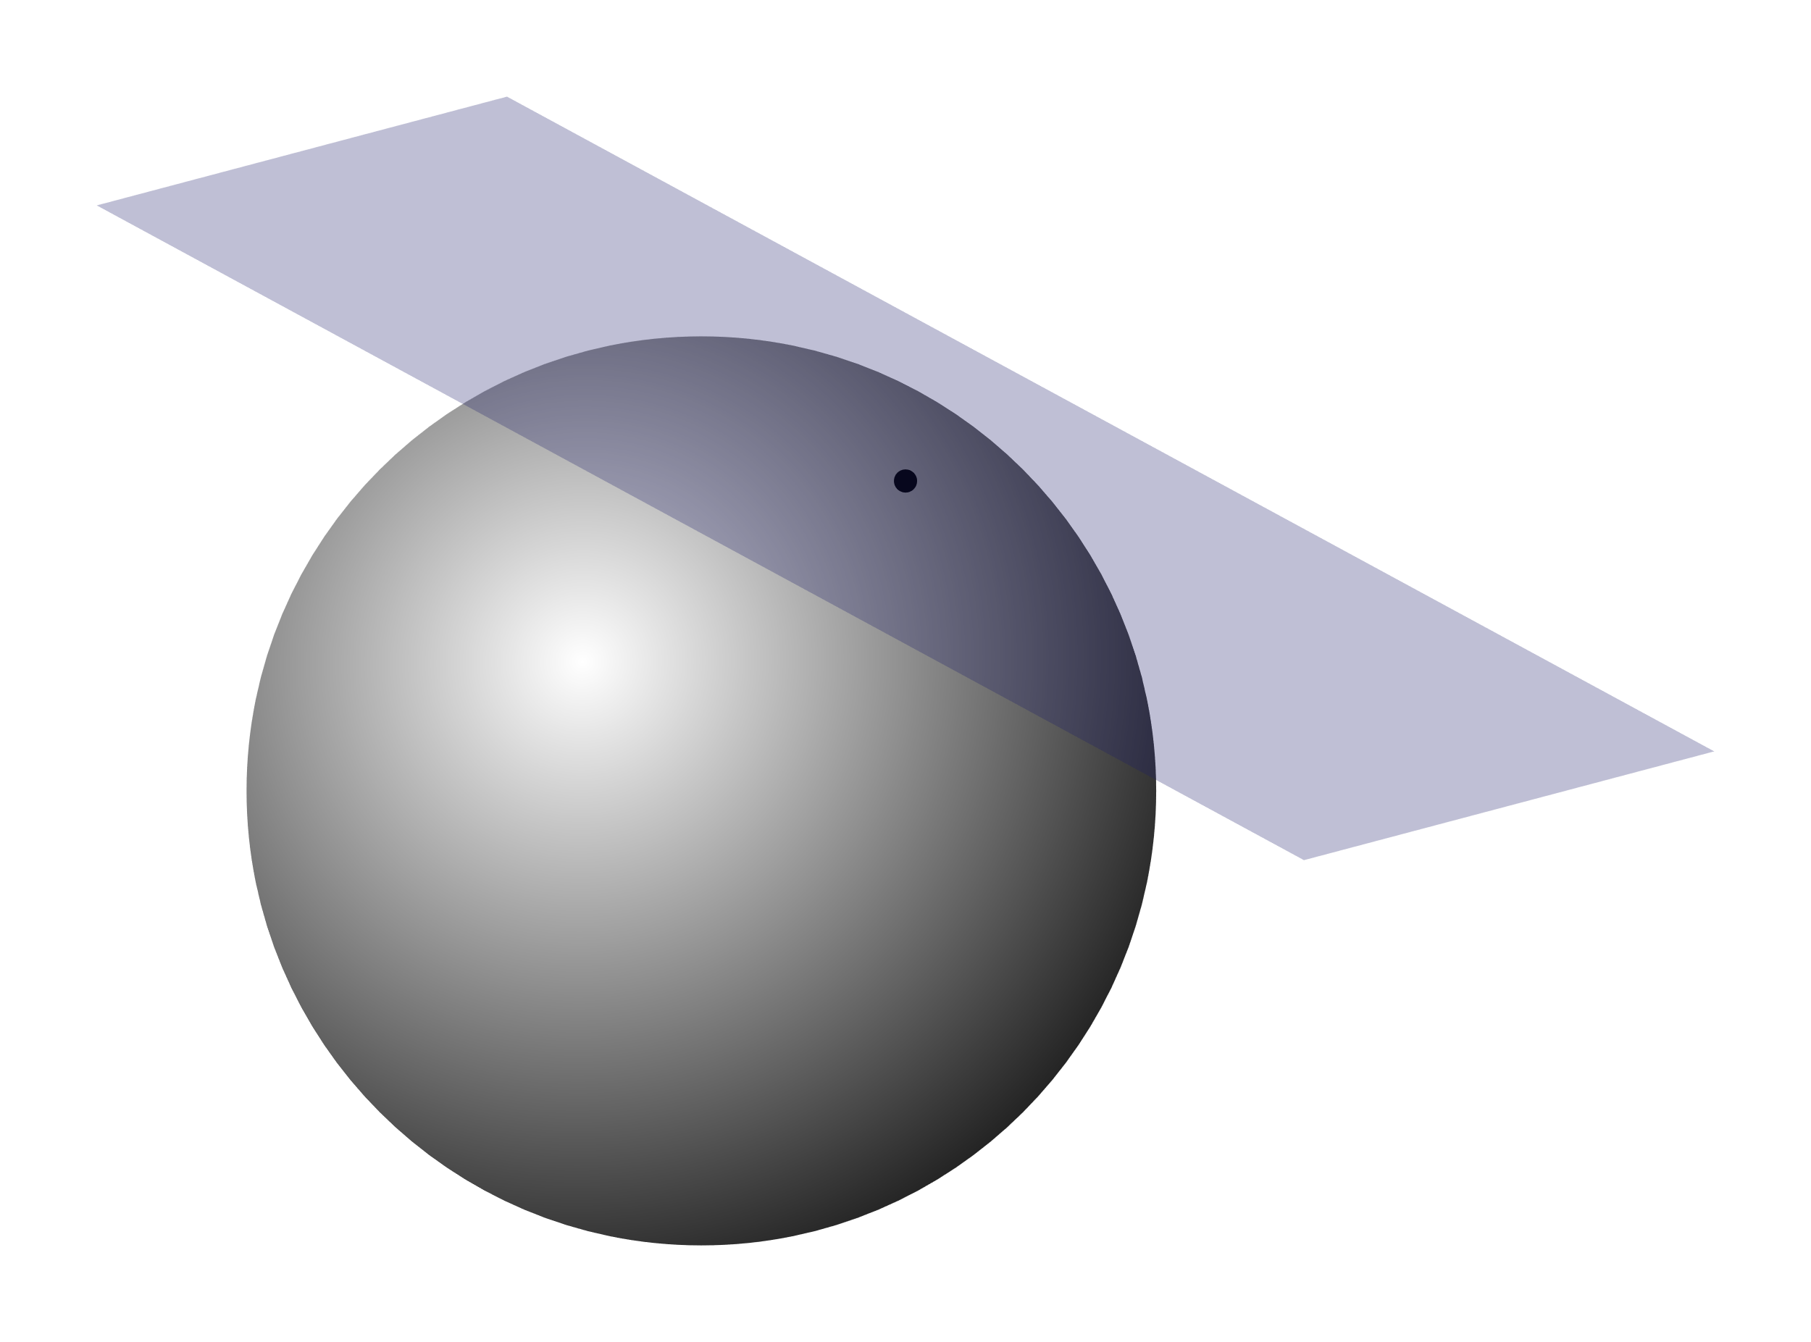

Tangent-space computation
Using knn we compute the tangent space $T_{i}$ to each point$x_{i}$. We use the same $k$ as before for this, but one may use a higher value if the dataset is very noisy.

Slide 6

Parallel Transport
For each $x_{i}$ and $x_{j}$ sharing an edge on the proximity graph $G$, we compute $R_{i,j}=\arg{\min_{R∈O(d}{{\left|\left|T_{i}−T_{j}R\right|\right|}^{2}}}$
For that we us the formula $R_{i,j}=VU^{T}$ with the SVD $T_{i}^{T}T_{j}=UΣV^{T}$

Slide 7
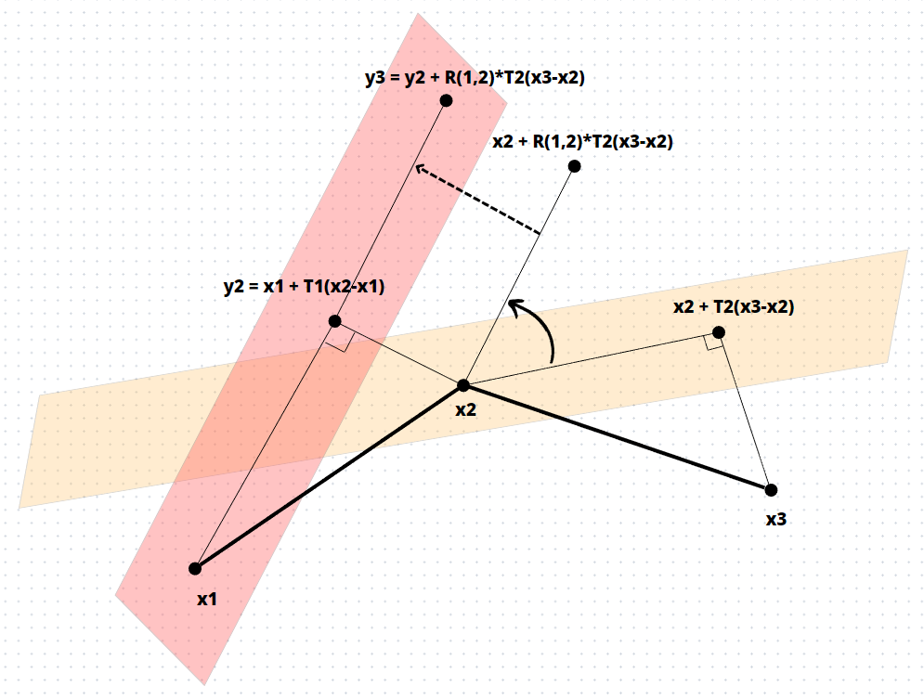

Local path unfolding
When computing geodesic lengths
project point onto neighbours tangent space
Apply rotation matrices between tangent spaces computed previously
This method allows for more rigorous geodesic distance calculations, which are crucial for the final MDS step
Using this distance function we create a distance matrix $D$

Slide 8

Multidimensional Scaling
Compute Gram matrix $G=−\frac{1}{2}\left(I_{n}−\frac{1}{n}ee^{T}\right)D(I_{n}−\frac{1}{n}ee^{T})$
Compute d greatest eigenvalues and associated eigenvectors
$Z=\sqrt{Λ}∗Q^{T}$ the product of the square root of eigenvalues and of eigenvectors is the new embedding of vectors

