Slide 2
Knowledge Base Question Answering and Its Potential Applications in Adaptive Education
Presenter: Yu Chen
Rensselaer Polytechnic Institute, USA
Joint work with Dr. Lingfei Wu and Dr. Mohammed J. Zaki

Slide 3
Introduction
Knowledge Base Question Answering (KBQA)
The goal is to automatically find answers to natural language (NL) questions from a knowledge base (KB).
A natural and intuitive way to access the vast knowledge resources.
Natural Question Generation (NQG)
The goal is to automatically generate NL questions from some context (e.g., KB, text).
QA+QG for virtual teaching assistants
Notes:
2’

Slide 4
Relevant theories of learning
Challenges of KBQA
Lexical gap
The same question can be expressed in various ways in NL while the knowledge source may use a canonical lexicon.
Complex reasoning
Multi-hop reasoning
Questions with various constraints
Related work
Information retrieval based approaches
Directly retrieving answers from the KB by mapping questions and KB into the same embedding.
Semantic parsing based approaches
Converting NL questions into intermediate logic forms, which can be further executed against the underlying KB.
Notes:
2’

Slide 5
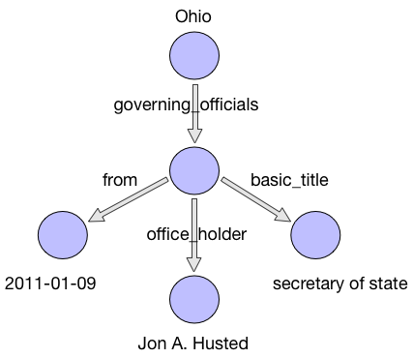
Enabling technological advances
Topic entity linking
Question: who is the secretary of Ohio
in 2011?
Nodes within a k-hop KB subgraph are candidate answers.
Figure 1. A 2-hop KB subgraph from FreeBase.
Notes:
1’

Slide 6
Enabling technological advances
For each candidate answer from the KB subgraph, we encode three types of information:
Answer type: entity type of the candidate answer.
Answer path: a sequence of relations from the candidate answer to the topic entity.
Answer context: surrounding entities of the candidate answer.
Answer type: PERSON
Answer path: [office_holder, governing_officials]
Answer context: {2011-01-09, secretary of state}
Notes:
1’

Slide 7
Enabling technological advances
When answering NL questions over a KB, different question components and KB aspects play different roles.
We propose to directly model the two-way flow of interactions between the questions and the KB via a deep learning model.
Query: Who did France surrender to in ww2?
KB aspects: entity type, relation path, context.
An example from the WebQuestions dataset.
Notes:
2’

Slide 8
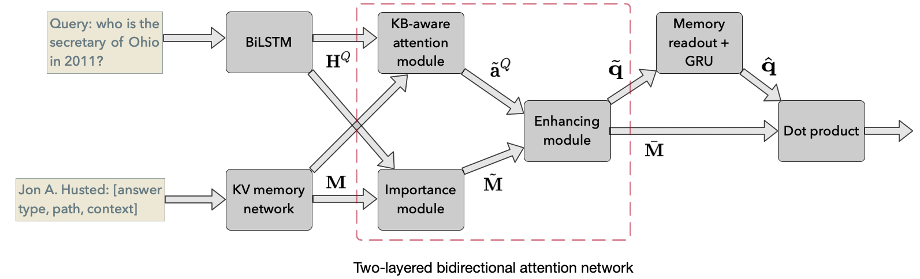
Enabling technological advances
Memory module
Reasoning module
Answer module
Notes:
1’

Slide 9
Real world application
AI for virtual teaching assistants
A unified framework for teaching and assessment.
QA:
Answering NL questions from learners.
QG:
Asking NL questions to test learners.
Continuous Self-training
Training the QA component on generated questions.
Training the QG component on collected questions.
Scalability & personalization
Serving millions of learners at the same time.
Dynamically adjusting the complexity or domains of the generated questions.
Notes:
1’

Slide 10
Summary
A novel deep learning approach for the task of KBQA.
QA+QG: a unified framework for virtual teaching assistants.
What can AI do for education?
Better scalability
Universal access to education
Better personalization
Notes:
1’

