Slide 1
GraphFlow: Exploiting Conversation Flow with Graph Neural Networks for Conversational Machine Comprehension
Yu Chen
Rensselaer Polytechnic Institute
hugochan2013@gmail.com
Lingfei Wu
IBM Research
lwu@email.wm.edu
Mohammed J. Zaki
Rensselaer Polytechnic Institute
zaki@cs.rpi.edu

Slide 2
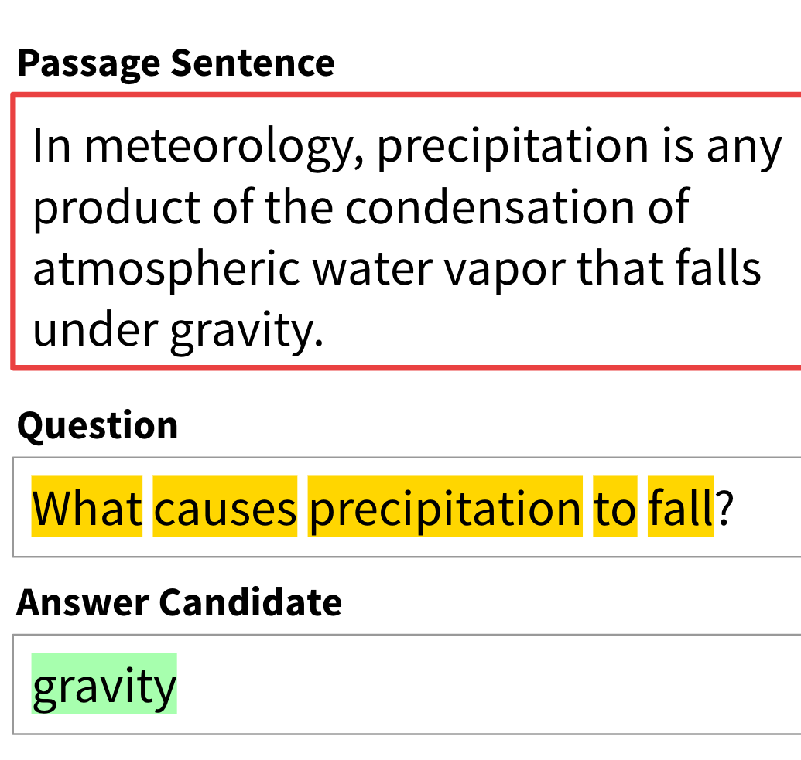
Machine Comprehension

Slide 3
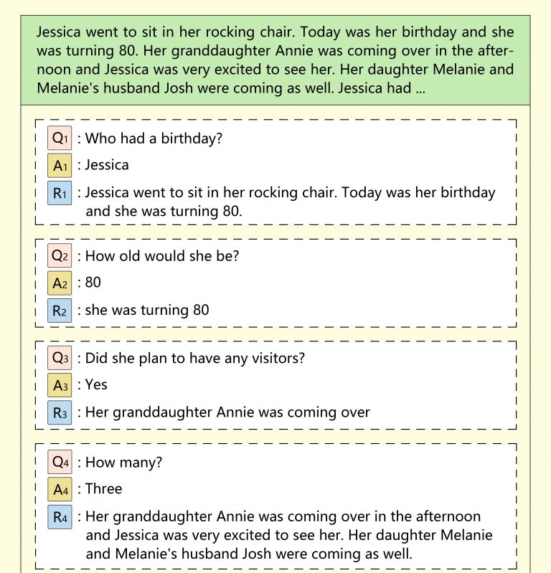
Conversational Machine Comprehension
Challenges:
Focus shift
Coreference or ellipsis

Slide 4
Motivation and Key Ideas
Motivation:
Modeling conversation history.
Capturing rich semantic relationships among passage words.
Key Ideas:
Dynamically construct a question and conversation history aware context graph at each dialog turn.
Conversation flow as a sequence of latent states.
A novel Recurrent Graph Neural Network based flow mechanism to process a sequence of context graphs.

Slide 5
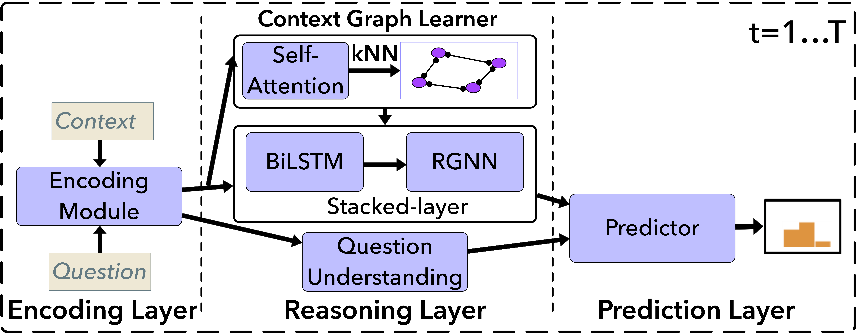
GraphFlow Architecture

Slide 6
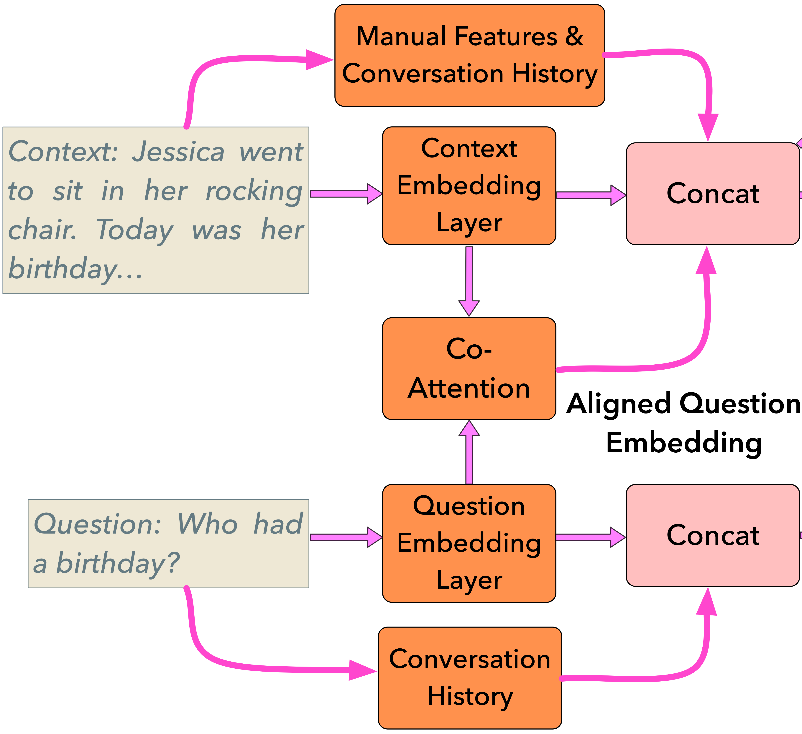
GraphFlow: Encoding Layer

Slide 7


GraphFlow: Reasoning Layer
Context graph learning:
Dynamically construct a question and conversation history aware context graph at each turn.
context embeddings
non-negative trainable weight vector
kNN-style sparsification

Slide 8
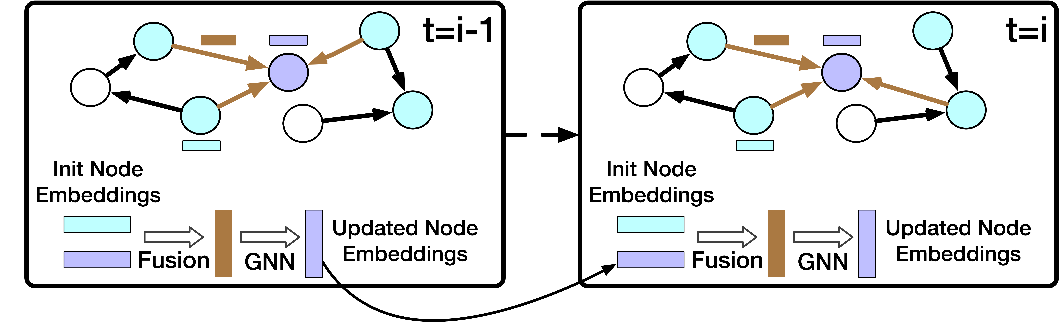
GraphFlow: Reasoning Layer (cont’d)
Context graph reasoning with RGNN

Slide 9
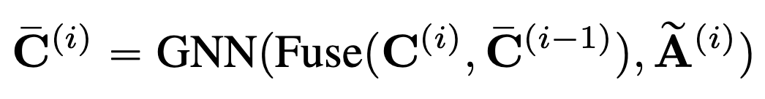
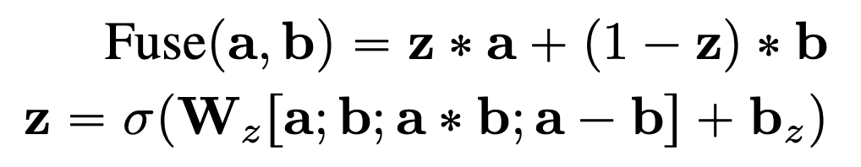
RGNN: Technical Details
updated context node embeddings
original context node embeddings

Slide 10
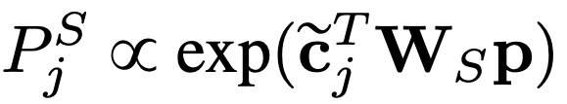
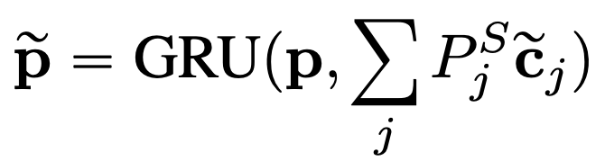
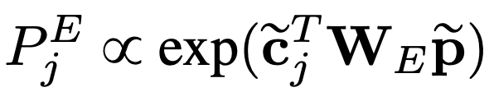
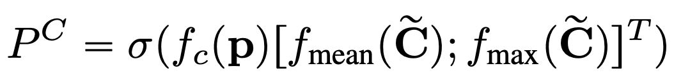
GraphFlow: Prediction Layer
start probability
end probability
answer type classifier

Slide 11
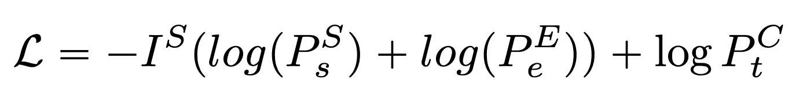
GraphFlow: Training and Inference
Objective function:

Slide 12
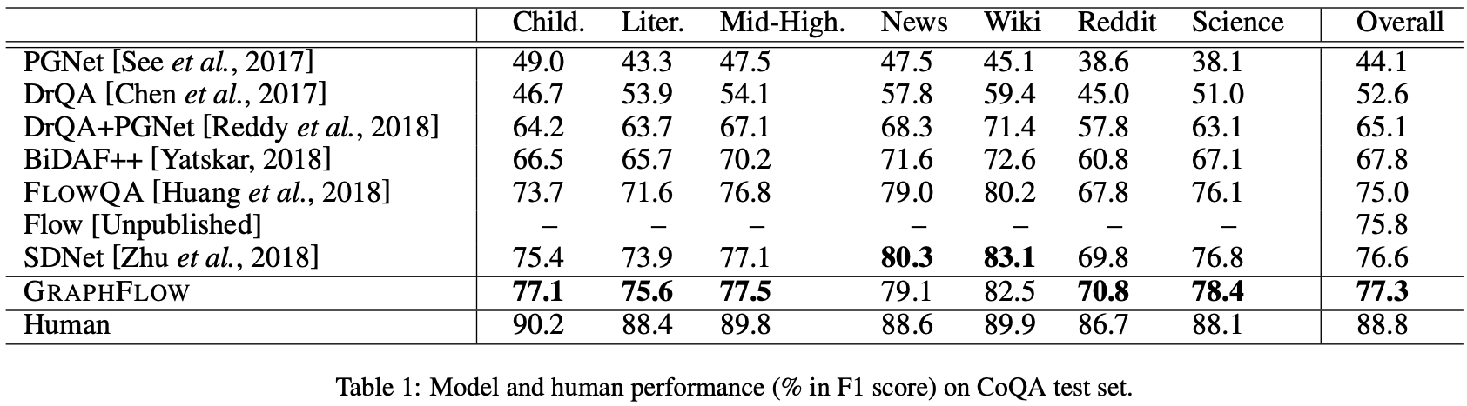
Experimental Results: CoQA Benchmark

Slide 13
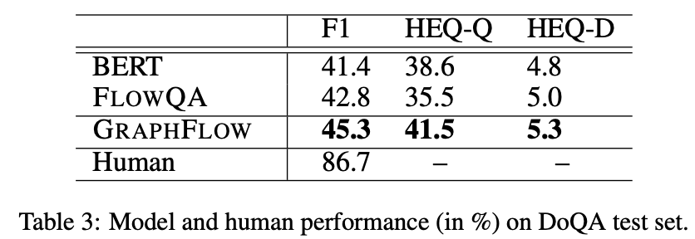
Experimental Results: DoQA Benchmark

Slide 14
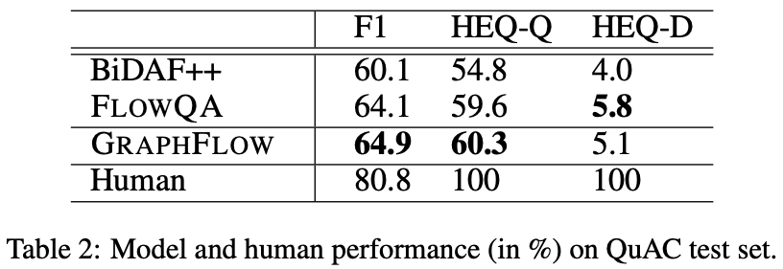
Experimental Results: QuAC Benchmark

Slide 15
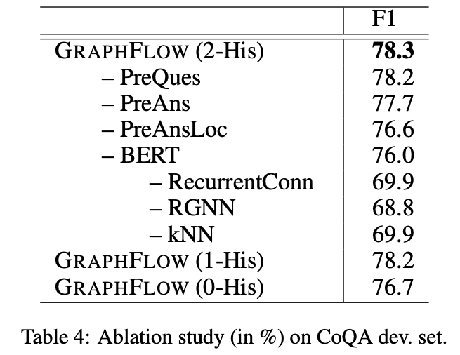
Experimental Results: Ablation Study

Slide 16
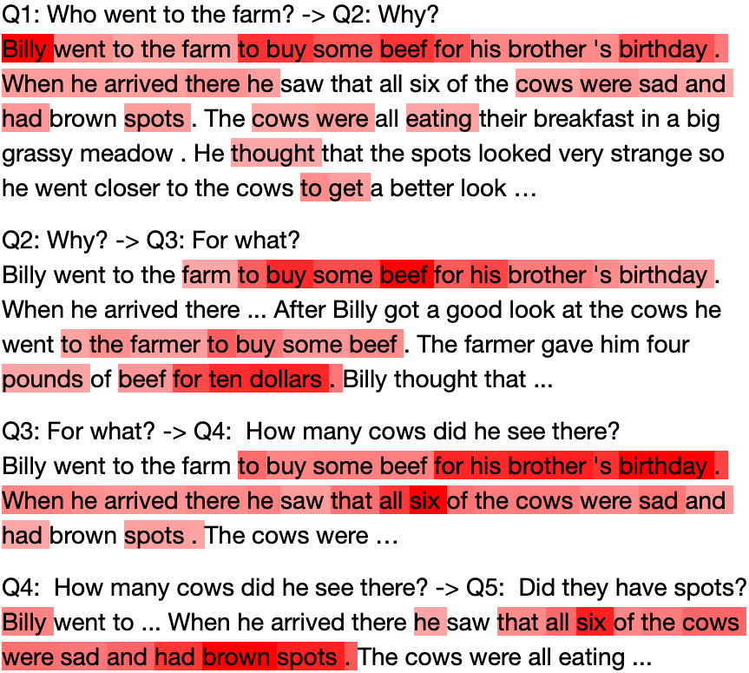
Experimental Results: Interpretability Analysis
The highlighted parts of the context indicate GraphFlow’s focus shifts between consecutive question turns.

Slide 17
Motivation and Key Ideas
Conclusions and Future Work
Conclusions:
A GNN-based model which carries over the reasoning output throughout a conversation for conversational MRC.
A simple yet effective graph structure learning technique for dynamically constructing context graphs.
Good performance on three public benchmarks.
Good interpretability for the reasoning process.
Future work:
Automatically learning graph structures from free text
Modeling temporal connections between sequential graphs.

Slide 18
Code is publicly available at
https://github.com/hugochan/GraphFlow.
Thank you!
Notes:
The implementation of our model is publicly available. Thank you for your attention!

