Slide 1
Reinforcement Learning Based Graph-to-Sequence Model for Natural Question Generation
Presenter: Yu (Hugo) Chen
Department of Computer Science
Rensselaer Polytechnic Institute, Troy, NY 12180
April 29, 2020
Joint work with Dr. Lingfei Wu and Dr. Mohammed J. Zaki

Slide 2
Outline
Background
Related work
Approach
Experiments
Conclusion & future work

Slide 3
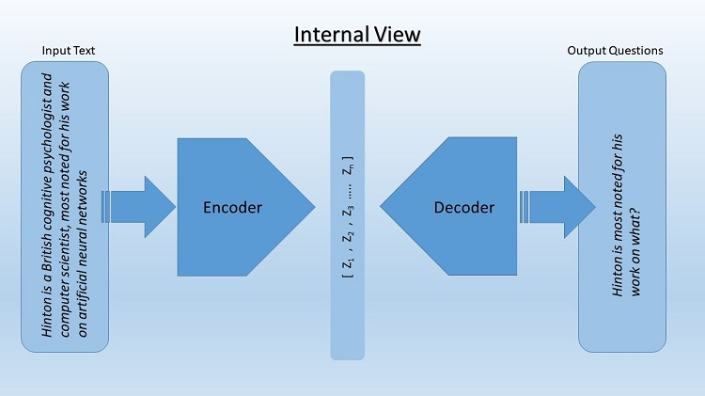
Natural Question Generation
Applications
providing training data for QA systems
generating practice exercises for educational purposes
helping dialog systems to kick-start and continue a conversation with human users

Slide 4
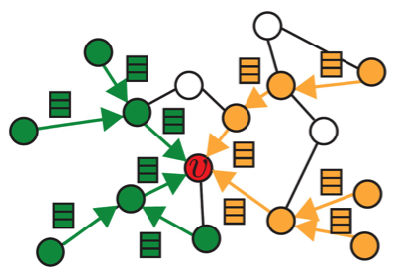
Graph Neural Networks
Graph Neural Networks (GNNs) generalize (structured) deep neural models to non-Euclidean domains such as graphs.
GNNs have been widely applied to many tasks/domains:
Computer vision (CV)
Natural language processing (NLP)
Drug discovery
Social network analysis
Recommendation systems
…
http://snap.stanford.edu/gnnexplainer/

Slide 5




Problem Formulation of Question Generation
Input:
a text passage
a target answer
Output:
the best natural language question
which maximizes the conditional likelihood
We focus on QG from text!

Slide 6
Outline
Background
Related work
Approach
Experiments
Conclusion & future work

Slide 7
Related Work
Template-based approaches
Mostow & Chen, 2009; Heilman & Smith, 2010; Heilman, 2011
Rely on heuristic rules or hand-crafted templates
low generalizability and scalability
Seq2Seq-based approaches
Du et al., 2017; Zhou et al., 2017; Song et al., 2018a; Kumar et al., 2018a
Fail to utilize the rich text structure information beyond the simple word sequence
Rely on cross-entropy based sequence training which has several limitations
Fail to effectively utilize the answer information
Notes:
Jack Mostow and Wei Chen. Generating instruction automatically for the reading strategy of self- questioning. 2009.
Michael Heilman and Noah A Smith. Good question! statistical ranking for question generation. In Human Language Technologies: The 2010 Annual Conference of the North American Chapter of the Association for Computational Linguistics, pp. 609–617. Association for Computational Linguistics, 2010.
Michael Heilman. Automatic factual question generation from text. 2011.
Xinya Du, Junru Shao, and Claire Cardie. Learning to ask: Neural question generation for reading comprehension. arXiv preprint arXiv:1705.00106, 2017.
Qingyu Zhou, Nan Yang, Furu Wei, Chuanqi Tan, Hangbo Bao, and Ming Zhou. Neural question generation from text: A preliminary study. In National CCF Conference on Natural Language Processing and Chinese Computing, pp. 662–671. Springer, 2017.
Linfeng Song, Zhiguo Wang, Wael Hamza, Yue Zhang, and Daniel Gildea. Leveraging context in- formation for natural question generation. In Proceedings of the 2018 Conference of the North American Chapter of the Association for Computational Linguistics: Human Language Technolo- gies, Volume 2 (Short Papers), pp. 569–574, 2018a.
Vishwajeet Kumar, Kireeti Boorla, Yogesh Meena, Ganesh Ramakrishnan, and Yuan-Fang Li. Au- tomating reading comprehension by generating question and answer pairs. In Pacific-Asia Con- ference on Knowledge Discovery and Data Mining, pp. 335–348. Springer, 2018a.

Slide 8
Related Work (cont’d)
Improving Neural Question Generation using Answer Separation [Kim et al, 2018]
Learn to identify which interrogative word should be used by replacing the target answer in the original passage with a special token
Limitations: rely on hand-crafted rules/features
Propose an answer-separated Seq2Seq model to treat the passage and the targeted answer separately.
Limitations: fail to effectively utilize the answer information
Notes:
Yanghoon Kim, Hwanhee Lee, Joongbo Shin, and Kyomin Jung. Improving neural question gener- ation using answer separation. arXiv preprint arXiv:1809.02393, 2018.

Slide 9
Related Work (cont’d)
Learning to Generate Questions by Learning What not to Generate [Liu et al, 2019]
Annotate clue words in the passage based on word frequency and overlapping, mask out low-frequency passage word embeddings, and reduce the target output vocabulary
Limitations: apply many heuristic rules and ad-hoc strategies
Apply a Graph Convolutional Network (GCN) for clue word prediction separately
Limitations: apply Gumbel-Softmax to maintain end-to-end training
Notes:
Bang Liu, Mingjun Zhao, Di Niu, Kunfeng Lai, Yancheng He, Haojie Wei, and Yu Xu. Learning to generate questions by learning what not to generate. arXiv preprint arXiv:1902.10418, 2019.

Slide 10
Motivation
Limitations of previous QG methods
Ignore the rich structure information hidden in text
Text is more than a sequence of tokens!
Solution: apply a GNN-based encoder to capture rich structure information.
Solely rely on cross-entropy loss
This leads to issues like exposure bias and inconsistency between train/test measurement
Solution: design a hybrid loss combining both cross-entropy loss and RL loss.
Fail to fully exploit the answer information
Solution: propose a deep alignment network for attention-based soft alignment between passage and answer.
Notes:
The motivation of our work is driven by some limitations of previous QG methods.

Slide 11
Contributions
We propose a novel RL-based Graph2Seq model for natural question generation. To the best of our knowledge, we are the first to introduce the Graph2Seq architecture for QG.
We design a novel deep alignment network to effectively utilize the answer information for QG.
We present a mixed loss function combining both cross-entropy loss and RL loss.
We explore both static and dynamic ways of constructing graph from text and are the first to systematically investigate their performance impacts on a GNN encoder.
The proposed model outperforms existing methods by a significant margin on the standard SQuAD benchmark for QG.

Slide 12
Outline
Background
Related work
Approach
Experiments
Conclusion & future work

Slide 13
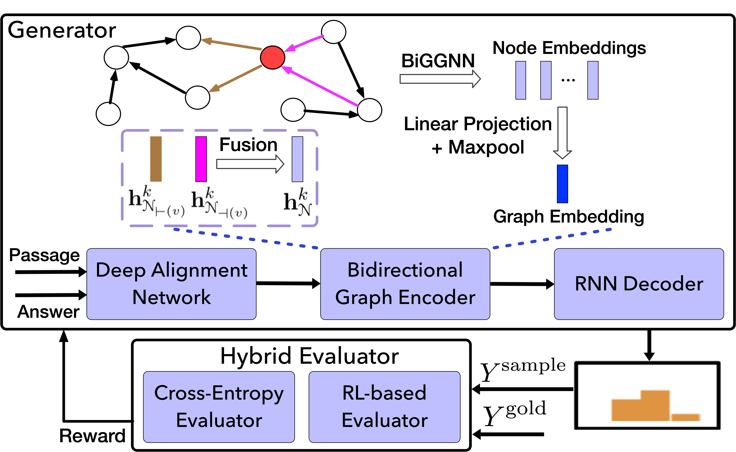
Overall Model Architecture

Slide 14
Deep Answer Alignment
Motivation:
Answer information is crucial for generating relevant and high quality questions from a passage.
We explicitly model the global interactions among them in the embedding space.
A deep alignment network for incorporating the answer information into passages with multiple granularity levels.
We perform attention-based soft-alignment at both the word level and the contextual level.
Multiple levels of alignments can help learn hierarchical representations.
Notes:
Talk about exact alignment first: exact text matching, does not capture semantic meanings
Unlike previous methods that neglect potential semantic relations between passage and answer words, we explicitly model the global interactions among them in the embedding space.

Slide 15

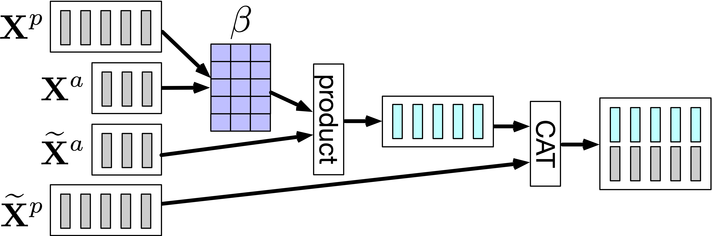

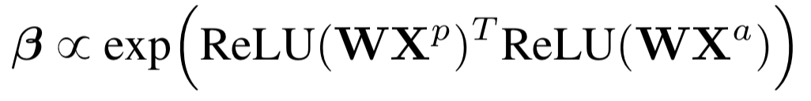
Deep Answer Alignment (cont’d)
denotes passage
denotes answer
Key-value representations of passage and answer
Step 2: compute aligned answer embeddings
Step 3: compute final passage embeddings
Step1: compute passage-answer attention matrix
Notes:
Let X^p and \tilde{X}^p denote two embeddings associated with passage text

Slide 16

Deep Answer Alignment – Word Level
On the passage side
We perform deep answer alignment between passage and answer based on their word embeddings to obtain the passage embeddings .
A BiLSTM is applied to to obtain contextualized passage embeddings.
On the answer side
A BiLSTM is applied to the answer word embedding sequence to obtain the contextualized answer embeddings.
Notes:
Let X^p and \tilde{X}^p denote two embeddings associated with passage text

Slide 17

Deep Answer Alignment – Contextual Level
On the passage side
We perform deep answer alignment between passage and answer based on their contextualized embeddings.
A BiLSTM is applied to the above obtained passage embeddings to compute the final passage embeddings .

Slide 18
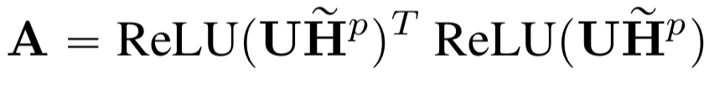



Generator – Passage Graph Construction
Syntax-based static graph construction
A directed and unweighted passage graph based on dependency parsing.
We connect neighboring dependency parse trees by connecting those nodes that are at a sentence boundary and next to each other in text.
Semantics-aware dynamic graph construction
Dynamically build a directed and weighted graph to model semantic relationships among passage words.
is the passage representation

Slide 19
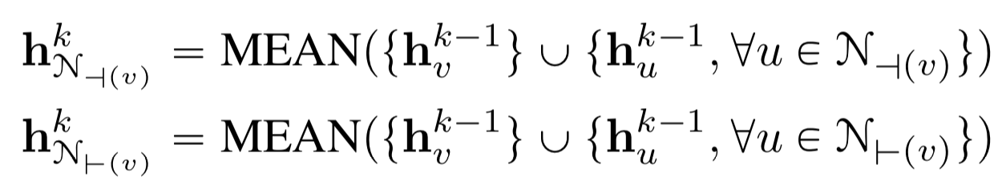


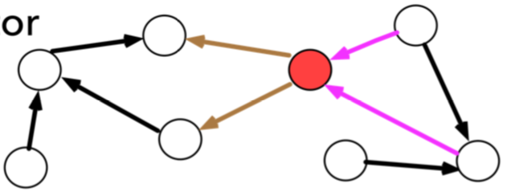
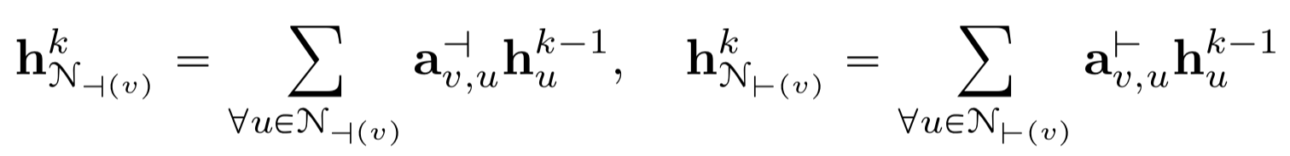
Generator- Bidirectional Gated GNNs
Node aggregation for the syntax-based static graph
Node embeddings are initialized to the passage embeddings returned by Deep Alignment Network.
Node aggregation for the semantics-based static graph
Weights come from the normalized adjacency matrices computed during dynamic graph construction. It is still end-to-end trainable.

Slide 20
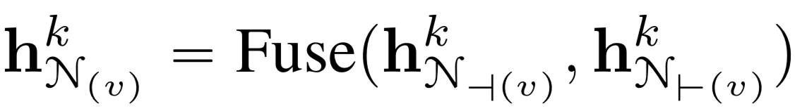
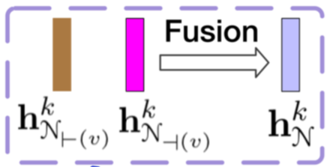

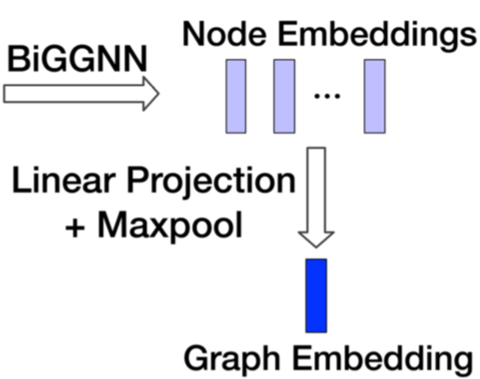

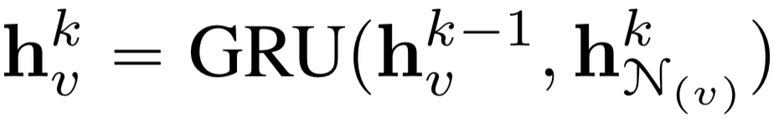
Bidirectional Graph2seq Generator (cont’d)
Fuse the aggregated node embeddings from both directions at each GNN hop
Update the node embeddings using fused information
where GRU is a Gated Recurrent Unit (Cho et al., 2014).
After n hops of GNN computation, we obtain the final node/graph embeddings.
Notes:
To effectively learn the graph embeddings from the constructed text graph, we propose a novel Bidirectional Gated Graph Neural Network (BiGGNN) which extends Gated Graph Sequence Neural Networks (Li et al., 2015) by learning node embeddings from both incoming and outgoing edges in an interleaved fashion when processing the directed passage graph.
we fuse the intermediate node embeddings from both incoming and outgoing directions in every iteration

Slide 21
Bidirectional Graph2seq Generator (cont’d)
RNN decoder
We adopt a state-of-the-art attention-based LSTM decoder with copy and coverage mechanisms (See et al., 2017).
Initial hidden states are based on graph embeddings.
Node embeddings can be accessed via attention mechanism as a memory bank.
Notes:
Abigail See, Peter J Liu, and Christopher D Manning. Get to the point: Summarization with pointer- generator networks. arXiv preprint arXiv:1704.04368, 2017.

Slide 22
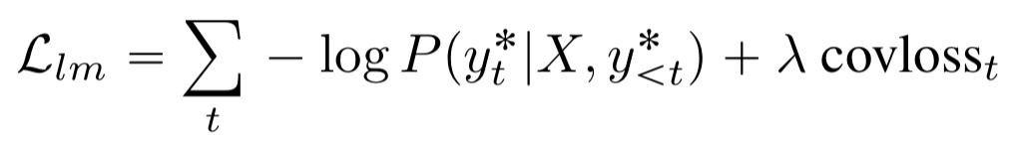
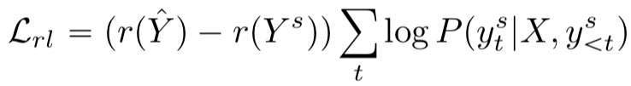

Hybrid Evaluator
Regular cross-entropy based training objectives have limitations
Exposure bias
Evaluation discrepancy between training and testing
A mixed loss combining both cross-entropy loss and RL loss
Ensure the generation of syntactically and semantically valid text
Two-stage training strategy:
Train the model with cross-entropy loss
Finetune the model by optimizing the mixed objective function
Greedy search
multinomial
sampling
self-critical sequence training (SCST) RL algorithm.
Notes:
It has been observed that optimizing such cross-entropy based training objectives for sequence learn- ing does not always produce the best results on discrete evaluation metrics
Major limitations of this strategy include exposure bias and evaluation discrepancy between training and testing.
To tackle these issues, some recent QG approaches (Song et al., 2017; Kumar et al., 2018b) directly optimize evaluation metrics using REINFORCE. We further use a mixed objective function with both cross-entropy and RL loss for guiding text generation.
RL algorithm
- self-critical sequence training (SCST) algorithm
- efficient, utilizes the output of its own test-time inference algorithm to normalize the rewards it experiences
- two outputs: the sampled output produced by multinomial sampling & baseline output produced by greedy search
- if the sampled output has a higher reward than the baseline one, we maximize its likelihood, and vice versa.

Slide 23
Outline
Background
Related work
Approach
Experiments
Conclusion & future work

Slide 24
Experimental Setup
Data:
SQuAD split 1: 75,500/17,934/11,805 (train/development/test) examples
SQuAD split 2: 86,635/8,965/8,964 examples
Evaluation metrics
Automatic evaluation
BLEU-4, METEOR, ROUGE-L, Q-BLEU1
Human evaluation
Syntactically correct, Semantically correct, Relevant
Notes:
SQuAD contains more than 100K questions posed by crowd workers on 536 Wikipedia articles. Since the test set of the original SQuAD is not publicly available, the accessible parts (90%) are used as the entire dataset in our experiments. For fair comparison with previous methods, we evaluated our model on both data split-1 (Song et al., 2018a)1 that contains 75,500/17,934/11,805 (train/development/test) examples and data split-2 (Zhou et al., 2017) 2 that contains 86,635/8,965/8,964 examples.
Initially, BLEU-4 and METEOR were designed for evaluating machine translation systems and ROUGE-L was designed for evaluating text summarization systems. Recently, Q-BLEU1 was de- signed for better evaluating question generation systems, which was shown to correlate significantly better with human judgments compared to existing metrics.

Slide 25
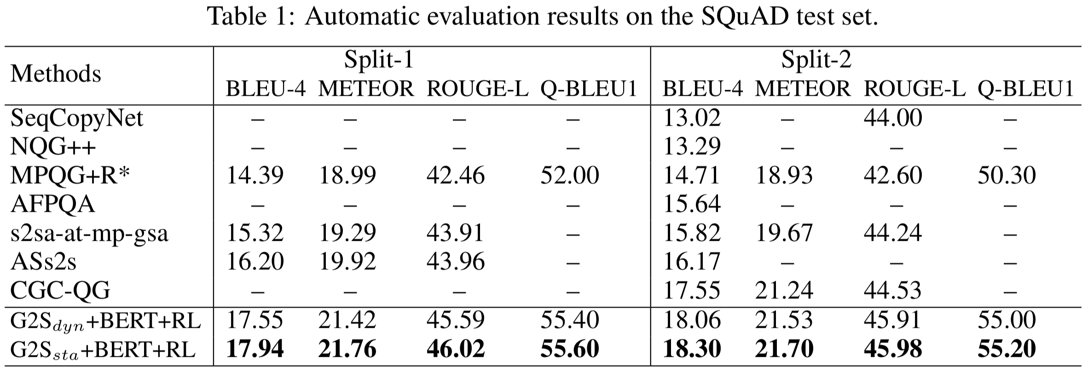
Automatic Evaluation Results
Notes:
we can see that both of our full models G2Ssta+BERT+RL and G2Sdyn+BERT+RL achieve the new state-of-the-art scores on both data splits and consistently outperform previous methods by a significant margin.
This highlights that our RL-based Graph2Seq model, together with the deep alignment network, successfully addresses the three issues we highlighted in Sec. 1.
Between these two variants, G2Ssta+BERT+RL outperforms G2Sdyn+BERT+RL on all the metrics.
Also, unlike the baseline methods, our model does not rely on any hand-crafted rules or ad-hoc strategies, and is fully end-to-end trainable.

Slide 26
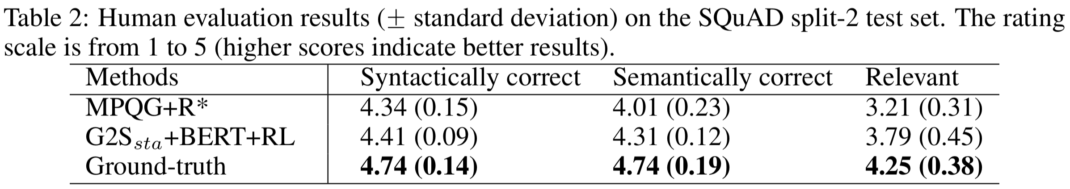
Human Evaluation Results
Notes:
We asked 5 human evaluators to give feedback on the quality of questions generated by a set of anonymized competing systems.
i) is this generated question syntactically correct? ii) is this generated question semantically correct? and iii) is this generated question relevant to the passage?
For each evaluation question, the rating scale is from 1 to 5 where a higher score means better quality (i.e., 1: Poor, 2: Marginal, 3: Acceptable, 4: Good, 5: Excellent). Responses from all evaluators were collected and averaged.
We can see that our best performing model achieves good results even compared to the ground-truth, and outperforms the strong baseline method MPQG+R.
Our error analysis shows that main syntactic error occurs in repeated/unknown words in generated questions. Further, the slightly lower quality on semantics also impacts the relevance.

Slide 27
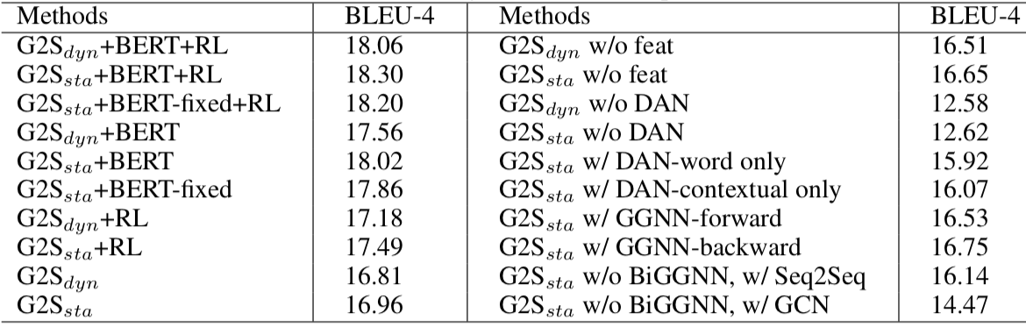
Ablation Study Results
Syntax-based static graph construction outperforms semantics-aware dynamic graph construction.
DAN is effective (both word-level and contextual level)
Graph2Seq outperforms Seq2Seq. BiGGNN works better than GGNN.
RL helps further improve the performance.
BERT is helpful.

Slide 28
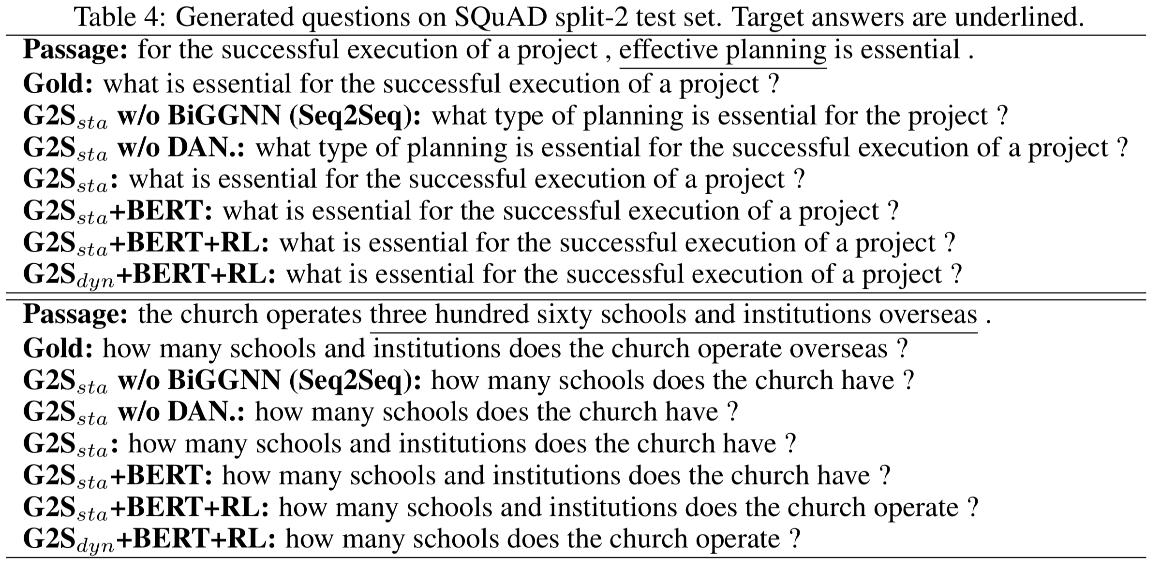
Case Study Results
Notes:
incorporating answer information helps the model identify the answer type of the question to be generated, and thus makes the generated questions more relevant and specific.
Graph2Seq model can generate more complete and valid questions compared to the Seq2Seq baseline.
fine-tuning the model using REINFORCE can improve the quality of the generated questions.

Slide 29
Outline
Background
Related work
Approach
Experiments
Conclusion & future work

Slide 30
Conclusion
We proposed a novel RL based Graph2Seq model for QG.
The answer information is utilized by an effective Deep Alignment Network.
A novel bidirectional GNN is proposed to process the directed passage graph.
Our two-stage training strategy benefits from both cross-entropy based and REINFORCE based sequence training.
We explore both static and dynamic graph construction from text, and systematically investigate the performance difference between the two.
On the benchmark SQuAD dataset, our proposed model achieves the new state-of-the-art results.
Code is publicly available at https://github.com/hugochan/RL-based-Graph2Seq-for-NQG.

Slide 31
Future Work
More effective ways of automatically learning graph structures from textual data.
It would be interesting to study the unpaired problem setting for QG.
Apply our framework to other relevant tasks such as natural question generation from structured data (e.g., tables, KGs).

Slide 32
References
[1] Jack Mostow and Wei Chen. Generating instruction automatically for the reading strategy of self- questioning. 2009.
[2] Michael Heilman and Noah A Smith. Good question! statistical ranking for question generation. In Human Language Technologies: The 2010 Annual Conference of the North American Chapter of the Association for Computational Linguistics, pp. 609–617. Association for Computational Linguistics, 2010.
[3] Michael Heilman. Automatic factual question generation from text. 2011.
[4] Xinya Du, Junru Shao, and Claire Cardie. Learning to ask: Neural question generation for reading comprehension. arXiv preprint arXiv:1705.00106, 2017.
[5] Qingyu Zhou, Nan Yang, Furu Wei, Chuanqi Tan, Hangbo Bao, and Ming Zhou. Neural question generation from text: A preliminary study. In National CCF Conference on Natural Language Processing and Chinese Computing, pp. 662–671. Springer, 2017.
[6] Linfeng Song, Zhiguo Wang, Wael Hamza, Yue Zhang, and Daniel Gildea. Leveraging context in- formation for natural question generation. In Proceedings of the 2018 Conference of the North American Chapter of the Association for Computational Linguistics: Human Language Technolo- gies, Volume 2 (Short Papers), pp. 569–574, 2018a.
[7] Vishwajeet Kumar, Kireeti Boorla, Yogesh Meena, Ganesh Ramakrishnan, and Yuan-Fang Li. Au- tomating reading comprehension by generating question and answer pairs. In Pacific-Asia Con- ference on Knowledge Discovery and Data Mining, pp. 335–348. Springer, 2018a.
[8] Yanghoon Kim, Hwanhee Lee, Joongbo Shin, and Kyomin Jung. Improving neural question gener- ation using answer separation. arXiv preprint arXiv:1809.02393, 2018.
[9] Bang Liu, Mingjun Zhao, Di Niu, Kunfeng Lai, Yancheng He, Haojie Wei, and Yu Xu. Learning to generate questions by learning what not to generate. arXiv preprint arXiv:1902.10418, 2019.
[10] Kyunghyun Cho, Bart van Merrienboer, Caglar Gulcehre, Dzmitry Bahdanau, Fethi Bougares, Hol- ger Schwenk, and Yoshua Bengio. Learning phrase representations using rnn encoder–decoder for statistical machine translation. In EMNLP, pp. 1724–1734, 2014.
[11] Abigail See, Peter J Liu, and Christopher D Manning. Get to the point: Summarization with pointer- generator networks. arXiv preprint arXiv:1704.04368, 2017.

Slide 33
Thank you!
Q&A

