Slide 1

Retrieval-Augmented Generation of
Code Summarization via Hybrid GNN
Shangqing Liu¹, Yu Chen², Xiaofei Xie¹, Jingkai Siow¹, Yang Liu¹
¹ Nanyang Technological University
² Rensselaer Polytechnic Institute

Slide 2
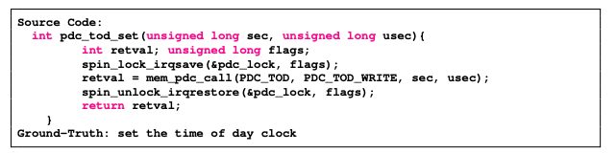

Motivation
Automatic source code summarization is meaningful.
Automatic source code summarization is a far from the settled problem.
Retrieval-based approaches.
Low generalization on unseen data.
Generation-based approaches.
a). Cannot use similar examples from the retrieval database.
b). Ignore rich structure behind code text.
How to combine both to achieve the state-of-the-art performance?

Slide 3
Motivation
Neural Message Passing.
Current GNN-based code modelling works (e.g., vulnerability detection, type inference, usually consider the k-hop neighborhood information).
C
G
A
D
A
D
E
B
F
G
Limitation of existing GNNs：
For a big graph, node A must go through many times of iterations to know node B’s information.

Slide 4
Motivation
Benchmark.
Current open-source benchmarks such as Java, Python contain intensive duplications .
C programming is widely used.
There is no open-source benchmark on C programming.
C programming is the functional programming, which is more challenging.

Slide 5
Contribution
We propose a general-purpose framework for automatic code summarization, which combines the benefits of both retrieval-based and generation-based methods via a retrieval-based augmentation mechanism.
We innovate a Hybrid GNN by fusing the static graph (based on code property graph) and dynamic graph (via structure-aware global attention mechanism) to mitigate the limitation of the GNN on capturing global graph information.
We conduct an extensive experiment to evaluate our framework. The proposed approach achieves the state-of-the-art performance and improves existing approaches by 1.42, 2.44 and 1.29 in terms of BLEU-4, ROUGE-L and METEOR metrics.
We release a new challenging C benchmark for the task of source code summarization.
https://github.com/shangqing-liu/CCSD-benchmark-for-code-summarization

Slide 6
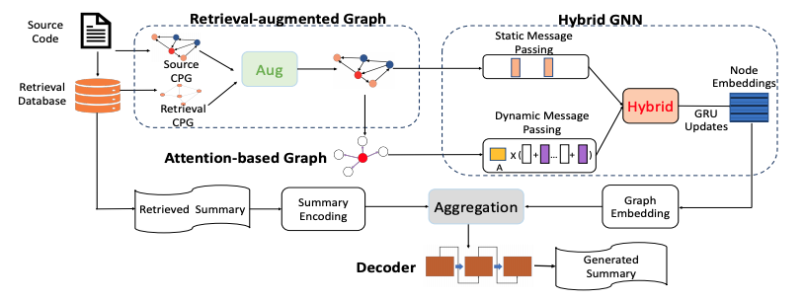
Method
Retrieval-augmented Static
Graph Construction.
Attention-based Dynamic
Graph Construction.
Hybrid GNN.
Decoder.

Slide 7
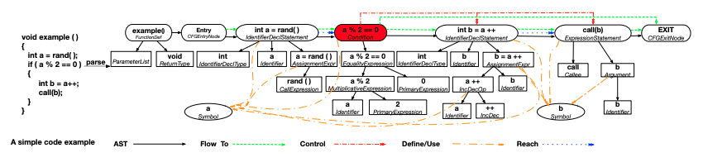
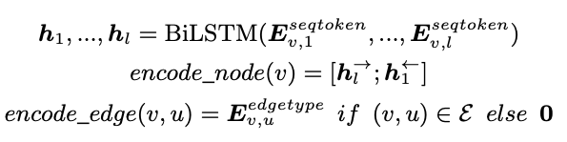
Method
Code Property Graph (CPG).
AST： syntactic information of program.
Flow To: statement execution order.
Control: control dependency.
Define/Use: variable definition and usage.
Reach: data dependency.

Slide 8




Method
Retrieval-based Augmentation.

Slide 9





Method
Retrieval-based Augmentation.
Step 1: Retrieving.
Step 2: Retrieved Code-based Augmentation.
Step 3: Retrieved Summary-based Augmentation.
Compute the relevance between the
code c and the retrieved code c’.
Add the feature of retrieved code c’ to c.

Slide 10
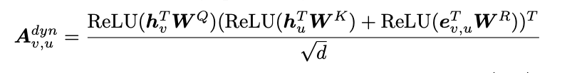

Method
Attention-based Dynamic Graph.
Structure-aware Global Attention.
Allow message passing among any pair （v，u） of nodes to capture the global dependency among nodes to supplement the static graph.

Slide 11

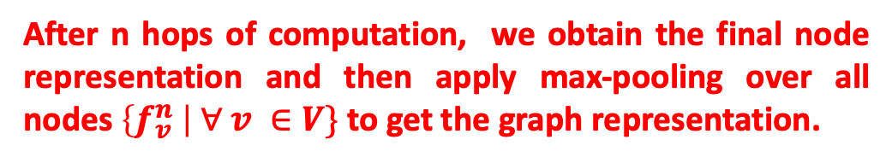


Method
Hybrid GNN (HGNN).
At each computation hop k:
Static Message Passing.
Dynamic Message Passing.
Hybrid Message Passing.

Slide 12

Method
Decoder
An attention-based LSTM decoder is used:
Input:
Initial Hidden State

Slide 13
Experimental Results
Experimental Setting
Dataset:
A new benchmark on C programming language
It contains 95k+ unique functions, from popular C projects
We made it public at https://github.com/shangqing-liu/CCSD-benchmark-for-code-summarization
Baselines:
Retrieval-based approaches: TF-IDF, NNGen;
Sequence-based approaches: CODE-NN, Transformer, DRL, Rencos;
Graph-based approaches: GCN2seq, GAT2seq, SeqGNN;
Metrics:
Automatic metrics: BLEU-4, ROUGE-L, METEOR;
Human evaluation metrics: Relevance, Similarity;

Slide 14
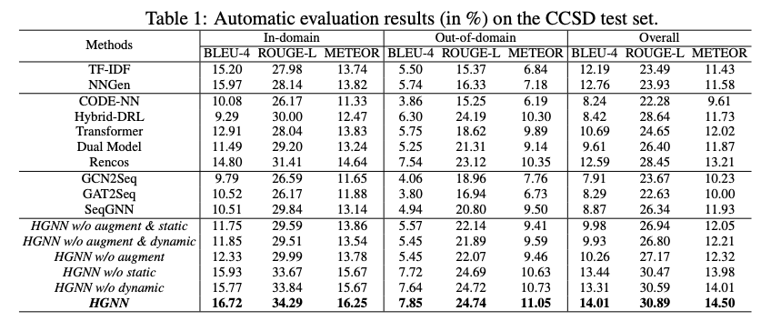
Experimental Results
Comparison with Baselines
Vs. Retrieval-based Approaches:
The retrieval-based approaches achieve competitive performance on BLEU-4 on in-domain dataset, however ROUGE-L and METEOR are fare less than ours. Moreover, they do not perform well on the out-of-domain dataset;
Vs. Generation-based Approaches:
Our approach outperforms (Sequence, Graph)-based
approaches;

Slide 15
Experimental Results
Ablation Study
HGNN vs. HGNN w/o augment
retrieval-augmented mechanism could contribute to
the overall model performance.
HGNN w/o static vs. HGNN w/o dynamic
Both static/dynamic graph is beneficial.

Slide 16

Experimental Results
Human Evaluation
Our method can generate better summaries which are more relevant with the source code and more similar with the ground-truth summaries.

Slide 17
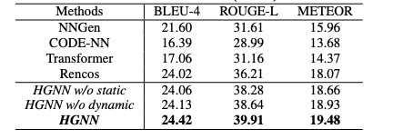
Experimental Results
Extension on the Python dataset
HGNN vs. Baselines
Our approach still outperforms current state-of-
the- art approaches.
HGNN w/o static vs. HGNN w/o dynamic
Both static/dynamic graph is beneficial.

Slide 18
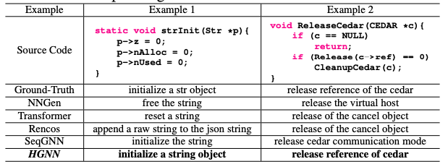
Experimental Results
Examples:
In the first example, our approach can learn more code semantics, i.e., p is a self-defined struct variable. Thus, we could generate a token object for the variable p.
Example 2 is a more difficult function with the functionality to “release reference of cedar”, as compared to other baselines, our approach effectively captures the functionality and generates a more precise summary.
More examples can be found in the Appendix E

Slide 19
Conclusion and Future Works
Conclusions:
We propose a general-purpose framework for automatic code summarization.
We develop a hybrid message passing GNN based on both static and dynamic graphs.
We release a new challenging C benchmark for the task of source code summarization.
Future works:
We plan to explore more code-based augmentation techniques.
We plan to introduce more information to learn better semantics of programs.

Slide 20
Thank You!

