Slide 1
Grey-Box Physics-Informed Networks for Payload-Conditioned Dynamics Learning and Control of a 7 DoF Manipulator
An automated pipeline from URDF file to controlled robot, and 1 kHz real-time control of a simulated Franka Emika Panda (Isaac Sim / MuJoCo)
Hugo Durieux
Master's research internship · University of Melbourne
Notes:
[0:00 – 0:20] Title slide.
Say who you are and the one-sentence framing: the input is a URDF file,
the output is a robot you can control in real time, and the contribution
sits in the dynamics model in between.
Do not read the title aloud.

Slide 2
MOTIVATION
A model that is exact — and still wrong
Torque-level control needs a faithful inverse dynamics model.
The URDF gives one for free: geometry and inertia, exactly.
But the rigid-body model knows nothing about:
  – dry and viscous friction in the harmonic drives
  – transmission compliance and mechanical backlash
  – actuator wear, and the payload the robot is carrying
Result: a systematic gap between predicted and measured torque — and it is largest exactly where precision matters.
2 / 15
Notes:
[0:20 – 1:20] The problem, in one idea.
The analytical model is not approximately right and slightly noisy — it is
structurally incapable of representing the effects that dominate at the
joint level. Emphasise: we are not trying to replace physics, we are trying
to complete it. That framing carries the whole talk.

Slide 3
POSITIONING
Objective and contributions
Goal: a pipeline whose only input is a URDF file and whose output is a trained, controllable robot.
Positioned against Liu, Borja & Della Santina (2024): same robot, same method class, same purpose.
1. An automated “URDF → model” pipeline with dissipation and payload conditioning in a grey-box architecture.
2. Controllers for real-time tracking at 1 kHz that exploit the learned model's structure, with hard physical guarantees.
3. Simulation and cross-simulator robustness evaluation on a 7-DoF manipulator.
3 / 15
Notes:
[1:20 – 2:20] What is claimed.
Three contributions, one per stage of the work. Say explicitly what is NOT
claimed: no new learning theory, no hardware results yet — everything is in
simulation, Isaac Sim for training and MuJoCo for deployment.

Slide 4

PRELIMINARIES
Rigid-body dynamics
M(q) inertia · C(q, q̇) Coriolis · G(q) gravity, n = 7 for the Panda.
Evaluated analytically by the recursive Newton–Euler algorithm (RNEA), through Pinocchio, straight from the URDF.
Never optimised, never relearned — this term is the white box.
4 / 15
Notes:
[2:20 – 3:10] Standard, move fast.
The audience knows this equation. The only point worth landing: RNEA is
evaluated, not fitted. Nothing in the training loop can change it, which is
what makes the guarantees downstream meaningful.

Slide 5
PRELIMINARIES
Why not a purely structural model?
Deep Lagrangian / Hamiltonian networks assume the non-conservative forces are fully known.
They learn the inertia matrix in Cholesky-factorised form — positive-definite by construction.
Two costs:
  – friction and compliance still have to come from somewhere
  – gravity and inertia are relearned, although the URDF already provides them exactly
Our position: keep what the description file already knows, learn only what it cannot express.
5 / 15
Notes:
[3:10 – 4:00] The design argument.
This is where you justify grey box over pure structure. The line to deliver
slowly is the last one: relearning gravity is not just wasted capacity, it
also throws away the automation — a structural model has to be re-derived
per robot, ours is generated from the URDF.

Slide 6
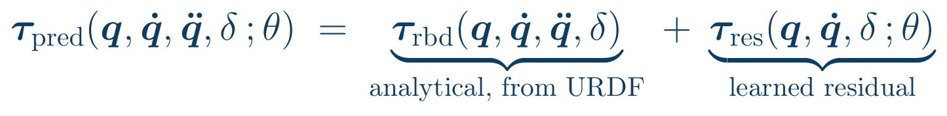
METHOD
The proposed hybrid model
The residual absorbs dissipation and modelling error only.
Conditioned on the carried payload δ — following Hu et al., backlash error depends on position and velocity, not on mass, so only the residual is conditioned.
τ_res does not depend on the acceleration q̈ → fast enough to query inside the control loop.
6 / 15
Notes:
[4:00 – 5:00] The core idea. Take your time here.
Point at the two braces. Then the real-time argument: q̈ is available offline
during training but never inside a 1 kHz loop, so excluding it from the
residual is a deployment requirement, not a modelling preference.

Slide 7
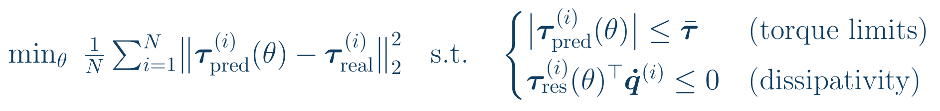
METHOD
Learning under hard physical constraints
Solved with an augmented Lagrangian and dual ascent — multipliers are optimised, not fixed penalty weights.
Minimising the mean squared error alone is not enough: a model can show an excellent mean error and absurd maxima (Deng et al.).
7 / 15
Notes:
[5:00 – 6:00] The constraints are the contribution, not the loss.
Two constraints: never command a torque the motor cannot deliver, and never
let the learned term inject energy. Anticipate the obvious question — "is
this a soft penalty?" — the answer is that dissipativity is additionally
guaranteed by construction in FrictionNet, coming on slide 9.

Slide 8
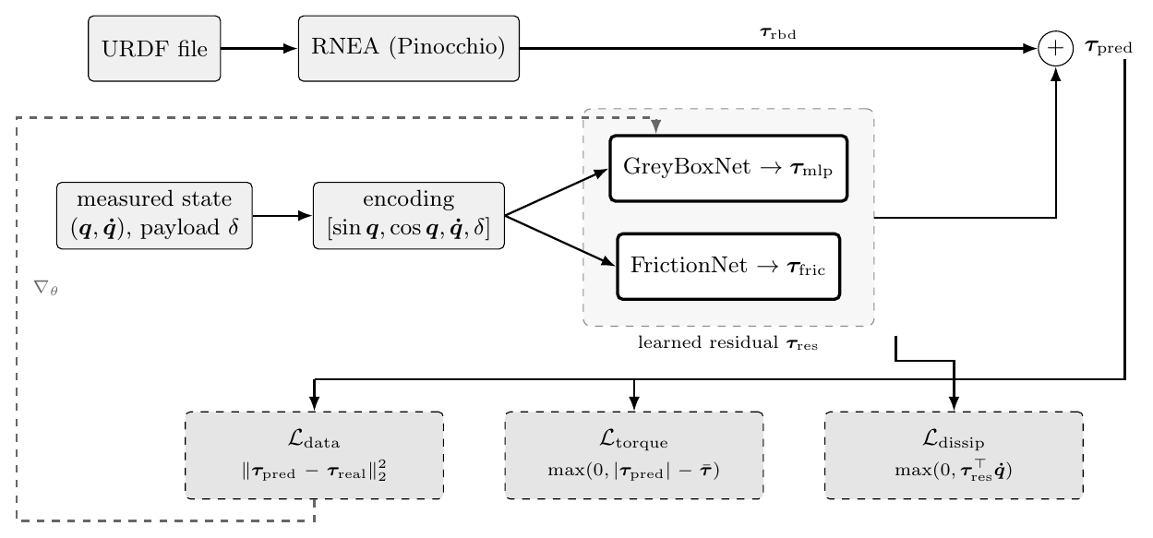
METHOD
Architecture and gradient flow
Grey background: computed from the URDF, no learning. Bold outline: learned. Dashed: loss terms and backpropagation.
8 / 15
Notes:
[6:00 – 7:00] One figure, one path through it.
Trace it left to right, once: URDF → RNEA → τ_rbd, and separately the
measured state → encoding → the two residual networks. They meet at the
sum. Then the losses at the bottom and the single gradient path — note that
the gradient reaches only the residual networks, never RNEA.

Slide 9
METHOD
Structure inside the residual
Input encoding x = [sin q, cos q, q̇, δ] — removes angular discontinuities, captures gearbox torque ripple.
Activation: Mish — C¹ continuous, so the commanded torque is smooth. Never ReLU.
FrictionNet guarantees dissipation by construction:
D positive-definite and diagonal ⇒ τ_fric·q̇ ≤ 0 for every input, with no reliance on the data.
9 / 15
Notes:
[7:00 – 8:00] Three degrees of guarantee.
Free (the MLP), imposed by the augmented Lagrangian (torque limits), and
structural (FrictionNet). Land the difference: the third one cannot fail on
unseen data, because it is a property of the function class, not of the fit.
This matters again on slide 14, where the accuracy gain turns out to be
small — the guarantee is the point, not the precision.

Slide 10
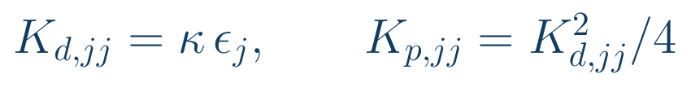
CONTROL
From model to torque, at 1 kHz
Gains bounded by the 99.9 % error quantile of the test set (ε_j), following Liu et al.:
Computed-torque feedforward + PD, implemented as a ROS2 node against the MuJoCo engine.
The model's own measured error sets the feedback gains — the learning result feeds the control design directly.
10 / 15
Notes:
[8:00 – 9:00] Closing the loop.
The one non-obvious point: ε_j is measured, not tuned. A better model gives
a smaller error bound, which gives lower gains, which gives a softer and
safer arm. If asked about the known weakness of this template — deriving Kp
from a stability lower bound means the best-modelled joints track worst —
say so plainly; it is a limitation of the template, not of the
implementation.

Slide 11
METHODS
Experimental design
Data: robot dynamics simulated in Isaac Sim.
  – Sobol sequences + Fourier series to excite the configuration space.
  – Samples clipped by the simulator are filtered out (|τ| ≤ 0.97 τ̄) so saturation is not learned.
  – Strict trajectory-wise partition — no leakage, so the test set measures extrapolation.
Baselines:
  – RNEA alone — the URDF, no learning at all.
  – Direct MLP — a black box of the same capacity predicting the full torque, trained with AdamW.
The black box is the control that tells us whether the physical prior is doing any work.
11 / 15
Notes:
[9:00 – 10:00] Protocol. Be crisp, this is a setup slide.
The two design decisions worth defending are the saturation filter (learning
a clipped torque would teach the network the simulator's limits, not the
robot's physics) and the trajectory-wise split (a random split lets
neighbouring timesteps of the same trajectory land on both sides, which
makes any model look good).

Slide 12
RESULTS
Prediction error against the baselines
Model | Mean RMSE [N·m] | Worst joint [N·m] | Over torque limit | Guarantees
RNEA alone (analytical) | 1.456 | 2.841 | 0.99 % | none
Direct MLP (black box) | 1.847 | 4.120 | 1.24 % | limits (penalty)
Grey box (proposed) | 0.624 | 1.022 | 0.00 % | limits + dissipativity
The black box fails to extrapolate to unseen trajectories — no acceleration input, no physical prior.
The grey box divides the analytical model's error by more than two, and violates no torque limit where the analytical model violates on 0.99 % of samples.
12 / 15
Notes:
[10:00 – 11:30] The headline. Slow down.
Read the table by column, not by row: accuracy first, then the guarantee
column, which is the one the black box cannot fill in. If asked how the
split was made, be ready to explain the partition precisely — this is the
question most likely to come.

Slide 13
RESULTS
Per-joint analysis: an honest caveat
Test RMSE [N·m] | J1 | J2 | J3 | J4 | J5 | J6 | J7
RNEA alone | 1.588 | 2.841 | 1.824 | 1.953 | 0.883 | 1.062 | 0.042
Grey box (proposed) | 1.022 | 0.935 | 0.553 | 0.843 | 0.371 | 0.355 | 0.288
Large joints: the residual compensates the analytical model drastically — J2 falls 2.841 → 0.935 N·m.
J7, the wrist roll: RNEA is already excellent (0.042), and the residual makes it 6.9× worse.
Cause: an unweighted global loss gives the network no incentive to keep a zero residual where zero is the right answer.
Fix, and it is future work: a diagonal weighting matrix in the loss.
13 / 15
Notes:
[11:30 – 13:00] Report the negative result yourself, before anyone finds it.
This slide earns credibility for the whole talk. The mechanism is worth one
sentence: the loss aggregates over joints, so a joint contributing almost
nothing to the total has almost no gradient pressure to stay at zero.
Say clearly that this is a limitation you measured, not one you were told.

Slide 14
RESULTS
Ablation and cross-simulator transfer
Ablating FrictionNet costs only 1.4 % of accuracy (vs 0.624 N·m).
  – Its value is not precision — it is the formal dissipativity guarantee, which is what certification of a collaborative robot asks for.
Closed loop: control law at 1 kHz, ROS2 node against MuJoCo, while the model was trained under Isaac Sim.
  – Disabling the learned residual halves the Cartesian error instantly.
  – The Isaac-trained residual is being evaluated out of distribution: it adds a gap that the new engine does not have.
This isolates the cost of domain transfer, and motivates a fine-tuning protocol (frozen backbone, Duong et al.).
14 / 15
Notes:
[13:00 – 14:00] Two results that both cut against the naive story.
Frame the transfer result carefully and defensively: it does NOT show that
the grey-box approach fails. It shows that a residual learned on one physics
engine does not transfer unchanged to another — which is exactly what a
residual is supposed to be sensitive to. It also gives the fine-tuning work
a measured baseline to beat.

Slide 15
WRAP-UP
Conclusion
A URDF file in, a payload-conditioned dynamics model out, with torque limits and dissipativity guaranteed rather than hoped for.
Error of the analytical model cut by more than half, with zero torque-limit violations.
Good enough for feedforward control: a plain PD on top runs the arm at 1 kHz.
Next:
  – frozen-backbone fine-tuning on data from the physical Franka
  – a diagonal weighting matrix in the loss, to stop the residual degrading the joints that were already right
Thank you — questions welcome.
15 / 15
Notes:
[14:00 – 15:00] Land it, then stop talking.
Three sentences: what was built, what it measured, what is next. Do not
introduce anything new here.
Likely questions to have ready: why not train on the real robot (no hardware
access during the internship); why grey box rather than black box (the
guarantee column and the URDF automation, not raw accuracy); how the split
was made; what happens to J7.

