Slide 1
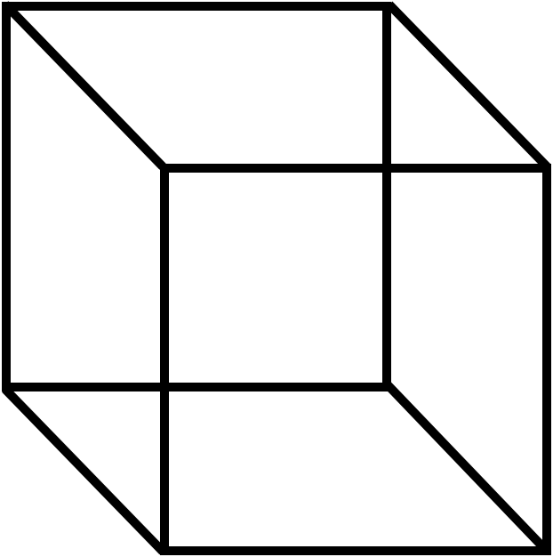
3D Animation of Barendregt’s Lambda Cube
Level 4 Project, Hugo Findlay / 2554911f

Slide 2
Agenda
Background about the Lambda Cube
Technology which I used to implement my design
Details about my Design
Highlights from the implementation
User Trials I ran and what I was able to learn from them
Site Walkthrough
Summary

Slide 3
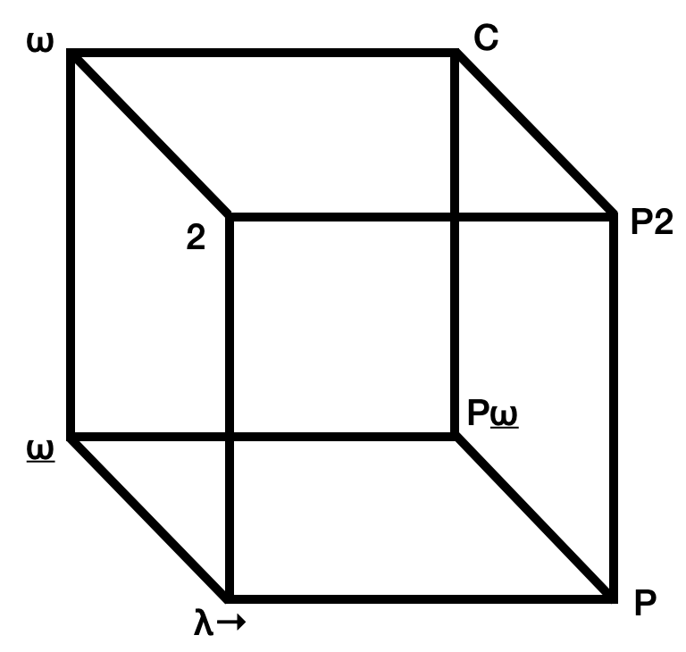
What my project was
The Lambda Cube is a logical framework introduced in 1991 by Henk Barendregt. It describes the way that three type systems, Polymorphic types, Dependent types and Type operators, can be added to the untyped lambda calculus in any combination to extend its capability.
There are currently few resources available online which discuss the Lambda Cube, and my project was an attempt to remedy this, while taking advantage of the web as an interactive medium. This would be achieved through an animated 3D representation, where a user could chose to zoom in on a node to learn more information

Slide 4
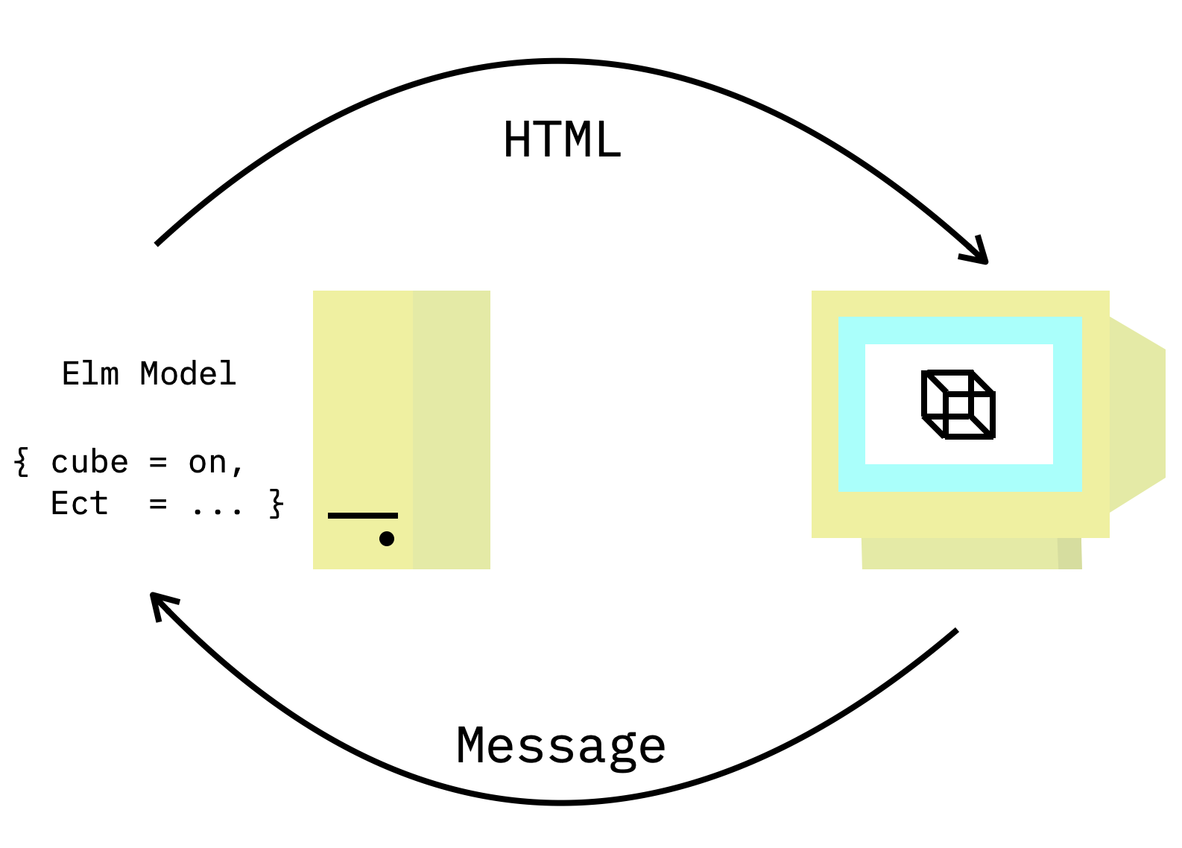
Technology
I chose to use Elm to create the website in, which is a strongly typed functional language. It also based on the Polymorphic lambda calculus, and I am interested in functional languages.
Elm works on a ‘Model-View-Update’ architecture: The model stores the website’s state, a view function uses it to render HTML, and the model can be updated by elements in the rendered HTML sending messages to the model.
I used WebGL to render the cube, and made my own latex to elm compiler to write the EBNF syntax equations needed.
As well as designing and programming the website, I had to spend a lot of time researching the systems which comprise the Lambda Cube, as there is no good centralised resource for information about the cube.

Slide 5
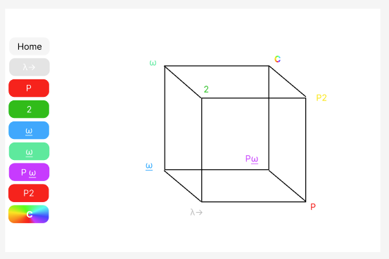
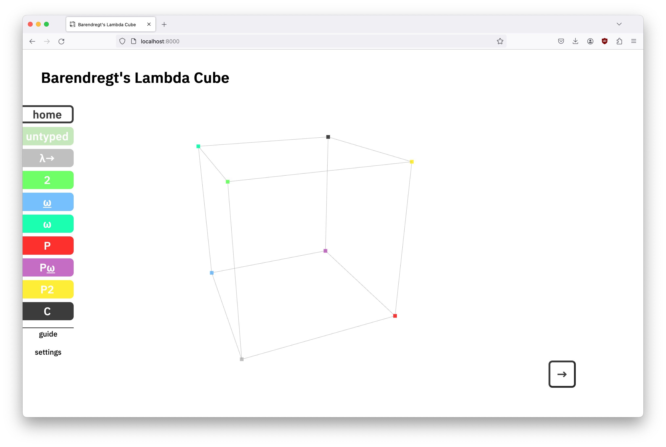
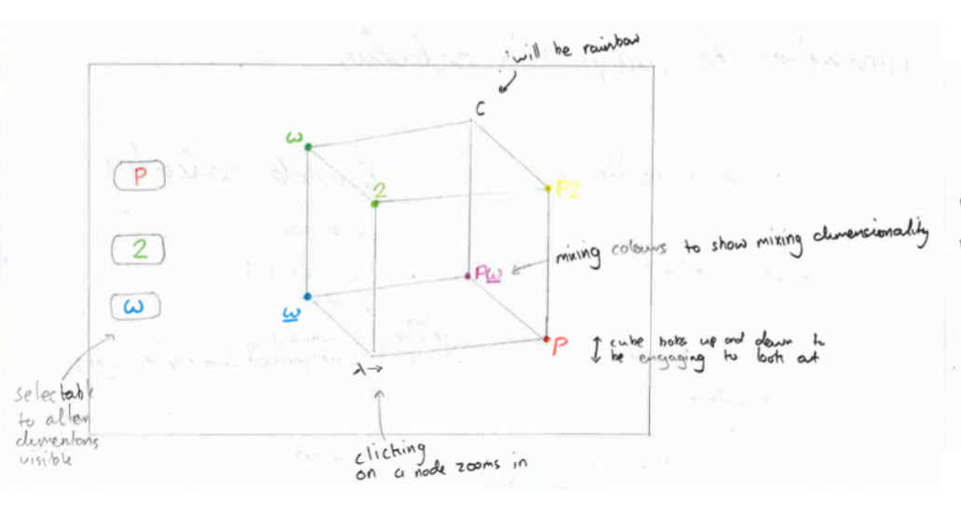
Design
I designed the first versions of the website on paper, before moving on to using Figma to prototype my designs further.
The Main problems I had with the design of the website were having enough space on the page to display all the relevant information, and building recognition of the specific systems in the user. I solved these with themed text boxes and by relating each specific set of type rules with a colour
Paper version
Figma Version
Final Website

Slide 6
Implementation
The model of the Elm program I created is very slim, with only 9 variables. Most of the state of the website is derived from the ‘system’ field, which is set to a custom type representing each of the 9 possible camera positions
I rendered the cube in real time using WebGL, and had the camera move smoothly to zoom in on different points with a linear interpolation
I implemented the translator using Deno, which is a JavaScript runtime. The translator I created is specific to my project, as it creates files which follow a specific template with the imports I needed
As the website was planned to be used by the School of Computing Science, I created a test deployment to GitHub pages to test how this would be done in practice

Slide 7
User Trials
In order to test how effective my website was at teaching the lambda cube, I ran a user trial using students who had previously studied the Programming Languages course last year.
The study I ran was in two parts: Firstly the user would be given the website to explore, while I took notes and answered any questions they had. Then, the user would be given a questionnaire to complete, with questions designed to test how effective the website was at explaining the information
From this study, I was able to find several ways that the website was deficient, and set about implementing fixes to these problems. The most Interesting changes I made were to add a colourblind mode and a system to guide a user through the systems in a pre determined order
In order to implement the colour blind mode, I used the Html.WithContext package to be able to get and update CSS variables, and use these values to change the colours between normal and safe

Slide 8
Summary
The Lambda Cube is a relatively unknown but important concept for Theoretical Programming, which deserves better representation on the internet.
I believe that my website was successful in using the interactivity offered by modern web frameworks to make learning about the Lambda Cube more engaging to a modern audience.
I conducted user studies to see where I could make my website even better, and was able to use these to refine my project, and make it more accessable to a wider range of potential students.

Slide 9
Thanks for Watching!

