Slide 1
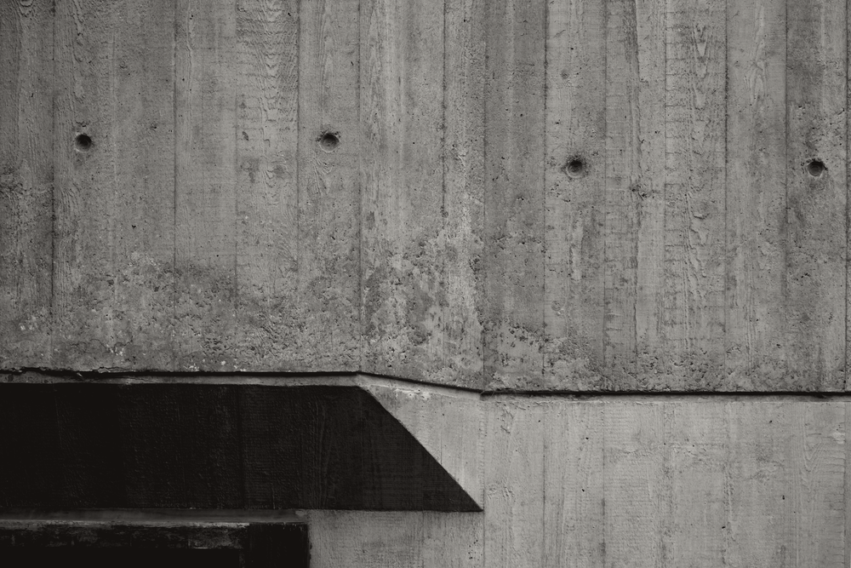
BRUTALIST ARCHITECTURE · A FIELD GUIDE
01
CONCRETE, HONEST, UNFORGIVING
THE CLAIM
minimalist construction showcasing the bare building materials and structural elements over decorative design
© Tom Parnell / Wikimedia Commons / CC BY-SA 4.0
ACTIVE 1950s – EARLY 1980s · INTERNATIONAL
FIELD GUIDE · No 01
Notes:
Concrete, honest, unforgiving. Those three words are not an insult here — they are close to what the movement asked to be judged by. Brutalist architecture is a style that emerged in the nineteen fifties in the United Kingdom, among the reconstruction projects of the post-war era, and it stayed active until the early nineteen eighties, across every continent. The claim printed on the ink block is the source's own definition: minimalist construction showcasing the bare building materials and structural elements over decorative design. Hold on to that sentence, because everything that follows — the arguments for the style and the campaigns to demolish it — comes out of it. The photograph on the right is not a building, it is a wall: board-marked concrete, the surface this guide is really about.

Slide 2
PART ONE · THE WORD
02
1950: a name for a house in Kåbo
1950
What it showed was the "as found" approach that would later sit at the core of brutalism: the building was allowed to say what it was made of, and no finish was added to soften the answer.
THE FIRST USE
Villa Göth was listed as historically significant by the Uppsala county board on 3 March 1995 — the house that named the movement outlived most of the towers built in its name.
The word arrived before the concrete. The Swedish architect Hans Asplund coined the term nybrutalism — new brutalism — to describe Villa Göth, a modern brick home in Uppsala.
01
visible I-beams over the windows
The house was designed in January 1950 by Bengt Edman and Lennart Holm, contemporaries of Asplund. Nothing about it was monumental.
02
exposed brick, inside and out
03
poured concrete keeping the tongue-and-groove pattern of its forms
BRUTALIST ARCHITECTURE · A FIELD GUIDE
02 / 16
Notes:
The word arrived before the concrete, and it arrived in Sweden. The architect Hans Asplund coined the term nybrutalism — new brutalism — to describe Villa Göth, a modern brick home in Uppsala, designed in January nineteen fifty by his contemporaries Bengt Edman and Lennart Holm. There is no tower here, no raw concrete slab, no social housing. What the house had was the as-found approach that would later sit at the core of the movement: visible I-beams over the windows, exposed brick inside and out, and poured concrete keeping the tongue-and-groove pattern of the boards that formed it. Nothing was covered up, and nothing was smoothed. It is worth noting that the house outlived most of the towers built in its name — it was listed as historically significant by the Uppsala county administrative board on the third of March, nineteen ninety-five.

Slide 3
PART ONE · THE WORD
03
Then it spread like wildfire
1950
English architects visiting Sweden — Michael Ventris, Oliver Cox, Graeme Shankland — carry the term home, where it "spread like wildfire".
1953
Alison Smithson puts "new brutalism" in print for the first time, describing the unbuilt Soho house in Architectural Design.
It is our intention in this building to have the structure exposed entirely, without interior finishes wherever practicable.
1954
Hunstanton School completes in Norfolk: the first finished building in the world its own architects called "new brutalist".
— ALISON SMITHSON, 1953
1955
The Sugden House completes in Watford. Hunstanton was likely inspired by Mies van der Rohe's 1946 Alumni Memorial Hall in Chicago.
BRUTALIST ARCHITECTURE · A FIELD GUIDE
03 / 16
Notes:
From one Swedish house the term travelled fast. In the summer of nineteen fifty a group of visiting English architects, including Michael Ventris, Oliver Cox and Graeme Shankland, picked it up, and it spread, in the phrase recorded at the time, like wildfire among a certain faction of young British architects. Three years later Alison Smithson put new brutalism into print for the first time, describing an unbuilt house in Soho in the November issue of Architectural Design, with the intention she stated plainly in the box on the right: to have the structure exposed entirely, without interior finishes wherever practicable. In nineteen fifty-four Hunstanton School completed in Norfolk — the first finished building anywhere that its own architects called new brutalist, and described at the time as the most truly modern building in England. The Sugden House followed in Watford a year later. Hunstanton itself was likely inspired by Mies van der Rohe's nineteen forty-six Alumni Memorial Hall in Chicago, so even the first brutalist building had a modernist parent.

Slide 4
PART ONE · THE WORD
04
Raw concrete, raw art
Reyner Banham, British architectural historian, used "new brutalism" to identify both an ethic and an aesthetic in his 1955 essay The New Brutalism.
THE CRITIC NAMES THE MATERIAL
béton brut
RAW CONCRETE
art brut
He named Hunstanton and the Soho house as "the reference by which The New Brutalism in architecture may be defined".
RAW ART
He expanded the argument in his 1966 book The New Brutalism: Ethic or Aesthetic?
"if there is one single verbal formula that has made the concept of Brutalism admissible in most of the world's Western languages, it is that Le Corbusier himself described that concrete work as 'béton-brut'"
— REYNER BANHAM, 1966
BRUTALIST ARCHITECTURE · A FIELD GUIDE
04 / 16
Notes:
So where did the concrete come from? From a critic. Reyner Banham, a British architectural historian, used new brutalism to identify both an ethic and an aesthetic style in his nineteen fifty-five essay, naming Hunstanton and the Soho house as the reference by which the new brutalism in architecture may be defined. He also tied the term to two French phrases: art brut, raw art, and béton brut, raw concrete. Eleven years later, in his book The New Brutalism: Ethic or Aesthetic?, he explained why that second phrase stuck. If there is one single verbal formula that has made the concept of brutalism admissible in most of the world's Western languages, he wrote, it is that Le Corbusier himself described that concrete work as béton-brut. That is the whole origin of the association most people now take for granted: the material got attached to the movement through a critic quoting an architect about somebody else's concrete.

Slide 5
PART TWO · THE ETHIC
05
"An ethic, not an aesthetic"
New brutalism was never only a style. It was a philosophical approach to design — a striving to create simple, honest, functional buildings that accommodate their purpose, inhabitants and location, a strict modernist language set against the retrospective nostalgia of much 1940s architecture.
BANHAM'S THREE TERMS
1
formal legibility of plan
2
clear exhibition of structure
Peter Smithson held that the core of brutalism was a reverence for materials, expressed honestly: "Brutalism is not concerned with the material as such but rather the quality of material", and "the seeing of materials for what they were: the woodness of the wood; the sandiness of sand".
3
valuation of materials for their inherent qualities
"as found"
an ethic, not an aesthetic
John Voelcker said the new brutalism "cannot be understood through stylistic analysis, although some day a comprehensible style might emerge" — supporting the Smithsons' description of the movement as an ethic, not an aesthetic.
Banham also required the aesthetic "image" — the coherence of the building as a visual entity.
BRUTALIST ARCHITECTURE · A FIELD GUIDE
05 / 16
Notes:
This is the page where the movement defines itself, and it does so as a moral position rather than a look. New brutalism was a philosophical approach to design — a striving for simple, honest, functional buildings that accommodate their purpose, inhabitants and location, and a strict modernist language set against the retrospective nostalgia of much nineteen forties architecture. Peter Smithson put the heart of it in two sentences: brutalism is not concerned with the material as such but rather the quality of material, and the seeing of materials for what they were — the woodness of the wood, the sandiness of sand. John Voelcker agreed that the movement could not be understood through stylistic analysis at all, supporting the Smithsons' own description of it as an ethic, not an aesthetic. Banham then did something useful with that: he turned the ethic into three testable conditions. Formal legibility of plan. Clear exhibition of structure. Valuation of materials for their inherent qualities, as found. He added a fourth consideration, the aesthetic image — the coherence of the building as a visual entity. Keep those three numbered terms; we come back to them at the end.

Slide 6
PART TWO · THE ETHIC
06
The grain of the formwork stays in the wall
CONCRETE
BRICK
GLASS
STEEL
TIMBER
ROUGH-HEWN STONE
GABIONS
Raw concrete is often used because of its low cost, and then left to reveal the basic nature of its construction — rough surfaces carrying the wood "shuttering" pattern produced when the forms were cast in situ.
Buildings are constructed with recurring modular elements representing specific functional zones, distinctly articulated and grouped into a unified whole.
Emphasis falls on graphic expression in the external elevations and in the whole-site plan, in regard to the main functions and people-flows of the building.
The style commonly uses exposed, unpainted concrete or brick, angular geometric shapes and a predominantly monochrome colour palette; steel, timber and glass also feature.
Examples are frequently massive in character even when not large, and challenge traditional notions of what a building should look like, with focus given to interior spaces as much as exterior.
BRUTALIST ARCHITECTURE · A FIELD GUIDE
06 / 16
Notes:
Now the material itself. Brutalist buildings can use concrete, brick, glass, steel, timber, rough-hewn stone, even gabions — but raw concrete dominates, and the reason is prosaic: it is cheap. It is then left to reveal the basic nature of its construction, which is why the surface is rough and why the wood shuttering pattern is still legible in the wall. That pattern is the imprint of the boards used to build the forms the concrete was cast into, on site. Nobody polished it off, because polishing it off would be the dishonest move. Two other habits follow from the same logic. Buildings are made from recurring modular elements that represent specific functional zones, distinctly articulated and grouped into a unified whole; and there is often an emphasis on graphic expression, in the elevations and in the whole-site plan, in regard to the main functions and people-flows of the building. The results are frequently massive in character even when they are not large, and they challenge traditional notions of what a building should look like, with as much attention given to interior space as to exterior.

Slide 7
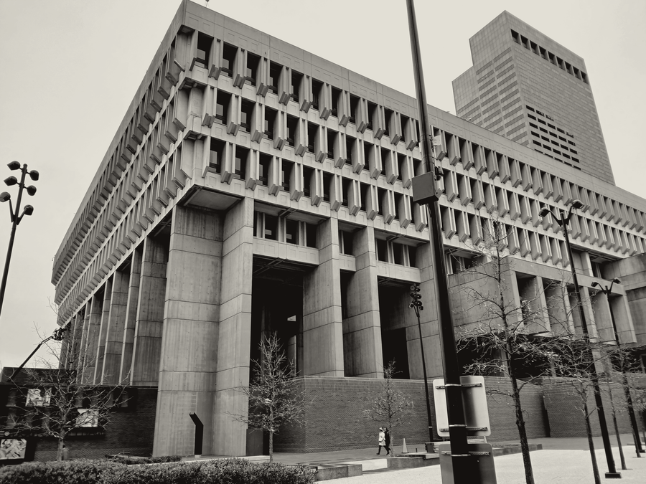
PART TWO · THE ETHIC
07
A façade that admits what it is doing
A common theme is the exposure of the building's inner workings — structure, services and human use — on the exterior.
EXAMPLE ONE · BOSTON
Boston City Hall, designed in 1962: the strikingly different and projected portions of the building indicate the special nature of the rooms behind those walls, such as the mayor's office or the city council chambers.
Hunstanton School put the facility's water tank — normally a hidden service feature — in a prominent, visible tower. Its water and electric utilities were delivered via readily visible pipes and conduits rather than hidden in the walls.
© Epicgenius / Wikimedia Commons / CC BY-SA 4.0
BRUTALIST ARCHITECTURE · A FIELD GUIDE
07 / 16
Notes:
If the material is honest, the plan should be too. A common theme in brutalist design is the exposure of the building's inner workings — structure, services, and human use — on the exterior, so that the façade reports what is happening behind it. Boston City Hall, designed in nineteen sixty-two, is the clearest case: the strikingly different and projected portions of the building indicate the special nature of the rooms behind those walls, such as the mayor's office or the city council chambers. You can read the plan off the elevation. Hunstanton School did the same thing with services rather than rooms. The water tank, normally a hidden feature, was put in a prominent visible tower, and the water and electric utilities were delivered by readily visible pipes and conduits instead of being buried in the walls. Two different buildings, one principle: put the thing on the outside.

Slide 8
PART TWO · THE ETHIC
08
Concrete was the point, not the compromise
Brutalism as an architectural philosophy was often associated with a socialist utopian ideology, supported by its designers and especially by Alison and Peter Smithson near the height of the style. Their work sought to connect architecture with what they saw as the realities of modern life.
MID-1960s TO LATE 1980s
BULGARIA
CZECHOSLOVAKIA
EAST GERMANY
Among their early contributions were "streets in the sky", in which traffic and pedestrian circulation were rigorously separated — a theme popular in the 1960s. In Britain the style featured in utilitarian, low-cost social housing influenced by socialist principles, and spread from there to other regions.
USSR
YUGOSLAVIA
Brick brutalism, or "brickalism", is the sub-genre where brick dominates instead of concrete — from the Smithsons' Soho house (1952) to Colin St John Wilson's British Library (1982–1998).
In Czechoslovakia it was presented as an attempt at a "national" but also "modern socialist" style; such prefabricated socialist-era buildings are called panelaky.
TRADITIONAL STYLES BELONGED TO THE BOURGEOISIE —
concrete emphasised equality
BRUTALIST ARCHITECTURE · A FIELD GUIDE
08 / 16
Notes:
There is a politics attached to all of this. Brutalism as an architectural philosophy was often associated with a socialist utopian ideology, and that association was supported by its designers — especially by Alison and Peter Smithson near the height of the style. Their work sought to connect architecture with what they saw as the realities of modern life, and among their early contributions were streets in the sky, where traffic and pedestrian circulation were rigorously separated, a theme that stayed popular through the nineteen sixties. In Britain the style featured in utilitarian, low-cost social housing influenced by socialist principles, and spread from there to other regions. It held a strong position in the architecture of European communist countries from the mid-nineteen sixties to the late nineteen eighties: Bulgaria, Czechoslovakia, East Germany, the Soviet Union, Yugoslavia. In Czechoslovakia it was presented as an attempt at a national but also modern socialist style, and the prefabricated buildings of that era are called panelaky. The reason for that popularity is the line on the black band: traditional styles were associated with the bourgeoisie, whereas concrete emphasised equality. And a footnote worth keeping — there is a sub-genre, brick brutalism or brickalism, where brick rather than concrete dominates, running from the Smithsons' Soho house of nineteen fifty-two to Colin St John Wilson's British Library, built between nineteen eighty-two and nineteen ninety-eight.

Slide 9
PART THREE · THE BUILDINGS
09
Eight countries, one language of concrete
COUNTRY
ARCHITECTS AND THE WORKS THE SOURCE NAMES
UNITED KINGDOM
Alison and Peter Smithson (pioneers) · Ernő Goldfinger · Chamberlin, Powell and Bon (Barbican) · Denys Lasdun (National Theatre) · Norman Engleback (Hayward Gallery) · Basil Spence · Owen Luder
John Bancroft · Leslie Martin · James Stirling with James Gowan · LCC/GLC Architects Dept
UNITED STATES
Evans Woollen III (brought the style to Indianapolis) · Walter Netsch (academic buildings) · Marcel Breuer (curves, not corners) · Eero Saarinen (Milwaukee County War Memorial, 1957) · Ted Levy (Plaza Towers, Atlanta) · Louis Kahn, opposed to its posturing yet informed by it
AUSTRALIA
Robin Gibson (Queensland Art Gallery) · Ken Woolley (Fisher Library, Sydney) · Christopher Kringas (High Court of Australia) · John Andrews · Daryl Jackson and Kevin Borland (Harold Holt Memorial Swimming Centre, Malvern, 1967)
CANADA
Arthur Erickson (Simon Fraser University, MacMillan Bloedel Building, UBC Museum of Anthropology, Vancouver Law Courts) · Green Blankstein Russell (Winnipeg Civic Centre) · Waisman Ross Blankstein Coop Gillmor Hanna (Manitoba Students' Union; Royal Manitoba Theatre Centre)
ARGENTINA
Clorindo Testa (Banco de Londres y América del Sur; National Library of Argentina) · Federico Peralta Ramos (Entel building)
SERBIA
Božidar Janković (the “Belgrade School of residence”) · Mihajlo Mitrović (Western City Gate / Genex Tower, 1977)
VIETNAM
Garol Isakovich (Vietnam-Soviet Friendship Palace of Culture and Labour, 1985) · Ngô Viết Thụ (Independence Palace, 1966)
BOSNIA AND HERZEGOVINA
Slobodan Jovandić (Hotel Internacional; the residential building Lamela — both in Zenica)
BRUTALIST ARCHITECTURE · A FIELD GUIDE
09 / 16
Notes:
This table is the answer to the assumption that brutalism was a British problem. Within about two decades the same language of concrete was being spoken in at least eight countries, and the source names the architects. In Britain the pioneers are Alison and Peter Smithson, with Ernő Goldfinger, Chamberlin, Powell and Bon at the Barbican, Denys Lasdun at the National Theatre, Norman Engleback at the Hayward Gallery, and the London County Council architects' department behind a great deal of the rest. In the United States Evans Woollen the third brought the style to Indianapolis, Walter Netsch built academic buildings with it, and Marcel Breuer softened it with curves instead of corners — while Louis Kahn, who was opposed to what he saw as the muscular posturing of most brutalism, was nonetheless informed by some of the same ideas. Australia and Canada each produced whole institutional programmes; Clorindo Testa carried it in Argentina, Mihajlo Mitrović in Serbia, Garol Isakovich in Vietnam during the subsidy era, and Slobodan Jovandić in Bosnia and Herzegovina. The point of the grid is the spread, not the individual row.

Slide 10
PART THREE · THE BUILDINGS
10
The universities built them first, and biggest
BRITAIN, EARLY
THE NEW UNIVERSITIES
AMERICA AND BEYOND
The 'beehives' at St John's College, Oxford (Michael Powers, Architects' Co- Partnership, 1958–60).
Basil Spence's Grade I Falmer House at Sussex (1960–62), a “meeting of Arts and Crafts with modernism” — hand-made bricks and colonnades of board-marked concrete arches inspired by the Colosseum.
Paul Rudolph's Art and Architecture Building at Yale (1963), where as department chair he was both client and architect. His 1964 UMass Dartmouth is a rare entire campus in the style.
The 1959 architecture department extension at Cambridge under Leslie Martin, by Colin St John Wilson and Alex Hardy with student participation — it inspired the Grade II listed University Centre.
William Pereira's Geisel Library at UC San Diego (1969–70), “a fascinating nexus between brutalism and futurism” — intended in steel and glass until cost moved the structure outside.
Denys Lasdun's 'ziggurats' at UEA
(1968): six linked halls in Norfolk Terrace, four in Suffolk Terrace, with the library and teaching wall between them.
Stirling's Red Trilogy: Leicester Engineering with James Gowan (1959–63), often called Britain's first postmodern building; the Grade II* History Faculty, Cambridge (1964–67); the Florey Building, Oxford (1966–71).
Robarts Library, Toronto (Warner, Burns, Toan and Lunde, 1968–73), condemned on opening as “a blunder on the grandest scale”.
Ove Arup's Grade I Kingsgate Bridge at Durham (1963) and Dunelm House (1964–66), saved from demolition in 2021 after a five-year campaign.
STILL CLOSED —
The UEA ziggurats closed in 2023 in the reinforced autoclaved aerated concrete crisis, with no refurbishment date set as of February 2025.
BRUTALIST ARCHITECTURE · A FIELD GUIDE
10 / 16
Notes:
The largest single patron of brutalism was not the housing authority. It was the university. In Britain the earliest examples are the beehives at St John's College, Oxford, and the nineteen fifty-nine architecture department extension at Cambridge under Leslie Martin, designed by Colin St John Wilson and Alex Hardy with the students taking part, which then inspired the listed University Centre. James Stirling's Red Trilogy runs through the same decade: the Leicester Engineering Building with James Gowan, sometimes called Britain's first postmodern building; the History Faculty at Cambridge; and the Florey Building at Oxford. Then the new universities gave brutalist architects whole sites. Basil Spence's Falmer House at Sussex is listed Grade One and was described as a meeting of Arts and Crafts with modernism, with hand-made bricks and colonnades of bare board-marked concrete arches inspired by the Colosseum. Denys Lasdun's ziggurats at East Anglia — six linked halls in Norfolk Terrace, four in Suffolk Terrace, with the library and teaching wall between them — are considered one of the finest brutalist campuses of the decade. At Durham, Ove Arup's Kingsgate Bridge is one of only six post-nineteen sixty-one buildings listed Grade One by twenty seventeen, and Dunelm House was saved from demolition in twenty twenty-one after a five-year campaign. America has Paul Rudolph at Yale, where as department chair he was both client and architect, and William Pereira's Geisel Library, which was meant to be steel and glass until cost pushed the structure outside in concrete. And then the black band: the ziggurats closed in twenty twenty-three during the reinforced autoclaved aerated concrete crisis, with no refurbishment date set as of February twenty twenty-five. Even the finest examples are not safe from their own material.

Slide 11
PART THREE · THE BUILDINGS
11
117 metres of Belgrade
The Western City Gate — also known as the Genex Tower — in Belgrade, Serbia.
36
117
1977
STOREYS
METRES · 384 FT
MIHAJLO MITROVIĆ
Formed by two towers connected with a two- storey bridge, with a revolving restaurant at the top. With the restaurant it reaches 135–140 m (443–459 ft).
NO DATA
The source calls the Genex Tower the second-tallest high-rise in Belgrade, after Ušće Tower — but gives no height for it. The gap is printed, not estimated.
Considered a prime representative of the style in Serbia, and one of the best built anywhere in the 1960s and 1970s.
BRUTALIST ARCHITECTURE · A FIELD GUIDE
11 / 16
Notes:
To feel the scale the movement worked at, take one building. Mihajlo Mitrović designed the Western City Gate in Belgrade in nineteen seventy-seven — better known as the Genex Tower. Thirty-six storeys. One hundred and seventeen metres, or three hundred and eighty-four feet, rising to between one hundred and thirty-five and one hundred and forty metres with the revolving restaurant at the top. It is formed by two towers joined by a two-storey bridge, designed in the brutalist style with elements of structuralism and constructivism, and it is considered a prime representative of the style in Serbia and one of the best built anywhere in the nineteen sixties and seventies. There is one thing this page deliberately does not tell you. The source calls the Genex Tower the second-tallest high-rise in Belgrade, after the Ušće Tower, but it gives no height for the Ušće Tower. So the comparison is printed as no data rather than estimated. That is a rule this guide follows throughout: where the article states no figure, the page says so.

Slide 12
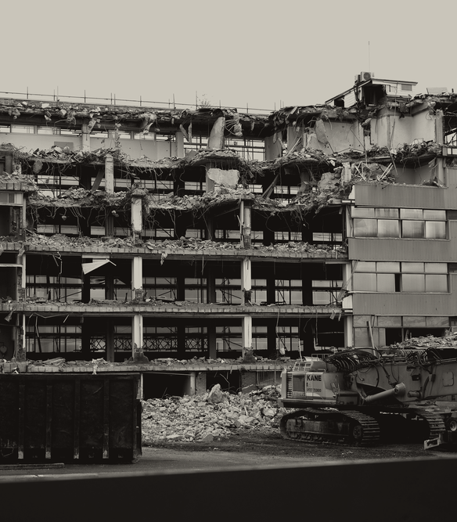
PART FOUR · THE RECKONING
12
The public verdict
Few styles in history can have been met with so many pleas from its users to see it destroyed.
— SIMON JENKINS
A 2014 article in The Economist noted that a campaign to demolish a building will usually be directed against a brutalist one.
8
In 2005 the British TV programme Demolition ran a public vote to select twelve buildings that ought to be demolished — eight of those selected were brutalist.
Concrete façades do not age well in damp maritime climates: water stains, moss and lichen, rust from the reinforcing bars. Critics add the "cold" look and an air of totalitarianism.
The Queen Elizabeth Square flats in Glasgow (1962) were demolished in 1993.
BRUTALIST ARCHITECTURE · A FIELD GUIDE
12 / 16
Notes:
And then the public turned. Simon Jenkins put it most sharply: few styles in history can have been met with so many pleas from its users to see it destroyed. The Economist made the same observation in twenty fourteen, noting that a campaign to demolish a building will usually be directed against a brutalist one. The most concrete evidence is a television programme. In two thousand and five the British series Demolition ran a public vote to choose twelve buildings that ought to be pulled down, and eight of the twelve selected were brutalist. Part of the case against the style is not aesthetic at all, it is chemical. Concrete façades do not age well in damp, cloudy maritime climates like north-western Europe and New England: the surface streaks with water stains, sometimes moss and lichen, and rust from the steel reinforcing bars bleeds through. On top of that, critics object to the cold appearance and an atmosphere they read as totalitarian. The photograph is what that verdict looks like when it is carried out — and the Queen Elizabeth Square flats in Glasgow, built in nineteen sixty-two, were demolished in nineteen ninety-three.

Slide 13
PART FOUR · THE RECKONING
13
The score sheet
BUILDING
ARCHITECT
YEAR
OUTCOME
DEMOLISHED
Tricorn Centre, Portsmouth
Owen Luder and Rodney Gordon
2004
Demolished
Third Church of Christ, Scientist, D.C.
Araldo Cossutta
2014
Demolished
Birmingham Central Library
John Madin
2016
Demolished
Robin Hood Gardens, East London
Alison and Peter Smithson
2017
Demolished
Welbeck Street car park, London
NO DATA
2019
Demolished
American Press Institute, Reston VA
Marcel Breuer
NO DATA
Demolished
SAVED OR LISTED
Villa Göth, Uppsala
Bengt Edman and Lennart Holm
1995
Listed by Uppsala county
Preston bus station garage
NO DATA
2013
Grade II listed
Dunelm House, Durham
Architects' Co-Partnership
2021
Saved, 5-year campaign
Southbank Centre, London
NO DATA
2026
Grade II listed
The Twentieth Century Society lost the Tricorn and Trinity Square, and won Preston and the Southbank.
NO DATA = A FACT THE SOURCE DOES NOT GIVE
13 / 16
Notes:
Here is the record, and it runs in both directions at once. On the demolished side: the Tricorn Centre by Owen Luder and Rodney Gordon in two thousand and four; the Third Church of Christ, Scientist in Washington in twenty fourteen; John Madin's Birmingham Central Library in twenty sixteen; the Smithsons' own Robin Hood Gardens in twenty seventeen; and the Welbeck Street car park in twenty nineteen. Marcel Breuer's American Press Institute building in Reston is also gone, though the source gives no year, so the cell says no data — as it does for the architects the article never names. On the saved side, over exactly the same decades: Villa Göth listed in nineteen ninety-five; Preston bus station garage listed Grade Two in twenty thirteen after two failed demolition proposals; Dunelm House saved in twenty twenty-one; and the Southbank Centre, including the Queen Elizabeth Hall and the Hayward Gallery, listed in twenty twenty-six after a thirty-five year campaign. The Twentieth Century Society lost the Tricorn and Trinity Square and won Preston and the Southbank. On that last listing its director, Catherine Croft, said the battle has been won and brutalism has finally come of age — while Simon Heffer responded by calling for the centre's demolition. Both reactions are still live.

Slide 14
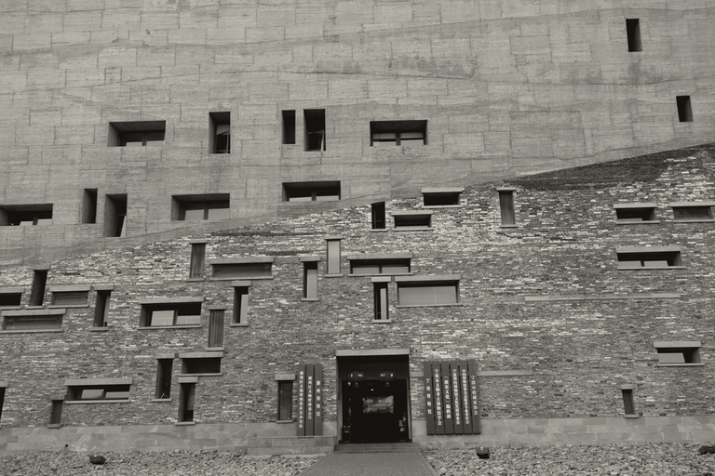
PART FOUR · THE RECKONING
14
Printed back into fashion
THE REVIVAL IN PRINT
BUILT AGAIN
BRUTAL LONDON · Zupagrafika, 2015
Wang Shu's Ningbo Museum (2008) shows traces of the bamboo framework on its monumental concrete, called "an urban icon" in his 2012 Pritzker Prize citation.
BRUTALIST LONDON MAP · 2015
THIS BRUTAL WORLD · 2016
SOS BRUTALISM: A GLOBAL SURVEY · 2017
The campus of the private University of Engineering and Technology (UTEC) in Peru, by Yvonne Farrell and Shelley McNamara, is referenced in their 2020 Pritzker citation.
ATLAS OF BRUTALIST ARCHITECTURE · 2018
The original movement was largely over by the late 1970s and early 1980s, having given way to structural expressionism and deconstructivism. Interest resurged from 2015, and new construction followed, termed neobrutalism.
© Siyuwj , building designed by Wang Shu / Wikimedia Commons / CC BY-SA 3.0
Many defining aspects have been softened: façades sandblasted to a stone-like surface, covered in stucco, or made of patterned precast elements — as in the redevelopment of Sheffield's Park Hill. But board-marked concrete is still used, as at the neobrutalist Silberrad Student Centre, University of Essex (2015).
Neobrutalist buildings tend to be commissioned by the private sector, and may use recycled brick or timber rather than concrete — while still exposing materials and structure.
BRUTALIST ARCHITECTURE · A FIELD GUIDE
14 / 16
Notes:
The movement itself was largely over by the late nineteen seventies and early eighties, having given way to structural expressionism and deconstructivism. What brought it back was print. From twenty fifteen a run of guides and books appeared — Brutal London, the Brutalist London Map, This Brutal World, SOS Brutalism, and the Atlas of Brutalist Architecture — and interest in the style resurged with them. New construction followed, under the name neobrutalism. Two of its best-known examples are attached to Pritzker citations. Wang Shu's Ningbo Museum of two thousand and eight, shown here, keeps the traces of its bamboo framework visible on the monumental concrete, and was called an urban icon in his twenty twelve citation. The campus of the private University of Engineering and Technology in Peru, by Yvonne Farrell and Shelley McNamara, appears in their twenty twenty citation. Notice the reversal, though: neobrutalist buildings tend to be commissioned by the private sector rather than the state, and they may use recycled brick or timber rather than concrete, while still exposing their materials and structure. Many of the defining aspects have been softened too — façades sandblasted to a stone-like surface, covered in stucco, or made of patterned precast elements, as in the redevelopment of Sheffield's Park Hill. But genuine board-marked concrete is still being poured, as at the Silberrad Student Centre at the University of Essex in twenty fifteen.

Slide 15
PART FIVE · CLOSE
15
Honest to the end
Judge it the way it asked to be judged
AN ETHIC, NOT AN AESTHETIC
FORMAL LEGIBILITY OF PLAN · CLEAR EXHIBITION OF STRUCTURE · MATERIALS AS FOUND
The style has been polarising throughout its history — public campaigns to demolish brutalist buildings are common, and in the United Kingdom some have been preserved.
BRUTALIST ARCHITECTURE · A FIELD GUIDE
15 / 16
Notes:
So how should you look at the next concrete building you walk past? Not with the reflex, in either direction. Brutalism set its own test, and the fairest thing is to use it. Formal legibility of plan. Clear exhibition of structure. Materials valued for their inherent qualities, as found. That is what its architects meant by calling it an ethic and not an aesthetic, and it is the same honesty that made the buildings hated when the concrete streaked and cheap and cold became the only words people had for them. The style has been polarising throughout its history — public campaigns to demolish brutalist buildings are common, and in the United Kingdom some of those same buildings have now been preserved. Both facts are true at once, and both follow from a movement that refused to hide anything.

Slide 16
PART FIVE · CLOSE
16
Source
EVERY FACT IN THIS GUIDE COMES FROM ONE PAGE
"Brutalist architecture", Wikipedia, the free encyclopedia.
Retrieved 4 September 2026 · en.wikipedia.org
Text from that article is reused under CC BY-SA 4.0; this deck is a derivative work and carries the same licence.
Photographs are individually credited on the pages where they appear.
No claim in this deck comes from outside that article. Where the article states no figure, the page prints NO DATA rather than an estimate.
Concrete, honest, unforgiving
BRUTALIST ARCHITECTURE · A FIELD GUIDE
16 / 16
Notes:
One last thing, on where all of this came from. Every fact, name, date and quotation in this guide comes from a single page: the Wikipedia article on brutalist architecture, retrieved on the fourth of September twenty twenty-six. The text is reused under the Creative Commons Attribution-ShareAlike licence, and this deck is a derivative work carrying the same licence. The photographs are credited individually on the pages where they appear. Nothing here comes from outside that article — and where the article states no figure, the page prints no data rather than an estimate.

