Slide 1
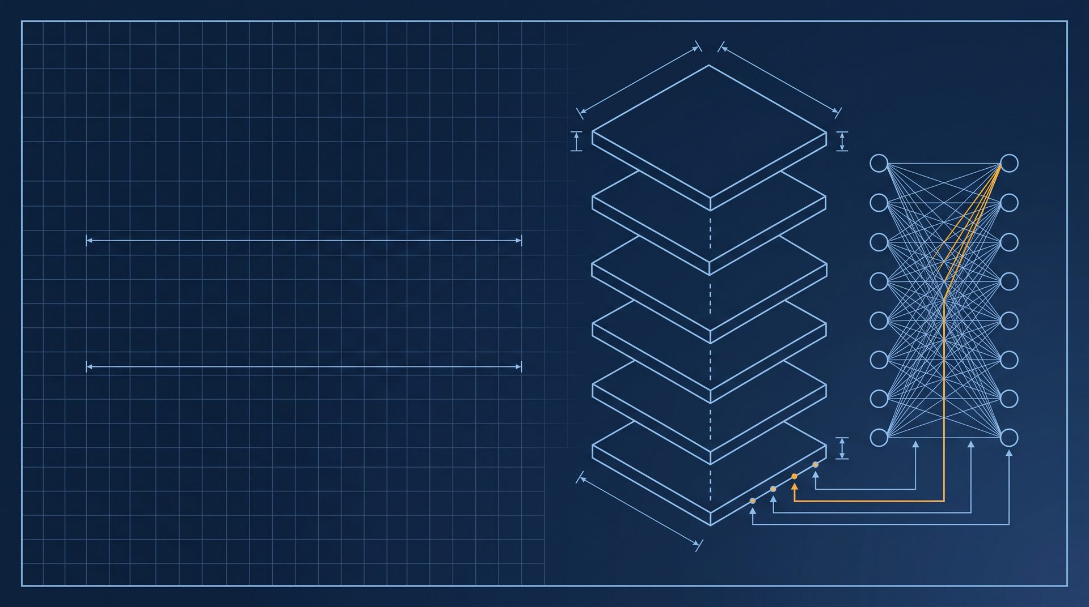
ARXIV 1706.03762 · NEURIPS 2017
Attention Is All You Need
The Transformer, explained: one paper, no recurrence, no convolutions, and a training run measured in days
VASWANI · SHAZEER · PARMAR · USZKOREIT · JONES · GOMEZ · KAISER · POLOSUKHIN GOOGLE BRAIN · GOOGLE RESEARCH
AIAYN · 2017
SHEET 01 / 15

Slide 2
DRAWING INDEX
What this drawing set covers
01
The bottleneck
SHEETS 03–04
Why recurrent and convolutional models paid for word order with time
02
The architecture
SHEET 05
Encoder, decoder, and the six identical layers stacked on each side
03
Attention, step by step
SHEETS 06–10
Scaled dot-product, multi-head, the three places it is used, and positional encoding
04
Training and results
SHEETS 11–13
The recipe, the BLEU numbers against the field, and what the ablations taught
05
Legacy
SHEETS 14–15
What was built on top of it, and why the title still holds
AIAYN · 2017
SHEET 02 / 15

Slide 3
§ 01 · THE BOTTLENECK
Before 2017, models paid for word order with time
A · RECURRENT (LSTM / GRU)
B · CONVOLUTIONAL (ByteNet / ConvS2S)
h_{t} = f(h_{t−1}, x_{t}) — every step waits for the previous one
1
2
3
4
5
n
O(log_{k} n)
n SEQUENTIAL STEPS · PATH LENGTH O(n)
Position 1 reaches position n only through n hops. Inside one example nothing can run in parallel, so longer sentences mean longer wall-clock time.
Parallel inside a layer, but two distant positions only meet after a stack of kernel-k layers — the path shrinks to O(log n), it does not vanish.
Both architectures charge a distance tax: the farther apart two positions are, the longer the path a signal must travel — and recurrence cannot run in parallel within one training example. The paper's question: what if every path had length 1?
AIAYN · 2017
SHEET 03 / 15

Slide 4
§ 01 · THE PROPOSAL
Keep attention, drop everything else
“We propose a new simple network architecture, the Transformer, based solely on attention mechanisms, dispensing with recurrence and convolutions entirely.”
— ABSTRACT, VASWANI ET AL. 2017
THREE CLAIMS THE PAPER MAKES — AND MEASURES
28.4 BLEU
O(1)
3.5 days
Better quality
More parallelizable
Far less training time
WMT14 EN–DE, over 2 BLEU above
sequential ops per layer —
8 × P100 GPUs, big model;
the best prior ensembles
all positions handled at once
41.8 BLEU on WMT14 EN–FR
AIAYN · 2017
SHEET 04 / 15

Slide 5
§ 02 · THE ARCHITECTURE
Six identical layers on each side
DECODER · N = 6
Linear
Softmax
OUTPUT PROBABILITIES
ENCODER · N = 6
Add & Norm
d_model = 512
Feed Forward
One width for every sub-layer output
Add & Norm
Add & Norm
h = 8 · d_k = d_v = 64
Feed Forward
8 heads, each a 64-wide subspace
Multi-Head Attention
Add & Norm
d_ff = 2048 · position-wise
Add & Norm
$FFN\left(x\right)=\max\left(0, xW_{1}+b_{1}\right)W_{2}+b_{2}$
Multi-Head Attention
Masked Multi-Head Attention
Add & Norm around each sub-layer
$LayerNorm\left(x+Sublayer\left(x\right)\right)$
+
+
POSITIONAL ENCODING
POS. ENCODING
PARAMETERS
Input Embedding
Output Embedding
base 65 M · big 213 M
INPUTS
OUTPUTS (SHIFTED RIGHT)
AIAYN · 2017
SHEET 05 / 15

Slide 6
§ 03 · ATTENTION, STEP 1
Scaled dot-product attention
$$Attention\left(Q,K,V\right)=softmax\left(\frac{QK^{T}}{\sqrt{d_{k}}}\right)V$$
ATTENTION(Q, K, V)
Q
query: what this position is looking for
K
key: what each position offers for matching
weighted V
MatMul · V
V
value: what is passed along once matched
weights
Softmax
Why divide by √d_k?
With large d_k the dot products grow large and push softmax into regions with tiny gradients; the 1/√d_k factor keeps the scores tame.
scaled
Scale ÷ √d_k
scores
MatMul Q · Kᵀ
d_k = 64 → divide every score by 8
Q
K
V
AIAYN · 2017
SHEET 06 / 15

Slide 7
§ 03 · ATTENTION, STEP 2
Multi-head attention: eight views at once
$$MultiHead\left(Q,K,V\right)=Concat\left({head}_{1},…,{head}_{h}\right)W^{O}$$
$${head}_{i}=Attention\left(QW_{i}^{Q}, KW_{i}^{K}, VW_{i}^{V}\right)$$
Scaled Dot-Product Attn
Q
Linear W^{Q}
K
Linear W^{K}
Concat
Linear W^{O}
MULTIHEAD (Q, K, V)
V
Linear W^{V}
× h = 8 HEADS · d_k = 64 EACH
d_k = d_v = 512 / 8 = 64 — eight reduced heads cost about as much as one full-width head ● Ablation (Table 3): a single attention head is 0.9 BLEU worse than the best setting
AIAYN · 2017
SHEET 07 / 15

Slide 8
§ 03 · ATTENTION, STEP 3
The same block is used in three places
A · ENCODER SELF-ATTENTION
B · MASKED DECODER SELF-ATTN
C · ENCODER–DECODER ATTENTION
Q, K, V ← previous encoder layer
Q, K, V ← previous decoder layer
Q ← decoder · K, V ← encoder output
rightward flow masked (−∞ before softmax)
ENCODER OUTPUT (K, V)
input positions 1 … n
Every position looks at every other position, in both directions, in one step — the O(1) path.
Same block, but position i may only attend to positions ≤ i. The mask keeps generation auto-regressive.
DECODER POSITIONS (Q)
Queries come from the decoder; keys and values from the encoder output. Every output position can read the whole input sentence.
Six of these, stacked, build the encoder's contextual representation.
Outputs are shifted right by one position for the same reason.
This replaces the classic seq2seq encoder–decoder attention.
AIAYN · 2017
SHEET 08 / 15

Slide 9
§ 03 · ATTENTION, STEP 4
Injecting order without recurrence
$$PE_{\left(pos, 2i\right)}=\sin\left(pos/10000^{2i/d_{model}}\right)$$
ONE SINUSOID PER DIMENSION
$$PE_{\left(pos, 2i+1\right)}=\cos\left(pos/10000^{2i/d_{model}}\right)$$
Why sinusoids, not learned positions?
Learned positional embeddings performed nearly identically in the ablation (Table 3). The sinusoidal version was kept because it may extrapolate to lengths never seen in training.
pos = 0
pos = 50
— dim 0 (2i/d = 0)
— dim 64 (2i/d = 0.125)
— dim 128 (0.25)
wavelengths run from 2π to 10000·2π
Each dimension is a sinusoid with its own wavelength, so a position gets a unique code. For any fixed offset k, PE(pos+k) is a linear function of PE(pos): relative offsets are easy.
Input Embedding
+
Positional Encoding
=
d_model = 512
added, not concatenated — same width, no extra parameters
AIAYN · 2017
SHEET 09 / 15

Slide 10
§ 03 · WHY SELF-ATTENTION
Three costs, four layer types (Table 1)
Layer type
Complexity per layer
Sequential operations
Maximum path length
Self-Attention
O(n² · d)
O(1)
O(1)
Recurrent
O(n · d²)
O(n)
O(n)
Convolutional
O(k · n · d²)
O(1)
O(log_k n)
Self-Attention (restricted)
O(r · n · d)
O(1)
O(n / r)
n = sequence length · d = representation dimension · k = kernel width · r = neighbourhood size
Any two positions are one operation apart
Per-layer cost O(n²·d) beats recurrence whenever n < d — the usual case for word-piece or BPE sentences. For very long inputs the restricted variant keeps a window r; the path grows to O(n/r), still shorter than O(n).
AIAYN · 2017
SHEET 10 / 15

Slide 11
§ 04 · TRAINING RECIPE
The spec sheet: data, hardware, schedule
DATA · EN–DE
OPTIMIZER
4.5 M sentence pairs · shared BPE vocabulary ≈ 37 k
Adam · β₁ = 0.9 · β₂ = 0.98 · ε = 10⁻⁹
DATA · EN–FR
LEARNING RATE · warmup_steps = 4 000
36 M sentences · 32 k word-piece vocabulary
$$lrate=d_{model}^{−0.5}⋅\min\left(step^{−0.5}, step⋅warmup_steps^{−1.5}\right)$$
BATCHING
≈ 25 k source + 25 k target tokens per batch
WARMUP
HARDWARE
Linear ramp for 4 000 steps, then decay ∝ 1/√step
One machine · 8 × NVIDIA P100 GPUs
REGULARIZATION
SCHEDULE · BASE MODEL
Residual dropout 0.1 (0.3 for the big EN–FR run) Label smoothing ε = 0.1
100 k steps · 0.4 s per step · ≈ 12 hours
SCHEDULE · BIG MODEL
MODEL SIZE
300 k steps · 1.0 s per step · 3.5 days
Base 65 M parameters · Big 213 M parameters
REV 1 · 2017-06-12 · ARXIV 1706.03762 · WMT 2014
ALL VALUES FROM §5 OF THE PAPER · 8 × P100 · 3.5 DAYS
AIAYN · 2017
SHEET 11 / 15

Slide 12
§ 04 · RESULTS (TABLE 2)
State of the art on both WMT 2014 tasks
English→German · BLEU on newstest2014
English→French · BLEU on newstest2014
ByteNet
23.75
Deep-Att + PosUnk
39.2
GNMT + RL
24.6
GNMT + RL
39.92
ConvS2S
25.16
ConvS2S
40.46
MoE
40.56
MoE
26.03
Deep-Att + PosUnk Ens.
40.4
GNMT + RL Ensemble
26.3
GNMT + RL Ensemble
41.16
ConvS2S Ensemble
26.36
ConvS2S Ensemble
41.29
Transformer (base)
27.3
Transformer (base)
38.1
Transformer (big)
28.4
Transformer (big)
41.8
0
10
20
30
0
15
30
45
Training cost: Transformer base used 3.3·10¹⁸ FLOPs against 1.8·10²⁰ for the GNMT + RL ensemble — about 55× less compute for a better EN→DE score.
Source: Vaswani et al. 2017, Table 2 (newstest2014). Single models and ensembles listed together, as in the paper.
AIAYN · 2017
SHEET 12 / 15

Slide 13
§ 04 · ABLATIONS & GENERALIZATION
What the ablations taught (Table 3)
HEADS · h
GENERALIZATION · WSJ PARSING
A single head is 0.9 BLEU worse than the best setting
KEY SIZE · d_k
91.3
92.7
Smaller d_k hurts — compatibility is not trivial to compute
F1 · WSJ only
F1 · semi-supervised
MODEL SIZE
4-layer Transformer
4-layer Transformer
Bigger is better; the big model wins on both tasks
REGULARIZATION
A 4-layer Transformer trained on WSJ alone reaches 91.3 F1; with semi- supervised data it reaches 92.7. The abstract's claim holds: the architecture generalizes beyond translation, large data or small.
Dropout is very helpful in avoiding over-fitting
POSITIONS
Learned vs sinusoidal positions: nearly identical
Each row varies one setting of the base model on EN–DE (newstest2013 dev set)
AIAYN · 2017
SHEET 13 / 15

Slide 14
§ 05 · LEGACY
What was built on it
SYSTEMS BUILT ON THE TRANSFORMER ARCHITECTURE
2017
2018
2021
2024
Transformer
BERT · GPT
ViT · DALL-E
Stable Diffusion 3 · Sora
the paper
pretrained language models
vision and image generation
image and video generation
250,000+
8 of 8
“All You Need Is Love”
citations as of 2026 — among the
authors later left Google to join
the Beatles song the title nods to
top-ten most-cited this century
other companies or found startups
— one joke, still landing
AIAYN · 2017
SHEET 14 / 15

Slide 15
§ 05 · CLOSING
Attention is all you need — the rest was engineering.
01
Drop recurrence: every position attends to every other in O(1).
02
Eight heads, scaled dot-products, sinusoidal positions do the work.
03
28.4 / 41.8 BLEU, 3.5 days, 8 GPUs — quality and speed at once.
Read the paper: arxiv.org/abs/1706.03762 · Vaswani et al., NeurIPS 2017
AIAYN · 2017
SHEET 15 / 15

