Slide 1
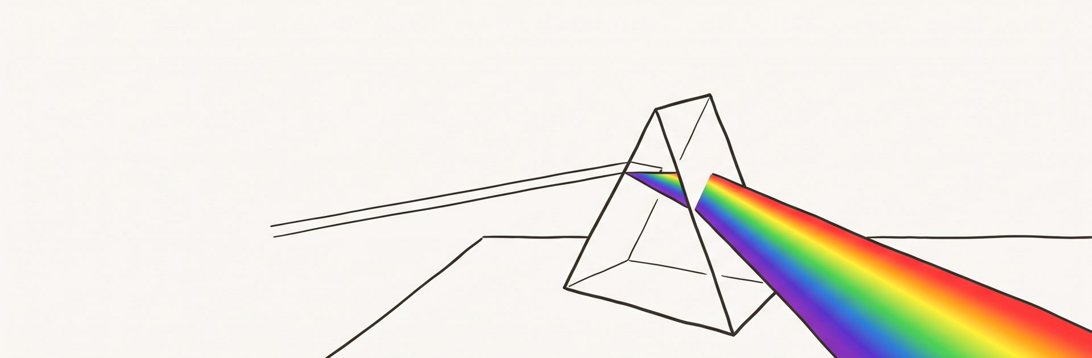
HANDS-ON WORKSHOP
Two exercises · bring a screen
How Color Works
A 90-minute hands-on workshop
One beam goes in. Everything you argue about comes out.
Notes:
Open on the picture rather than the title. One beam of white light goes into the prism and a whole spectrum comes out the other side, and that single fact is the reason every argument in this room about colour is possible at all. Say plainly what this session is not: it is not ninety minutes of taste, and nobody is going to be told their palette is wrong because someone senior prefers blue. What is not printed on the slide is the promise behind it, which is that by the end each person will be able to defend a colour decision with a number instead of an adjective. If someone asks whether this is an accessibility session, the honest answer is that accessibility is where the only hard rule lives, so we go there, but the rule turns out to be useful far beyond compliance.

Slide 2
THE CONTRACT
By the end of this session you will be able to
1
Name why a specific color pair fails to read
The 90 minutes
Check any pair against a WCAG threshold
and read the result out loud
0–10
Why color is not taste
2
10–35
The minimum model
35–50
Worked demonstration
3
Pull a five-color palette off a real image,
then repair the pair that fails
50–62
Your turn (12 min)
4
Say why a rainbow ramp is the wrong
default for ordered data
62–90
Mistakes, check and close
This session simplifies in two places, and says so where it does.
Bring a screen you can pick colors on.
02 / 14
Notes:
Read the four objectives as things people will do, not topics they will hear about. The one worth pausing on is the third, because it is the only one that requires them to touch their own material, and it is the one they will be doing at the fifty-minute mark. The run sheet on the right is there so nobody has to ask how long this goes on; point at the twelve-minute block and say that it is real working time, not a demo. The question that usually comes now is whether they need special software, and the answer is no, any image and one free web checker. Mention the simplification note at the bottom before anyone catches it later: this deck flattens two things on purpose, and both are marked where they happen.

Slide 3
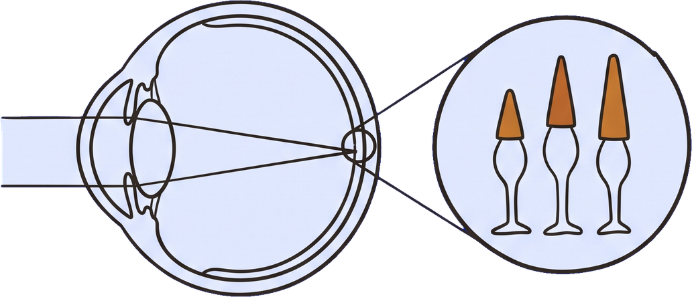
MINIMUM CONCEPT · 1 OF 3
Your eye does not measure light
It samples the spectrum three times.
Everything you will ever see is rebuilt from those three numbers.
≈380 nm
≈700 nm
CONVENTION
Sensitivity fades out at both ends, and different authorities round the endpoints differently.
600
nm
RULE
Human vision is trichromatic: S, M and L.
534
563
400
420
200
0
S cone
M cone
L cone
Peaks: Bowmaker & Dartnall 1980 · retina counts: NCBI Bookshelf · full curves: Stockman & Sharpe via cvrl.org
03 / 14
Notes:
The spectrum band across the top is the thing being sampled, and the point of the faded ends is that the boundary is a rounding convention, not a wall. Different textbooks give 380 to 700, 380 to 750, or 400 to 700 nanometres, so treat any exact figure with suspicion. The chart underneath is the whole of colour vision in three bars: three cone types, with measured mean peaks at about 420, 534 and 563 nanometres from the classic Bowmaker and Dartnall measurement. Say the number that usually lands hardest, which is that there are only about six million cones against a hundred and twenty million rods, so colour is a thin, expensive layer of vision concentrated in the middle of the retina. Then mark the simplification out loud: the real sensitivity curves are broad and heavily overlapping, not three clean spikes, and anyone who wants the actual tabulated curves can get them from the Colour and Vision Research Lab at UCL.

Slide 4
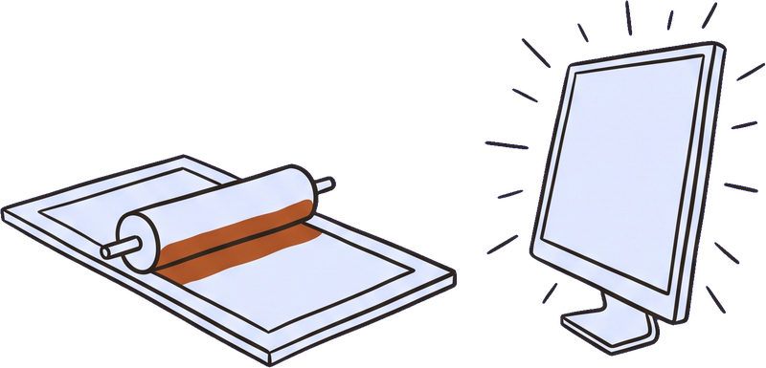
MINIMUM CONCEPT · 2 OF 3
Two ways color mixes — and you ship into both
ADDITIVE · LIGHT · EVERY SCREEN
SUBTRACTIVE · INK · ALL PRINT
Start at black. Adding light moves toward white.
Start at white. Adding ink moves toward black.
RULE
Two machines, two directions.
The two primary sets are complements of each other:
each additive primary is a secondary in the other
system, and the other way round.
A screen color need not be reachable in ink.
Additive / subtractive systems: RMIT Colour Theory 1 (open textbook)
04 / 14
Notes:
Both diagrams have exactly the same geometry on purpose, so the only thing that differs is what happens where the circles cross. On the dark side you are adding light and the overlaps get brighter until all three together give white, which is how every screen in the room works. On the light side you are adding ink to paper that already reflects everything, and each layer takes part of the spectrum away, so the overlaps get darker and all three together approach black. The relationship worth stating slowly is that each primary in one system is a secondary mixture in the other, which is why cyan, magenta and yellow are not an arbitrary choice by printers. The practical consequence is the one to leave hanging: a colour picked on a screen has no obligation whatsoever to be reachable in ink, and that is where most print surprises come from.

Slide 5
MINIMUM CONCEPT · 3 OF 3
Three dials — schemes turn only one of them
HUE — an angle, 0–360°
Itten’s twelve-hue wheel: a teaching
device, not a law of light.
red 0 / 360 · green 120 · blue 240
SATURATION — 0% gray to 100%
how much of the hue is left in the color
LIGHTNESS — 0% black to 100% white
the only dial the contrast rule looks at
CONVENTION
harmony schemes
The scheme names come from Johannes Itten’s 1961 Art of Color,
taught at the Bauhaus. Munsell drew a different wheel — so which
colors count as “complementary” depends on which wheel you
started from.
complementary = two wedges 180° apart
HSL definition: W3C CSS Color 4 · Itten: Getty Bauhaus teaching materials · competing wheels: Munsell
05 / 14
Notes:
Introduce hue, saturation and lightness as three independent controls, and make sure the hue dial is understood as an angle rather than a list of colour names. The wheel on the right is Johannes Itten's twelve-hue wheel from his 1961 Art of Color, built out of the course he taught at the Bauhaus, and he presented those schemes as one of several kinds of contrast useful for teaching, not as a law. Draw the line between the two opposite wedges and say that this is all a complementary pair is: two positions a hundred and eighty degrees apart on a circle somebody drew. Munsell drew a different circle using perceptually equal steps, and on that circle the complements land somewhere else, which is the whole argument in one sentence. Anyone who wants to defend harmony rules should be free to use them, but they are inherited practice and not something you could derive from the physics on the previous pages.

Slide 6
THE ONE MEASURABLE RULE
Lightness is the dial that carries legibility
RULE
WCAG SC 1.4.3
The same wheel, with only the part
the rule actually measures left.
The W3C’s text-contrast rule is defined purely by
relative luminance. There is no hue term and no
saturation term in it.
L = 0.2126 R + 0.7152 G + 0.0722 B
FAIL — far apart in hue, almost equal in luminance
1.10:1
Read this
PASS — one hue, far apart in lightness
9.90:1
the same two wedges: 2.78:1
Read this
Relative luminance and SC 1.4.3: W3C WCAG 2.1 · ratios computed from the swatches on this page
06 / 14
Notes:
This is the hinge of the session, so slow down. The W3C's text-contrast rule is written purely as a function of relative luminance, and if you read the formula on the slide you will notice there is no term in it for hue and no term for saturation at all. The two demonstrations make the same point from opposite directions: red and green sit a hundred and twenty degrees apart and still measure 1.10 to 1, which is effectively no contrast, while two tones of one blue measure 9.90 to 1 and read cleanly. The wheel on the right is the same wheel from the previous page with the hue and saturation drained out, leaving only what the rule actually measures, and the two so-called complementary wedges come out at 2.78 to 1 either way. The instruction that follows is simple enough to remember without notes: judge the pair in greyscale first, and only argue about hue after it passes.

Slide 7
REFERENCE CARD
The numbers you actually have to hit
Five numbers. You can check any of them in about ten seconds.
TEXT OR ELEMENT CLASS
CRITERION
LEVEL AA
LEVEL AAA
Normal text
1.4.3 / 1.4.6
4.5:1
7:1
Large text
1.4.3 / 1.4.6
3:1
4.5:1
UI components and graphics
1.4.11
3:1
no higher level
RULE
how the number is computed
What counts as large text
Contrast ratio is (L1 + 0.05) / (L2 + 0.05) with the lighter luminance on
top. It runs from 1:1 to 21:1, and must not be rounded before you
compare it with a threshold.
Large text means at least 18 pt, or at
least 14 pt bold — the spec puts that at
roughly 24 px and 18.5 px.
W3C WCAG 2.1 Understanding SC 1.4.3, SC 1.4.6 and SC 1.4.11
07 / 14
Notes:
Treat this as the page they photograph. There are only five numbers in the whole rule, and the most used one is 4.5 to 1 for normal body text at level AA. Large text drops to 3 to 1, and large text has an exact definition worth reading out because people guess it wrong: eighteen point, or fourteen point bold, which the spec itself puts at roughly twenty-four and eighteen and a half pixels. The row that surprises people is the last one, because 1.4.11 puts a 3 to 1 floor on interface components and on graphics you need in order to understand the content, which means icons, chart lines and form borders, not just text. Mention that the ratio must not be rounded before comparing, because a 4.49 that someone reported as 4.5 is a fail.

Slide 8
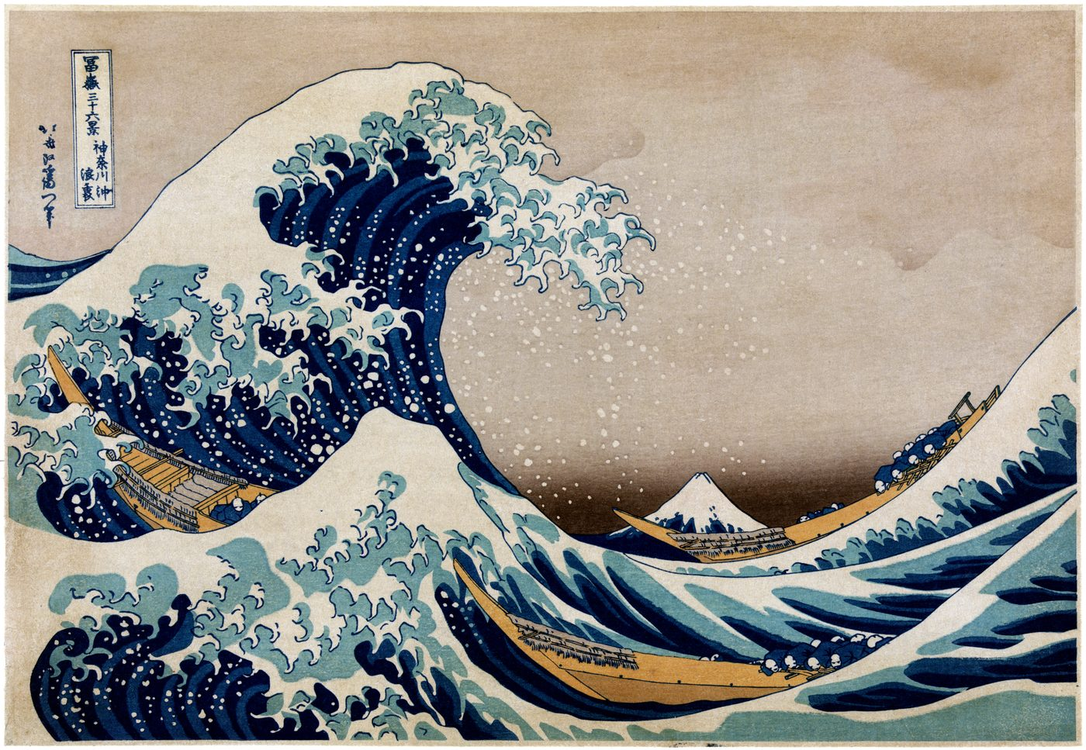
WORKED DEMONSTRATION · STEP 1 OF 2
Five colors out of one print
Sky paper
#E3DBCD
sky and paper ground
Aged ground
#C5B4A1
largest single area
Sea green
#6B8C8E
the wave body
Boat slate
#414D59
boats and Fuji shadow
Katsushika Hokusai, Under the Wave off Kanagawa,
c. 1830–32. Public domain, via Wikimedia Commons.
Deep indigo
Sampled in this order: the largest area first, then
the darkest, then the lightest, then two accents
chosen for meaning rather than area.
#060F2C
the trough shadows
Five samples. Not a palette — nothing measured.
Artwork provenance: The Metropolitan Museum of Art (Open Access, CC0) · this impression via Wikimedia Commons
08 / 14
Notes:
Do this live rather than describing it. The print is Hokusai's Under the Wave off Kanagawa from around 1830, and it works for this exercise because it is genuinely public domain and because its colours are structural rather than decorative. Narrate the order out loud as you sample, because the order is the transferable part: largest area first, then the darkest, then the lightest, and only then two accents chosen because they carry meaning rather than because they cover ground. Keep writing the region next to each swatch, since a hex value with no memory of where it came from is the thing people cannot defend a week later. End on the unglamorous line at the bottom rather than on the palette, because five samples that look pleasant together have not been tested against anything yet.

Slide 9
WORKED DEMONSTRATION · STEP 2 OF 2
Now measure it, then repair the pair that fails
Sky paper
Aged ground
Sea green
Boat slate
Deep indigo
Every pair, against the 4.5:1 body-text floor
The one pair that fails, and its repair
—
1.47
2.65
6.29
13.74
Body text
Body text
1.47
—
1.81
4.29
9.36
4.29:1 FAIL
4.55:1 PASS
2.65
1.81
—
2.37
5.18
Same hue, same saturation. Only the lightness moved,
from 30% down to 29%: #414D59 becomes #3E4955.
The palette still reads as the same palette.
6.29
4.29
2.37
—
2.18
13.74
9.36
5.18
2.18
—
PREFERENCE
Passing is not the same as good. Only usable.
Threshold: W3C WCAG 2.1 SC 1.4.3 · ratios computed from the five sampled values above
09 / 14
Notes:
The palette from the previous page comes across unchanged, and now every pair gets measured against the 4.5 to 1 body-text floor. Walk the grid quickly rather than reading it; the useful observation is how few pairs actually clear the line once you stop trusting your eye. The circled cell is the interesting one because it fails at 4.29, which is close enough that nobody would have caught it by looking. Show the repair as a single move: hue held, saturation held, lightness taken down about one percent, and the ratio clears at 4.55 while the palette still reads as the same palette. Close honestly, because someone always asks whether passing means good: it does not, it means usable, and taste starts after the floor is met, not instead of it.

Slide 10
GUIDED PRACTICE
Your turn — 12 minutes
TASK
SUCCESS CONDITION
Open any image you own. Sample five colors in
the order we just used, then measure the
pair you would actually put together for body
text on a background.
Five hex values written down, one
measured ratio, and that ratio at
4.5:1 or above.
STARTING POINT
Your own image, and the contrast checker linked on the last
page of this deck.
IF YOU GET STUCK
Stop sampling for meaning and sample by area instead:
largest first, then darkest, then lightest.
12 minutes — then we compare three of them out loud.
10 / 14
Notes:
Hand this over cleanly and then stop talking. The task is on their own image, because a palette pulled from something they care about is the one they will remember. Read the success condition word for word, since a vague success condition is why exercises drift: five hex values written down, one measured ratio, and that ratio at 4.5 to 1 or above. The escape route matters more than it looks, because the people who stall are almost always stalling on meaning rather than sampling, so tell them to fall back to sampling by area. Give the twelve minutes properly and give a two-minute warning; if the room is running behind, cut the comparison at the end rather than cutting the working time.

Slide 11
COMMON MISTAKE · 1 OF 2
Mistake 1 — turning up the saturation
AS DRAWN
SATURATION PUSHED
LIGHTNESS LOWERED
Caption text
Caption text
Caption text
#C98E62
#FF862C
#A06437
2.63:1
2.28:1
4.53:1
FAIL
FAIL
PASS
The same three colors, reduced to what the rule actually measures:
L 0.33
L 0.38
L 0.17
PREFERENCE
why it is tempting
RECOMMENDATION
what to do instead
On a big bright monitor the louder color really does
look stronger to you.
Move the lightness, keep the hue, then measure it again.
Ratios and relative luminances computed from the three swatches on this page, per W3C WCAG 2.1
11 / 14
Notes:
Show the three states in order and let the middle one do the work. The caption starts at 2.63 to 1, which fails, and the instinctive fix is to push the colour until it looks stronger. Pushing saturation to full takes it to 2.28 to 1, which is worse, and the reason is on the strip below: the relative luminance actually went up, from 0.33 to 0.38, which moved it closer to the page rather than further from it. Lowering lightness instead drops the luminance to 0.17 and the ratio clears at 4.53. Be generous about why the mistake happens, because on a large bright monitor the louder colour really does look stronger to the person making it, and that is a perception problem rather than carelessness.

Slide 12
COMMON MISTAKE · 2 OF 2
Mistake 2 — a rainbow ramp for ordered data
RAINBOW RAMP · FIVE ORDERED STEPS
MONOTONIC RAMP · SAME FIVE STEPS
0.02
0.17
0.26
0.73
0.16
0.82
0.56
0.31
0.14
0.04
relative luminance: up, up, up, then down
relative luminance: down, every step
RULE
Borland & Taylor 2007: three documented defects
1
No perceptual ordering: equal-looking color steps are not
equal data steps.
Deuteranomaly
5
Deuteranopia
1
2
Uncontrolled luminance variation across hues obscures
the data.
Protanomaly
1
3
It can create gradients that are not in the underlying
data at all.
Protanopia
1
RECOMMENDATION
0
2
4
6
Crameri et al. (2020): use a perceptually uniform map.
% of men
Rainbow maps: Borland & Taylor 2007; Crameri et al. 2020 · prevalence: NEI, Colour Blind Awareness
12 / 14
Notes:
Put the two ramps side by side and read the luminance numbers under them out loud, because that is the entire argument. The rainbow ramp goes 0.02, 0.17, 0.26, 0.73 and then back down to 0.16, so the fourth step is by far the brightest and the last step is darker than the second, which means the ordering the reader perceives is not the ordering in the data. Borland and Taylor documented three separate defects in 2007 and they are worth naming individually, because people usually only know the accessibility one. Crameri and colleagues found in 2020 that these maps are still common in published science and proposed perceptually uniform alternatives. The chart at the bottom is why this compounds: about one man in twelve has a colour vision deficiency, deuteranomaly alone accounts for five percent, and a hue-only encoding excludes all of them at once.

Slide 13
UNDERSTANDING CHECK
Check yourself — three questions
Q1
Q2
Q3
You have two colors
measured at 3.8:1 and
you need them for 16 px
body text. What exactly
do you change, and why
that and not the hue?
A colleague says a
palette is harmonious
because it is triadic.
Which part of that is a
rule and which part is a
convention?
You have a sequential
heat map drawn in a
rainbow ramp. Name two
things that go wrong
before anyone’s vision is
involved.
ANSWERS — ALL THREE ARE CHECKABLE AGAINST THIS DECK
4.5:1 is the AA floor at that size, so
move the lightness until the measured
ratio clears it. The formula has no hue
term in it.
None of it is a rule. Triadic is an
angular convention on the hue dial, and
harmony is not a measurable property.
No perceptual ordering, and
uncontrolled luminance variation
across hues.
13 / 14
Notes:
Give the room a minute on the three questions before showing the answers, and resist answering them yourself in the meantime. The first question is really asking whether they understood that the fix lives on the lightness dial and not the hue dial. The second is checking whether the rule and convention distinction survived, and the correct answer is that none of the triadic claim is a rule. The third is checking whether the rainbow objection is understood as a data problem before it is understood as an accessibility problem. If anybody gets all three, they are ready to argue this in a design review, which was the point of the session.

Slide 14
RECAP AND NEXT STEPS
What you can do now, and where to go next
Separate hue from lightness, measure the lightness, then argue.
YOU CAN NOW
WHERE TO GO NEXT
Name why a color pair fails to read
WebAIM Contrast Checker — a ratio plus AA/AAA pass-fail
Check any pair against a WCAG threshold
W3C How to Meet WCAG — every criterion, filterable
Pull and repair a five-color palette
Coblis — any image under each type of deficiency
Say why a rainbow ramp is the wrong default
ColorBrewer — sequential, diverging, qualitative
Adobe Color — themes and harmony generators
CVRL, UCL — the cone-fundamentals data behind page 3
What this session simplified: the cone sensitivity curves overlap far more than three columns suggest, and a contrast
ratio is a floor, not a measure of quality.
Every destination above is linked live in this file; sources for each claim are on the page that makes it.
14 / 14
Notes:
Close by mapping the four capabilities back onto the four promises from the second page, in the same order, so the progress is visible rather than asserted. The single sentence at the top is the one to leave them with, because it compresses ninety minutes into an order of operations they can actually follow under deadline. Point at the destinations and say which one to open first: the contrast checker, today, on whatever they are currently building. End on the simplification note rather than on a flourish, since the cone curves really do overlap far more than three bars suggest, and a contrast ratio really is a floor rather than a measure of quality.

