Slide 1
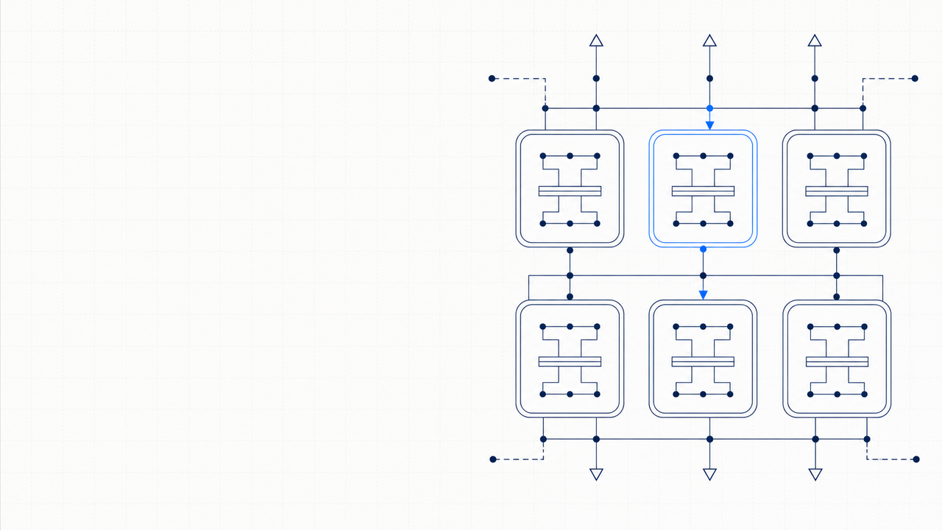
PAPER · DEEP READ
NeurIPS 2017 · arXiv:1706.03762
Attention
Is All
You Need
Vaswani · Shazeer · Parmar · Uszkoreit
Jones · Gomez · Kaiser · Polosukhin
Google Brain · Google Research · University of Toronto
THE 2017 IDEA
Drop recurrence and convolution. Use only attention.
01
Notes:
Today we are reading what is probably the single most influential machine learning paper of the last decade: Attention Is All You Need, by Vaswani and seven coauthors at Google Brain, Google Research, and the University of Toronto, presented at NeurIPS 2017. The title is the thesis: drop recurrence and convolution, use only attention, and you get a model that is faster to train, easier to parallelize, and stronger on machine translation than anything that came before. Over the next sixteen slides we'll walk through what the Transformer actually is, how the attention mechanism works, why the authors chose this design, and what the experiments showed.

Slide 2
A simpler model, better results, less training
WHY THIS PAPER MATTERS · 2017 SOTA ON WMT'14 TRANSLATION
EN → DE
EN → FR
TRAINING TIME
ARCHITECTURE
BLEU on WMT'14
BLEU on WMT'14
Transformer (big)
building blocks
28.4
41.8
3.5 days
Attention
only
+2.0
over prior ensembles
new single-model SOTA
on 8× P100 GPUs
no recurrence · no convolution
THE HEADLINE
The Transformer reaches new translation SOTA while training
in a fraction of the time of strong baselines.
Quality up · cost down · parallelization unlocked. The whole rest of the paper explains
how attention alone makes this possible — and why nothing else is needed.
Source: Vaswani et al. 2017, Table 2 (BLEU) and §5.2 (training cost)
02
Notes:
Before we get into the architecture, let's see what the paper is actually claiming. On the WMT 2014 English to German translation task, the Transformer big model scored 28.4 BLEU, beating the previous best ensemble by two full points as a single model. On WMT 2014 English to French, it set a new single-model state of the art at 41.8 BLEU. And it did all this by training for three and a half days on eight P100 GPUs — a small fraction of the cost of the strong baselines. The architecture has no recurrence and no convolution; it is built entirely from attention and feed-forward layers. Quality up, cost down, parallelization unlocked.

Slide 3
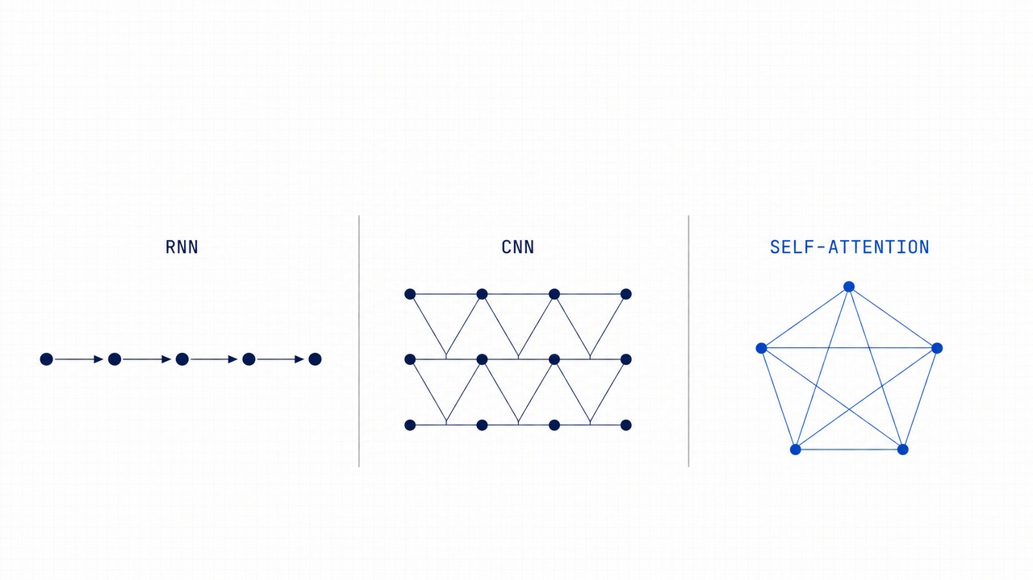
PART 2 · MOTIVATION & BACKGROUND
From recurrent chains to a fully-connected
attention mesh
RNN — sequential step by step. CNN — local receptive field grows with distance.
Self-attention — every position relates to every other in one constant-time hop.
03
Notes:
To appreciate the move, it helps to look at where sequence modeling was sitting in 2017. Recurrent networks — RNNs, LSTMs, GRUs — were the default, but they compute step by step and resist parallelization. Convolutional alternatives like ByteNet and ConvS2S could parallelize, but signals between distant positions still had to travel through many layers, growing linearly or logarithmically with distance. Self-attention does something different: every position relates to every other position in one constant-time hop. Visually you can think of it as moving from a chain to a local field to a fully connected mesh — and that mesh is what the Transformer leans into.

Slide 4
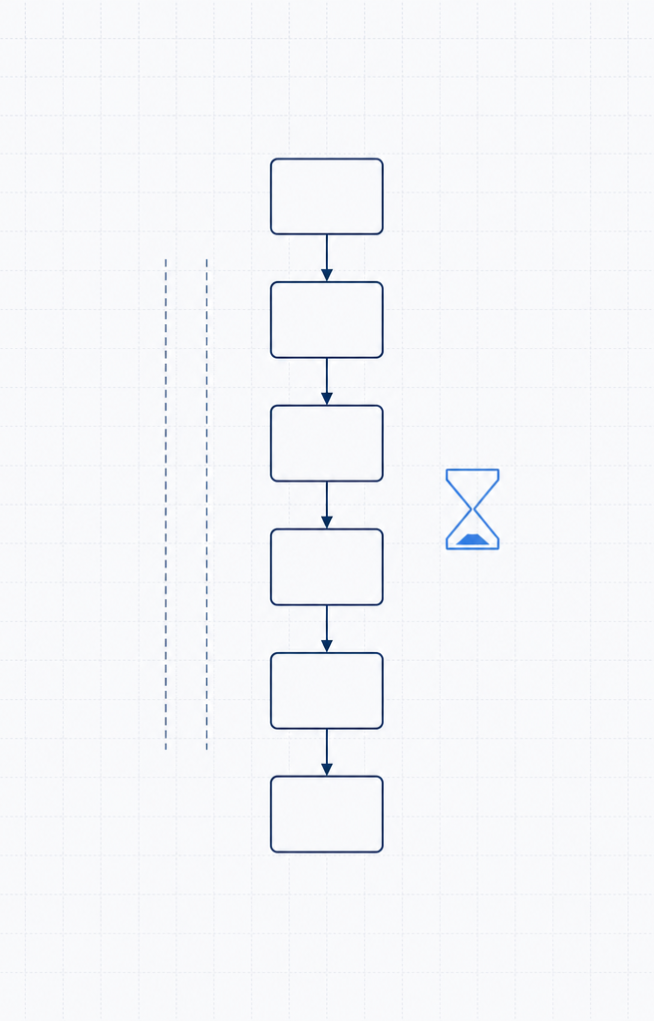
What hurts in RNN/CNN sequence models
THREE FUNDAMENTAL CONSTRAINTS THE TRANSFORMER LIFTS
01
02
03
SEQUENTIAL BOTTLENECK
LONG-RANGE PATH
MEMORY CEILING
hₜ depends on hₜ₋₁
Distant tokens, far apart
Batch size vs length
Each hidden state must wait for
ConvS2S path grows linearly,
Long sequences exhaust
the previous one — no within-
ByteNet logarithmically.
GPU memory, capping
example parallelism.
RNNs are even worse.
batch size across examples.
CONSEQUENCE
CONSEQUENCE
CONSEQUENCE
Training step time scales
Hard to learn dependencies
Throughput drops fast as
linearly with sequence
between positions that sit
context grows — a hard wall
length n.
far apart in the input.
at long sequence lengths.
Sequential hidden-state chain
— the constraint visualized
Source: Vaswani et al. 2017, §1 Introduction & §2 Background
04
Notes:
Let's name the constraints the authors are trying to lift. First, the sequential bottleneck: in any RNN, hidden state at time t depends on hidden state at t minus one, so you cannot parallelize within a single training example. Second, long-range path length: distant tokens have to be related through many intermediate operations, which makes learning long-range dependencies hard. Third, memory ceiling: long sequences eat GPU memory, capping batch size and throughput. The Transformer attacks all three at once by replacing the entire backbone with attention.

Slide 5
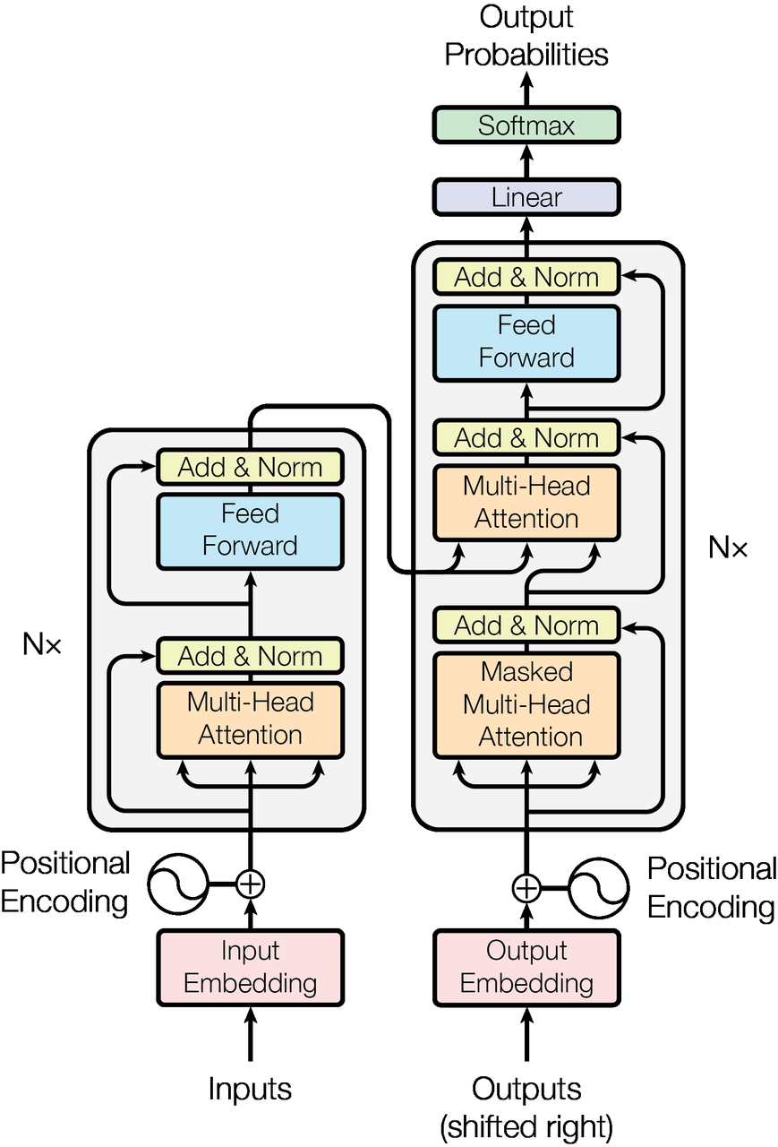
Encoder–Decoder, stacked self-attention, point-wise FFN
MODEL ARCHITECTURE · FIGURE 1 FROM THE PAPER
1
Inputs + Positional Encoding
Token embeddings get a deterministic sinusoidal position vector
added — order is injected, not learned (see P11).
2
Nx Encoder block
Multi-Head Self-Attention → Position-wise Feed Forward, both
wrapped by Add & Norm. N = 6 in the base configuration.
3
Nx Decoder block
Masked Self-Attn → Encoder-Decoder Attn → FFN, each with
Add & Norm. The mask enforces auto-regression.
4
Add & Norm — residual + LayerNorm
Every sub-layer output is LayerNorm(x + Sublayer(x)). Enables
deep stacks; d_model = 512 throughout (see P10).
5
Linear + Softmax — output probabilities
Decoder output is projected back to vocabulary size and
softmaxed to next-token probabilities.
SAME SKELETON AS PRIOR SEQ2SEQ
What is new is what fills the boxes: only self-attention + FFN.
Figure 1 · The Transformer — model architecture
Notes:
This is figure one from the paper — the Transformer architecture. Read it from the bottom up. Inputs and outputs both come in as embeddings, with a sinusoidal positional encoding added. The encoder on the left is a stack of six identical layers; each layer has multi-head self-attention followed by a position-wise feed-forward network, with Add and Norm wrapping each sub-layer. The decoder on the right is also six layers, but inserts a third sub-layer that attends back to the encoder output, and its self-attention is masked so it cannot peek at future tokens. The whole thing ends with a linear projection and softmax to produce token probabilities. The skeleton is the same as prior seq2seq models — what is new is what fills the boxes.

Slide 6
Same skeleton, three asymmetries
ENCODER STACK · DECODER STACK · N = 6 · d_model = 512
Encoder
Decoder
N = 6 IDENTICAL LAYERS
N = 6 IDENTICAL LAYERS · INSERTS A THIRD SUB-LAYER
1
Multi-Head Self-Attention
1
Masked Multi-Head Self-Attention
Every position attends to every position
Position i attends only to positions ≤ i
2
Position-wise Feed Forward
2
Encoder-Decoder Attention
Two linear layers, ReLU between
Q from decoder · K, V from encoder output
WRAPPER AROUND EACH SUB-LAYER
3
Position-wise Feed Forward
Output = LayerNorm( x + Sublayer(x) )
Same shape as encoder FFN
— residual connection then layer normalization.
THREE ASYMMETRIES VS ENCODER
SHAPE CONTRACT
· third sub-layer attends to encoder output
All sub-layers and embeddings emit dimension d_model = 512
· self-attention is masked (no peeking at future)
so residual addition is well-defined.
· output embeddings are offset by one position
Source: Vaswani et al. 2017, §3.1 Encoder and Decoder Stacks
06
Notes:
Let's compare the encoder and decoder side by side. The encoder has two sub-layers per block: multi-head self-attention, then a position-wise feed-forward network. The decoder has three: masked multi-head self-attention, then encoder-decoder attention, then the feed-forward network. Around every sub-layer the same wrapper applies — output equals LayerNorm of x plus Sublayer of x, the classic residual connection plus normalization. All sub-layers and embeddings emit a 512-dimensional vector so the residual addition is well-defined. The three asymmetries on the decoder side are the third sub-layer, the causal mask that preserves auto-regression, and the one-position shift of the output embeddings.

Slide 7
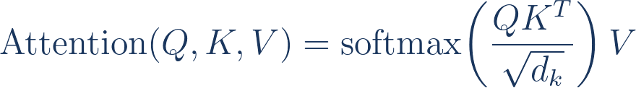
Attention as a weighted average — keys, values, queries
SCALED DOT-PRODUCT ATTENTION · §3.2.1
EQUATION (1)
HOW IT READS
DATAFLOW
1
Dot-product all queries with all keys
QKᵀ gives a similarity score between every query–key pair.
Q
Scale
Mask (opt.)
queries
MatMul
Scale by √d_k
QKᵀ
÷ √d_k
decoder only
2
For large d_k the dot products grow large, pushing softmax
K
into low-gradient regions. Scaling counteracts that.
keys
SoftMax
Softmax → attention weights
row-wise normalize
3
Normalize each row so the weights over keys sum to 1.
Weighted sum of values
MatMul
4
Multiply weights by V to get each output position's vector.
V
× V → output
values
Source: Vaswani et al. 2017, §3.2.1 Scaled Dot-Product Attention
07
Notes:
Here is the heart of the model — scaled dot-product attention. You start with three matrices: queries Q, keys K, and values V. You compute the dot product of every query with every key, scale by the square root of the key dimension, apply a row-wise softmax to get attention weights, and then multiply by V to produce the output. The scaling factor matters. For large key dimensions the dot products grow in magnitude, pushing the softmax into regions with vanishingly small gradients. Dividing by root d sub k counteracts that. Once you have the weights, the output is just a weighted average of the value vectors — that's all attention is.

Slide 8
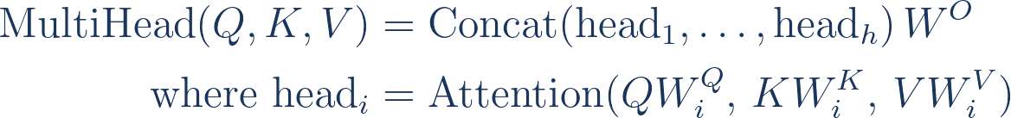
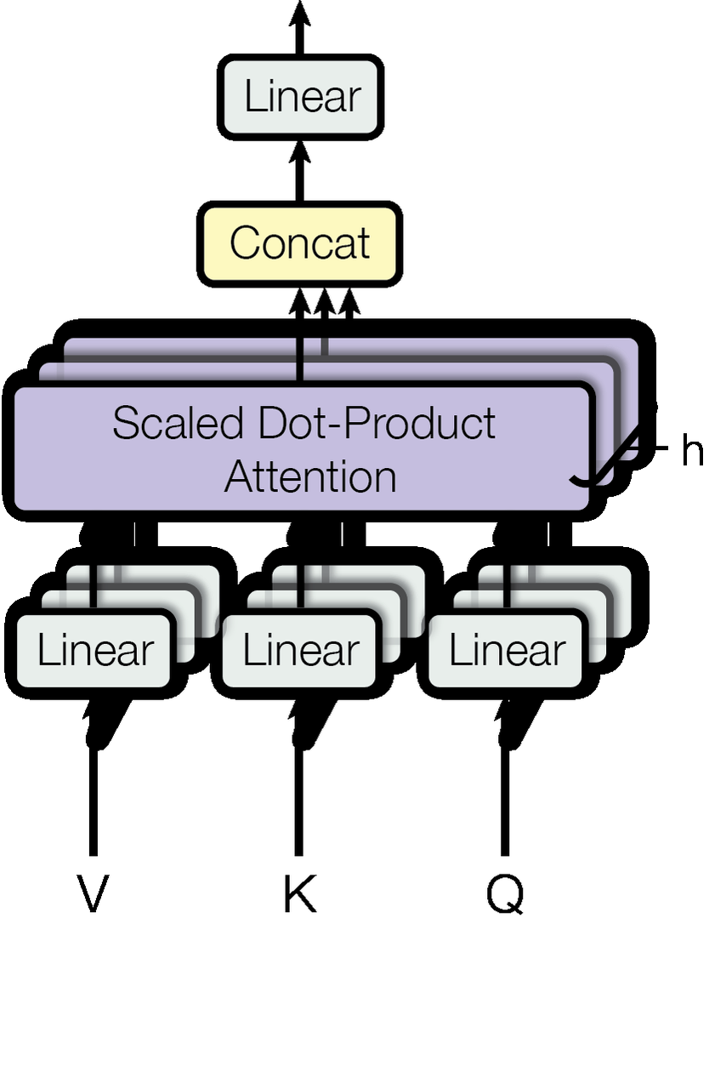
h parallel projections, then concatenate
MULTI-HEAD ATTENTION · §3.2.2 · h = 8 · d_k = d_v = 64
EQUATION
WHY MULTI-HEAD INSTEAD OF SINGLE
Project Q, K, V into h subspaces
Independent learned linear projections W_iᴽ, W_iᴷ, W_iⱽ — one
set per head; each head sees a different view of the inputs.
Run scaled DPA in each head in parallel
d_k = d_v = d_model / h = 64. Total compute stays comparable
to a single full-dimensional head.
Concat heads, project with Wᴼ
Concatenated head outputs go through a final linear map back
to d_model.
THE PAYOFF
Figure 2 (right) · Multi-Head Attention
Each head can attend to different representation subspaces at different positions.
Source: Vaswani et al. 2017, §3.2.2 Multi-Head Attention
08
Notes:
Multi-head attention is the next move. Instead of running one attention function over the full 512-dimensional vectors, the authors split into h equals eight independent heads, each operating on 64-dimensional projections of Q, K, and V. The projections are learned, so each head can specialize on a different kind of relationship. The heads run in parallel, their outputs are concatenated, and a final linear projection maps back to 512. The total compute is roughly the same as a single full-dimensional head, but the model gains the ability to attend to different representation subspaces at different positions simultaneously.

Slide 9
One mechanism, three roles in the Transformer
WHERE ATTENTION SHOWS UP IN THE ARCHITECTURE · §3.2.3
ENCODER
DECODER
ENCODER ↔ DECODER
Self-Attention
Masked Self-Attention
Cross-Attention
Q · K · V SOURCE
Q · K · V SOURCE
Q · K · V SOURCE
Q, K, V ← previous encoder layer
Q, K, V ← previous decoder layer
Q ← previous decoder layer
K, V ← encoder output
Every position attends to all
Only past, never future
Look back at the input
Every token in the source sequence can
Position i attends only to positions ≤ i.
Every decoder position can attend over
attend to every other token — including
Achieved by setting illegal positions to
all positions of the input sequence —
itself.
−∞ before the softmax.
the classic seq2seq attention role.
WHAT IT'S FOR
WHAT IT'S FOR
WHAT IT'S FOR
Build rich contextualized
Preserve auto-regression — the
Let each output token retrieve
representations of each source
model cannot peek at tokens it
the relevant source information,
token from its surroundings.
hasn't produced yet.
no matter where it sits.
attention_mask = none
attention_mask = causal triangular
attention_mask = none
Source: Vaswani et al. 2017, §3.2.3 Applications of Attention
09
Notes:
The same attention mechanism shows up in three places in the Transformer, with three slightly different roles. In encoder self-attention, queries, keys, and values all come from the previous encoder layer; every source position attends to every other. In decoder masked self-attention, the same setup applies, but illegal future positions are set to minus infinity before the softmax, so position i attends only to positions less than or equal to i — that's how auto-regression is preserved. In encoder-decoder attention, queries come from the decoder while keys and values come from the encoder output, letting every decoder position retrieve relevant information from anywhere in the source sequence. One mechanism, three roles.

Slide 10
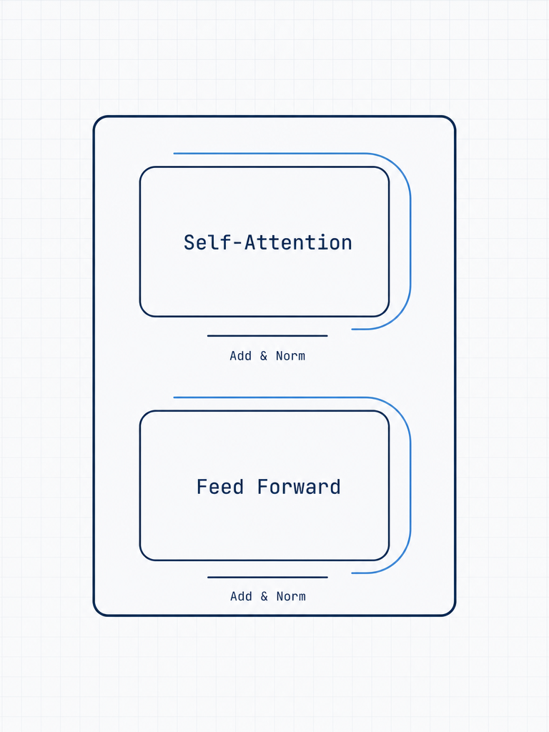
The supporting cast inside every layer
POSITION-WISE FFN · RESIDUAL CONNECTION · LAYERNORM
ONE TRANSFORMER LAYER · ENCODER OR DECODER
Position-wise FFN
Residual
LayerNorm
Two linear layers with ReLU
Skip the sub-layer, add the
Normalize across feature
between, applied identically
input back to the output.
dimension after the residual
at every position.
Enables deep stacks.
addition.
FFN(x) = max(0, xW₁+b₁) W₂+b₂
y = x + Sublayer(x)
LayerNorm(x + Sublayer(x))
inner dim = 2048 · outer = 512
straight gradient path top → bottom
stabilizes training, scale-invariant
HOW THEY COMPOSE — APPLIED TO EVERY SUB-LAYER
Sublayer(x)
+
x
→
LayerNorm
→
final sub-layer output
next
SHAPE CONTRACT
All sub-layers and embeddings emit dimension d_model = 512 so the residual addition is well-defined.
One layer block · two sub-layers · residual arcs
Source: Vaswani et al. 2017, §3.1 + §3.3 Position-wise Feed-Forward Networks
10
Notes:
The supporting cast inside every layer is just three small ideas. The position-wise feed-forward network is two linear layers with a ReLU between, applied identically at every position, with an inner dimension of 2048. The residual connection adds the sub-layer's input back to its output, which keeps the gradient signal flowing through deep stacks. Layer normalization then standardizes across the feature dimension. Put them together and the output of every sub-layer is LayerNorm of x plus Sublayer of x. Nothing here is novel by itself — but composing them around attention is what makes the architecture trainable at depth.

Slide 11
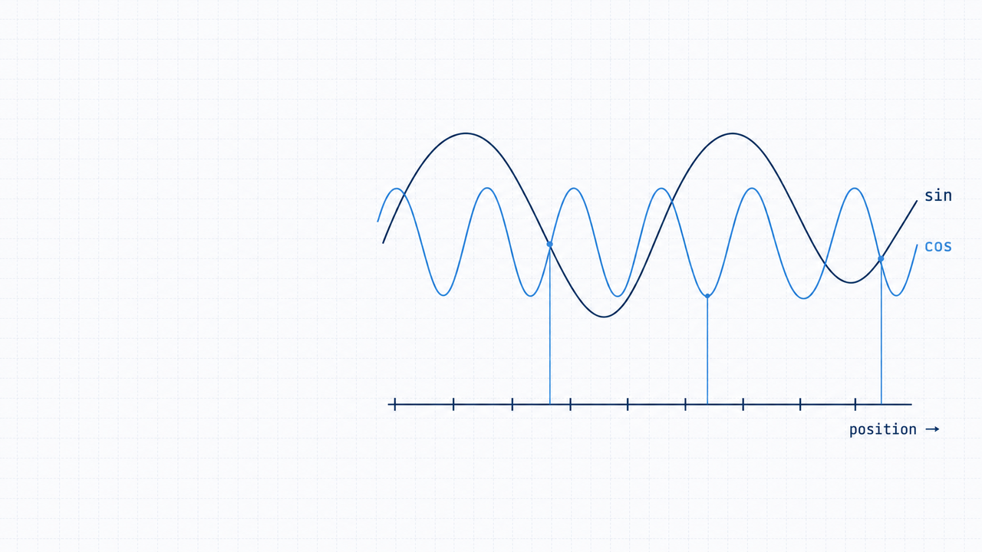
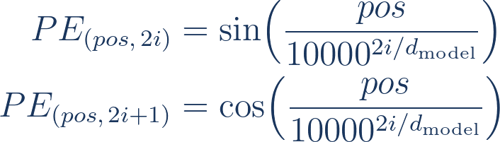
§3.5 · POSITIONAL ENCODING
Recovering order
without recurrence
No recurrence and no convolution means the model has
no built-in notion of token order. Add a deterministic
sinusoidal position vector to each input embedding —
order is injected, not learned.
WHY SINUSOIDS
Wavelengths form a geometric progression
from 2π up to 10000·2π. For any fixed offset k,
PE(pos + k)
is a linear function of PE(pos) — so the model
can easily learn to attend by relative position.
EQUATION
11
Notes:
Because there is no recurrence and no convolution, the model has no built-in notion of token order. The authors recover order with a deterministic sinusoidal positional encoding added to each input embedding. Even dimensions use a sine wave, odd dimensions use a cosine wave, and the wavelengths form a geometric progression from two pi up to ten thousand times two pi. The neat property is that for any fixed offset k, the encoding at position pos plus k is a linear function of the encoding at pos — so the model can easily learn to attend by relative position via a simple linear combination. Order is injected, not learned.

Slide 12
Complexity per layer, sequential ops, max path length
TABLE 1 · WHY SELF-ATTENTION · n = sequence length, d = representation dim
LAYER TYPE
COMPLEXITY PER LAYER
SEQUENTIAL OPS
MAX PATH LENGTH
Self-Attention
O(n² · d)
O(1)
O(1)
the Transformer
Recurrent
O(n · d²)
O(n)
O(n)
RNN / LSTM / GRU
Convolutional
O(k · n · d²)
O(1)
O(log_k n)
kernel width k
Self-Attention (restricted)
O(r · n · d)
O(1)
O(n / r)
window r around each position
READ THE TABLE LIKE THIS
Self-attention pays O(n²·d) compute, but in return any two positions are one hop apart.
For typical NLP where n < d (sequence shorter than representation), self-attention is faster than recurrent layers
— and it learns long-range dependencies more easily.
Source: Vaswani et al. 2017, Table 1 (§4 Why Self-Attention)
12
Notes:
This is table one from the paper, and it is the strongest argument for self-attention. A self-attention layer pays O of n squared times d in compute, but in exchange every pair of positions is exactly one operation apart. A recurrent layer pays O of n times d squared, but it takes O of n sequential operations and the maximum path length between two positions is O of n. Convolutional layers fall in between. For typical NLP workloads where the sequence length is shorter than the representation dimension, self-attention is actually faster than recurrence — and the constant path length makes long-range dependencies far easier to learn.

Slide 13
How they trained it
TRAINING SETUP · §5 WMT'14 ENGLISH-GERMAN & ENGLISH-FRENCH
HARDWARE & SCALE
TRAINING TIME
8 × NVIDIA P100
base
12 h
· 100k steps
One machine, eight GPUs — a single-node setup.
big
3.5 d
Batches of ~25,000 source + 25,000 target tokens,
· 300k steps
grouped by similar sequence length for efficiency.
A small fraction of the training cost of prior best models.
OPTIMIZER
REGULARIZATION
Adam
Dropout
p = 0.1
β₁ = 0.9 · β₂ = 0.98 · ε = 1e-9
on every sub-layer output and on the sum of embedding + PE.
Custom learning-rate schedule:
Label smoothing
ε_ls = 0.1
lr ∝ min(step⁻⁰·⁵, step · warmup⁻¹·⁵)
Slightly hurts perplexity, but improves BLEU and accuracy.
warm up for 4,000 steps, then decay as 1/√step.
Source: Vaswani et al. 2017, §5.1 Training Data and Batching · §5.2 Hardware and Schedule · §5.3 Optimizer · §5.4 Regularization
13
Notes:
A quick word on how this was trained. The base model trains in twelve hours on eight P100 GPUs in one machine; the big model trains in three and a half days on the same hardware. Batches were grouped by similar sequence length to keep about twenty-five thousand source and twenty-five thousand target tokens per batch. The optimizer is Adam with beta two pushed up to 0.98, and a custom learning rate schedule that warms up linearly for four thousand steps then decays as one over the square root of the step count. Regularization is dropout at 0.1 applied to every sub-layer output and to the sum of embedding and positional encoding, plus label smoothing of 0.1.

Slide 14
New SOTA on WMT'14 — at a fraction of the cost
TABLE 2 · BLEU SCORES + TRAINING-COST FLOPS · BEST PRIOR ROWS VS TRANSFORMER
MODEL
EN → DE BLEU
EN → FR BLEU
TRAIN FLOPs
ByteNet
23.75
—
—
ConvS2S
25.16
40.46
9.6 × 10¹⁸
MoE
26.03
40.56
2.0 × 10¹⁹
ConvS2S Ensemble
26.36
41.29
7.7 × 10¹⁹
Transformer (base)
27.3
38.1
3.3 × 10¹⁸
N=6, d_model=512, h=8
Transformer (big)
28.4
41.8
2.3 × 10¹⁹
N=6, d_model=1024, h=16
THREE RESULTS WORTH NAMING
· EN-DE — Transformer (big) beats the prior best ensemble by +2.0 BLEU, single model.
· EN-FR — new single-model SOTA at 41.8 BLEU.
· Training cost — well below most strong baselines; base model trains in 12 hours.
Source: Vaswani et al. 2017, Table 2 (§6.1 Machine Translation)
14
Notes:
Here are the headline results — table two from the paper. The Transformer big scores 28.4 BLEU on English to German, beating the previous best ensemble by two full BLEU points as a single model. On English to French it scores 41.8, a new single-model state of the art. And it does all this with about 2.3 times 10 to the 19 training floating-point operations, which is well below most strong baselines. The base model alone, trained in twelve hours, already beats almost every prior published model. The combination of better quality and lower training cost is what made this paper land so hard.

Slide 15
Five takeaways from the variation study
TABLE 3 ABLATIONS · WHAT THE ARCHITECTURE NEEDS TO STAY GOOD
01
Head count has a sweet spot
Single head loses −0.9 BLEU vs h = 8; too many heads (h = 32) also degrade. Eight is empirically right.
02
Key dim matters more than value dim
Reducing d_k hurts quality more than reducing d_v — determining compatibility is the harder learning problem.
03
Bigger is better
Larger d_model and deeper stacks consistently improve BLEU — the architecture scales monotonically with capacity.
04
Dropout is essential
Removing dropout loses ~0.5–1.0 BLEU. Even p = 0.1 measurably regularizes — it isn't decorative.
05
Label smoothing helps BLEU (and hurts perplexity)
Slightly worse perplexity, better BLEU. Optimize for the metric you ship on.
Source: Vaswani et al. 2017, Table 3 (§6.2 Model Variations)
15
Notes:
The variation study in table three gives us five takeaways worth remembering. First, head count has a sweet spot: a single head loses about 0.9 BLEU compared to eight heads, but going to thirty-two also degrades. Second, the key dimension matters more than the value dimension — determining compatibility is the harder learning problem. Third, scaling up the model dimension and the depth consistently improves quality, so the architecture scales monotonically with capacity. Fourth, dropout is essential — removing it loses roughly half a BLEU to a full BLEU point even at p equals 0.1. Fifth, label smoothing slightly hurts perplexity but improves BLEU, which is a reminder to optimize for the metric you actually ship on.

Slide 16
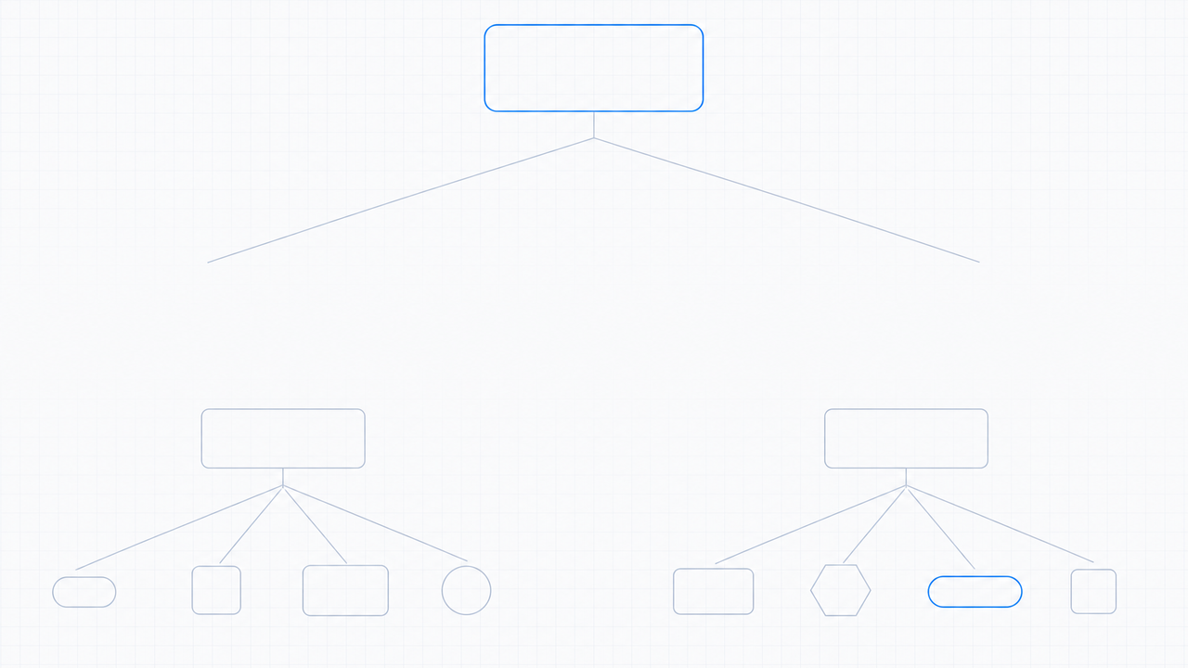
CLOSING · WHAT THIS PAPER STARTED
One paper, a generation
of models
The 2017 idea — just attention — turned out to be the right inductive bias
for almost every modality.
DESCENDANTS · A NON-EXHAUSTIVE FAMILY
BERT
GPT
T5
ViT
CLIP
AlphaFold
LLaMA
Claude
— and most modern LLMs trace their architecture back to this one paper.
Vaswani et al. · "Attention Is All You Need" · NeurIPS 2017 · arXiv:1706.03762
16
Notes:
To close — this 2017 paper turned out to be one of the most consequential architectural ideas in modern machine learning. The Transformer became the substrate for BERT, for GPT, for T5, for the Vision Transformer, for AlphaFold, for CLIP, for almost every large language model in production today, including the one talking to you right now. The core insight — that just attention, with no recurrence and no convolution, is the right inductive bias for sequence modeling — turned out to generalize far beyond translation, to almost every modality we work with. One paper, a generation of models.

