Slide 1

Kimsoong Customer
Loyalty Programme
Strategic Framework for Customer Retention & Growth
European Headquarters|Strategic Proposal|April 2026
CONFIDENTIAL
Notes:
Good morning / afternoon. Thank you for making time for this presentation.
Today, I'm presenting a strategic framework for the Kimsoong Customer Loyalty Programme — a programme designed to transform our customer relationships across European operations.
[Pause]
The challenge is clear, and the opportunity is significant. Let's walk through it together.
Key points: ① Strategic loyalty programme proposal ② Targeting European HQ senior management ③ Data-driven, phased approach
Duration: 1 minute

Slide 2
Only 15% of Customers Return — A Critical Retention Gap
The cost of acquiring a new customer is 5-7x retaining an existing one. With only 15% repeat purchases, Kimsoong is leaving significant lifetime value on the table.
15%
78%
52%
Repeat Buyer Rate
Fair / Poor After-sales Rating
Lost to Competitors
vs. industry benchmark ~40%
Only 33% rate service as Good or above
Largest driver of customer churn
"With 85% of customers not returning, every lost buyer represents
3-4 potential vehicle purchases over the next decade."
Questionnaire return rate: only 40% — current customer data is incomplete and unreliable
Source: Kimsoong Customer Service Department
CONFIDENTIAL
2
Notes:
[Transition] Let me begin with why this matters — the numbers speak for themselves.
Only 15% of our customers come back for a second purchase. [Pause] That's against an industry benchmark of roughly 40%. [Data] We're losing 85 out of every 100 customers after their first transaction.
78% rate our after-sales care as Fair or Poor. And 52% — more than half — leave us for a competitor's model. [Benchmark] The cost of acquiring a new customer is 5 to 7 times the cost of retaining an existing one. With only 15% repeat purchases, we're leaving significant lifetime value on the table.
[Scan Room] Every lost customer represents 3 to 4 potential vehicle purchases over the next decade.
Key points: ① 15% repeat rate vs 40% industry benchmark ② 78% after-sales dissatisfaction ③ 52% lost to competitors — addressable churn
Duration: 2 minutes

Slide 3
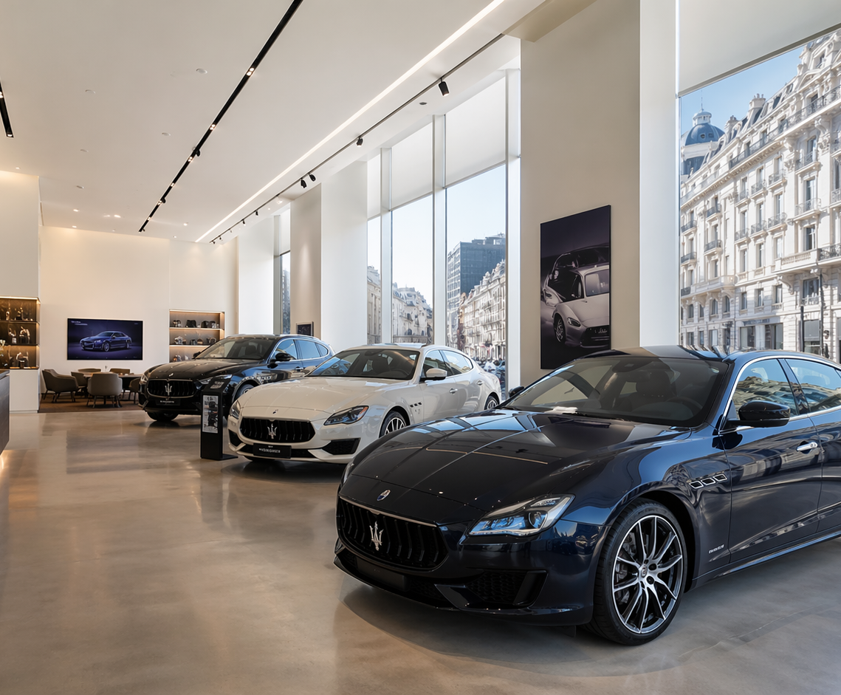
Strong Brand Assets Provide Foundation for Loyalty Strategy
Brand equity is high — the gap is in post-purchase experience, not product appeal. Kimsoong's eco-conscious image and value positioning are strategic differentiators.
Brand Strengths
• Reputation for reliability at competitive prices
• Standard "extras" included (competitors charge extra)
• Strong eco-conscious brand image
European Footprint
• HQ near Paris; franchises across most EU countries
• Sales + Service + Tyres/Exhausts + Used Cars
• 10-year market share growth at lower end
R&D Pipeline
• "Eco-car" with alternative power source in development
• Major donations to environmental groups
• Positions brand for future green regulation compliance
Loyalty Programme Cost Model:
50/50 cost-sharing between head office and European franchises — minimises per-unit investment risk
Key Constraint:
Profit pressure means objectives must be achieved at low cost — high-ROI initiatives are essential
Source: Kimsoong European HQ Briefing
CONFIDENTIAL
3
Notes:
[Transition] But here's the encouraging part — our brand foundation is strong.
Kimsoong has built genuine brand equity. Our reputation for reliability at competitive prices, our standard "extras" package, and our eco-conscious image are real differentiators. We've grown market share at the lower end for ten consecutive years.
[Data] We have franchises across most European countries, covering sales, service, tyres, and used cars. And our R&D pipeline includes the eco-car with alternative power source — perfectly aligned with the environmental consciousness of our customer base.
[Pause] The gap is not in product appeal. It's in post-purchase experience. Brand equity is high — we need to match it with service excellence.
Key points: ① Strong brand assets (reliability, value, eco-image) ② Pan-European franchise network ③ Gap is service, not product
Duration: 2 minutes

Slide 4
Young, Employed, Middle-Income — High Lifetime Value Potential
75% of Kimsoong buyers are under 40 and employed — a demographic with 3-4 vehicle purchase cycles ahead. Gender split is near-even (52M / 48F).
Age Distribution
Income Distribution
Under 30
48%
Higher
5%
31–40
27%
Middle
82%
75%
41–50
15%
Over 50
10%
Lower
16%
Under 40
↑ Young base = long customer lifetime
82% middle income — price-sensitive but financially stable.
Ideal for value-driven loyalty incentives (discounts, trade-ins).
Occupation Breakdown
Customer Interests (Ranked)
Employed
75%
1
Eating / Drinking
5
Health / Fitness
Self-employed
15%
2
Sport
6
Reading
Student
8%
3
Travel
7
The Arts
Retired
2%
4
Environment ★
8
Politics
Environment ranks #4 — aligns with Kimsoong's eco-brand.
90% are working professionals — active economic participants with purchasing power
Loyalty programme can leverage eco-positioning for deeper engagement.
Source: Kimsoong Customer Questionnaire (n=40% response rate)
CONFIDENTIAL
4
Notes:
[Transition] Who exactly are our customers? The data reveals a high-potential demographic.
[Data] 75% of Kimsoong buyers are under 40 — 48% are under 30. These are young professionals with potentially 3 to 4 vehicle purchase cycles ahead of them. The gender split is near-even at 52% male, 48% female.
82% sit in the middle income bracket — price-sensitive but financially stable. 90% are working professionals — employed or self-employed. [Benchmark] This is exactly the demographic that responds to value-driven loyalty incentives.
And here's a strategic alignment point: Environment ranks fourth in customer interests. [Pause] Our eco-brand positioning is not just marketing — it resonates with who our customers actually are.
Key points: ① 75% under 40 — long customer lifetime potential ② 82% middle income — ideal for value-driven incentives ③ Environment interest aligns with eco-brand strategy
Duration: 2 minutes

Slide 5
After-Sales Service: High Importance, Critically Low Satisfaction
After-sales ranks #4 in customer priorities but only 33% rate it Good or above — the single largest gap between what customers want and
what they receive. This is the strategic intervention point.
100%
After-Sales Rating
Excellent
4%
Economy
~80%
Price
Very Good
12%
75%
~75%
Reliability
Good
17%
~70%
Perf.
— 33% threshold —
GAP
Warranty
~60%
Fair
61%
~55%
Satisfaction Level (%)
50%
Poor
6%
After-
67% Dissatisfied
Sales
(Fair + Poor combined)
33%
25%
Data Quality Warning
Only 40% questionnaire return
rate — potential response bias
CRITICAL GAP ZONE
0%
#1
#2
#3
#4
#5
#6
Customer Priority Ranking (1 = Highest)
Source: Customer Priority Survey & After-Sales Satisfaction Survey
CONFIDENTIAL
5
Notes:
[Transition] Now, let's map what customers want against what they're actually getting.
This matrix plots customer priority ranking against satisfaction level. [Data] Economy and price — our top two customer priorities — show strong satisfaction. Reliability, ranked third, also performs well. Kimsoong's value proposition is working where it matters most.
[Pause] But look at after-sales service. It ranks fourth in customer priorities — meaning customers genuinely care about it. Yet only 33% rate it as Good or above. 61% rate it merely Fair, and 6% rate it Poor. [Benchmark] That's a 67% dissatisfaction rate on a high-priority service element.
One data quality note: our questionnaire return rate is only 40%. [Scan Room] The real picture could be even worse than what we're seeing.
Key points: ① After-sales: high priority, critically low satisfaction ② 67% dissatisfied (Fair + Poor combined) ③ 40% questionnaire return rate — data quality gap
Duration: 2 minutes

Slide 6
78% of Customer Loss Is Addressable — Competitors and Service Dominate
78% of churn is within Kimsoong's control. Service improvement and competitive positioning are the two levers. Only 13% of losses
(relocation + no longer driving) are truly uncontrollable.
Reason for Not Repurchasing
Bought competitor's model
52%
78% Addressable
Disappointed with service
26%
— uncontrollable —
Don't know
9%
Relocated
8%
No longer drive
5%
Cumulative % of Addressable Churn
Competitors: 52%
Service: 26%
Uncontrollable: 22%
Strategic Implication
Two levers control 78% of churn: (1) Competitive positioning — enhance value proposition to prevent switching;
(2) Service excellence — address the #1 dissatisfaction driver. The loyalty programme must target both.
Source: Kimsoong Customer Services — Non-repurchase Reasons Analysis
CONFIDENTIAL
6
Notes:
[Transition] Let's decompose why customers don't come back.
[Data] 52% bought a competitor's model — that's our largest single driver. 26% were disappointed with our service. Together, that's 78% of all customer loss. [Pause] And both of these are within our control.
The remaining 22% — relocated, no longer driving, or unknown — are largely uncontrollable. But 78% is addressable. [Benchmark] That means for every 100 customers we lose, we have the potential to retain 78 of them through better service and competitive positioning.
[Pause] The loyalty programme must target both levers: enhance the competitive value proposition to prevent switching, and fundamentally improve the after-sales experience to eliminate service-driven churn.
Key points: ① 78% of churn is addressable ② Two levers: competitive positioning + service excellence ③ Only 13% of losses are truly uncontrollable
Duration: 2 minutes

Slide 7
A Four-Pillar Framework to Transform Customer Relationships
From transactional sales to enduring loyalty — a strategic architecture for Kimsoong Europe
RELATIONSHIPS
LOYALTY
Build Long-term
Increase Customer
Relationships
Loyalty
→ Increase profits
15% → 30%+ repeat rate
Customer
Loyalty
Programme
PROFILING
ENGAGEMENT
Cost model:
50/50 shared with head office
Accurate Buyer
Staff
Profiling
Engagement
→ Data-driven decisions
→ Service excellence
Source: Kimsoong Customer Services Department — Strategic Framework
CONFIDENTIAL
7
Notes:
[Transition] Based on this diagnosis, we propose a four-pillar strategic framework.
At the centre is the Customer Loyalty Programme itself. It radiates into four interconnected objectives. [Pause]
First: Build long-term relationships to increase profits — moving from transactional to relational. Second: Increase customer loyalty — our target is to move repeat buyer rate from 15% to 30% or above. Third: Accurate buyer profiling — data-driven decisions require better data. Fourth: Staff engagement — because service excellence requires frontline buy-in.
The cost model is pragmatic: 50/50 shared between head office and European franchises. This minimises per-unit investment risk while ensuring aligned incentives.
[Scan Room]
Key points: ① Four pillars: Relationships, Loyalty, Profiling, Engagement ② Target: 15% → 30%+ repeat rate ③ 50/50 cost-sharing model
Duration: 2 minutes

Slide 8
Prioritize Service and Data — Financial Incentives Follow
Lead with service; follow with incentives. The branded pen initiative has the highest ROI for data collection (projected 40% → 70% response rate).
INITIATIVE
IMPACT
COST
ROI SIGNAL
1
3-Year Free After-Sales Service
HIGH
Med-High
Reduces 26% service
churn → high CLV gain
Directly addresses #1 pain point — transforms service from
cost center to loyalty driver
2
20% Loyalty Discount
HIGH
Medium
Counters competitor pull
Financial incentive — directly lowers switching barrier for repeat buyers
3
Enhanced Trade-in Programme
MEDIUM
Low-Med
Captures used car value
Generous trade-in offers reduce switching barrier and lock customers in ecosystem
4
Customer Magazine
LOW-MED
Low
Brand affinity uplift
Free monthly magazine with owner features — builds emotional connection and brand community
5
Questionnaire Incentive (Branded Pen)
MEDIUM
Very Low
★ Highest ROI
Premium branded pen for completing lifestyle questionnaires — improves data quality (40% → 70%)
40% → 70% response rate
Source: Director A & Director B Proposals — Consolidated & Prioritized
CONFIDENTIAL
8
Notes:
[Transition] Let me walk you through the five specific initiatives we're recommending, in priority order.
Number one — and this is our flagship recommendation — 3-Year Free After-Sales Service. [Pause] This directly addresses the number one pain point. Impact is high, cost is medium-to-high, but it targets the 26% service churn directly.
Number two: 20% Loyalty Discount for existing customers buying new models. A powerful financial incentive to counter the competitor pull.
Number three: Enhanced Trade-in Programme. Generous trade-in offers lock customers into our ecosystem.
Number four: Customer Magazine. Low cost, builds emotional connection and brand community.
[Pause] And number five — this one has the highest ROI of all — the Questionnaire Incentive. A premium branded pen for completing lifestyle questionnaires. Very low cost, but it could move our response rate from 40% to 70%. [Data] Better data means better decisions.
[Scan Room] The strategic sequence matters: lead with service, follow with incentives.
Key points: ① Flagship: 3-Year Free After-Sales Service ② Highest ROI: Branded pen questionnaire incentive ③ Sequence: service first, then financial incentives
Duration: 3 minutes
Flex: [If time is tight, focus on initiatives 1 and 5, skip detail on 3 and 4]

Slide 9
Quick Wins First, Then Systematic Service Transformation
A phased 12-month rollout — launch low-cost, high-data-value initiatives first, then scale to service and financial incentives as infrastructure matures.
Q1
Q2
Q3
Q4
Phase 1: Quick Wins
Phase 2: Service Uplift
Phase 3: Incentives
Phase 4: Evaluate
Launch Magazine
3-Year Free After-
20% Loyalty Discount
Measure KPIs
Monthly customer publication
sales Service
For existing customers on
Track repeat rate, satisfaction,
with owner stories
Roll out across all European
new model purchases
questionnaire return metrics
franchise locations
Deploy Questionnaire
Addresses 26% service churn
Trade-in Programme
Adjust Programme
Incentive
Generous trade-in offers for
Refine based on data;
Branded pen programme
Staff training programme
existing Kimsoong vehicles
prepare Year 2 plan
for data collection
Cost: Very Low | Impact: Quick Data
Cost: Med-High | Impact: Core Fix
Cost: Medium | Impact: Retention
Cost: Low | Impact: Optimization
12-Month KPI Targets
Repeat Buyer Rate
Satisfaction (Good+)
Questionnaire Return Rate
15%
→
30%+
33%
→
60%
40%
→
70%
DATA FOUNDATION
SERVICE TRANSFORMATION
FINANCIAL INCENTIVES
OPTIMIZE
Source: Kimsoong Customer Services — Implementation Plan
CONFIDENTIAL
9
Notes:
[Transition] Now, how do we execute this? We propose a phased 12-month rollout.
Phase 1, Q1: Quick Wins. Launch the customer magazine and deploy the questionnaire incentive. Both are low-cost, immediately actionable, and start building our data foundation.
Phase 2, Q2: Service Uplift. Roll out the 3-Year Free After-Sales Service across all franchise locations. This is the core transformation — it requires staff training and operational alignment.
Phase 3, Q3: Financial Incentives. Activate the 20% loyalty discount and the enhanced trade-in programme. By this point, the service foundation is in place.
Phase 4, Q4: Evaluate and Optimize. Measure KPIs, refine the programme, and prepare for Year 2.
[Data] Our 12-month targets: repeat buyer rate from 15% to 30%, satisfaction from 33% to 60% Good or above, questionnaire return from 40% to 70%. [Pause] All achievable with disciplined execution.
Key points: ① Quick wins in Q1 build data foundation ② Core service fix in Q2 ③ Three KPI targets: 30% repeat, 60% satisfaction, 70% questionnaire return
Duration: 2 minutes

Slide 10

Customer Retention Is the Highest-ROI
Growth Lever for Kimsoong Europe
"Transforming 15% repeat buyers into 30%+ is achievable
within 12 months with a phased, data-driven loyalty programme."
1
Fix after-sales service first
It's the #1 reason customers leave — 26% churn is directly service-related
2
Build data capability
40% questionnaire return rate is a strategic blind spot — the branded pen closes this gap at minimal cost
3
Phase financial incentives after service foundation
Discounts and trade-ins amplify — but cannot substitute for — a strong service experience
Approve Q1 Launch of Phase 1 Quick Wins
Kimsoong Customer Services Department | European Headquarters
CONFIDENTIAL
10
Notes:
[Transition] Let me close with the strategic imperative.
Customer retention is the highest-ROI growth lever for Kimsoong Europe. [Pause]
Three things must happen: Fix after-sales service first — it's the number one reason customers leave. Build data capability — our 40% questionnaire return rate is a strategic blind spot. And phase financial incentives after the service foundation is in place.
[Pause] Transforming 15% repeat buyers into 30% or more is achievable within 12 months. The framework is ready. The data supports it. The cost model is shared.
[Scan Room] We are asking for approval to launch Phase 1 quick wins in Q1. The investment is minimal, the data returns are immediate, and it sets the foundation for everything that follows.
Thank you.
Key points: ① Customer retention = highest-ROI growth lever ② Three imperatives: service → data → incentives ③ Requesting Q1 launch approval
Duration: 2 minutes

