Slide 1
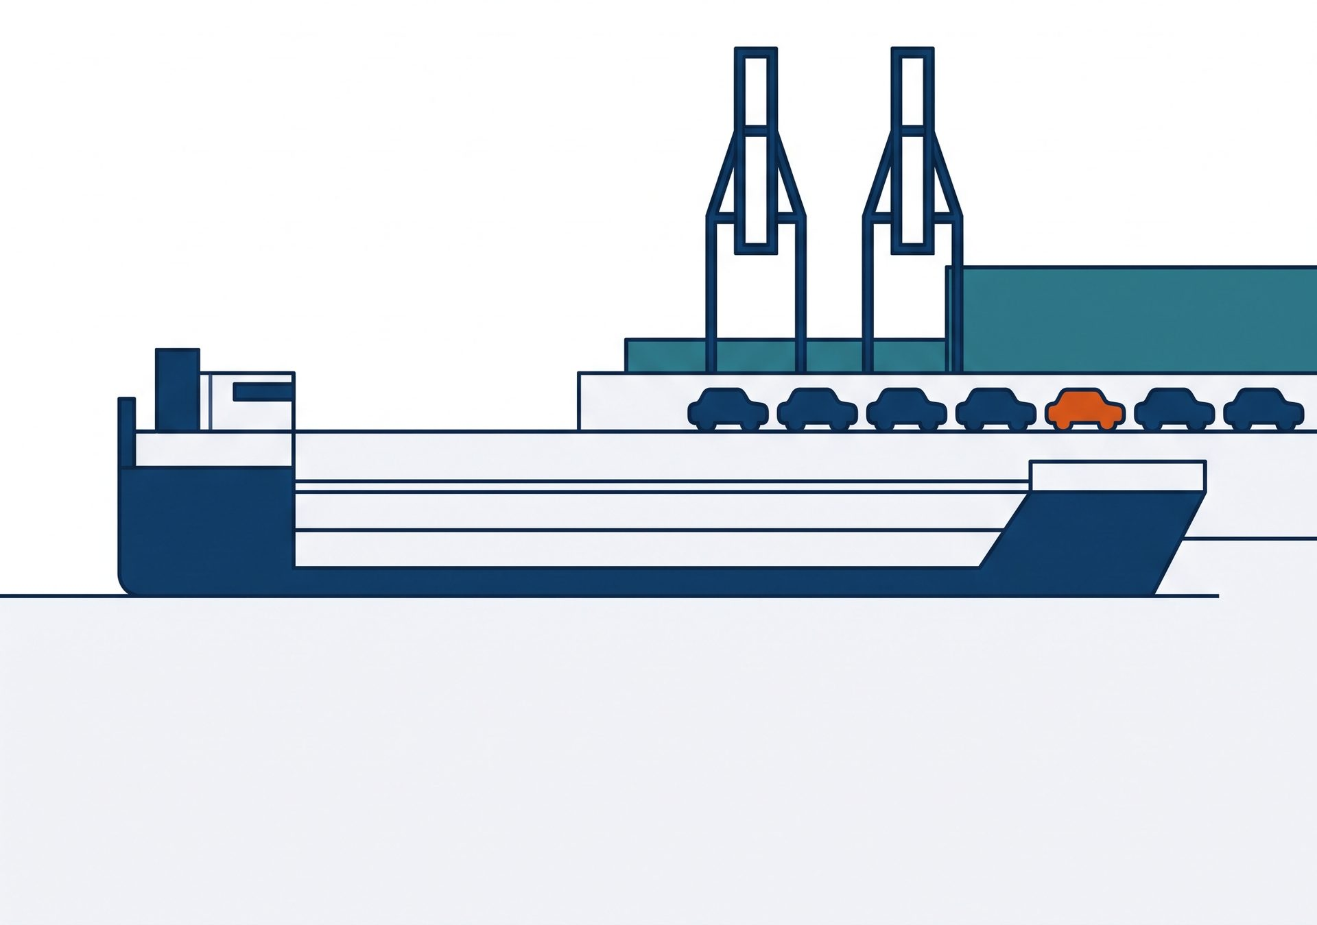
行业简报 · 公开数据
中国新能源汽车
出海 2025
China's NEV Exports 2025
出口翻倍,但增长方式变了
Exports doubled — the growth model changed
口径:中汽协为主,乘联分会并列标注 · 15 页
Calibres: CAAM primary,
CPCA shown alongside · 15 slides
2026-09
数据来源:中国汽车工业协会、乘联分会、欧盟委员会、USTR 等公开发布(2024–2026)
Sources: CAAM, CPCA, European Commission, USTR (2024–2026)
Notes:
这份简报只讲一件事:2025 年中国新能源汽车出口翻了一倍,但真正值得两边同事一起讨论的,是增长方式已经变了。全部数据来自公开发布来源,以中国汽车工业协会口径为主,乘联分会口径在同一页并列标注,每页底部都写明机构与年份,方便会后各自引用核对。今天大约三十分钟,四个部分。
This briefing makes one point: China's NEV exports doubled in 2025, but what matters for both sides is that the growth model itself has changed. Every figure comes from public sources, CAAM first, with CPCA shown alongside on the same page, and each page footer names the institution and the year so you can cite it afterwards. About thirty minutes, four parts.

Slide 2
本次简报的四个部分
Four Parts of This Briefing
从规模到方式,再到规则:四个部分回答四个问题。
From scale to method to rules — four parts, four questions.
1
2
3
4
规模与口径
市场与企业
本地化
壁垒与展望
Scale & Calibres
Markets & Players
Localization
Barriers & Outlook
出口了多少,
按谁的口径
卖到哪里,
谁在卖
为什么开始
在当地造车
规则怎么变,
2026 怎么看
How much, and on
whose count
Where they go,
who ships them
Why plants follow
shipments
Rule shifts and the
2026 view
部分顺序即本简报的论证顺序 / Part order is the order of the argument
02 / 15
Notes:
四个部分依次回答四个问题:第一部分先把规模和口径说清楚,出口了多少、按谁的口径;第二部分讲卖到哪里、谁在卖;第三部分解释为什么开始在当地造车;第四部分是规则怎么变、2026 年怎么看。部分顺序就是论证顺序,如果只关心某一段,可以直接跳到那一部分。
The four parts answer four questions in order: how much was exported and on whose count; where the cars went and who shipped them; why plants are replacing shipments; and how the rules are changing into 2026. The order of the parts is the order of the argument, so feel free to jump to the part you care about.

Slide 3
先说口径:同一年有两个数字
一 规模与口径
Two Calibres, One Year
Part 1 · Scale & Calibres
本简报以中汽协为主口径,乘联分会口径并列标注,两者不相加、不折中。
CAAM is the primary calibre here; CPCA figures are shown alongside — never added together or averaged.
中国汽车工业协会
乘联分会
CAAM
CPCA
引用规则
2025 年新能源汽车
出口 261.5 万辆
同年 343 万辆,
统计范围更宽
How to cite
每页底部标注机构
与年份
2.615m NEVs exported in 2025
3.43m on a wider definition
Every page names its
source and year
本简报主口径
并列标注,不相加
本页为编者整理:口径对照由调研来源整理而成,非任一来源的原文表述。
Editor's note — this comparison is our reading of the sources, not a quotation from any one of them.
来源:中国汽车工业协会(2026)、乘联分会崔东树(2026) / Sources: CAAM 2026; CPCA 2026
03 / 15
Notes:
在看任何数字之前,先讲口径,否则两边引用的数据永远对不上。中国汽车工业协会的口径是 2025 年新能源汽车出口 261.5 万辆,这是本简报的主口径;乘联分会同一年给出的是 343 万辆,统计范围更宽。两个数字都对,差别在统计范围,所以我们既不相加也不折中,而是在需要时并列标注。本页的口径对照是编者按调研来源整理的,不是任何一家机构的原文表述。
Before any number, a word on calibres, otherwise the two sides will never quote the same figure. CAAM puts 2025 NEV exports at 2.615 million units, and that is the primary calibre here. CPCA gives 3.43 million for the same year on a wider definition. Both are correct; the difference is scope, so we never add them together or average them. This comparison is our own reading of the sources, not a quotation from either institution.

Slide 4
总量 709.8 万辆,增量全部来自新能源
一 规模与口径
All the Growth Came from NEVs
Part 1 · Scale & Calibres
汽车出口 709.8 万辆,同比 +21.1%
Total vehicle exports 7.098m units, +21.1% YoY
709.8
新能源汽车 261.5 万辆,同比 +103.7%
NEVs 2.615m units, +103.7% YoY
万辆 · 10k units
传统燃料汽车 448.3 万辆,同比 −2%
ICE vehicles 4.483m units, −2% YoY
新能源占出口总量约 36.8%(由前两项计算)
新能源 NEV 261.5 万辆 · 36.8%
≈36.8% of all vehicle exports (calculated)
传统燃料 ICE 448.3 万辆 · 63.2%
来源:中国汽车工业协会,2026 年 1 月发布 / Source: CAAM, released January 2026
04 / 15
Notes:
2025 年中国汽车出口总量 709.8 万辆,同比增长 21.1%。拆开看,新能源汽车 261.5 万辆,同比增长 103.7%,几乎正好翻了一倍;传统燃料汽车 448.3 万辆,同比下降 2%。也就是说,这一年的增量全部来自新能源,燃油车已经在收缩。按这两个数计算,新能源约占出口总量的 36.8%,这个百分比是我们自己算的,不是来源里的原始数字。
Total vehicle exports reached 7.098 million units in 2025, up 21.1 percent. Within that, NEVs were 2.615 million, up 103.7 percent — almost exactly double — while conventional vehicles fell 2 percent to 4.483 million. All of the growth came from NEVs; the combustion side is already shrinking. From those two figures NEVs are about 36.8 percent of exports, and that share is our calculation rather than a number taken from the source.

Slide 5
不是匀速,是两级台阶
一 规模与口径
Not Steady Growth, but Two Steps
Part 1 · Scale & Calibres
中汽协口径新能源汽车出口:2022–2025 年四个年度值 / CAAM calibre, NEV exports by year, 2022–2025
单位:万辆 · Unit: 10k units
300
261.5
2023→2024 仅约 +6.7%,
2024→2025 直接翻倍
200
128.4
Almost flat in 2024, then
doubled in 2025
120.3
100
67.9
2025 · CAAM
261.5
0
2022
2023
2024
2025
万辆,同比 +103.7% / 10k units, +103.7%
来源:中国汽车工业协会(2023–2026);2022 年数值见国家发改委引述中汽协统计 / Sources: CAAM 2023–2026; NDRC citing CAAM for 2022
05 / 15
Notes:
把四年放在一起看,增长不是匀速的,而是两级台阶。2022 年 67.9 万辆,2023 年 120.3 万辆,到 2024 年只有 128.4 万辆,几乎走平,增幅大约 6.7%;2025 年直接跳到 261.5 万辆。所以用平均增速去推 2026 年是危险的,这条曲线的形状本身就说明它受政策和产能节奏影响很大。
Seen across four years the growth is not steady, it comes in two steps. From 679,000 units in 2022 to 1.203 million in 2023, then almost flat at 1.284 million in 2024, a rise of only about 7 percent, and then a jump to 2.615 million in 2025. Extrapolating from an average growth rate would be misleading; the shape of this line shows how strongly policy and capacity timing drive it.

Slide 6
261.5 还是 343 万辆,取决于谁在统计
一 规模与口径
It Depends Who Is Counting
Part 1 · Scale & Calibres
差异来自统计范围,不是数据打架:引用时必须带上机构名。
The gap is scope, not a contradiction — always cite the institution.
中国汽车工业协会
乘用车市场信息联席分会
CAAM · primary calibre here
CPCA · shown alongside
261.5
343
万辆,同比 +103.7% / 10k units, +103.7%
万辆,同比 +70% / 10k units, +70%
口径:新能源整车出口
口径:范围更宽,含更多类别
两者不相加、不折中;本简报后续各页默认中汽协口径。
Never added, never averaged — later pages default to CAAM.
同期整车出口均价 1.6 万美元,低于 2024 年的 1.8 万美元:量增价减。
Average export price fell to USD 16k from USD 18k — more units, lower value.
来源:中国汽车工业协会(2026);乘联分会崔东树(2026) / Sources: CAAM 2026; Cui Dongshu, CPCA 2026
06 / 15
Notes:
这一页把两个口径放在一起。中汽协 261.5 万辆,统计的是新能源整车出口;乘联分会 343 万辆,范围更宽,增速口径也不同,是同比增长 70%。两者不是矛盾,是范围不同,所以引用时一定要带机构名。还有一个值得注意的方向性事实:同期整车出口均价从 2024 年的 1.8 万美元降到 1.6 万美元,量在增、单价在降,这对海外经销商的定价和库存策略是直接相关的。
This page puts the two calibres side by side. CAAM counts 2.615 million NEVs; CPCA counts 3.43 million on a wider definition, with growth of 70 percent on its own basis. They do not contradict each other, they measure different things, so always cite the institution. One more directional fact matters: the average export price fell from eighteen thousand US dollars in 2024 to sixteen thousand in 2025. More units at a lower unit price bears directly on pricing and inventory decisions overseas.

Slide 7
第一目的国换成了墨西哥
二 市场与企业
Mexico Took the Top Spot
Part 2 · Markets & Players
2025 年墨西哥以 62.52 万辆 首次超过俄罗斯。
Mexico passed Russia for the first time in 2025.
墨西哥 Mexico
62.52
北美 N. America
俄罗斯 Russia
58.27
独联体 CIS
阿联酋 UAE
57.2
中东 Middle East
单位:万辆 · Unit: 10k units
前三名差距不到 6 万辆;第四至第六位为英国、巴西、沙特,本简报无确切数值,不作图。
Top three within 60k units; 4th–6th are the UK, Brazil and Saudi Arabia (not charted).
来源:乘联分会崔东树,2026 年 1 月;本页为整车出口统计,含燃油车 / Source: Cui Dongshu, CPCA, Jan 2026 — all vehicles, ICE included
07 / 15
Notes:
出口地图在 2025 年发生了位置变化。墨西哥以 62.52 万辆首次超过俄罗斯,成为中国汽车出口第一大目的国;俄罗斯 58.27 万辆,阿联酋 57.2 万辆。前三名之间的差距不到 6 万辆,谁排第一并不稳定,更重要的是三个市场分属北美、独联体和中东三个完全不同的准入环境。第四到第六位是英国、巴西和沙特,本简报没有拿到可核对的确切数值,所以没有画进图里。提醒一下,这一页是乘联分会的整车出口统计,包含燃油车。
The export map shifted in 2025. Mexico took first place for the first time with 625,200 units, ahead of Russia at 582,700 and the UAE at 572,000. The top three are within sixty thousand units of each other, so the ranking is not stable; what matters more is that the three sit in three completely different access regimes — North America, the CIS and the Middle East. Fourth to sixth are the UK, Brazil and Saudi Arabia, but we have no verified figures for them, so they are not charted. Note this page counts all vehicles, combustion included.

Slide 8
量第一与增速第一不是同一家
二 市场与企业
The Largest Is Not the Fastest
Part 2 · Markets & Players
奇瑞以 134.4 万辆保持出口第一,比亚迪以 +145% 的增速首破百万辆。单位:万辆。
Chery stays largest at 1.344m units; BYD grew +145% to pass one million. Unit: 10k vehicles.
企业 Company
2025 出口 Exports
同比 YoY
集团总销量 Group sales
奇瑞 Chery
134.4
+17.4%
280.6
上汽 SAIC
107.1
—
450.7
比亚迪 BYD
104.96
+145%
460.2
长安 Changan
63.7
+18.9%
291.3
长城 GWM
50.6
+11.7%
132.4
补充:上汽 MG 品牌欧洲销量 30 万辆以上(同比接近 +30%);比亚迪出口约占其总销量 23%;上汽通用五菱出口 26.7 万辆,同比 +128.6%。
Also: MG sold 300k+ in Europe (≈+30%); exports are ≈23% of BYD sales; SGMW exported 267k (+128.6%).
来源:各企业公布数据,2026 年 1 月行业盘点 / Source: company disclosures, industry review, Jan 2026
08 / 15
Notes:
出口量第一和增速第一不是同一家,这一点对合作方判断对手很关键。奇瑞以 134.4 万辆继续保持中国车企出口第一,同比增长 17.4%,集团总销量 280.6 万辆;上汽出口 107.1 万辆;比亚迪海外销量 104.96 万辆,同比增长 145%,首次突破百万辆。长安 63.7 万辆,长城 50.6 万辆,增速都在两位数以内。补充三个事实:上汽 MG 品牌在欧洲卖了 30 万辆以上,同比接近 30%;比亚迪的出口约占它自己总销量的 23%;上汽通用五菱出口 26.7 万辆,同比增长 128.6%。
The largest exporter and the fastest-growing one are not the same company, which matters when you assess a counterpart. Chery remains first at 1.344 million units, up 17.4 percent, on group sales of 2.806 million. SAIC exported 1.071 million. BYD sold 1.0496 million abroad, up 145 percent, passing one million for the first time. Changan and Great Wall grew in the teens, at 637,000 and 506,000. Three additions: MG sold over 300,000 in Europe, up nearly 30 percent; exports are about 23 percent of BYD's own sales; and SGMW exported 267,000, up 128.6 percent.

Slide 9

建厂不是扩张动作,是回答三个问题
三 本地化
Local Plants Answer Three Questions
Part 3 · Localization
本地化同时回答关税、
交付与服务三个问题。
Local production answers tariffs,
delivery and service at once.
2026 年的增量更多来自海外产能,
而非整车出口。
The 2026 increment comes from overseas capacity.
示意图 / illustrative
一 出口整车
二 当地生产
三 当地网络
Shipping finished cars
Building locally
Local networks
受关税与运输成本直接约束
对冲关税,服务本地市场
充电与售后决定复购
Exposed to tariffs and freight
Hedges tariffs, serves locally
Service decides repeat sales
本页框架为编者按调研事实整理 / Framework: our reading of the sourced facts
09 / 15
Notes:
第三部分是本简报最想传达的判断。建厂常被理解为规模扩张,但从这几年的公开动作看,它同时回答三个问题。第一步出口整车,受关税和运输成本直接约束;第二步在当地生产,在欧洲是直接对冲关税并满足当地对投资的要求,在东南亚和拉美更多是服务本地与区域市场;第三步是当地网络,充电和售后决定复购,也决定品牌能不能留下来。这个三步框架是我们按调研事实整理的读法,不是某一家机构的原话。结论是,2026 年的增量更多来自海外产能,而不是整车出口。
Part three carries the judgement this briefing wants to leave you with. Building plants is usually read as expansion, but the public record of the past few years shows it answering three questions at once. Shipping finished cars is directly exposed to tariffs and freight. Producing locally hedges tariffs and meets investment expectations in Europe, while in Southeast Asia and Latin America it mainly serves local and regional demand. Local networks come third: charging and after-sales decide repeat purchase, and therefore whether a brand stays. This three-step framework is our reading of the sourced facts, not a quotation. The conclusion is that the 2026 increment comes more from overseas capacity than from shipments.

Slide 10
四个已落地的海外基地
三 本地化
Four Bases on the Ground
Part 3 · Localization
二 当地生产
四个基地覆盖两种目的:服务本地市场,或直接对冲关税。
Building locally
Two purposes: serving local demand, or hedging tariffs directly.
基地 Base
时间节点 Milestone
产能 Capacity
投资与就业 Investment & jobs
泰国 Rayong
2024-07 投产
约 15 万辆/年
同日下线第 800 万辆新能源车
巴西 Camaçari
2025-07 首车下线
15 万辆/年
55 亿雷亚尔(≈71 亿元),2 万岗位
匈牙利 Szeged
2026 Q2 量产
30 万辆/年
40 亿欧元(≈350 亿元)
西班牙 Barcelona
2024-11 投产
未披露
预计 1250 个当地岗位
匈牙利工厂 2026 年第一季度试生产,最大年产能 30 万辆、初期约 15 万辆;西班牙为合资工厂。
Szeged began trial production in Q1 2026 (300k peak, ≈150k initially); Barcelona is a joint venture.
来源:新华网(2024)、比亚迪官网(2025)、新浪财经(2026) / Sources: Xinhua 2024; BYD 2025; Sina Finance 2026
10 / 15
Notes:
四个已经落地的基地说明了这两种目的。泰国罗勇府工厂 2024 年 7 月 4 日竣工投产,年产能约 15 万辆,同一天下线了比亚迪第 800 万辆新能源汽车。巴西卡马萨里基地 2025 年 7 月 1 日首车下线,规划产能 15 万辆,投资 55 亿雷亚尔,约合 71 亿元人民币,预计带来 2 万个就业岗位。匈牙利塞格德工厂投资 40 亿欧元,约合 350 亿元人民币,最大年产能 30 万辆,初期约 15 万辆,2026 年第一季度试生产、第二季度量产。西班牙巴塞罗那自贸区的合资工厂 2024 年 11 月 23 日投产首款车型,有望带来 1250 个当地岗位。泰国和巴西偏向服务本地市场,匈牙利和西班牙则明显是对冲关税。
Four bases already on the ground show both purposes. Rayong in Thailand came on stream on 4 July 2024 with capacity of about 150,000 units a year, the same day BYD's eight-millionth NEV came off the line. Camaçari in Brazil produced its first car on 1 July 2025, planned at 150,000 units, on an investment of 5.5 billion reais, roughly 7.1 billion yuan, with an expected twenty thousand jobs. Szeged in Hungary carries a 4 billion euro investment, about 35 billion yuan, a peak capacity of 300,000 units and about 150,000 initially, with trial production in the first quarter of 2026 and volume production in the second. The joint-venture plant in the Barcelona free zone started its first model on 23 November 2024 and is expected to bring 1,250 local jobs. Thailand and Brazil lean towards serving local demand; Hungary and Spain are clearly about tariffs.

Slide 11
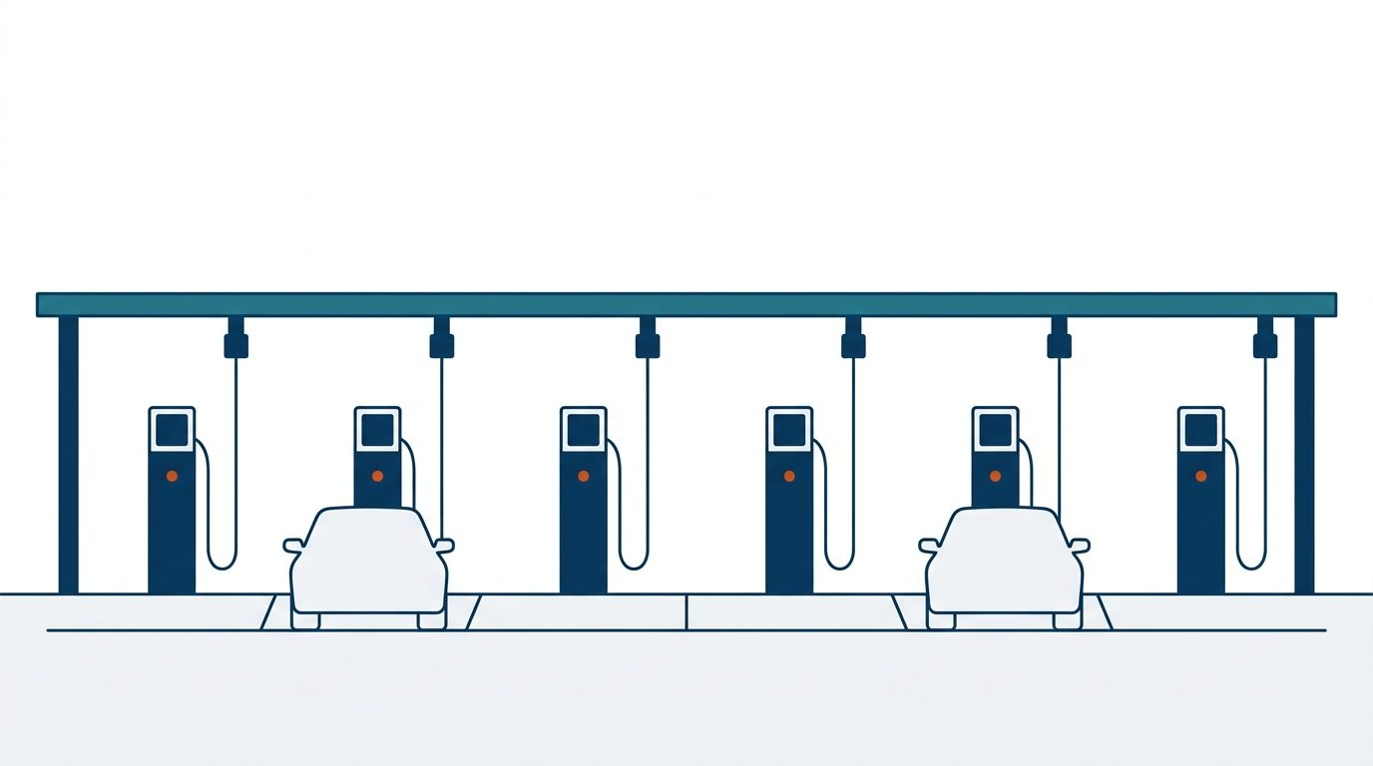
6000 座闪充站,和它为什么慢
三 本地化
6,000 Fast-Charging Sites, and Why It Is Slow
Part 3 · Localization
计划自 2026 年 3 月至 2027 年 3 月底在海外建成 6000 座闪充站
6,000 overseas fast-charging sites planned, March 2026 to March 2027
欧洲
美洲
亚太
合计
Europe
Americas
Asia-Pacific
Total sites
3000
2000
1000
6000
网络投入的两个现实
Two realities of network build-out
充电难与维修难,需要售后服务中心、
零件仓库与充换电设施同时配套。
Charging and repair gaps need service centres,
parts warehouses and charging sites together.
投入大、回报周期长;用地审批与
跨行业协作使进度常不及预期。
Heavy capex, slow payback, permits and partners.
示意图 / illustrative
来源:比亚迪李云飞,2026 年 7 月;行业出海观察 2025 / Sources: BYD (Li Yunfei), Jul 2026; industry review 2025
11 / 15
Notes:
卖出去只是开始。公开披露的计划是,自 2026 年 3 月到 2027 年 3 月底在海外建成 6000 座闪充站,其中欧洲 3000 座、美洲 2000 座、亚太 1000 座,这是比亚迪集团品牌及公关处总经理李云飞 2026 年 7 月给出的数字。量级很清楚,但推进通常慢于计划,原因也很具体:充电难和维修难要同时靠售后服务中心、零件仓库和充换电设施解决,基础设施投入大、回报周期长,再加上用地审批和跨行业协作,进度往往不及预期。对合作伙伴来说,这一段恰恰是可以共同出力的地方。
Selling the car is only the start. The disclosed plan is six thousand overseas fast-charging sites between March 2026 and the end of March 2027 — three thousand in Europe, two thousand in the Americas, one thousand in Asia-Pacific — a figure given by BYD's brand and public relations head Li Yunfei in July 2026. The scale is clear, but build-out usually runs behind plan for concrete reasons: charging and repair gaps have to be closed together through service centres, parts warehouses and charging sites; the capital outlay is heavy and payback slow; and land permits and cross-industry coordination add delay. For partners, this is exactly where joint effort pays.

Slide 12
一道按企业分级,一道一刀切
四 壁垒与展望
One Tiered, One Flat
Part 4 · Barriers & Outlook
欧盟按企业征收 7.8%–35.3% 反补贴税并叠加 10% 进口关税;美国统一提高到 100%。
EU: 7.8%–35.3% duties plus the 10% import duty. US: a flat 100%.
欧盟 · 分企业反补贴税率
美国 · 301 条款电动汽车关税
EU · countervailing duty by producer
US · Section 301 tariff on Chinese EVs
特斯拉 Tesla
7.8%
比亚迪 BYD
100%
17.0%
吉利 Geely
18.8%
自 2024 年 9 月 27 日起生效
未抽样加权 Others
20.3%
In force since 27 September 2024
上汽 SAIC
35.3%
同批还包括光伏电池 50%、动力电池与关键矿产 25%
叠加 10% 进口关税后,综合税负最高 45.3%
Same package: solar cells 50%,
EV batteries and key minerals 25%
Up to 45.3% once the 10% import duty is added
发布机构:美国贸易代表办公室(USTR)
来源:欧盟委员会确定性反补贴税(2024-10-31 生效);USTR 301 条款(2024-09-27 生效) / Sources: European Commission 2024; USTR 2024
12 / 15
Notes:
第四部分讲规则。两道墙的性质完全不同。欧盟自 2024 年 10 月 31 日起征收确定性反补贴税,按企业分级:特斯拉 7.8%,比亚迪 17%,吉利 18.8%,配合调查但未被抽样的企业加权平均 20.3%,上汽 35.3%。关键是这笔税叠加在原有 10% 的汽车进口关税之上,所以综合税负最高可达 45.3%。美国是另一种做法:301 条款下,中国产电动汽车关税自 2024 年 9 月 27 日起统一提高到 100%,同一批还包括光伏电池 50%、动力电池与关键矿产 25%,发布机构是美国贸易代表办公室。分级税率意味着不同企业的欧洲策略会不一样,一刀切则基本关闭了整车路径。
Part four is about rules, and the two walls are different in kind. The EU has charged definitive countervailing duties since 31 October 2024, tiered by producer: Tesla 7.8 percent, BYD 17, Geely 18.8, a 20.3 percent weighted average for cooperating but unsampled producers, and SAIC 35.3. Crucially these sit on top of the existing 10 percent car import duty, so the combined burden reaches 45.3 percent. The United States took the other route: under Section 301 the tariff on Chinese EVs rose to a flat 100 percent on 27 September 2024, in a package that also raised solar cells to 50 percent and EV batteries and key minerals to 25, announced by the US Trade Representative. Tiered rates mean each company's European strategy differs; a flat rate closes the shipment route almost entirely.

Slide 13
框架已达成,生效日还没有
四 壁垒与展望
Framework Agreed, Date Unset
Part 4 · Barriers & Outlook
2026 年 1 月,欧盟发布《关于提交价格承诺申请的指导文件》,中国商务部同日通报。
In January 2026 the EU issued its guidance on price-undertaking applications; MOFCOM notified the same day.
最低进口价格机制(MIP)可替代 17%–35.3% 的反补贴税
Minimum import price may replace the duties
替代对象
定价依据
附加条件
What it replaces
How the price is set
The condition attached
17%–35.3% 反补贴税,
原综合税负最高 45.3%
调查期到岸价加反补贴
税额,并对标欧盟同类
非补贴纯电车售价
企业需承诺在欧建厂的
投资规模与时间表
The 7.8%–35.3% duties, a burden
of up to 45.3% with import duty
CIF price plus the duty,
benchmarked against EU cars
A committed European plant
investment and timetable
状态:框架已达成、进入“软着陆”阶段,未明确生效日期——本页按未生效处理 / Status: agreed but not yet in force
来源:新浪财经报道中欧电动汽车价格承诺框架,2026 年 1 月 / Source: Sina Finance on the China–EU price-undertaking framework, Jan 2026
13 / 15
Notes:
2026 年出现了一个新变量。当年 1 月,欧盟发布《关于提交价格承诺申请的指导文件》,中国商务部同日通报。机制本身是最低进口价格,企业承诺不低于某个价格销售,以此替代 17% 到 35.3% 的反补贴税,也就是替代那个最高 45.3% 的综合税负。价格怎么定,依据是调查期到岸价加上反补贴税额,并对标欧盟同类非补贴纯电车的售价。还有一个附加条件:企业需要承诺在欧洲建厂的投资规模与时间表,这一点正好和第三部分的本地化判断对上。必须说清楚的是,报道只说框架已经达成、进入软着陆阶段,没有明确生效日期,所以本页按未生效处理,这也是我们建议双方共同跟踪的第一件事。
A new variable appeared in 2026. In January the EU issued its guidance on submitting price-undertaking applications and China's Ministry of Commerce notified it the same day. The mechanism is a minimum import price: a company commits to selling at or above a set price instead of paying the 17 to 35.3 percent duties, that is, instead of the combined burden of up to 45.3 percent. The price is derived from the CIF value in the investigation period plus the duty amount, benchmarked against comparable non-subsidised EU electric cars. One condition is attached: the company must commit to the scale and timetable of a European plant, which lines up exactly with the localization argument in part three. To be precise, reporting says only that a framework has been agreed and the case has entered a soft landing; no effective date has been announced, so we treat it as not yet in force, and it is the first thing we suggest both sides track together.

Slide 14
总量增速回落,重心转向海外生产
四 壁垒与展望
Slower Volume, Local Production Leads
Part 4 · Barriers & Outlook
2026 年两个公开预测都指向个位数增长;真正的增量在海外产能。单位:万辆。
Both 2026 forecasts point to single-digit growth; the increment sits in overseas capacity.
2026 年汽车出口预测 / 2026 export forecasts
2030 年展望 / The 2030 view
中汽协 CAAM
车百会 CEV100
1000
740
800
万辆:含出口在内的海外产销
万辆,同比 +4.3%
万辆(张永伟)
10m units made or sold abroad
7.4m units, +4.3%
8m units (Zhang Yongwei)
其中海外生产销售占比有望冲击 50%
Local production could reach half of that
对比 2025 年实际 +21.1%,2026 年预测增速
明显回落至 +4.3%,增长重心转向海外生产。
Against +21.1% actual in 2025, growth slows to +4.3% —
the increment moves to overseas production.
来源:中国汽车工业协会 2026-01-14 预测;中国电动汽车百人会张永伟 / Sources: CAAM forecast, 14 Jan 2026; CEV100 (Zhang Yongwei)
14 / 15
Notes:
对 2026 年,两个公开预测都指向个位数增长。中国汽车工业协会 2026 年 1 月 14 日预测全年汽车出口 740 万辆,同比增长 4.3%;中国电动汽车百人会理事长张永伟给出的判断是冲击 800 万辆。对比 2025 年实际的 21.1%,总量增速明显回落。更值得注意的是更长的判断:车百会预计到 2030 年,中国汽车含出口在内的海外产销达到 1000 万辆,其中海外生产销售的占比有望冲击 50%。如果这个方向成立,今天讨论的重点就不该是出口量,而是海外产能。
Both public forecasts for 2026 point to single-digit growth. On 14 January 2026 CAAM projected 7.4 million vehicle exports, up 4.3 percent, while Zhang Yongwei of the China EV100 put the figure nearer eight million. Against the 21.1 percent actually recorded in 2025, volume growth clearly slows. The longer view matters more: the EV100 expects overseas production and sales, exports included, to reach ten million units by 2030, with locally produced and sold vehicles possibly approaching half of that. If that direction holds, the subject of conversations like this one should be overseas capacity rather than export volume.

Slide 15
下一阶段比什么
What the Next Stage Is About
2025 年出口翻倍至 261.5 万辆(中汽协口径),
下一阶段比的是本地产能、网络与规则适配。
Exports doubled in 2025 — next: local capacity, networks and rules.
01
02
03
口径对齐
本地化配套
规则跟踪
Align the numbers
Match the plants
Track the rules
引用数字时标注机构
与年份
按基地时间表对齐产能、
零部件与售后计划
共同跟踪 MIP 生效进展
与各市场准入变化
Always name the institution
and the year
Align capacity, parts and
service to plant timetables
Watch the MIP timetable and
market-access changes
全部数据引自公开发布来源,口径与年份见各页页脚 / All figures from public sources; calibres and years are on each page footer
15 / 15
Notes:
收一下。2025 年出口确实翻倍到 261.5 万辆,中汽协口径;但下一阶段比的不是出口量,而是本地产能、网络与规则适配。给双方三件可以马上做的事:第一,口径对齐,以后引用任何数字都标注机构和年份,避免会议上出现两套数据;第二,本地化配套,按各基地的时间表去对齐产能、零部件与售后计划,尤其是匈牙利 2026 年第二季度量产这个节点;第三,规则跟踪,共同盯住最低进口价格机制的生效进展和各市场准入变化。全部数据的口径与年份都在各页页脚,会后可以直接引用。
To close. Exports did double, to 2.615 million units on the CAAM calibre, but the next stage is about local capacity, networks and rule alignment rather than volume. Three things both sides can act on now. First, align the numbers: cite the institution and the year for every figure so we never argue from two datasets. Second, match the plants: align capacity, parts and after-sales plans to each base's timetable, especially volume production at Szeged in the second quarter of 2026. Third, track the rules: watch the minimum-import-price timetable and market-access changes together. Calibres and years are in every page footer, ready to cite after the meeting.

