Slide 1
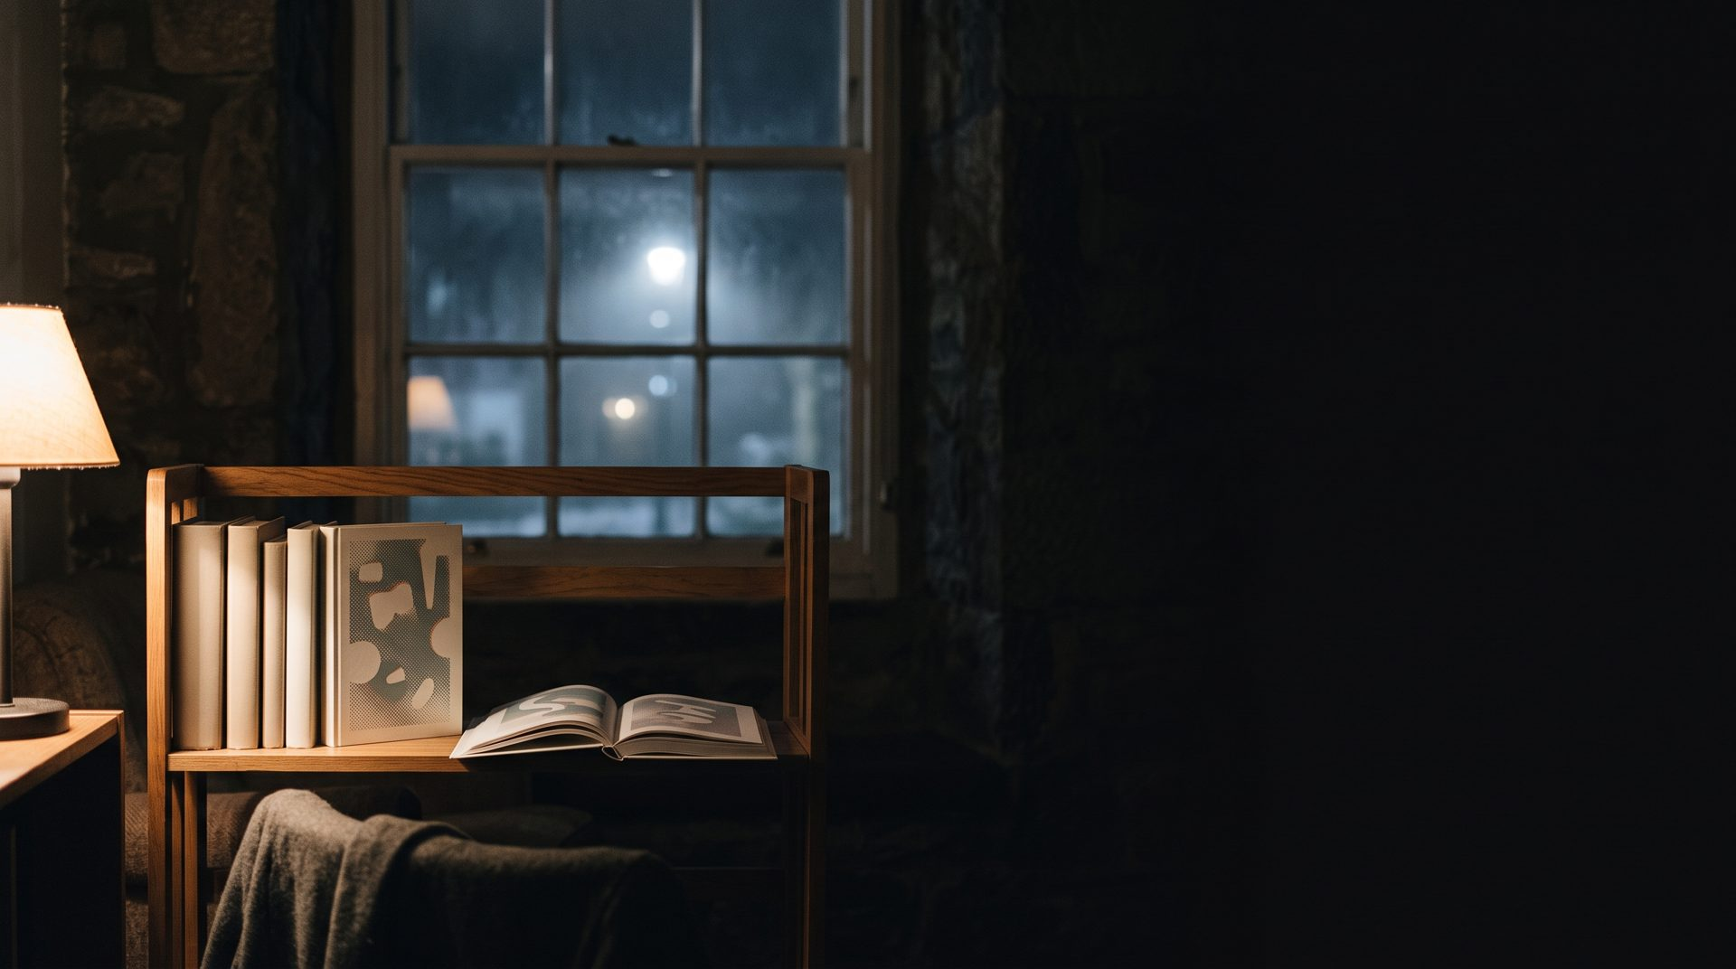
The Night Shelf
Give the night back to reading.
Fog & Fern Books — late autumn campaign
Example pitch. Fog & Fern Books, its figures, constraints and this campaign are
fictional; every research finding cited is real and sourced.
Notes:
Thank you for making the time. Before anything else, one piece of housekeeping: Fog and Fern Books is a fictional shop, and every commercial figure in this deck — footfall, budget, staffing, print quantities — is illustrative. The research is not. Every number about reading and sleep is real and linked at the back. What you are about to see is a late autumn campaign called The Night Shelf, and the whole thing rests on a single idea: give the night back to reading.

Slide 2
There are sixteen minutes left
Reading
Television
16 min
2 h 37 m
reading, per day
television, per day
258
184
136
106
113
106
32
10
10
13
13
13
15–24
25–34
35–44
45–54
55–64
65+
The youngest band reads for ten minutes a day and watches television for one hour forty-six.
US Bureau of Labor Statistics, American Time Use Survey, 2025 annual averages. Published hours converted to minutes.
Notes:
Here is the truth the work is built on, and it is a truth about time, not about taste. The Bureau of Labor Statistics measures how Americans actually spend a day, and in the 2025 averages, reading for personal interest comes to about sixteen minutes. Television comes to two hours and thirty-seven. That is the same day. Look at how the gap changes with age. Among fifteen to twenty-four year olds it is ten minutes of reading against one hour forty-six of television. Among people sixty-five and over, reading more than triples, but television nearly doubles as well. Nobody in this room has to argue that people should love books more. They already do. What they do not have is room.

Slide 3
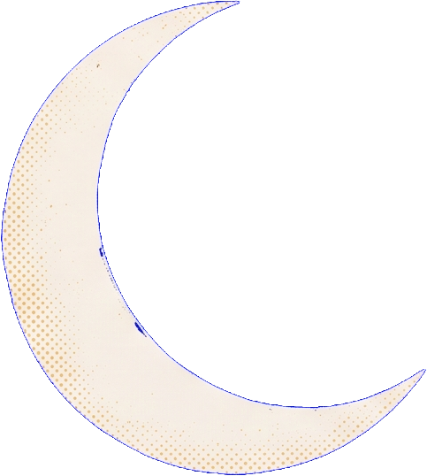
The last hour is already taken
Half of adults are on a screen in bed every day.
Another third are there most days or several days a week; a
quarter choose the phone over sleep.
Each extra hour of it costs 24 minutes of sleep.
One more hour of screen time after getting into bed raised the
odds of insomnia symptoms by 59 percent.
A book in bed does the opposite.
In a randomised trial, 42 percent of people who read in bed said
their sleep improved, against 28 percent who did not.
Sources: American Academy of Sleep Medicine, 2,007 US adults, June 2025; SHOT2022 in Frontiers in Psychiatry, 45,202 students,
March 2025; The People's Trial in Trials 22:873, 991 participants, 2021.
Notes:
So where is the room? There is exactly one place left, and something else is already sitting in it. The American Academy of Sleep Medicine surveyed two thousand US adults last June: half of them use a screen in bed every single day, another third most days of the week, and a quarter openly say they choose the phone over the sleep they know they need. And that hour has a measurable price. A Norwegian study of forty-five thousand students, published in Frontiers in Psychiatry in March, found that each additional hour of screen time after getting into bed raised the odds of insomnia symptoms by fifty-nine percent and cost twenty-four minutes of sleep. Now here is the part that turns a problem into a campaign. Reading in bed is the one behaviour that has been tested the other way. In a randomised trial of nine hundred and ninety-one people, forty-two percent of those who read a book in bed said their sleep improved, against twenty-eight percent who did not. The bookshop is not selling a nicer habit. It is selling a better one, and it can say so with a straight face.

Slide 4
What the work has to do
Make Fog & Fern the place a reader thinks of at nine in the
evening.
No paid media beyond the shop's own frontage and channels.
One season — six weeks from first paste-up to last event.
Five people, all of whom already work full shifts.
Shop scale, staffing, budget and timing are illustrative and belong to this fictional client.
Notes:
Which gives the work a very specific job. Make Fog and Fern the shop a reader thinks of at nine in the evening. Not the shop they visit on a Saturday afternoon — the one that owns the last hour of their day. And it has to happen inside three constraints, all of which are illustrative for this example client but realistic for a shop your size. No paid media at all beyond the frontage and the channels you already own. One season, six weeks from the first paste-up to the last event. And five people, every one of whom is already working a full shift.

Slide 5
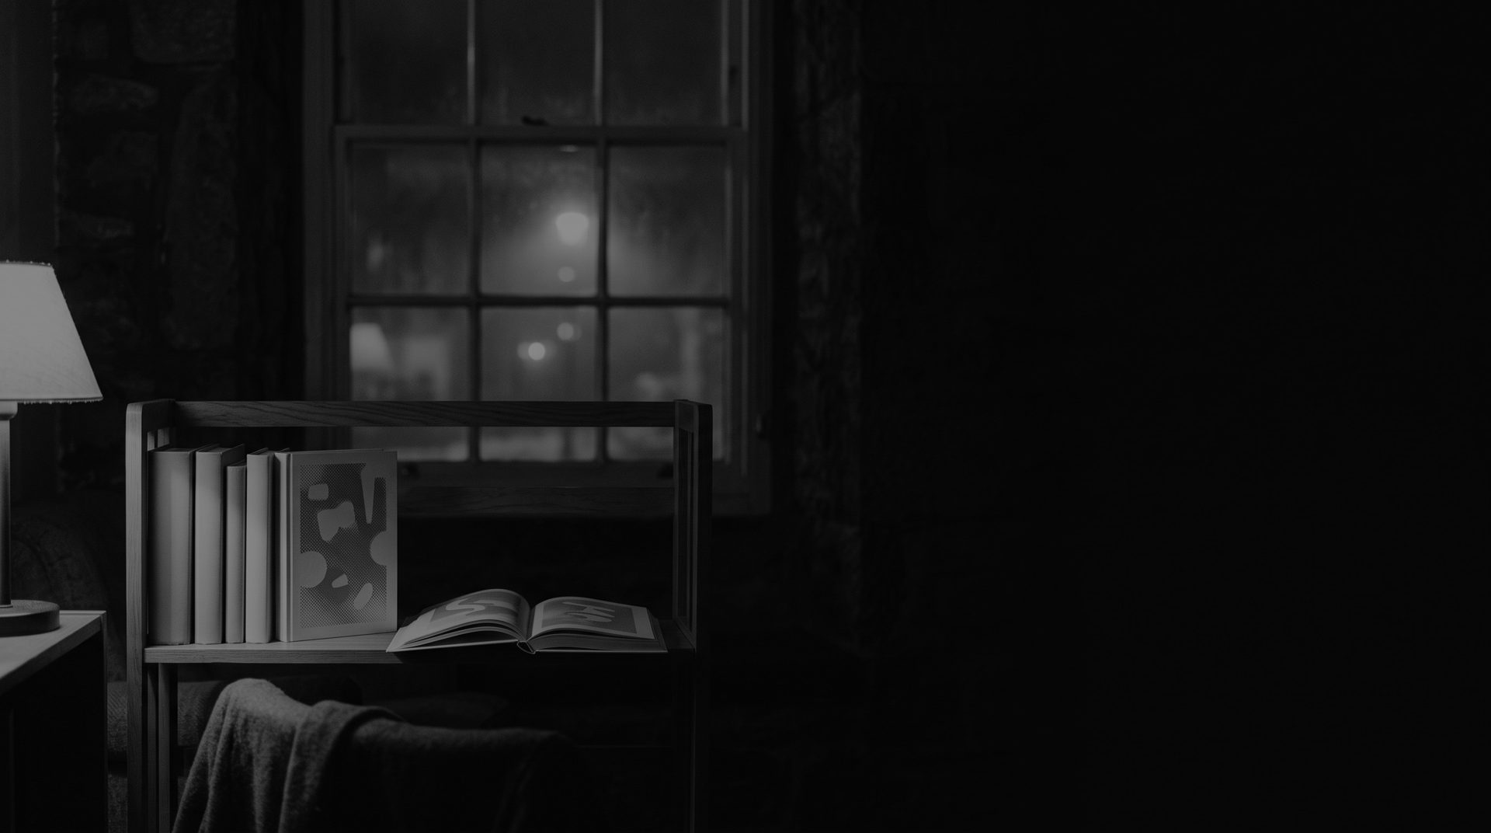
Reading is not competing with the day.
It is competing with the last hour.
So stop arguing for reading. Own bedtime.
Which changes where the work has to appear: the street at seven, the shelf at eight, the
bedside at ten.
Notes:
The bridge is one sentence long, and it is the reason the constraints stop being a problem. Reading is not competing with the day. It is competing with the last hour. Stop arguing for reading in general and go and own bedtime. That single move makes a no-budget campaign winnable, because it tells you exactly where the work has to appear — the street at seven, the shelf at eight, the bedside at ten — and it tells you what it has to sound like.

Slide 6
The last hour
belongs to a book.
The Night Shelf — the books chosen for the hour before sleep, and a shop that
stays open into it.
Notes:
The Night Shelf. The last hour belongs to a book. That is the whole idea, and it is deliberately something a customer can repeat without being told twice. The shelf is real — a physical shelf in the shop, restocked every week with books chosen for the hour before sleep, staff-picked and short enough to finish. And the shop stays open into that hour, which is the part nobody else on the street is doing.

Slide 7
The last hour
belongs to a book.
Fog & Fern Books
Notes:
This is the work. One lamp, one shelf, one open book, and the rest of the room left dark. I am not going to explain it.

Slide 8
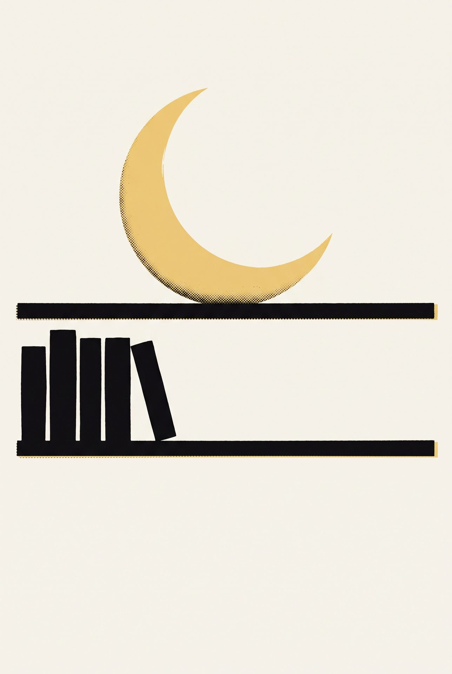
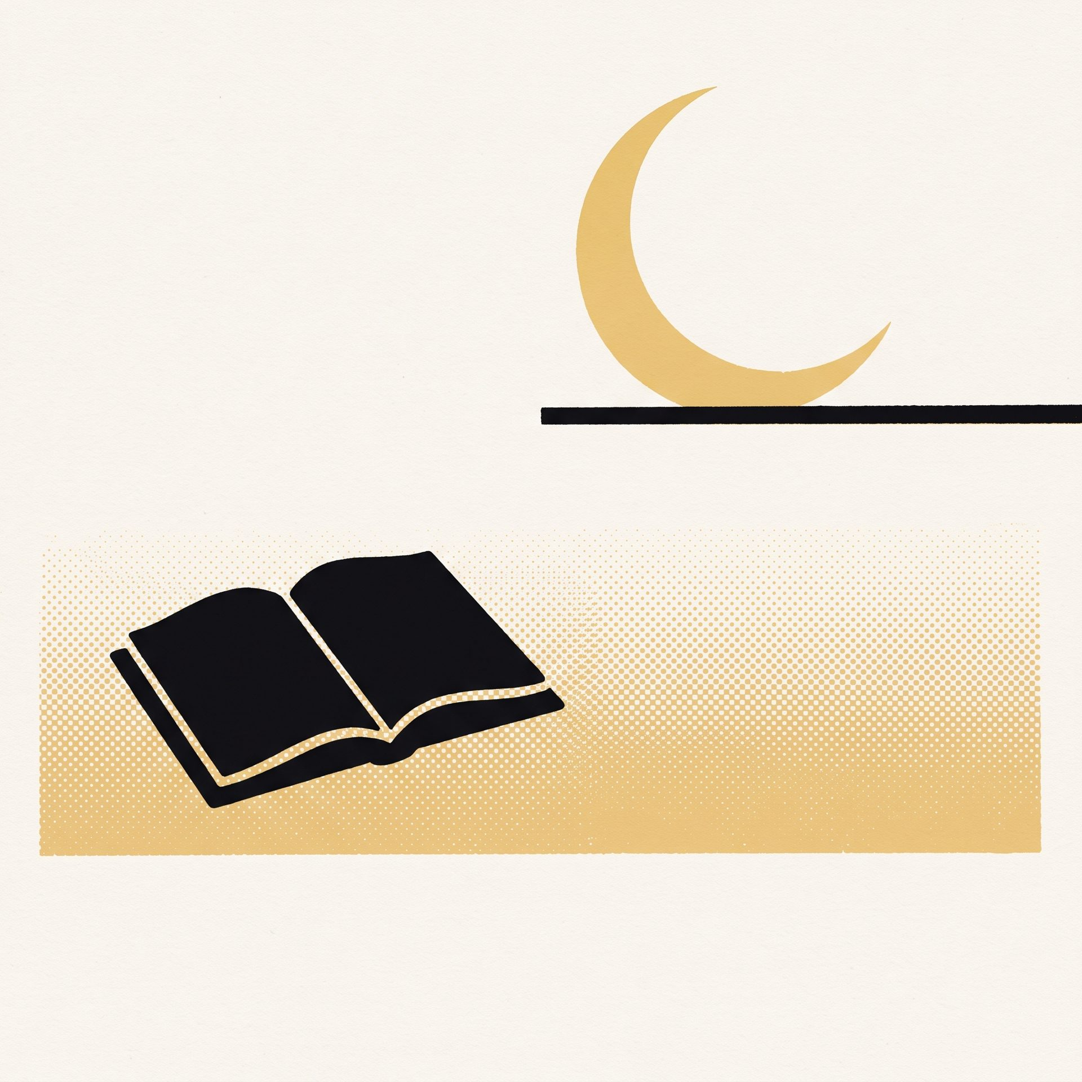
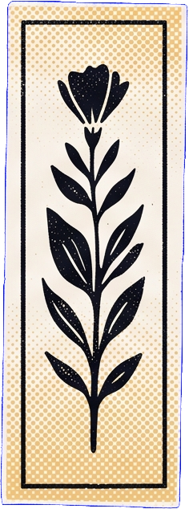
It runs everywhere the hour is spent
Fog & Fern
The last hour
belongs to a book.
The last hour
belongs to a book.
Fog & Fern Books
Street poster
the walk home
Phone
already in hand
Shop window
the lightbox the shop already owns
Bookmark
goes home
All four are mockups of proposed executions; no placement is shown that the shop does not already own.
Notes:
It is a platform, not a poster, and here is the proof — four surfaces, four different moments of the same evening. The street poster catches the walk home, printed two colours on uncoated stock so it looks like something the shop made. The phone post arrives when the screen is already in your hand, which is the honest place to interrupt it. The window lightbox is the panel you already own, running the same picture at full width so someone crossing the road can read it. And the bookmark leaves with the book and shows up at the bedside, which is where the idea finally lands. All four are mockups of proposed executions, and none of them assumes a placement you do not already control.

Slide 9
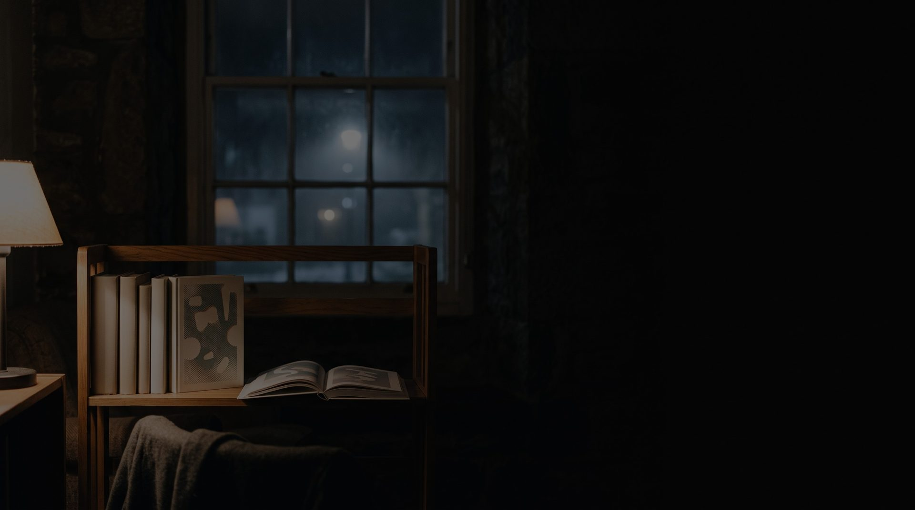
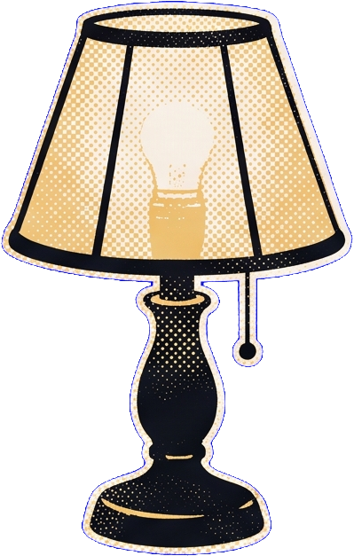

The identity, in use
Type voice
The last hour belongs to a book.
Georgia for everything the campaign says; a quiet sans for everything the shop adds later.
Palette, by job
Lamplight is a light source, never
a type colour.
Night ink
Lamplight
Paper cream
Fern
the ground
the only light
what readers touch
the shop's own mark
The mark, at three scales
poster
window
bookmark
Fern marks only the surfaces the
shop itself owns.
Ember appears only where a screen is being referred to; nothing else in the campaign is red.
Notes:
This is the system underneath, and it is small enough that you can keep running it yourself after we have gone. One type voice: a bookish serif for everything the campaign says, and a quiet sans for everything the shop adds later, so your own notices never look like they are shouting. Four colours, each doing exactly one job. Night ink is always the ground. Lamplight is the light in the picture and the mark — it is never used for type, which is the rule that keeps everything legible. Paper cream is anything a reader physically touches. Fern is only ever your own signature, so a customer learns to read it as the shop speaking rather than the campaign. And the crescent on the shelf rule works from a poster down to a bookmark without redrawing it. The one prohibition worth remembering: red only ever appears when we are talking about a screen.

Slide 10
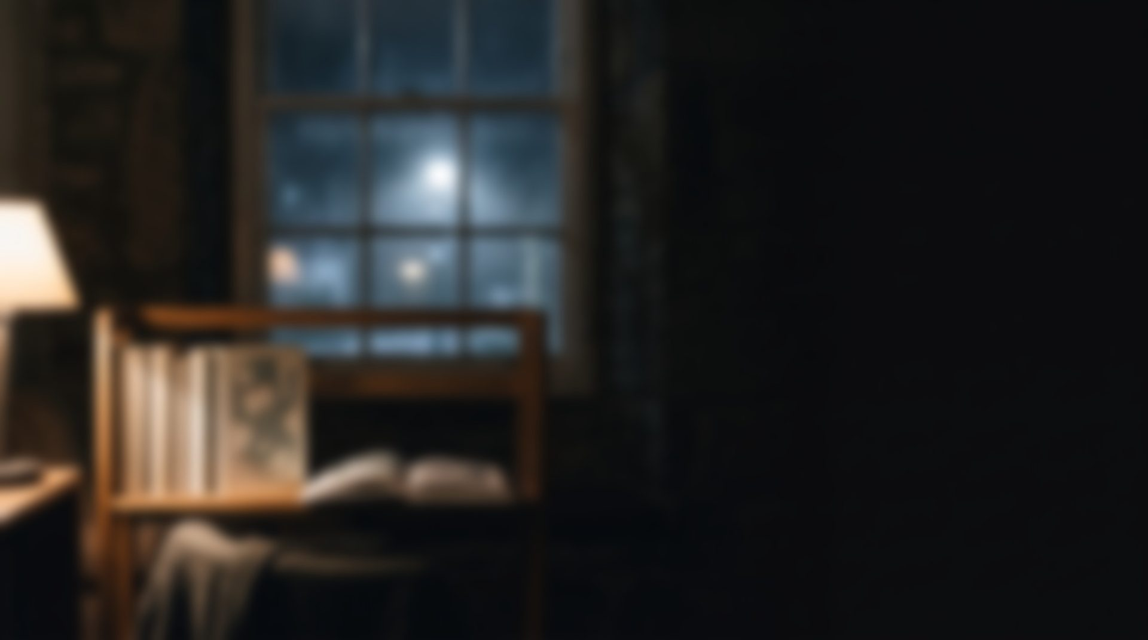

Tone and craft
Unhurried
Warm, printed, made by the shop.
Uncoated cream stock, two inks, no laminate.
Photographed at night in the shop, not on a set.
Every line written to be read aloud in one breath.
Something the shop made, not
something it bought.
Notes:
A word about how the finished thing should feel, because that is easier to lose than the idea. Unhurried. Warm, printed, and made by the shop rather than bought by it. In practice that means three decisions. Uncoated cream stock, two inks, no laminate — it should feel like paper, not packaging. The photography happens at night in your shop with the lights you already have, not lit as a studio set. And every line gets written to be read aloud in one breath, because half of these will be spoken by a bookseller before anyone reads them.

Slide 11
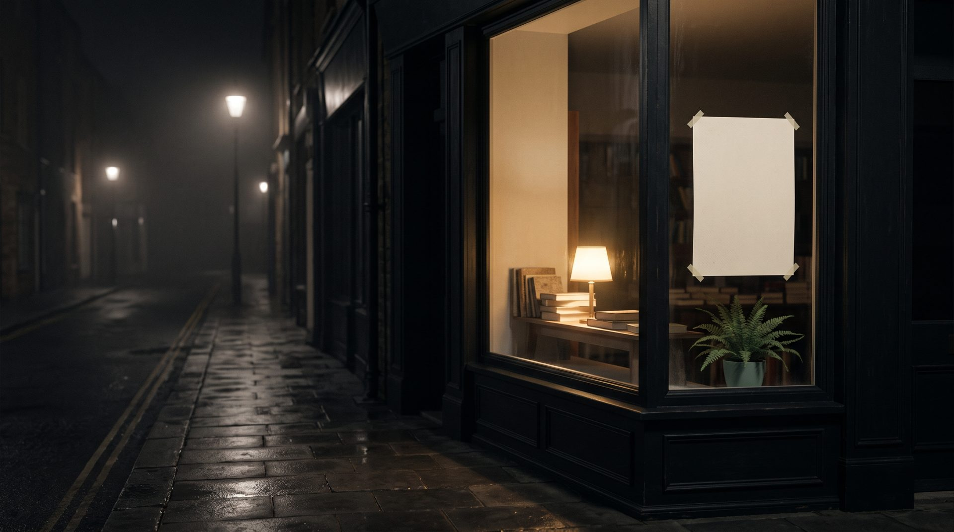
The last hour
At real size, from the far pavement,
the poster still reads.
Mockup at the window's real dimensions, seen at ordinary standing eye level.
Notes:
And this is the only test that actually matters for a shop with no media budget. At real size, from the pavement on the far side of the street, seen at ordinary standing height — does the poster still read? It does, because the composition is one shape and four words. This is a mockup, but it is at the window's real dimensions and at honest eye level. Nothing here assumes a site you do not already have.

Slide 12

What it takes to make
Print
Social
In-store
Events
brief
artwork
print
paste-up
launch
events
six weeks
Deliverable
Format
Quantity
Lead time
Owner
Street poster
2:3, two inks
120
3 weeks
Print supplier A
Window lightbox panel
1180 × 340 mm
1
3 weeks
Print supplier A
Social film and stills
1:1 and 9:16
9 posts
2 weeks
Shop team
Printed bookmark
55 × 180 mm
3,000
2 weeks
Print supplier B
Shelf talker
A6, two inks
40
2 weeks
Print supplier B
Evening event series
90 minutes
6 evenings
6 weeks
Shop team
Local radio read
30 seconds
4 spots
4 weeks
Shop team
Every quantity, lead time and owner above is illustrative for this fictional client; nothing here is a quotation.
Notes:
Now the unglamorous half, and I want to be straightforward about it. Six weeks: brief, artwork, print, paste-up, launch, then the event run. Seven deliverables across four channel classes, two print suppliers, and no paid media anywhere. Every quantity, lead time and owner on this page is illustrative for this fictional client and none of it is a quotation — but the shape is right, and the shape says this is buildable by five people who are already busy. The two things that genuinely constrain the timeline are the poster and the lightbox panel, both at three weeks, so artwork has to be signed off in week two or the whole run slides.

Slide 13
How you will know it worked
If the shop is busier between eight and ten in the evening in
week six than in week one, the idea worked.
Approve The Night Shelf for late autumn.
Sources
Pew Research Center — book reading, October 2025
Frontiers in Psychiatry — screens after bedtime, 2025
US Bureau of Labor Statistics — Time Use Survey, 2025
American Academy of Sleep Medicine — bedtime screens
National Endowment for the Arts — SPPA 2022
The People's Trial — Trials 22:873, 2021
National Literacy Trust — reading in 2025
American Booksellers Association — members
Fog & Fern Books, its figures, its constraints and this campaign are fictional and exist only as an example. Every research finding
cited above is real and linked.
Notes:
Finally, how you will know it worked, using only something you can already count. If the shop is busier between eight and ten in the evening in week six than it was in week one, the idea worked. No panel, no tracking study, no attribution model — just your own door in your own hour. So the ask is simple: approve The Night Shelf for late autumn. Everything on the research side is listed here and every link is live, and to say it once more plainly, Fog and Fern Books and every figure attached to it are fictional and exist only as an example.

