Slide 1
PAUSE POINT
A PILOT PROPOSAL FOR DMART
Make room
for a pause.
THE SHOPPER TRUTH
Long billing queues can exhaust older
and pregnant shoppers with nowhere to rest.
Concept schematic / not an engineering drawing
TEST COMFORT. DON'T PRE-SELL ROI.
Source: Group 7 HCD deck, pp. 16, 23, 26. Commercial upside remains a pilot hypothesis.
01 / 10
Notes:
Pause Point addresses a simple shopper truth in the source: older and pregnant shoppers can become exhausted in long billing queues without somewhere to rest; the trolley illustration is a conceptual schematic, not an engineering drawing or a finished product.
For DMart, the pitch is to test practical comfort while protecting everyday-value positioning—not to add a premium claim or promise ROI.
The next question is whether the source gives us a credible signal that resting matters.

Slide 2
PAUSE POINT
WHY / THE SHOPPER SIGNAL
Rest is not
a niche concern.
~75%
Around 50 responses.
Shared through college,
relatives and family.
Exploratory. Mixed retailers.
[NEEDED] THE DMART BASELINE
flagged no seating / resting
as a serious issue.
Incidence and any effect on
baskets, visits or repeat shopping.
Source: Group 7 HCD deck, pp. 9–10, 16. Approximate survey figures; not a DMart-wide finding.
02 / 10
Notes:
The source reports that around seventy-five percent flagged no seating or resting as a serious issue, based on roughly fifty responses gathered through college, relatives and family.
This is exploratory, mixed-retailer evidence—not a DMart-wide finding; DMart-specific incidence and any effect on baskets, visits or repeat shopping are still needed.
That limitation makes the shopper journey a useful guide to where a pilot might focus.

Slide 3
PAUSE POINT
WHY / THE MOMENT THAT MATTERS
The last stretch
needs a pause.
~1 hr
THE LAST CHECK
THE TIGHT SPACE
Shop
Recheck
Billing queue
Fatigue starts to build.
More time on feet.
A short rest is missing.
Let the resting point travel with the shopper.
Source: Group 7 HCD deck, pp. 14–16. Qualitative journey observations, not a timed DMart study.
03 / 10
Notes:
The source journey notes fatigue around an hour into shopping, followed by a last grocery check and the billing queue; these are qualitative observations rather than a timed DMart study.
The insight is to make a short rest available near the shopper in a tight billing space, rather than assume a fixed seating area solves every moment of fatigue.
That leads us from a broad store problem to a trolley-linked concept.

Slide 4
PAUSE POINT
WHAT / THE NARROWING
Explore broadly.
Choose with evidence.
01
02
03
Store friction
Customer focus
Two seat mechanisms
Seating. Loose grains.
Trolleys. Navigation.
Staff / retailer primary
data was unavailable.
Independent. Supportive.
Clear flow. Daily durability.
START WITH THE WHOLE SYSTEM
FOLLOW THE EVIDENCE
FILTER AGAINST PRACTICAL NEEDS
[NEEDED] Documented comparison, selection scoring and why the final mechanism won.
Source: Group 7 HCD deck, pp. 4, 8, 18–22. Two mechanism ideas are shown; a scored winner is not.
04 / 10
Notes:
The team explored seating, loose grains, trolley handling and navigation, then focused on customers because staff and retailer primary data could not be obtained.
Two seating mechanism ideas were explored against independent use, body support, unobstructed flow and daily durability; the source does not document a scored comparison or a final winning rationale, which remains needed.
The prototype work helps explain what was built, but should not be mistaken for proof that the chosen mechanism works safely.

Slide 5
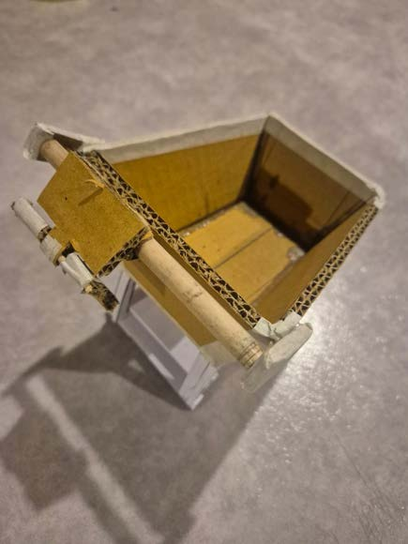
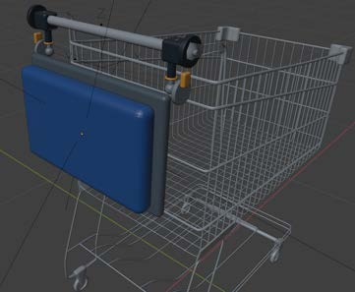
PAUSE POINT
WHAT / THE BUILD + THE LEARNING
Mock-ups found the risk.
BUILT TO LEARN
THE FIRST MOCK-UP
THE DIGITAL CONCEPT
Mini mock-up → Blender models
→ mechanism proofs.
Seat load can move the cart.
Proposed response: stop /
lock the wheels.
[NEEDED] PROOF BEFORE SHOPPER USE
User tests, load rating
and brake verification.
Source photo / cardboard model
Source Blender render / not a finished product
Source: Group 7 HCD deck, pp. 20–23, 26–27. Shopper validation results are not documented.
05 / 10
Notes:
The source shows a mini mock-up, Blender models and mechanism proofs; the cardboard photograph and digital concept render are evidence of that early build process, not shopper testing.
The team identified that seat load could move the cart and proposed stopping or locking its wheels, but user-test methods and results, load rating and brake verification are still needed.
Those unresolved safety questions frame how we should describe the product today.

Slide 6
PAUSE POINT
WHAT / THE PRODUCT
Rest, right at the trolley.
A foldable trolley-linked resting-seat concept for a short pause.
THE SOURCE CONCEPT
01
PROPOSED USE / TO VALIDATE
Stop + secure the trolley
02
Unfold + rest
03
Fold + continue
[NEEDED] Operating sequence, brake + stability sign-off.
Source: Group 7 HCD deck, pp. 18, 23–26. Concept, not a certified product; proposed operating sequence.
06 / 10
Notes:
Pause Point is a foldable trolley-linked resting-seat concept for shoppers who need a short pause; the image is the source's folded-seat render, not a production product.
The proposed experience is to stop and secure the trolley, unfold the seat and rest, then fold it away and continue; operating-sequence approval, brake checks and stability sign-off are needed before shopper use.
With that safety boundary clear, the intended functions can be tied to practical DMart benefits without claiming tested outcomes.

Slide 7
PAUSE POINT
WHAT / FIVE INTENDED FUNCTIONS
Built around
practical
value.
01 FOLDABLE SEAT / 02 BODY-SUPPORT INTENT
Independent rest
A less tiring wait for shoppers.
03 COMPACT FORM / 04 PROPOSED WHEEL BRAKE
Flow + stability
Rest without blocking the shop.
Five intended functions.
Three practical benefits.
All still to validate.
05 FIRM, WIPE-CLEAN SURFACE
Routine upkeep
Simpler everyday cleaning.
[NEEDED] Comfort, clearance, stability and durability proof. These are intended benefits, not tested outcomes.
07 / 10
Source: Group 7 HCD deck, pp. 18, 23, 26.
Notes:
The five intended functions form three practical benefit groups: a foldable seat and body-support intent for independent rest; compact fold-away form and a proposed wheel brake for flow and stability; and a firm wipe-clean surface for routine upkeep.
These are intended benefits, not demonstrated results: comfort, aisle clearance, stability and durability all need validation.
The design challenge is to make the whole physical experience easy to find, easy to use and easy to clear away.

Slide 8
PAUSE POINT
WHAT / THE PHYSICAL EXPERIENCE
Make a pause feel effortless.
01 / EASY TO FIND
A visible resting option.
Bags stay nearby.
Notice.
02 / EASY TO USE
Independent use. Rounded, firm surface.
Body-support intent.
Rest.
03 / EASY TO CLEAR
Simple fold-away.
Keep the aisle and queue clear.
Resume.
[NEEDED] On-trolley instructions, accessibility checks and safety validation.
Source: Group 7 HCD deck, pp. 15, 18, 23–26. Design goals, not verified capabilities; no app screens.
08 / 10
Notes:
This is a physical experience, not an app: a visible resting option lets shoppers keep bags nearby, pause independently on a firm rounded surface with body-support intent, and fold it away to resume without obstructing the aisle or queue.
Those are design goals rather than verified capabilities; on-trolley instructions, accessibility checks and safety validation are needed before shoppers use it.
The pilot therefore needs to measure both comfort and the practical consequences of introducing it.

Slide 9
PAUSE POINT
PROVE / THE MEASUREMENT PLAN
Comfort first.
Then the business case.
Feel
Shop
Earn the case
Rest uptake, feedback
and safety incidents.
Footfall, basket size
and repeat rate.
Cost, incremental
contribution and ROI.
Baseline → target: [NEEDED]
Baselines → targets: [NEEDED]
ROI baseline → target: [NEEDED]
Observation + shopper feedback.
Visit counts + transaction data.
Cost + contribution tracking.
PROPOSED: PRE-PILOT BASELINE → PILOT / CONTROL → REVIEW DATES [NEEDED]
[NEEDED] Owners, definitions, repeat tracking and attribution. Proposed evaluation only; no source commercial results.
09 / 10
Notes:
The proposed evaluation has three parts: comfort and use through rest uptake, feedback and incidents; shopping behavior through footfall, basket size and repeat rate; and economics through cost, incremental contribution and ROI—all baselines and targets are needed.
Candidate methods are observation and feedback, visit counts and transaction data, and cost tracking, with a pre-pilot baseline followed by a pilot/control comparison; owners, definitions, repeat-visit tracking, attribution and review dates remain needed.
None of these are source results: this is a framework to approve so the pilot earns a business case rather than assumes one.

Slide 10
PAUSE POINT
PROVE / THE DECISION
Pilot. Prove.
Then decide.
01 / VALIDATE
Clear safety.
[NEEDED] Brake, load, stability + aisle-fit sign-off.
02 / PILOT
Set the scope + investment.
[NEEDED] Stores, trolleys, owner, timeline + budget.
THE ASK
Sponsor a safety-cleared pilot plan.
03 / DECIDE
Evidence—not a rollout promise.
Agree go / no-go rules.
[NEEDED] Comfort / safety thresholds, KPIs + review.
Expected outcome: a decision grounded in evidence. Quantified uplift: [NEEDED].
Proposed gates, not commitments. Protect everyday value. Source risks: Group 7 HCD deck, pp. 26–27.
10 / 10
Notes:
The ask is sponsorship for a gated pilot plan, not immediate rollout: first validate brake, load, stability and aisle fit; then agree stores, trolley count, owner, timeline and investment; then set comfort, safety and business decision thresholds and a review date.
All of those sign-offs, scope choices, budgets and go/no-go criteria remain needed; the expected outcome is decision evidence, while quantified commercial uplift is unknown.
This protects DMart's everyday-value positioning and makes adoption conditional on proof, not a pre-sold ROI promise.

