Slide 1
Support Vector Machines
Data Mining & Machine Learning
Week 3 · Lecture 1

Slide 2
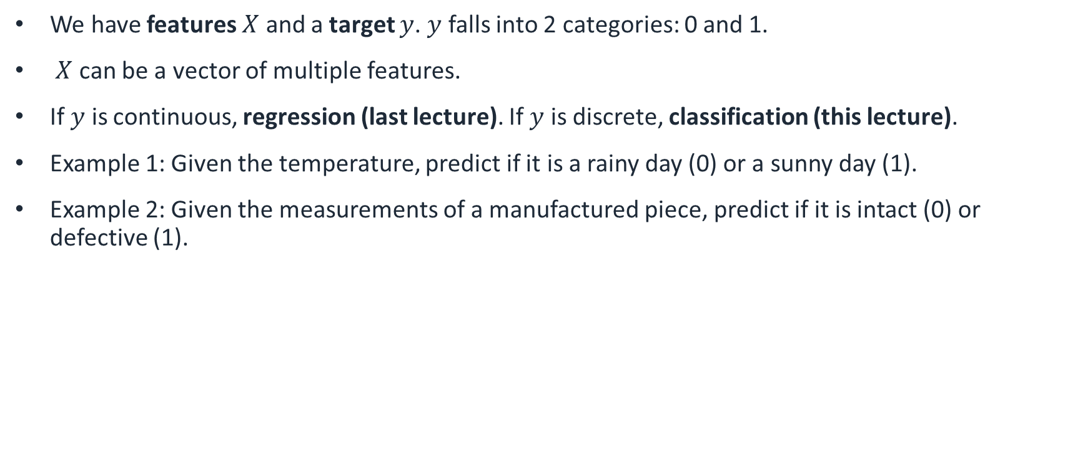
Supervised learning
We have features $X$ and a target $y$. $y$ falls into 2 categories: 0 and 1.
$X$ can be a vector of multiple features.
If $y$ is continuous, regression (last lecture). If $y$ is discrete, classification (this lecture).
Example 1: Given the temperature, predict if it is a rainy day (0) or a sunny day (1).
Example 2: Given the measurements of a manufactured piece, predict if it is intact (0) or defective (1).

Slide 3
Conclusion
Classification separates data in 2 or more classes.
Logistic regression classifies data between 0 and 1.
We use gradient descent to find the parameters of the model.
Another classification algorithm is k-nearest neighbours.
It is important to normalize our data properly to avoid scale effect and leakage.
We can use the confusion matrix to determine how good the model is.

