Slide 1
LLM FOR FINANCIAL NEWS GENERATION
APRIL 2025
HUGO LATENDRESSE
17-644 - Applied Deep Learning
Carnegie Mellon University

Slide 2
Problem Statement and FNSPID Dataset
Can we train a language model to write text similar to a financial news article?
“The following are the top-rated Industrial stocks according to Validea's Value Investor model based on the published strategy of Benjamin Graham. This deep value methodology screens for stocks that have low P/B and P/E ratios, along with low debt and solid long-term earnings growth.
NOW INC (DNOW) is a small-cap value stock in the Misc. Capital Goods industry. The rating according to our strategy based on Benjamin Graham is 86% based on the firm’s underlying fundamentals and the stock’s valuation. A score of 80% or above typically indicates that the strategy has some interest in the stock and a score above 90% typically indicates strong interest.”
Source: https://www.nasdaq.com/articles/valideas-top-industrial-stocks-based-on-benjamin-graham-12-12-2023

Slide 3
Data Transformations
Step 2: Tokens
Step 3: Tensors
Step 1: Plain Text
[[8795, 27864, 29462, 17283], [19779, 24355, 33502, 42700], [37926, 17813, 31317, 44926], [25923, 33615, 25301, 6811], [49909, 8155, 19481, 4313], [33353, 21839, 25469, 10582], [22992, 25365, 17743, 29410], [31775, 7827, 45208, 1841], [47746, 9889, 4254, 33222]]
The following are the top-rated Industrial stocks according to Validea's Value Investor model based on the published strategy of Benjamin Graham. This deep value methodology screens for stocks that have low P/B and P/E ratios, along with low debt and solid long-term earnings growth. NOW INC (DNOW) is a small-cap value stock in the Misc. Capital Goods industry. The rating according to our strategy based on Benjamin Graham is 86% based on the firm’s underlying fundamentals and the stock’s valuation. A score of 80% or above typically indicates that the strategy has some interest in the stock and a score above 90% typically indicates strong interest…
[8795, 27864, 29462, 17283, 19779, 24355, 33502, 42700, 9105, 11329, 11927, 20214, 22418, 30196, 14826, 24734, 38052, 11056, 36419, 17575, 9305, 37264, 27165, 11537, 19064, 5938, 22768, 31709, 43965, 23604, 4462, 10105, 43883, 39867, 44887, 48360, 41085, 40829, 23188, 16883, 28653, 2212, 46913, 2853, 11980, 25955, 34382, 2380, 18177, 9870, 35186, 11069, 18310, 35996, 9881, 40443, 15801, 30244, 2575, 42218, 34941, 21737, 38840, 13073, 32810, 45924, 14022, 24412, 16023, 36380, 38969, 42144, 25278, 1210, 24871, 24967, 28544, 19157, 17735, 27723, 46136, 5536, 21026, 38907, 15253, 15125, 4982, 39924, 16814, 29189, 7554, 25059, 43292, 17505, 19324, 4175, 5288, 28554, 4221, 5311, ...
Sequence Length
Batch size

Slide 4
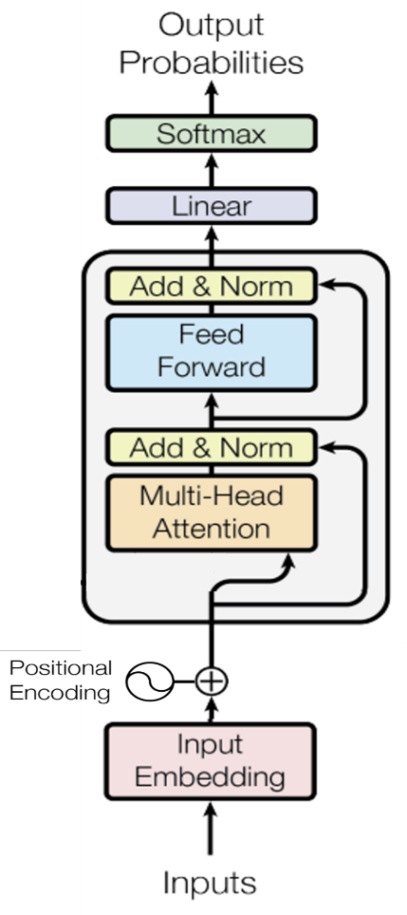
Modular Model Architecture
Source: arxiv.org/pdf/1706.03762.pdf

Slide 5
Modular Model Architecture

Slide 6

Modular Model Architecture

Slide 7
Modular Model Architecture

Slide 8
Modular Model Architecture

Slide 9
Modular Model Architecture
Source: arxiv.org/pdf/1706.03762.pdf

Slide 10
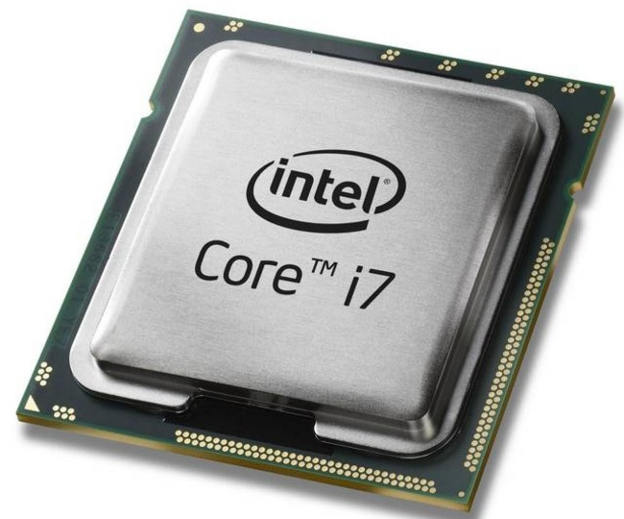
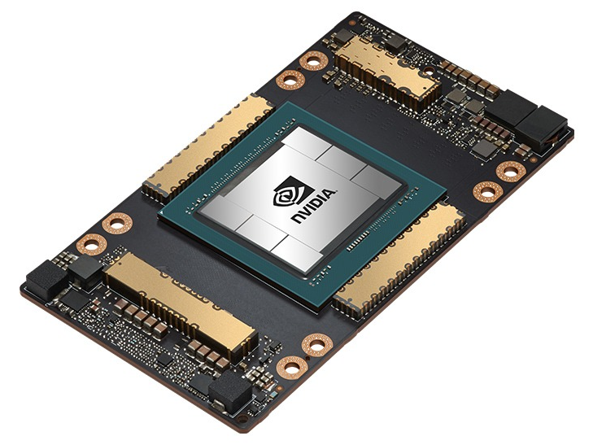
Training on GPU
Intel i7 (My Laptop)
0.06 TLOPS
NVIDIA A100 (Google Colab)
312 TLOPS

Slide 11
First Random Search (10,000 Training Steps)
Weight Decay | Head Count | Block Count | Batch Size | Embedding Size | Learning Rate | Final Validation Loss
0.05 | 12 | 6 | 32 | 768 | 0.00010 | 3.69
0.1 | 12 | 12 | 32 | 768 | 0.00010 | 3.77
0.05 | 16 | 12 | 32 | 1024 | 0.00010 | 3.79
0.1 | 12 | 6 | 32 | 768 | 0.00005 | 3.83
0.1 | 8 | 6 | 32 | 512 | 0.00010 | 4.05
0.1 | 12 | 12 | 8 | 768 | 0.00010 | 4.52
0.1 | 6 | 12 | 8 | 768 | 0.00010 | 4.61
0.05 | 12 | 6 | 32 | 768 | 0.00500 | 6.73
Takeaways
Bigger batch helps
Embeddings should be at least 768
Head count should be at least 12
A smaller learning rate is better

Slide 12
Second Random Search (100,000 Training Steps)
Weight Decay | Head Count | Block Count | Batch Size | Embedding Size | Learning Rate | Final Validation Loss
0.1 | 12 | 12 | 32 | 768 | 0.00001 | 3.349
0.05 | 12 | 6 | 32 | 768 | 0.00001 | 3.352
0.05 | 16 | 12 | 32 | 1024 | 0.00001 | 3.425
0.05 | 12 | 6 | 32 | 768 | 0.00005 | 3.537

Slide 13
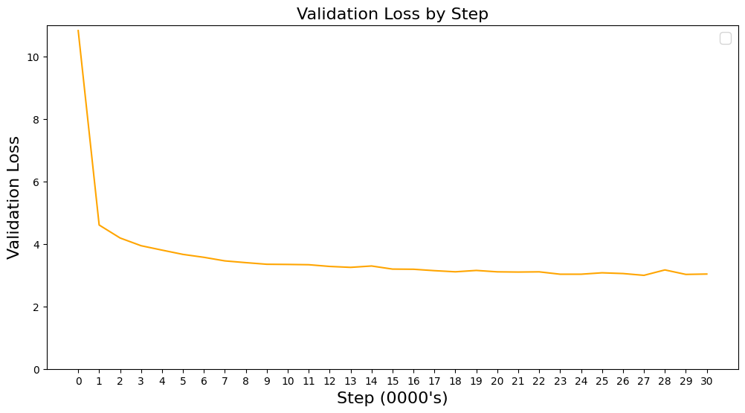
Final Run
I let the model train until validation loss stops improving

Slide 14
Generation Results
Prompt
Fintel reports that on December 13, 2023,

Slide 15
Generation Results
After 10,000 training steps
Fintel reports that on December 13, 2023,000 shares of A shares, with an average price of $1.00 per share, which includes companies that are not the stock-to-based stock at a Zacks Rank #2 (Buy) stocks. The Zacks Consensus Estimate for the quarter is $1.00 to $3.00, with an average price of $2.30. The stock is expected to report its current price of $1.25 per share is scheduled to be a Zacks Rank #3 (Hold).

Slide 16
Generation Results
After 10,000 training steps
Fintel reports that on December 13, 2023,000 shares of A shares, with an average price of $1.00 per share, which includes companies that are not the stock-to-based stock at a Zacks Rank #2 (Buy) stocks. The Zacks Consensus Estimate for the quarter is $1.00 to $3.00, with an average price of $2.30. The stock is expected to report its current price of $1.25 per share is scheduled to be a Zacks Rank #3 (Hold).

Slide 17
Generation Results
After 10,000 training steps
Fintel reports that on December 13, 2023,000 shares of A shares, with an average price of $1.00 per share, which includes companies that are not the stock-to-based stock at a Zacks Rank #2 (Buy) stocks. The Zacks Consensus Estimate for the quarter is $1.00 to $3.00, with an average price of $2.30. The stock is expected to report its current price of $1.25 per share is scheduled to be a Zacks Rank #3 (Hold).

Slide 18
Generation Results
After 300,000 training steps
Fintel reports that on December 13, 2023, the company reported a quarterly net loss of $0.02 per share on $1.02 billion in revenue. This compares to the year-ago quarter when earnings came to $0.04 per share on $1.03 billion in revenue.
What to watch: Shares of Zoom Video Communications are still down about 30% from their all-time high reached on February 12.

