Slide 1
MACHINE LEARNING OPERATIONS · MINI-PROJECT
Credit Default Risk Prediction with MLOps
Fabrício Olo
Hugo Lima
Maria Teresa Neves
Olívia Rua
Pedro Martim Lota
Executive Master in Business Analytics & AI · Porto Business School · 1 October 2026
Notes:
[~15 sec] Hi, we are [names]. We built a model that predicts which credit card customers may miss next month's payment, and we built the MLOps setup around it: tracking, a model registry, an API and Docker.

Slide 2



THE PROBLEM
Which customers will miss their next payment?
Banks often find out about a default when it is too late to help.
DATASET
Default of Credit Card Clients (Kaggle / UCI)
We predict the probability that each customer defaults next month.
30,000 customers, Taiwan 2005
23 features: credit limit, age, 6 months of payments and bills
Target: default next month (yes / no)
An analyst reviews the flagged customers. The model does not decide.
Notes:
[~30 sec] Banks often only find out about a default when it is already too late. So we predict, for each customer, the probability of defaulting next month. The output is a risk score for an analyst to review; the model does not approve or reject anyone. We used a public Kaggle dataset with 30,000 customers from Taiwan.

Slide 3







HOW WE BUILT IT
Our pipeline and the tools we used
1. Data
2. Train
3. Track
4. Register
5. Serve
6. Package
Monitor
Explore & split
Train 2 models
Log every run
Keep the best
Prediction API
Run anywhere
Not built yet
TOOLS
pandas
scikit-learn
MLflow
Tracking
MLflow
Model Registry
FastAPI
Docker Compose
pytest · GitHub CI
e.g. Evidently
Steps 1 to 4 run with one command: docker compose run --rm trainer
Notes:
[~25 sec] These are our six steps and the tool for each one: pandas to explore the data, scikit-learn to train, MLflow to track the runs and to register the best model, FastAPI to serve predictions, and Docker to run everything the same way on any laptop. Steps one to four run with a single command. Monitoring is the step we did not build yet.

Slide 4





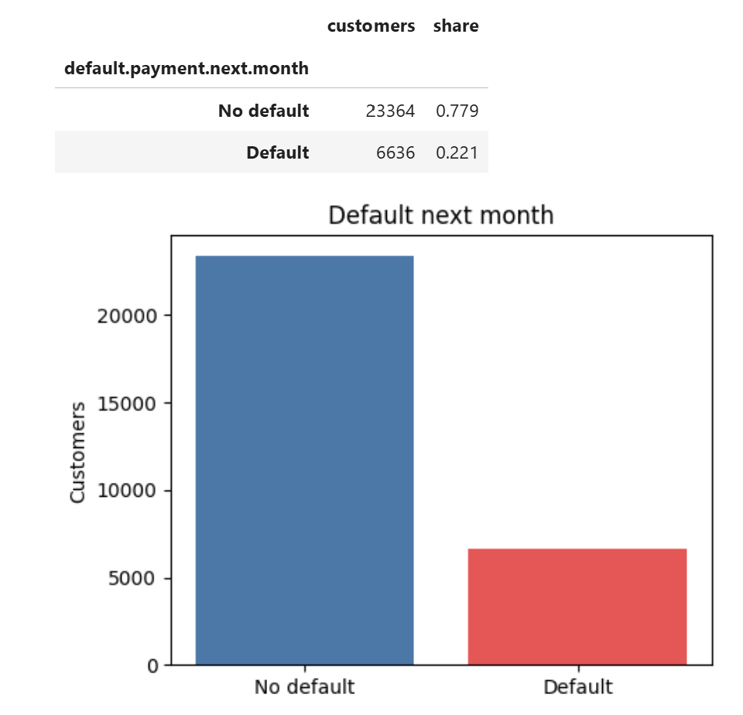
1. Data
2. Train
3. Track
4. Register
5. Serve
6. Package
Monitor (next)
STEP 1 · DATA
Exploring the data
Only 22% of customers default
Understanding this is crucial to interpret metrics and design the model, as classes are imbalanced.
We used a stratified split: train and test keep the same 22%
Notes:
[~30 sec] We started by exploring the data in a notebook. [Point at the chart] Only 22% of customers default. That is important: a model that says "no default" to everyone is already 78% accurate and useless, so we did not judge our models on accuracy. We also used a stratified split, so the training and test sets keep the same 22%.

Slide 5

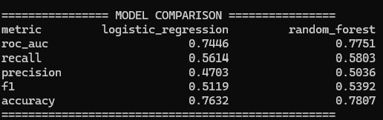
1. Data
2. Train
3. Track
4. Register
5. Serve
6. Package
Monitor (next)
STEP 2 · TRAIN
Training two models with one command
> docker compose run --rm trainer
Two models: Logistic Regression and Random Forest
Cleaning, features and model are saved together in one pipeline, so the API prepares new data the same way
Fixed random seed: same results every time
Notes:
[~25 sec] Training runs with one command. [Point at the table] It trains Logistic Regression and Random Forest and prints this comparison. The cleaning steps and the model are saved together as one pipeline, so the API later applies exactly the same steps. We fixed the random seed, so anyone who runs it gets the same numbers.

Slide 6

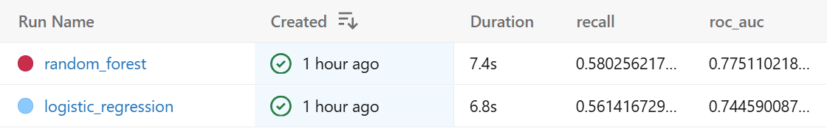
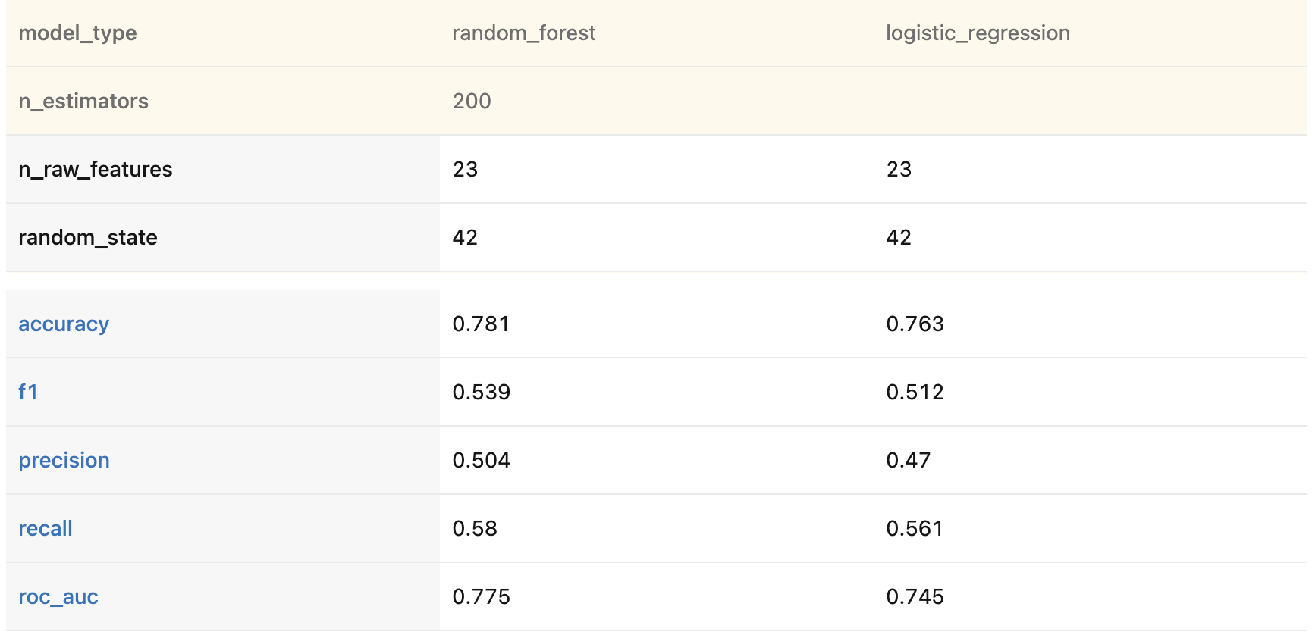
1. Data
2. Train
3. Track
4. Register
5. Serve
6. Package
Monitor (next)
STEP 3 · TRACK
Tracking the experiments in MLflow
Every training run is saved automatically
Each run keeps its parameters, metrics, charts and the model file
We can compare runs side by side instead of keeping notes
Compare view: both runs side by side
Notes:
[~35 sec] Every time we train, MLflow saves a run for each model automatically. [Point at the list] Here are our two runs. Each one keeps the parameters, the metrics, the charts and the model file itself. [Point at the compare view] And we can compare them side by side, so we always know which settings produced which result.

Slide 7

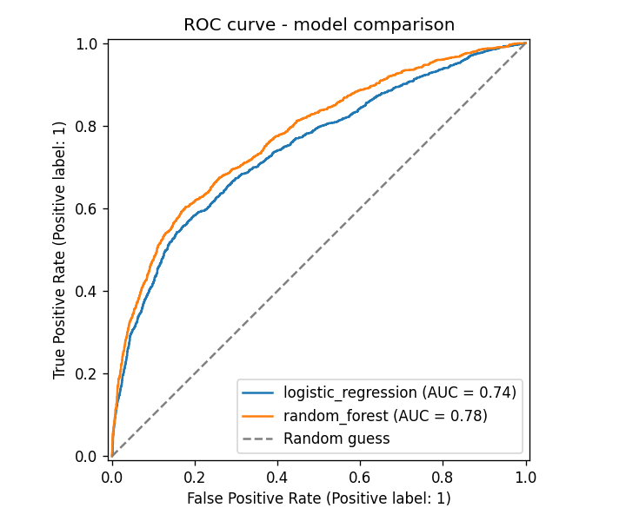
1. Data
2. Train
3. Track
4. Register
5. Serve
6. Package
Monitor (next)
STEP 4 · REGISTER
Choosing and registering the best model
ROC-AUC
Random Forest 0.775
Logistic Regr. 0.745
The script picks the highest ROC-AUC and registers it as @champion
Version 1
created automatically
@champion
the model the API loads
MLflow → Models → credit_default_model
Notes:
[~40 sec] The script compares the two runs on ROC-AUC, which measures how well the model ranks risky customers above safe ones. [Point at the chart] Random Forest wins, 0.775 against 0.745. The script then registers the winner in the MLflow Model Registry. [Point at the screenshot] You can see it here as credit_default_model with the alias champion. Nobody picks it by hand. It catches 58% of the defaulters, so it is an early warning, not a perfect model.

Slide 8

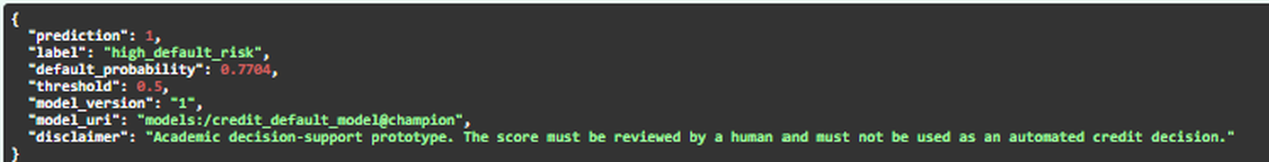
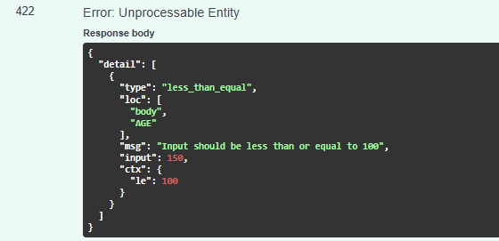
1. Data
2. Train
3. Track
4. Register
5. Serve
6. Package
Monitor (next)
STEP 5 · SERVE
Serving predictions through an API
Valid customer → prediction (real response from our API, Swagger)
high_default_risk
0.77
version 1
Wrong input (AGE = 150) → rejected
label
default probability
model that answered
The API loads the @champion model
Wrong input is rejected before it reaches the model
Every answer says a human must review the score
Notes:
[~30 sec] The API loads the champion model from MLflow. We sent one customer's data to /predict and [point at the top] got back a 77% probability of default, so the label is high risk. The answer also says it came from model version 1, the one we saw in the registry, and reminds the user that a human must review the score. [Point at the right] And if the input is wrong, here an age of 150, the API rejects it with error 422 before it ever reaches the model.

Slide 9

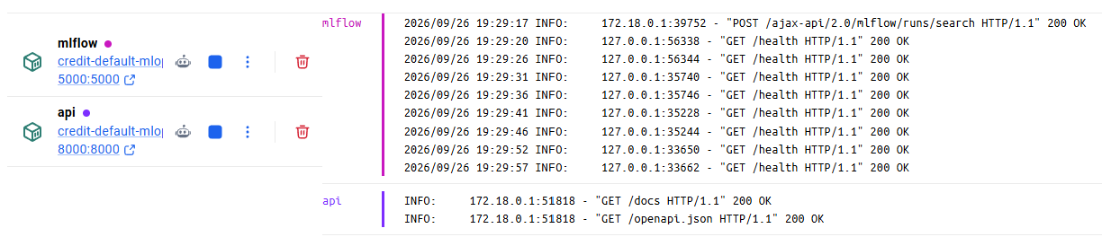
1. Data
2. Train
3. Track
4. Register
5. Serve
6. Package
Monitor (next)
STEP 6 · PACKAGE
Running everything with Docker
Docker Desktop: our containers running, with their live logs
mlflow
api
trainer
tracking + registry · port 5000
prediction service · port 8000
runs once when we train, then removed
A teammate needs only Git, Docker and the CSV. Automated tests run on every push to GitHub.
Notes:
[~20 sec] Everything runs in Docker. [Point at the left] MLflow and the API run as two containers, on ports 5000 and 8000, and on the right you can see their live activity. The trainer is a third container that only runs when we train and is removed afterwards. To run the project, a teammate only needs Git, Docker and the data file. We also have automated tests that run on every push to GitHub.

Slide 10
1. Data
2. Train
3. Track
4. Register
5. Serve
6. Package
Monitor (next)
CONCLUSION
What we built and what comes next
What we built
Next steps
Responsible use
Experiments tracked in MLflow
Best model registered automatically
Prediction API
Runs anywhere with Docker
Monitor the model over time
Version the data
Set the threshold with the business
Cross-validation
Check fairness (sex, age, marital status)
Keep a human in the loop
Protect personal data (GDPR)
Credit scoring is high-risk under the EU AI Act
Notes:
[~40 sec] To sum up: our experiments are tracked in MLflow, the best model is registered automatically, it is served through an API, and everything runs with Docker. Next, we would add monitoring to see if the model gets worse over time, version the data, and agree the decision threshold with the business. And since credit scoring is high-risk under the EU AI Act, we would need fairness checks, a human reviewing every decision, and proper data protection. Thank you.

Slide 11
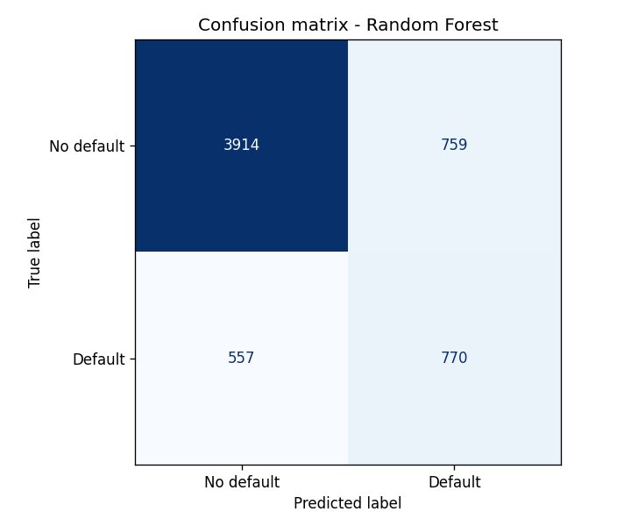
BACKUP · FOR QUESTIONS
Results in detail and limitations
Metric | Log. Regr. | Random Forest
ROC-AUC | 0.745 | 0.775
Recall | 0.561 | 0.580
Precision | 0.470 | 0.504
F1 | 0.512 | 0.539
Accuracy | 0.763 | 0.781
Limitations
Data from Taiwan, 2005
One train/test split
No tuning; threshold 0.5
No fairness metrics yet
No monitoring or data versioning
MLflow has no login (laptop only)
Random Forest on 6,000 test customers: 770 of 1,327 defaulters caught, 759 false alarms
Notes:
For questions. Why not accuracy? Saying "no default" to everyone is already 77.9% accurate, almost the same as our model. Why threshold 0.5? It is the default; the business should set it based on the cost of a missed defaulter versus a false alarm. Is Random Forest really better? On this split yes; cross-validation would confirm it. Monitoring? Next step, for example with Evidently.

