Slide 1
MACHINE LEARNING OPERATIONS · MINI-PROJECT
Credit Default Risk Prediction with MLOps
Fabrício Olo
Hugo Lima
Maria Teresa Neves
Olívia Rua
Pedro Martim Lota
Executive Master in Business Analytics & AI · Porto Business School · 1 October 2026
Notes:
[Fabrício · ~15 sec] Hi, we are Fabrício, Hugo, Maria Teresa, Olívia and Pedro. We built a model that predicts which credit card customers may miss next month's payment, and the MLOps setup around it: tracking, a registry with champion vs challenger, a fairness check, an API and Docker.

Slide 2



THE PROBLEM
Which customers will miss their next payment?
Banks often find out about a default when it is too late to help.
DATASET
Default of Credit Card Clients (Kaggle / UCI)
We predict the probability that each customer defaults next month.
30,000 customers, Taiwan 2005
23 features: credit limit, age, 6 months of payments and bills
Target: default next month (yes / no)
An analyst reviews the flagged customers. The model does not decide.
Notes:
[Fabrício · ~30 sec] Banks often only find out about a default when it is already too late. So we predict, for each customer, the probability of defaulting next month. The output is a risk score for an analyst to review; the model does not approve or reject anyone. We used a public Kaggle dataset with 30,000 customers from Taiwan.

Slide 3







HOW WE BUILT IT
Our pipeline and the tools we used
1. Data
2. Train
3. Track
4. Register
5. Serve
6. Package
Monitor
Explore & split
2 models + fairness
Log every run
Only if better
Prediction API
Run anywhere
Not built yet
TOOLS
pandas
scikit-learn
MLflow
Tracking
MLflow
Model Registry
FastAPI
Docker Compose
pytest · GitHub CI
e.g. Evidently
Steps 1 to 4 run with one command: docker compose --profile train run --rm trainer
Notes:
[Maria Teresa · ~20 sec] These are our six steps and the tool for each one: pandas to explore, scikit-learn to train, MLflow to track runs and register models, FastAPI to serve predictions, and Docker to run everything the same way on any laptop. Steps one to four run with one command. Monitoring is the step we have not built yet.

Slide 4





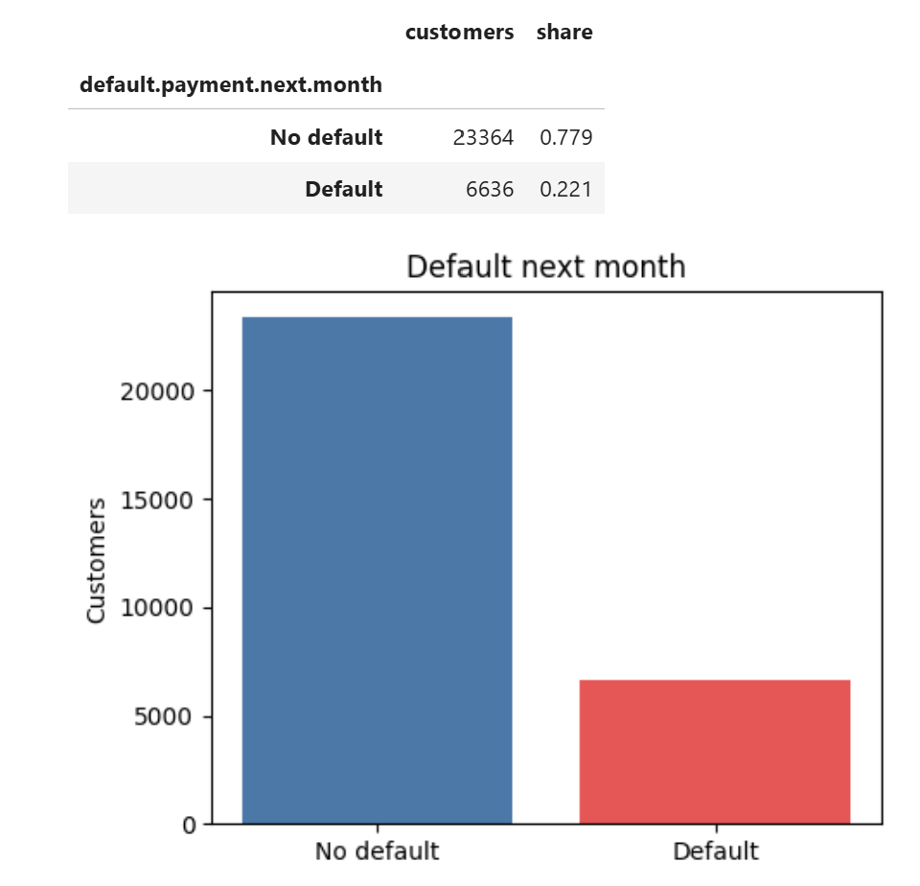
1. Data
2. Train
3. Track
4. Register
5. Serve
6. Package
Monitor (next)
STEP 1 · DATA
Exploring the data
Only 22% of customers default
Understanding this is crucial to interpret metrics and design the model, as classes are imbalanced.
We used a stratified split: train and test keep the same 22%
Notes:
[Maria Teresa · ~25 sec] We started by exploring the data. [Point at the chart] Only 22% of customers default. So a model that says 'no default' to everyone is already 78% accurate and useless, which is why we did not judge our models on accuracy. We also used a stratified split, so train and test keep the same 22%.

Slide 5

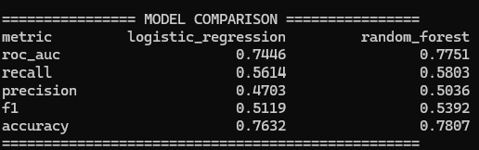
1. Data
2. Train
3. Track
4. Register
5. Serve
6. Package
Monitor (next)
STEP 2 · TRAIN
Training two models with one command
> docker compose --profile train run --rm trainer
Two models: Logistic Regression and Random Forest
Cleaning, features and model are saved together in one pipeline, so the API prepares new data the same way
Every run also checks fairness per group
Fixed random seed: same results every time
Notes:
[Hugo · ~25 sec] Training runs with one command. [Point at the table] It trains Logistic Regression and Random Forest and prints this comparison. Cleaning, features and model are saved as one pipeline, so the API applies exactly the same steps. Every run also checks fairness. And the random seed is fixed, so anyone gets the same numbers.

Slide 6

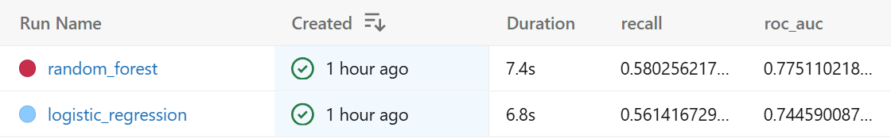
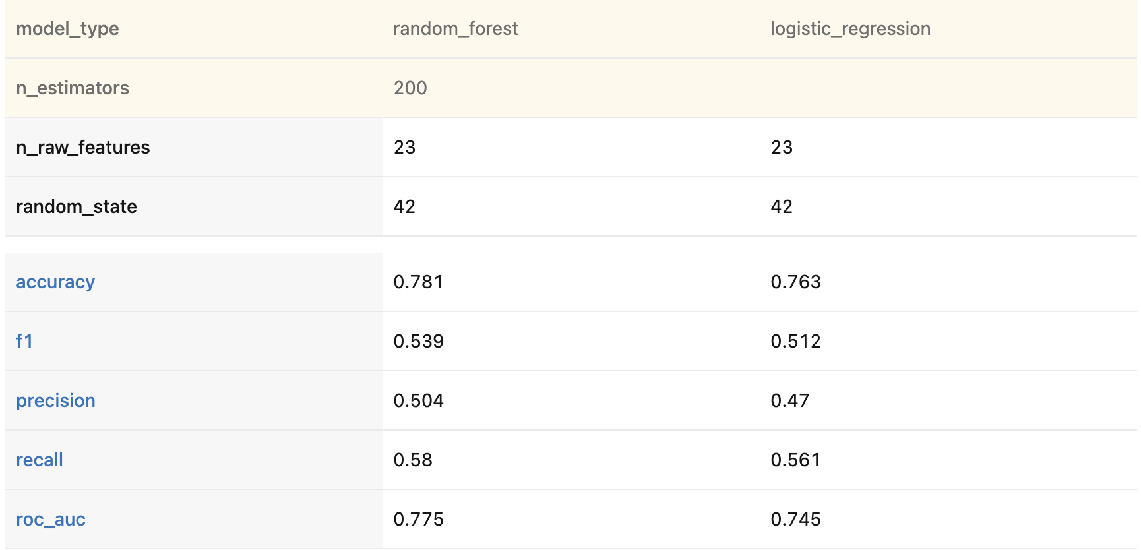
1. Data
2. Train
3. Track
4. Register
5. Serve
6. Package
Monitor (next)
STEP 3 · TRACK
Tracking the experiments in MLflow
Every training run is saved automatically
Each run keeps its parameters, metrics, charts and the model file
We can compare runs side by side instead of keeping notes
Compare view: both runs side by side
Notes:
[Hugo · ~25 sec] Every time we train, MLflow saves a run for each model automatically. [Point at the list] Each run keeps the parameters, metrics, charts, the fairness report and the model file. [Point at the compare view] We compare runs side by side instead of keeping notes.

Slide 7

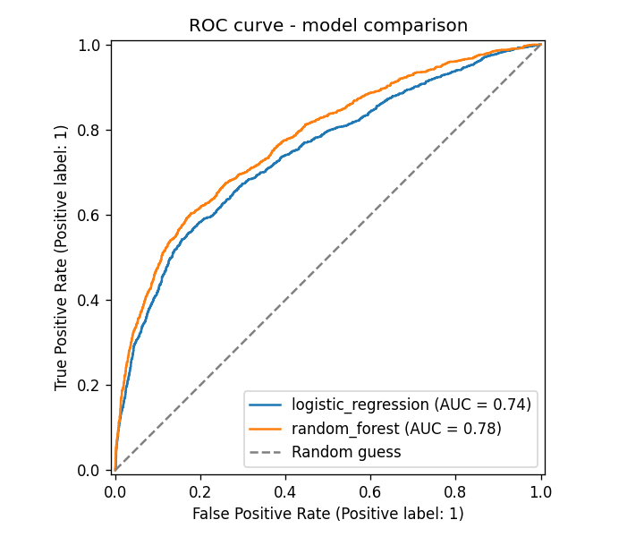
1. Data
2. Train
3. Track
4. Register
5. Serve
6. Package
Monitor (next)
STEP 4 · REGISTER
Champion vs Challenger: only a better model goes live
ROC-AUC
Random Forest 0.775
Logistic Regr. 0.745
The best model is the challenger. It becomes @champion only if its ROC-AUC beats the current champion.
@champion
v1 · the model the API serves
@challenger
v2 · same score, so not promoted
MLflow → Models → credit_default_model · the decision is saved on every version
Notes:
[Olívia · ~30 sec] Random Forest wins on ROC-AUC, 0.775 against 0.745. But a new model does not go to production automatically. It is registered as a challenger, and it only takes the champion alias if it beats the current champion. [Point at the cards] When we retrained on the same data the score was the same, so the challenger was not promoted and the API kept version 1. A bad retrain can never replace a better model.

Slide 8
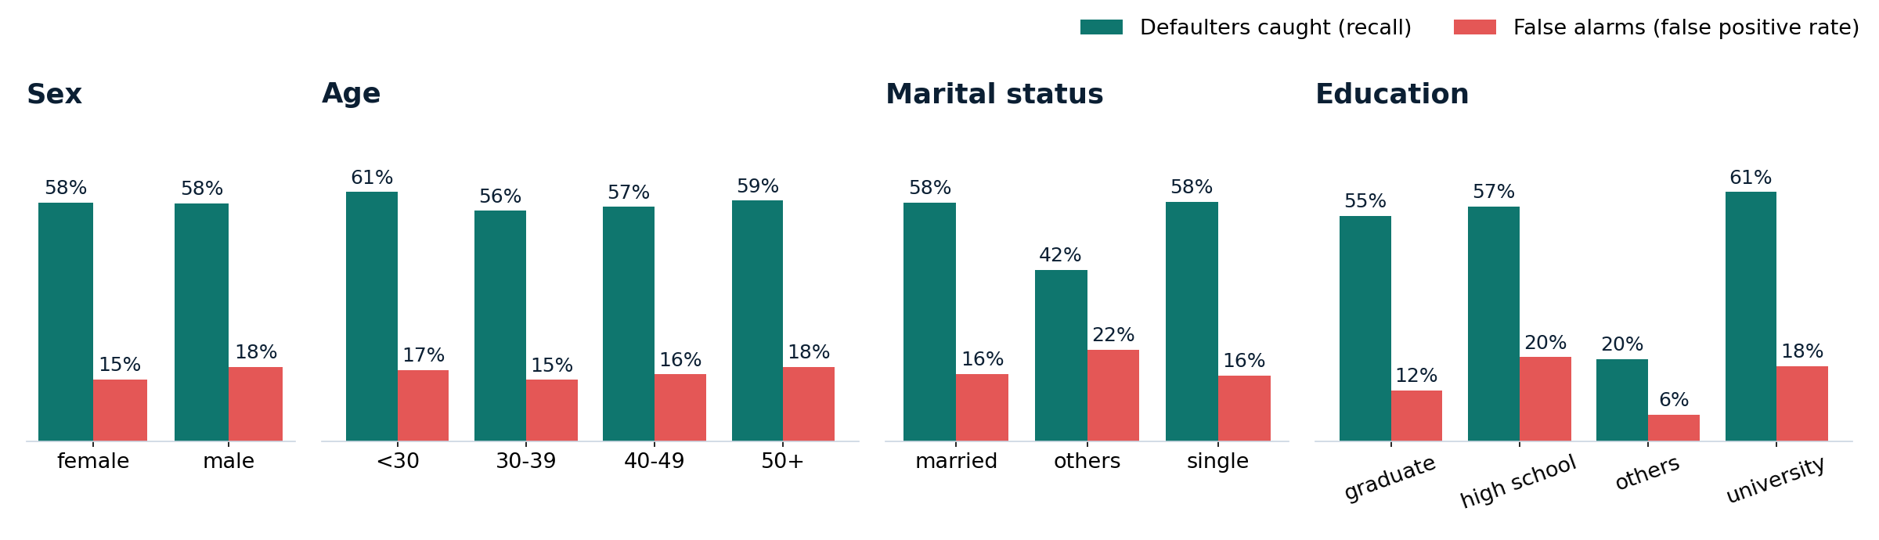
1. Data
2. Train
3. Track
4. Register
5. Serve
6. Package
Monitor (next)
STEP 4 · VALIDATE
Is the model fair? Checked on every training run
Sex · passes
women and men: 58% of defaulters caught
Age · passes
all age bands within the 80% rule
Marital status · review
small 'others' group gets more false alarms
Education · review
false alarms: high school 20%, graduate 12%
80% rule: a gap below 0.8 is flagged for human review · logged to MLflow · documented in MODEL_CARD.md
Notes:
[Olívia · ~35 sec] Credit scoring is high-risk under the EU AI Act, so every training run checks fairness automatically. We compare defaulters caught and false alarms across groups, with the 80% rule. [Point at left] Sex and age pass: we catch 58% of defaulters for both women and men. [Point at right] Education does not: good customers with high-school education get more false alarms than graduates. So a human reviews every flag, it is documented in our model card, and our next step is to retrain without sensitive attributes and compare.

Slide 9

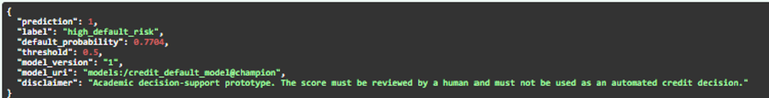
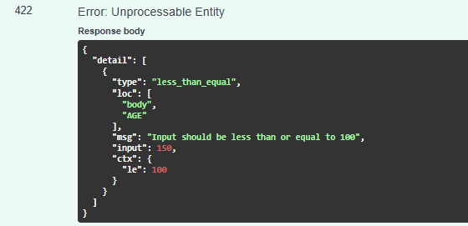
1. Data
2. Train
3. Track
4. Register
5. Serve
6. Package
Monitor (next)
STEP 5 · SERVE
Serving predictions through an API
Valid customer → prediction (real response from our API, Swagger)
high_default_risk
0.77
version 1
Wrong input (AGE = 150) → rejected
label
default probability
model that answered
The API loads the @champion model
Wrong input is rejected before it reaches the model
Every answer says a human must review the score
Notes:
[Pedro · ~25 sec] The API loads the champion model from MLflow. We sent one customer to /predict and [point at the top] got a 77% probability of default, so high risk. The answer says which model version answered and reminds the user that a human must review the score. [Point at the right] Wrong input, like an age of 150, is rejected with error 422 before it reaches the model.

Slide 10

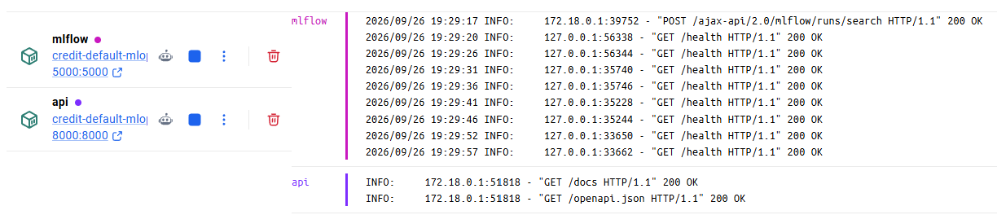
1. Data
2. Train
3. Track
4. Register
5. Serve
6. Package
Monitor (next)
STEP 6 · PACKAGE
Running everything with Docker
Docker Desktop: our containers running, with their live logs
mlflow
api
trainer
tracking + registry · port 5000
prediction service · port 8000
runs once when we train, then removed
A teammate needs only Git, Docker and the CSV. 27 automated tests + a Docker build run on every push to GitHub (CI green).
Notes:
[Pedro · ~20 sec] Everything runs in Docker: MLflow and the API as two containers, and the trainer as a third that runs only when we train. A teammate only needs Git, Docker and the data file. And on every push, GitHub runs our 27 automated tests and builds the Docker image.

Slide 11
1. Data
2. Train
3. Track
4. Register
5. Serve
6. Package
Monitor (next)
CONCLUSION
What we built and what comes next
What we built
Next steps
Responsible use
Experiments + fairness tracked in MLflow
Champion vs Challenger registry
Prediction API with input checks
Docker + 27 tests in GitHub CI
Monitor drift over time (Evidently)
Retrain without sensitive attributes
Set the threshold with the business
Cross-validation and tuning
Sex and age pass; education under review
A human reviews every flag
Model card documents the limits
High-risk under the EU AI Act; GDPR
Notes:
[Pedro · ~30 sec] To sum up: experiments and fairness tracked in MLflow, champion vs challenger in the registry, a validated API, and everything in Docker with automated tests. Next: monitor drift, retrain without sensitive attributes, and agree the threshold with the business. Because credit scoring is high-risk, a human stays in the loop. Thank you.

Slide 12
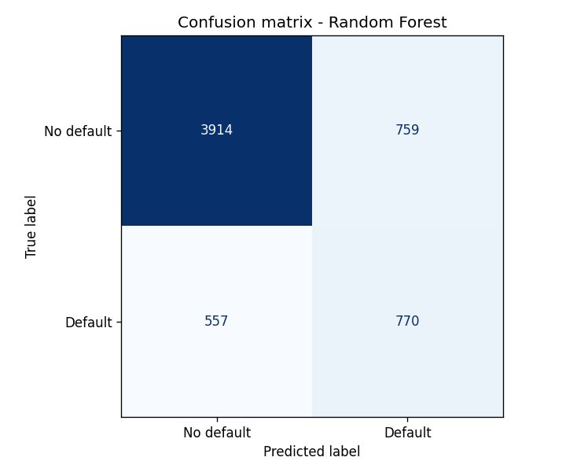
BACKUP · FOR QUESTIONS
Results in detail and limitations
Metric | Log. Regr. | Random Forest
ROC-AUC | 0.745 | 0.775
Recall | 0.561 | 0.580
Precision | 0.470 | 0.504
F1 | 0.512 | 0.539
Accuracy | 0.763 | 0.781
Limitations
Data from Taiwan, 2005
One train/test split
No tuning; threshold 0.5
Education fairness gap (in review)
No monitoring or data versioning
MLflow has no login (laptop only)
Random Forest on 6,000 test customers: 770 of 1,327 defaulters caught, 759 false alarms
Notes:
For questions. Why not accuracy? Saying 'no default' to everyone is already 77.9% accurate. Why threshold 0.5? It is the default; the business should set it from the cost of a missed defaulter versus a false alarm. Is Random Forest really better? On this split yes; cross-validation would confirm it. Why is education unfair? High-school customers default more in the data (26% vs 19%), but good high-school customers still get more false alarms; that needs a human and legal review. Why not remove sensitive columns? It is our next experiment, but other columns can act as proxies. Monitoring? Next step, for example with Evidently. Roles? Data scientist (models), ML engineer (pipeline, Docker, CI), responsible-AI owner (fairness, model card).

