Slide 1
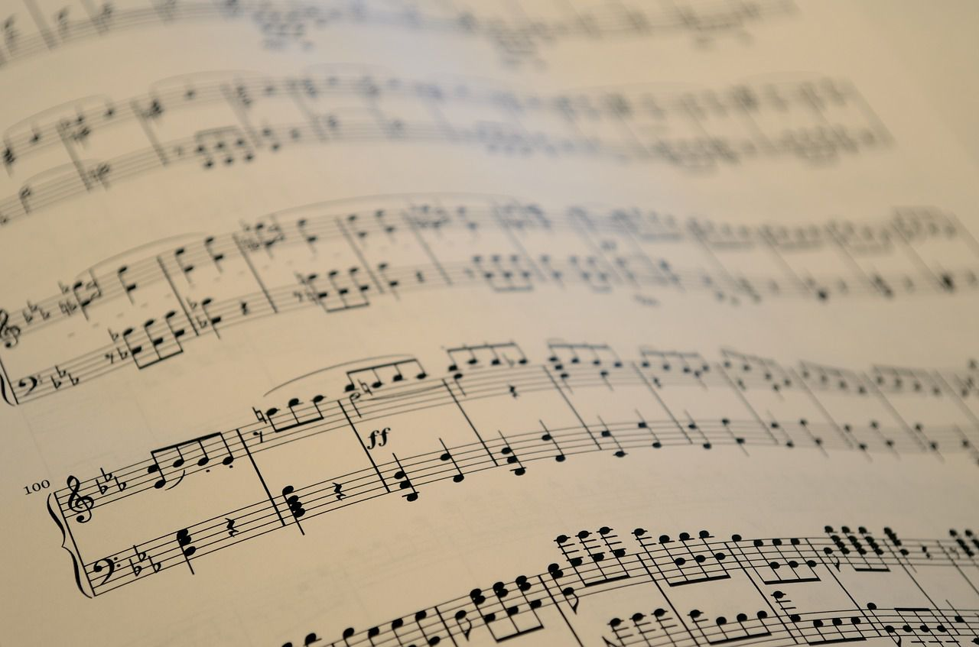



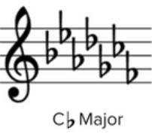

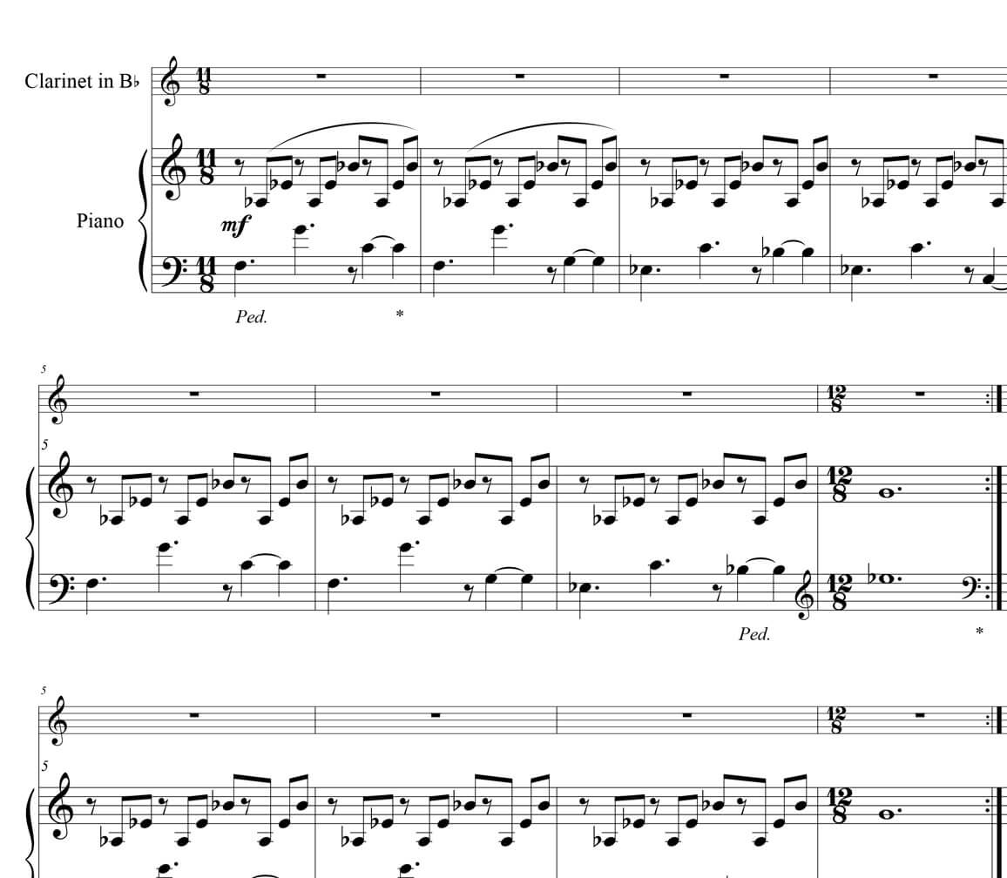
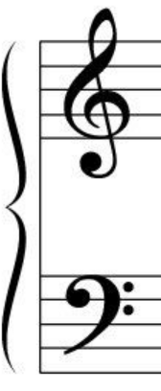


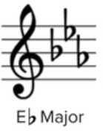
Automatic Sheet Music Reader (ASMR)
General Pipeline
Post-processing
Pre-processing
Transformation of the input sheet music photo/scan into a standardized binary image
OCR
Recognition of all the symbols located on a sheet music
Sheet Music Digitalization
Virtual sheet music generation to store the éléments previously detected
Transposition and other functions
Export
Generate an output sheet music in a convenient format (XML, pdf …) from the virtual sheet music

Slide 2
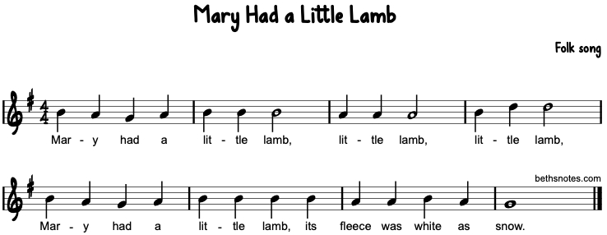
Automatic Sheet Music Reader (ASMR)
Pre-processing
Extraction of staffs
Clean Input Sheet Music
Staffs
Size standization of staffs
OCR
Recognition of all the symbols located on a sheet music
Inputs
w_standard
h_standard

Slide 3
Automatic Sheet Music Reader (ASMR)
Optical Music Recognition (OMR)
Horizontal location of notes
Vertical location of notes
Notes’ values
Input
Vertical scan
Value attribution
Output
Staff at standard size
Vertical location of staff lines
Staff without lines
Horizontal location of symbols
Sheet Music Digitalization
Virtual sheet music
Seperation between notes and other symbols
Vertical scan
Staff line detection: Vertical scan
Filter staff
Horizontal scan
Horizontal location of other musical symbols
Filter parameters to be adjusted
Symbols’ threshold to be adjusted
Vertical location of the other musical symbols
Values of the other musical symbols
threshold to be adjusted
Template matching
Parameters to be adjusted

