Slide 1
Lecture 1 Describing Inverse Problems
Notes:
This lecture outlines the general scope of inverse theory.

Slide 2
Syllabus
Lecture 01 Describing Inverse Problems Lecture 02 Probability and Measurement Error, Part 1 Lecture 03 Probability and Measurement Error, Part 2 Lecture 04 The L₂ Norm and Simple Least Squares Lecture 05 A Priori Information and Weighted Least Squared Lecture 06 Resolution and Generalized Inverses
Lecture 07 Backus-Gilbert Inverse and the Trade Off of Resolution and Variance Lecture 08 The Principle of Maximum Likelihood Lecture 09 Inexact Theories Lecture 10 Nonuniqueness and Localized Averages Lecture 11 Vector Spaces and Singular Value Decomposition
Lecture 12 Equality and Inequality Constraints Lecture 13 L₁ , L∞ Norm Problems and Linear Programming Lecture 14 Nonlinear Problems: Grid and Monte Carlo Searches Lecture 15 Nonlinear Problems: Newton’s Method Lecture 16 Nonlinear Problems: Simulated Annealing and Bootstrap Confidence Intervals Lecture 17 Factor Analysis Lecture 18 Varimax Factors, Empircal Orthogonal Functions Lecture 19 Backus-Gilbert Theory for Continuous Problems; Radon’s Problem Lecture 20 Linear Operators and Their Adjoints Lecture 21 Fréchet Derivatives Lecture 22 Exemplary Inverse Problems, incl. Filter Design Lecture 23 Exemplary Inverse Problems, incl. Earthquake Location Lecture 24 Exemplary Inverse Problems, incl. Vibrational Problems

Slide 3
Purpose of the Lecture
distinguish forward and inverse problems
categorize inverse problems
examine a few examples
enumerate different kinds of solutions to inverse problems
Notes:
It develops some
This lecture introduces some important lingo, first of the names of important quantities such as data and model parameters,
and the classification of problems by their structure. It then examines a few examples. Finally, it deals with the question of
what we are looking for when we solve an inverse problem; just what constitutes a solution?

Slide 4
Part 1 Lingo for discussing the relationship between observations and the things that we want to learn from them
Notes:
Observations (data) are not knowledge. The purpose of data analysis in general, and inverse theory in particular,
is to use data to derive knowledge. While knowledge can take many forms, we assume here we are primarily after
knowledge that is numerical in nature.

Slide 5
three important definitions

Slide 6
data, d = [d₁, d₂, … d_{N}]^{T}
things that are measured in an experiment or observed in nature…
model parameters, m = [m₁, m₂, … m_{M}]^{T}
things you want to know about the world …
quantitative model (or theory)
relationship between data and model parameters
Notes:
data = what you measure; model parameters = numbers that constitute knowledge, something distilled from data; the quantitative model (or theory) is the link between the two.

Slide 7
data, d = [d₁, d₂, … d_{N}]^{T}
gravitational accelerations
travel time of seismic waves
model parameters, m = [m₁, m₂, … m_{M}]^{T}
density
seismic velocity
quantitative model (or theory)
Newton’s law of gravity
seismic wave equation
Notes:
Examples: You measure gravitational acceleration of, say a satellite in orbit about the planet; that’s the data. You want to know the density of the planet; that the knowledge, summarize by a parameter such as density; the two are linked by the physics of gravitation; that’s th equantitative model or theory.

Slide 8
Forward Theory
m^{est}
Quantitative Model
d^{pre}
estimates
predictions
Inverse Theory
m^{est}
d^{obs}
Quantitative Model
estimates
observations
Notes:
Lingo: Forward theory starts with estimates of the model parameters and predicts the observations.
Inverse Theory starts with observations and make estimates of the model parameters.

Slide 9
m^{true}
Quantitative Model
d^{pre}
due to observational error
≠
m^{est}
Quantitative Model
d^{obs}
Notes:
Suppose you knew the true values of the model parameters. The data predicted by them is never equal to the observed data, die to observational error.

Slide 10
m^{true}
Quantitative Model
d^{pre}
due to observational error
≠
due to error propagation
≠
m^{est}
Quantitative Model
d^{obs}
Notes:
Consequently, the estimates of the model parameters are never equal to their true values. Error has propagated through
the solution process.

Slide 11
Understanding the effects of
observational error
is central to Inverse Theory
Notes:
Data analysis must be prepared to deal with noise.

Slide 12
Part 2 types of quantitative models (or theories)
Notes:
This is a classification exercise.

Slide 13
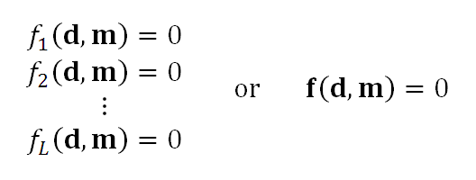
A. Implicit Theory
L relationships between the data and the model are known
Notes:
An implicit theory is the most general case. You know relationship between the data and model parameters.

Slide 14
Example
mass = density ⨉ length ⨉ width ⨉ height
M = ρ ⨉ L ⨉ W ⨉ H
L
ρ
H
M
Notes:
Here you know a relationship between mass, density and volume.
Of these, density is the most fundamental – the knowledge – because it provides compositional information.
That’s the model parameter.
The other quantities are measured; they’re the data.

Slide 15
weight = density ⨉ volume
measure
mass, d₁
size, d₂, d₃, d₄,
want to know
density, m₁
d=[d₁, d₂, d₃, d₄]^{T} and N=4
m=[m₁]^{T} and M=1
d₁ = m₁ d₂ d₃ d₄ or d₁ - m₁ d₂ d₃ d₄ = 0
f₁(d,m)=0 and L=1
Notes:
observed; data = mass, height, width, depth
knowledge; model parameters, density
we know one relationship between them

Slide 16
note
No guarantee that
f(d,m)=0
contains enough information
for unique estimate m
determining whether or not there is enough
is part of the inverse problem
Notes:
L=1. Is one relationship enough? Its all we have, so we will learn from it as much as we can.

Slide 17
B. Explicit Theory
the equation can be arranged so that d is a function of m
d = g(m) or d - g(m) = 0
L = N one equation per datum
Notes:
Explicit theory. Manipulate so that the data is on the left hand side of the equation.
Makes predicting the data easy: d-predicted = g(m-estimated).

Slide 18
Example
rectangle
H
L
Circumference = 2 ⨉ length + 2 ⨉ height
Area = length ⨉ height
Notes:
Observed: length, height
Want to know: model parameters, Circumference, area

Slide 19
Circumference = 2 ⨉ length + 2 ⨉ height
C = 2L+2H
Area = length ⨉ height
A=LH
measure
C=d₁
A=d₂
want to know
L=m₁
H=m₂
d=[d₁, d₂]^{T} and N=2
m=[m₁, m₂]^{T} and M=2
d₁ = 2m₁ + 2m₂
d₂ m₁m₂
d=g(m)
Notes:
Arrange so that daraare on l.h.s. of equation, model parameters are on r.h.s.

Slide 20
C. Linear Explicit Theory
the function g(m) is a matrix G times m
d = Gm
G has N rows and M columns
Notes:
This is the special case where the data are linear related to the model parameters.
Note rectangle example was nonlinear, owing to combination m1*m2.
Linear is simple; just a matrix G.
Linear: double m, double d;
if m broken into two parts m=(mA+mB) then d=G*mA+G*mb.

Slide 21
C. Linear Explicit Theory
the function g(m) is a matrix G times m
d = Gm
“data kernel”
G has N rows and M columns
Notes:
G called the “data kernel”

Slide 22
Example
quartz
gold
total volume = volume of gold + volume of quartz
V = V _{g}+ V _{q}
total mass = density of gold ⨉ volume of gold
+ density of quartz ⨉ volume of quartz
M = ρ_{g} ⨉ V _{g}+ ρ_{q} ⨉ V _{q}
Notes:
You want to know how much gold is in the rock.
You measure mass and volume.
You want to infer the volume of the gold.

Slide 23
V = V _{g}+ V _{q}
M = ρ_{g} ⨉ V_{g}+ ρ_{q} ⨉ V _{q}
measure
V = d₁
M = d₂
want to know
V_{g} =m₁
V_{q} =m₂
assume
ρ_{g}
ρ_{g}
d=[d₁, d₂]^{T} and N=2
m=[m₁, m₂]^{T} and M=2
known
d =
1
1
m
ρ_{g}
ρ_{q}
Notes:
Note that, in this problem, the densities are assumed to be known. They are auxiliary information
that accompanies the problem.

Slide 24
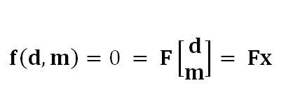
D. Linear Implicit Theory
The L relationships between the data are linear
L rows
N+M columns
Notes:
Implicit theories also have a linear special case. Note that the data and model parameters are
(for convenience) combined into a single vector x. Then the problem involves a single matrix F.

Slide 25
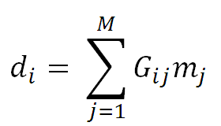
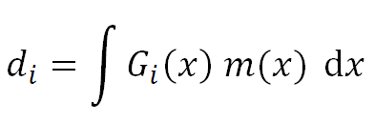
in all these examples m is discrete
discrete inverse theory
one could have a continuous m(x) instead
continuous inverse theory

Slide 26
as a discrete vector m
in this course we will usually approximate a continuous m(x)
m = [m(Δx), m(2Δx), m(3Δx) … m(MΔx)]^{T}
but we will spend some time later in the course dealing with the continuous problem directly
Notes:
Discrete variable: list of individual numbers; e.g. a vector m. Continuous: Infinite detail; e.g. a function m(x).
Data are always discrete: you can measure only a finite number of things.
Model parameters can be discrete or continuous, but in this course we will mostly consider discrete model parameters.
A continuous function can be approximated as a discrete vector by sampling it at regular intervals.

Slide 27
Part 3 Some Examples

Slide 28
A. Fitting a straight line to data
T = a + bt
temperature anomaly, T_{i} (deg C)
time, t (calendar years)
Notes:
The straight line has only two model parameters, intercept and slope.
But they often constitute really important knowledge. Especially slope,
which makes a prediction about how fast a quantity is increasing or decreasing.
Go through the graph, point out the axes: horizontal axis is time in years, vertical is temperature anomaly
(temperature minus a reference temperature) in degrees C. Red dots are the data. Blue line is the
theory. Note that the data do not exactly fit the theory. That’s OK. It means either that 1) the red dots
contain observational error; or 2) the straight line is an approximate theory that does not capture all lthe
nuiances of the data.
is only an approximate theory
Fig. 1.1. (Red) Average global temperature for the time period, 1965-2010. The inverse problem is to determine the rate of increase of temperature and its confidence interval. (Blue) Straight line fit to data. The slope of the line is 0.015±0.002 (2σ) ºC/year. Data from Hansen et al. 2006. MatLab script gda01_??.

Slide 29
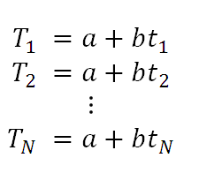
each data point
is predicted by a straight line
Notes:
Write out the straight line equation for every observation.

Slide 30
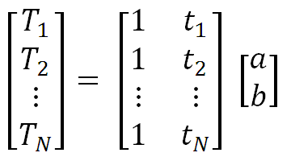
matrix formulation
d = G m
M=2
Notes:
Arrange into a matrix equation.

Slide 31
B. Fitting a parabola
T = a + bt+ ct²
Notes:
Parabola is similar in form to a straight line; just one additional model parameter, c.

Slide 32
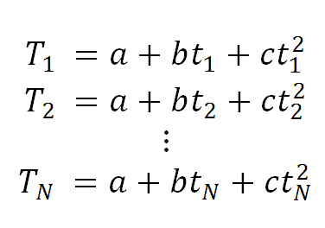
each data point
is predicted by a strquadratic curve
Notes:
Write out equation for each observation.

Slide 33
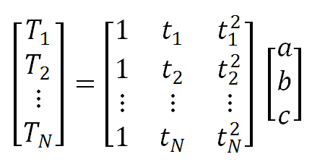
matrix formulation
d = G m
M=3
Notes:
Group into a matrix equation.

Slide 34
straight line
parabola
note similarity
Notes:
Note similarity in structure to the straight line problem.
Shows power of using matricies.

Slide 35
in MatLab
G=[ones(N,1), t, t.^2];
Notes:
The data kernel can be created in one line in MatLab.

Slide 36
C. Acoustic Tomography
h
1
2
3
4
h
5
6
7
8
source, S
receiver, R
13
14
15
16
travel time = length ⨉ slowness
Notes:
Tomography: Making an image using observations made along rays.
Theory: travel time of sound = distance / velocity. But rather than to have a division, define slowness = 1/velocity and then travel time = distance * slowness.
Model parameters: The way seismic slowness varies from place to place. It’s a continuous function s(x,y). But we discretize it here into set of 16 “pixels” (constant slowness regions). Think of each pixel as a uniform brick.
Data: Travel time of sound wave to travel from a source S to a receiver R. In this hypothetical problem,
just measure along rows and columns.
Fig. 1.2. The travel time of acoustic waves (blue line) thorough the rows and columns of a square array of bricks is measured with with acoustic source, S, and receiver, R, placed on the edges of the square. The inverse problem is to infer the acoustic properties of the bricks, here depicted by the colors. Although the overall pattern is spatially-variable, individual bricks are assumed to be homogeneous.

Slide 37
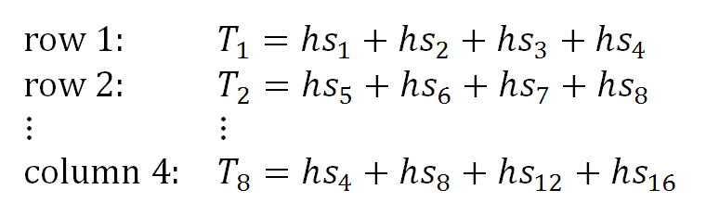
collect data along rows and columns
Notes:
Data collected along 4 rows and 4 columns, so a total of N=8 data.
16 bricks, so 16 model parameters. Arrange them in a vector m rowwise,
m = [ s1, s2, s3, s4, s5, s6, s7, … s16]^{T}.

Slide 38
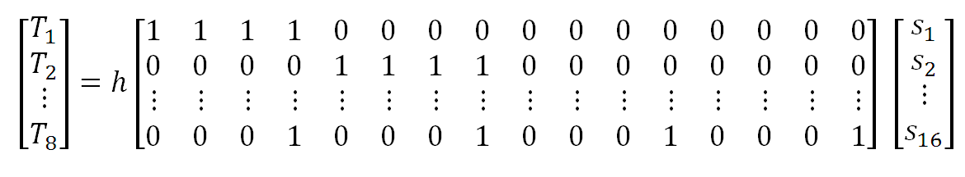
matrix formulation
d = G m
N=8
M=16
Notes:
Matrix version. Lots of zeros in that matrix!

Slide 39
In MatLab
G=zeros(N,M);
for i = [1:4]
for j = [1:4]
% measurements over rows
k = (i-1)*4 + j;
G(i,k)=1;
% measurements over columns
k = (j-1)*4 + i;
G(i+4,k)=1;
end
end
Notes:
A bit brute force. Perhaps a student could think of a better way. Note that the 4x4 array
of pixels is being “unfolded” into a vector using the formula k = (i-1)*4 + j.

Slide 40
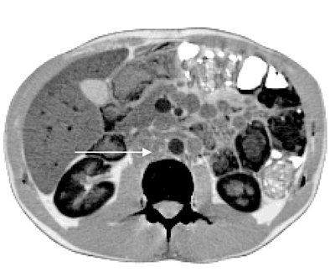
D. X-ray Imaging
(A)
(B)
S
R₁
R₂
R₃
R₄
R₅
enlarged lymph node
Notes:
X-ray tomography. Similar to acoustic tomography, but now use X-rays. Also collect data at every angle (by rotating source & receivers).
Fig. 1.3. (A) An idealized Computed Tomography (CT) medical scanner measures the x-ray absorption along lines (blue) passing through the body of the patient (orange). After a set of measurements are made, the source, S, and receivers, R_{i}, are rotated, and the measurements are repeated, so that data along many crisscrossing lines are collected. The inverse problem is to determine the x-ray opacity as a function of position in the body. (B) Actual CT image of a patient infected with Mycobacterium genavense (from de Lastours et al., 2008).

Slide 41
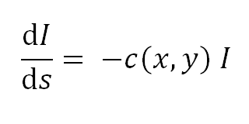
theory
I = Intensity of x-rays (data)
s = distance
c = absorption coefficient (model parameters)
Notes:
X-rays are absorbed at a rate that depends on the absorption coefficient c(x,y) in the body.
The absorption coefficient is the model parameter, different organs have different coefficients.
Note that it is a continuous variable; we’ll have to discretize it.

Slide 42
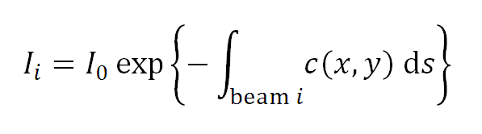
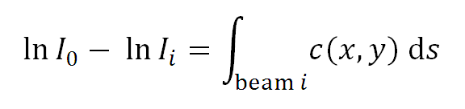
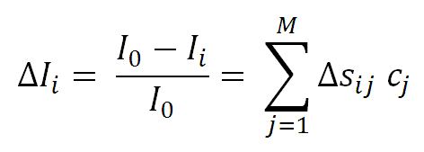
Taylor Series
approximation
Notes:
Solve equation. Tae logarithm. Linearize l.h.s. by assuming that the amount of absorption is small.

Slide 43
Taylor Series
approximation
discrete pixel
approximation
Notes:
Discretize absortion coefficient using pixels – tiny regions of constant absorption coefficient.

Slide 44
Taylor Series
approximation
discrete pixel
approximation
length of beam i in pixel j
d = G m
Notes:
Note data kernel G_{ij} = Δs_{ij}, that is the length of beam i in pixel j.

Slide 45
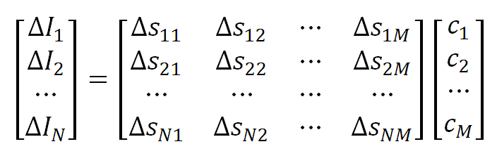
matrix formulation
d = G m
N≈10⁶
M≈10⁶
Notes:
Typically, d and m are very long vectors.

Slide 46
note that G is huge 10⁶⨉10⁶ but it is sparse (mostly zero) since a beam passes through only a tiny fraction of the total number of pixels
Notes:
Sparse matrix: contains mosty zeros. In this case, beam passes through roughly sqrt(M) pixels, so if
M=1,000,000 then matrix is 999/1000 sparse.

Slide 47
in MatLab
G = spalloc( N, M, MAXNONZEROELEMENTS);
Notes:
We will routinely use sparse matrices when appropriate. They must be explicitly defined,
but otherwise they operate the same as ordinary matrices. But they save on memory hugely.

Slide 48
E. Spectral Curve Fitting
Notes:
Mossbauer spectrum: sum on absorption peaks.
Area of each peak diagnostic of amount of Fe in a particular atomic arrangement in the rock.
Fig 2.4. Example of a Mossbauer spectroscopy experiment performed by the Spirit rover on Martian soil. (Red) Absorption peaks reflect the concentration of different iron-bearing minerals in the soil. The inverse problem is to determine the position and area of each peak, which can be used to determine the concentration of the minerals. (Blue) The sum of ten Lorentzian curves fit to the data. Data courtesy of NASA and the University of Mainz. MatLab script gda01_??.

Slide 49
single spectral peak
area, A
p(z)
width, c
z
position, f
Notes:
One peak. Note is upside down with respect to actual spectrum.
M=3 model parameters per peak, area, width, position.

Slide 50
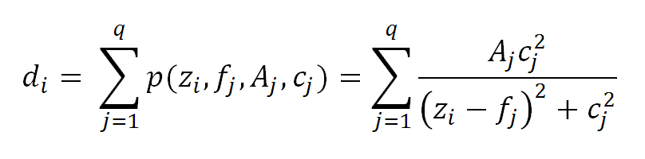
q spectral peaks
“Lorentzian”
d = g(m)
Notes:
Theory: spectrum is a sum of q peaks.
M = 3*q.

Slide 51
F. Factor Analysis
s₁
s₂
e₁
e₁
e₂
e₂
e₃
e₃
e₄
e₄
e₅
e₅
ocean
sediment
Notes:
Theory:
Sediments from different sources, S1, S2 flow into oceans, where they mix.
Sediments contain elements e1, e2, … so sediments on ocean floor are a mix of these elements.
Fig 1.5. Sediment on the floor of this idealized ocean is a mixture of rocks eroded from several sources, s_{i}. The sources are characterized by chemical elements, e₁ through e₅, depicted here with color bars. The chemical composition of the sediments is a simple mixture of the composition of the sources. The inverse problem is to determine the number and composition of sources from observations of the composition of the sediments. MatLab script gda01_??.

Slide 52
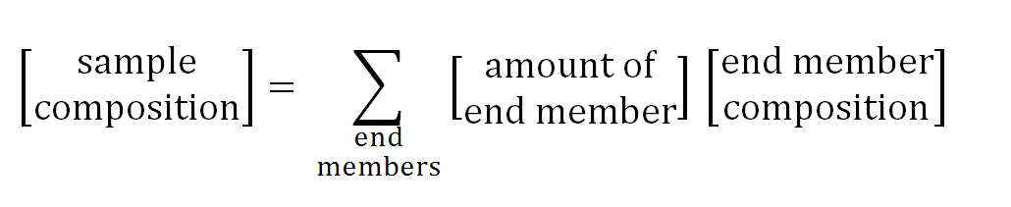
d = g(m)
Notes:
Sample is a mixture of end-members.
Data: elemental composition of samples.
Model parameters: elemental composition of end members and their amounts.
A nonlinear explicit problem

Slide 53
Part 4 What kind of solution are we looking for ?
Notes:
Ask the class to contribute ideas. Try to at least get them to realize that numeric values of model parameters is
insufficient. Need confidence intervals as well.

Slide 54
A: Estimate of model parameters meaning numerical values m₁ = 10.5 m₂ = 7.2
Notes:
Numeric values.

Slide 55
But we really need confidence limits, too
m₁ = 10.5 ± 0.2 m₂ = 7.2 ± 0.1
m₁ = 10.5 ± 22.3 m₂ = 7.2 ± 9.1
or
completely different implications!
Notes:
Numeric values with confidence intervals much more meaningful.

Slide 56
B: probability density functions
if p(m₁) simple
not so different than confidence intervals
Notes:
Could go with entire probabiity density function.

Slide 57
m is either
about 3
plus of minus 1
or about 8
plus or minus 1
but that’s less likely
m is about 5
plus or minus 1.5
we don’t really know anything useful about m
Notes:
But in simple cases it has similar info to a value and a confidence interval.
An in complicated cases means little.
Only in intermediate cases does it add information.
Fig. 1.6. Three hypothetical probability density functions for a model parameter, m. (A) The first is so simple that its properties can be summarized by its central position, at m=5, and the width of its peak. (B) The second implies that the model parameter has two probable ranges of values, one near m=3 and the other near m=8. (C) The third is so complicated that it provides no easily interpretable information about the model parameter.

Slide 58
C: localized averages
A = 0.2m₉ + 0.6m₁₀ + 0.2m₁₁
might be better determined than either
m₉ or m₁₀ or m₁₁ individually
Notes:
Sometimes a localized average has a much smaller confidence interval than any of the individual parameters.

Slide 59
Is this useful? Do we care about A = 0.2m₉ + 0.6m₁₀ + 0.2m₁₁ ? Maybe …
Notes:
Ask class to think of cases where an average might be useful.

Slide 60
Suppose if m is a discrete approximation of m(x)
m₁₀
m₁₁
m₉
m(x)
x
Notes:
A continuous variable m(x) has an “infinite number of points”. We can’t determine each of them.

Slide 61
A= 0.2m₉ + 0.6m₁₀ + 0.2m₁₁ weighted average of m(x) in the vicinity of x₁₀
m₁₀
m₁₁
m₉
m(x)
x₁₀
x
Notes:
But we can determine the average value of m(x) centered about a given point, such as x=10.

Slide 62
average “localized’ in the vicinity of x₁₀
m₁₀
m₁₁
m₉
m(x)
x₁₀
x
weights
of weighted average
Notes:
The weights, (…, 0.0, 0.2, 0.6, 0.2, 0.0, …), might be considered a discrete approximation of a triangular weighting function.

Slide 63
Localized average mean can’t determine m(x) at x=10 but can determine average value of m(x) near x=10 Such a localized average might very well be useful

