Slide 1
Lecture 3 Probability and Measurement Error, Part 2
Notes:
Probability is relevant to data analysis because all data contains noise, and noise can be understood using concepts drawn from probability.

Slide 2
Syllabus
Lecture 01 Describing Inverse Problems Lecture 02 Probability and Measurement Error, Part 1 Lecture 03 Probability and Measurement Error, Part 2 Lecture 04 The L₂ Norm and Simple Least Squares Lecture 05 A Priori Information and Weighted Least Squared Lecture 06 Resolution and Generalized Inverses
Lecture 07 Backus-Gilbert Inverse and the Trade Off of Resolution and Variance Lecture 08 The Principle of Maximum Likelihood Lecture 09 Inexact Theories Lecture 10 Nonuniqueness and Localized Averages Lecture 11 Vector Spaces and Singular Value Decomposition
Lecture 12 Equality and Inequality Constraints Lecture 13 L₁ , L∞ Norm Problems and Linear Programming Lecture 14 Nonlinear Problems: Grid and Monte Carlo Searches Lecture 15 Nonlinear Problems: Newton’s Method Lecture 16 Nonlinear Problems: Simulated Annealing and Bootstrap Confidence Intervals Lecture 17 Factor Analysis Lecture 18 Varimax Factors, Empircal Orthogonal Functions Lecture 19 Backus-Gilbert Theory for Continuous Problems; Radon’s Problem Lecture 20 Linear Operators and Their Adjoints Lecture 21 Fréchet Derivatives Lecture 22 Exemplary Inverse Problems, incl. Filter Design Lecture 23 Exemplary Inverse Problems, incl. Earthquake Location Lecture 24 Exemplary Inverse Problems, incl. Vibrational Problems

Slide 3
Purpose of the Lecture
review key points from last lecture
introduce conditional p.d.f.’s and Bayes theorem
discuss confidence intervals
explore ways to compute realizations of random variables
Notes:
The material in this lecture is both more abstract and more algebraically complicated than last lecture’s.

Slide 4
Part 1 review of the last lecture
Notes:
A key idea is the random variable.

Slide 5
Joint probability density functions
p(d) =p(d₁,d₂,d₃,d₄…d_{N})
probability that the data are near d
p(m) =p(m₁,m₂,m₃,m₄…m_{M})
probability that the model parameters are near m
Notes:
In inverse theory, we will consider both the data and the estimated model parameters as random variables. Whether the true model parameters are best considered determininstic or random will depend of circumstances. But the estimates are always random variables.

Slide 6
Joint p.d.f. or two data, p(d₁,d₂)
0
10
p
0
d₂
0.25
10
0.00
d₁
Notes:
A hypothetical joint distribution.

Slide 7
means <d₁> and <d₂>
<d₂ >
0
10
p
0
d₂
0.25
<d₁ >
10
0.00
d₁
Notes:
The means are at the balancing point of the distribution, which is usually near the center.

Slide 8
variances σ₁² and σ₂²
<d₂ >
0
10
p
0
d₂
0.25
<d₁ >
2σ₁
2σ₂
10
0.00
2σ₁
d₁
Notes:
Variance measures the width of the distribution along the two coordinate axes.

Slide 9
covariance – degree of correlation
<d₂ >
0
10
p
0
d₂
0.25
θ
<d₁ >
2σ₁
2σ₂
10
0.00
2σ₁
d₁
Notes:
To describe correlation, you must somehow quantify the “tilt” or “theta” of the p.d.f.

Slide 10
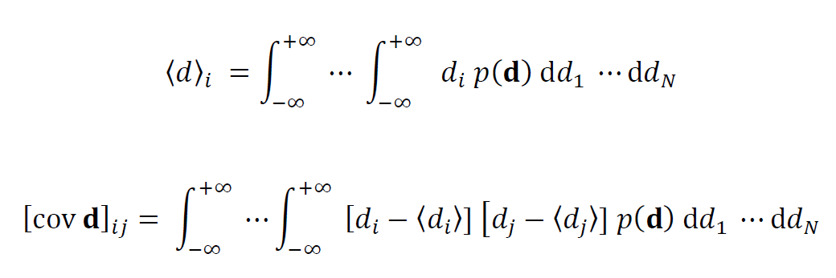
summarizing a joint p.d.f. mean is a vector covariance is a symmetric matrix
diagonal elements: variances
off-diagonal elements: covariances
Notes:
For a higher dimensional p.d.f., a very powerful idea is to group the means into a vector and the variances/covariances into a matrix. This arrangement substantially simplifies calculations.

Slide 11
error in measurement implies uncertainty in inferences
data with measurement error
inferences with uncertainty
data analysis process
Notes:
This is one of the most important concepts of the lecture. Be sure to emphasize it.

Slide 12
functions of random variables
given p(d)
with m=f(d)
what is p(m) ?
Notes:
Mathematically, we need to know how to transform a p.d.f. under a change of variables.

Slide 13

given p(d) and m(d) then
Jacobian determinant
∂d₁/∂m₁
∂d₁/∂m₂
…
det
∂d₂/∂m₁
∂d₂/∂m₂
…
…
…
…
Notes:
The rule for a multivariate distribution the so-called Jabobian determinant, which is related to the way that the volume element changes shape.

Slide 14
multivariate Gaussian example
N data, d
Gaussian p.d.f.
m=Md+v
M=N model parameters, m
linear relationship
Notes:
This case, Gaussian data with a linear relationship, is very important.

Slide 15
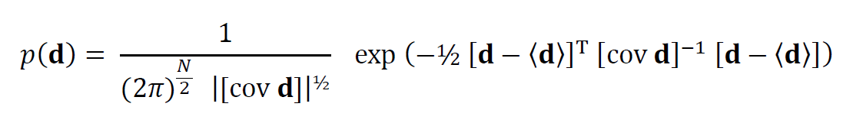
given
and the linear relation
m=Md+v
what’s p(m) ?
Notes:
(Top) Here’s the formula for a multivariate Gaussian distribution. The formula has been chosen so that it has A) Unit area, B) Mean <d> and C) Covariance [cov d] and so that it reduces to the product of univariate Gaussian distributions in the uncorrelated case.
(Bottom) The general linear formula allows for a multiplicative matrix M and add additive vector v.

Slide 16
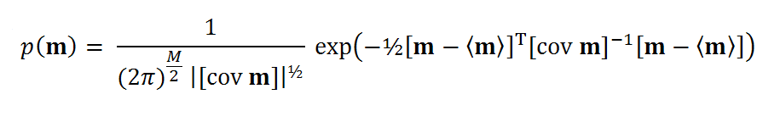

answer
with
Notes:
The p.d.f. of the model parameters is also Gaussian with mean and covariance as shown. Note that the mean is just the linear formula evaluated at the mean of the data.

Slide 17
answer
also Gaussian
with
rule for error propagation
Notes:
Here’s the formula for a multivariate Gaussian distribution. The formula has been chosen so that it has A) Unit area, B) Mean <d> and C) Covariance [cov d] and so that it reduces to the product of univariate Gaussian distributions in the uncorrelated case.

Slide 18

rule for error propagation
holds even when M≠N
and for non-Gaussian distributions
Notes:
Here’s the formula for a multivariate Gaussian distribution. The formula has been chosen so that it has A) Unit area, B) Mean <d> and C) Covariance [cov d] and so that it reduces to the product of univariate Gaussian distributions in the uncorrelated case.

Slide 19
rule for error propagation
memorize
holds even when M≠N
and for non-Gaussian distributions
Notes:
Here’s the formula for a multivariate Gaussian distribution. The formula has been chosen so that it has A) Unit area, B) Mean <d> and C) Covariance [cov d] and so that it reduces to the product of univariate Gaussian distributions in the uncorrelated case.

Slide 20
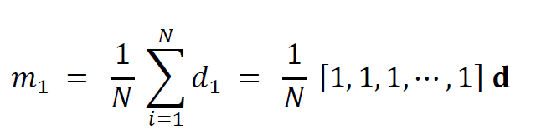
example given given N uncorrelated Gaussian data with uniform variance σ_{d}²
and formula for sample mean
i
Notes:
In this example, the sample mean is declared to be a “model parameter” without any justification. In fact, as we will show in a subsequent lecture, it is the least squares estimate of the problem di=m1; that is, all the model that assumes that all the data are the same.

Slide 21

[cov d ] = σ_{d}² I and
[cov m ] = σ_{d}² MM^{T} = σ_{d}² N/N² = (σ_{d}² /N)I = σ_{m}² I
or
σ_{m}² = (σ_{d}² /N)
Notes:
The data are assumed to be uncorrelated and with equal variance. You might do the matrix multiplication MM^{T} on the board.

Slide 22
so error of sample mean decreases with number of data
σ_{m}= σ_{d} /√N
decrease is rather slow , though,
because of the square root
Notes:
Explain the problem with the root-N decline. Decreasing the variance by a factor of ten requires a hundred data (not bad). But decreasing the variance by a factor of a thousand takes a million observations (impractical).

Slide 23
Part 2 conditional p.d.f.’s and Bayes theorem
Notes:
Bayes was an eightteenth centuty mathemetician who did early work in the theory of probability.

Slide 24
joint p.d.f. p(d₁,d₂) probability that d₁ is near a given value and probability that d₂ is near a given value conditional p.d.f. p(d₁|d₂) probability that d₁ is near a given value given that we know that d₂ is near a given value
Notes:
A key idea is the random variable.

Slide 25
Joint p.d.f.
0
10
p
0
d₂
0.25
10
0.00
d₁
Notes:
This is a joint distribution with negative correlation.

Slide 26
Joint p.d.f.
d₂ here
0
10
p
0
d₂
0.25
d₁ centered here
10
0.00
2σ₁
d₁
Notes:
If we know that d2 is small, then d1 will scatter about a large value.

Slide 27
Joint p.d.f.
d₂ here
0
10
p
0
d₂
0.25
d₁ centered here
10
0.00
2σ₁
d₁
Notes:
If we know that d2 is large, then d1 will scatter about a small value.

Slide 28
so, to convert a joint p.d.f. p(d₁,d₂) to a conditional p.d.f.’s p(d₁|d₂) evaluate the joint p.d.f. at d₂ and normalize the result to unit area
Notes:
The normalization assures that the total probability that d1 is something remains unity, regardless of the value of d2.

Slide 29
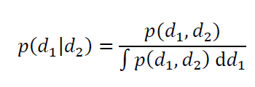
Notes:
The is the joint distribution divided by its area. The area under p(d1|d2) is thus assured to be unity.

Slide 30
area under p.d.f. for fixed d₂

Slide 31
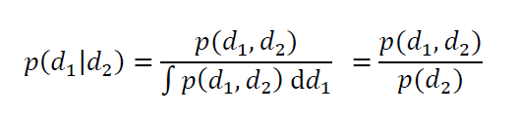
Notes:
Note that the integral of a bivariate p.d.f. p(d1,d2) with respect to d1 is just the univariate distribution p(d2)

Slide 32
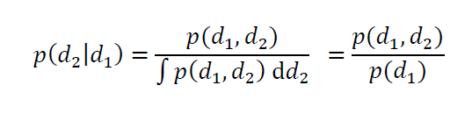
similarly conditional p.d.f. p(d₂|d₁) probability that d₂ is near a given value given that we know that d₁ is near a given value
Notes:
Here we have just reversed the roles of d1 and d2.

Slide 33

putting both together
Notes:
You might flash back to two slides with the component formulas.

Slide 34
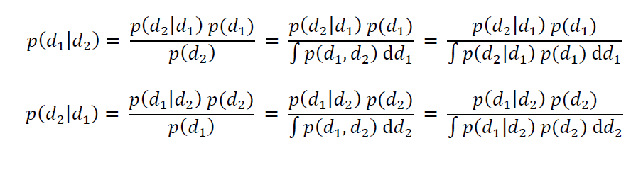
rearranging to achieve a result called Bayes theorem

Slide 35

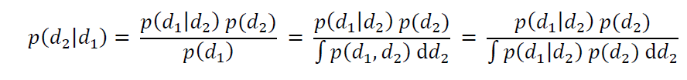
rearranging to achieve a result called Bayes theorem
three alternate ways to write p(d₂)
three alternate ways to write p(d₁)
Notes:
The third denominator might need explanation. Point out that it follows from the second using rule
p(d1,d2)=p(d2|d1)p(d2).

Slide 36
Important
p(d₁|d₂) ≠ p(d₂|d₁)
example
probability that you will die given that you have pancreatic cancer is 90%
(fatality rate of pancreatic cancer is very high)
but
probability that a dead person died of pancreatic cancer is 1.3%
(most people die of something else)
Notes:
Confusing these two conditional p.d.f.’s is very common both in science and in popular culture.

Slide 37
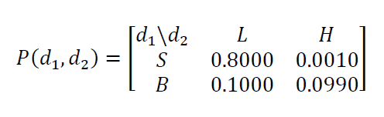
Example using Sand
discrete values
d₁: grain size S=small B=Big
d₂: weight L=Light H=heavy
joint p.d.f.
Notes:
The idea is to imagine a bucket of sand.

Slide 38
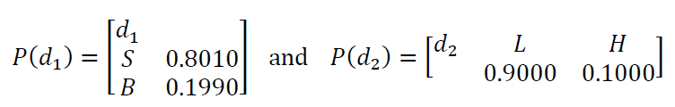
joint p.d.f.
univariate p.d.f.’s
Notes:
Compute the univariate p.d.f.’s by summing along columns and rows.

Slide 39
joint p.d.f.
most grains are small and light
univariate p.d.f.’s
most grains are small
most grains are light
Notes:
The bucket has mostly small, light grains

Slide 40
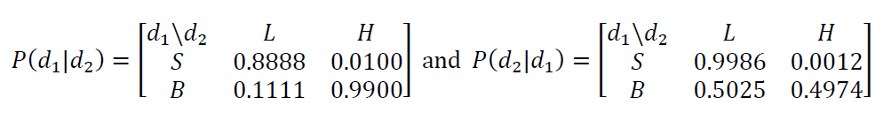
conditional p.d.f.’s
if a grain is light it’s probably small
Notes:
Point out the P(d1|d2) is the probability of size given weight,
and that P(d2,d1) is the probability of weigt given size.
The 0.8888 mean that if a graib is light, it has an 88.88% chance of being small.

Slide 41
conditional p.d.f.’s
if a grain is heavy it’s probably big
Notes:
If the grain is heavy, it has a 99% chance of being big.

Slide 42
conditional p.d.f.’s
if a grain is small it’s probabilty light
Notes:
If a grain is small, it has a 99.86% probability of being light.

Slide 43
conditional p.d.f.’s
if a grain is big the chance is about even that its light or heavy
Notes:
But if a grain is big, it has only a 49.74% percent change of being heavy.
This result is counterintuitive, since the bucket contains mostly small, light grains.
Shouldn’t most big grains be heavy?

Slide 44
If a grain is big the chance is about even that its light or heavy ? What’s going on?

Slide 45
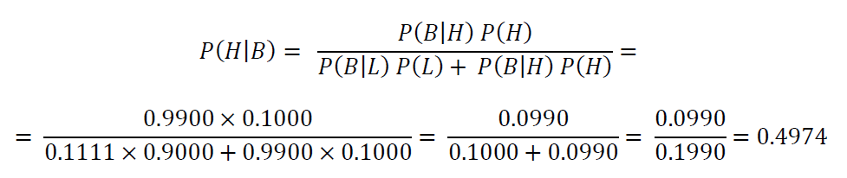
Bayes theorem provides the answer
Notes:
This is a discrete version of the last form of Bayes Theorem; that is, the integral has been converted into a sum, since there are only two possible values of each of the two variables.

Slide 46
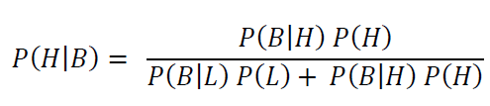
Bayes theorem provides the answer
probability of a big grain given it’s heavy
the probability of a big grain
=
probability of a big grain given it’s light
+
probability of a big grain given its heavy

Slide 47
Bayes theorem provides the answer
only a few percent of light grains are big
but
there are a lot of light grains
this term dominates the result
Notes:
The key is understanding the paradox is to remember that the bucket is dominated by light grains. Although 88.88% of light grains are small, the 11.11% of them that are big turns out to be about equal to the number of big heavy grains.
You might mention that this effect if really important in medical screening.

Slide 48
Bayesian Inference use observations to update probabilities
before the observation: probability that its heavy is 10%, because heavy grains make up 10% of the total.
observation: the grain is big
after the observation: probability that the grain is heavy has risen to 49.74%
Notes:
Even though we still do not know for sure whether the grain is big, the observation greatly improved our certainty that is is.

Slide 49
Part 2 Confidence Intervals
Notes:
A key idea is the random variable.

Slide 50
suppose that we encounter in the literature the result
m₁ = 50 ± 2 (95%) and m₂ = 30 ± 1 (95%)
what does it mean?
Notes:
We see confidence intervals like these all the time in the literature.

Slide 51
joint p.d.f. p(m₁,m₂)
univariate p.d.f.
p(m₁)
univariate p.d.f.
p(m₂)
compute mean <m₁> and variance σ₁²
compute mean <m₂> and variance σ₂²
m₁ = 50 ± 2 (95%) and m₂ = 30 ± 1 (95%)
<m₁>
2σ₁
<m₂>
2σ₂
Notes:
The point is that a confidence interval for a model parameter is normally a statement of the properties of that model parameter alone, irrespective of other model parameters.

Slide 52
irrespective of the value of m₂, there is a 95% chance that m₁ is between 48 and 52,
m₁ = 50 ± 2 (95%) and m₂ = 30 ± 1 (95%)
irrespective of the value of m₁, there is a 95% chance that m₁ is between 29 and 31,
Notes:
Highlight the word ‘irrespective’

Slide 53
So what’s the probability that both m₁ and m₂ are within 2σ of their means? That will depend upon the degree of correlation For uncorrelated model parameters, it’s (0.95)² = 0.90
Notes:
Probability of both things being true is less than probability that one of them is true.

Slide 54
m₂
m₂
m₂
m₁
m₁
m₁
m₁ = <m₁ >± 2σ₁
m₁ = <m₁ >± 2σ₁
m₂ = <m₂ >± 2σ₂
and
m₂ = <m₂ >± 2σ₂
Notes:
Graphical interpretation of the previous slide. Note that the probability within box in the third frame is less that the probability within either the slices in the first and second frames.

Slide 55
Suppose that you read a paper which states values and confidence limits for 100 model parameters What’s the probability that they all fall within their 2σ bounds?
Notes:
The answer is (0.95) raised to the 100 power, which is pretty close to zero.

Slide 56
Part 4 computing realizations of random variables
Notes:
That is, a list of numbers that follow a given distribution.

Slide 57
Why? create noisy “synthetic” or “test” data generate a suite of hypothetical models, all different from one another
Notes:
Synthetic data - fake data with known properties - important in testing data processing software.

Slide 58
MatLab function random()
can do many different p.d.f’s
Notes:
If MatLab can do the one you want, use it!

Slide 59
But what do you do if MatLab doesn’t have the one you need?

Slide 60
It requires that you: 1) evaluate the formula for p(d) 2) already have a way to generate realizations of Gaussian and Uniform p.d.f.’s
One possibility is to use the Metropolis-Hasting algorithm
Notes:
MatLab can do Gaussian and uniform, so you’re in luck.

Slide 61
goal: generate a length N vector d that contains realizations of p(d)

Slide 62
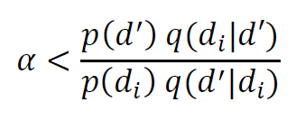
steps:
set d_{i} with i=1 to some reasonable value
now for subsequent d_{i+1}
generate a proposed successor d’
from a conditional p.d.f. q(d’|d_{i})
that returns a value near d_{i}
generate a number α from a uniform
p.d.f. on the interval (0,1)
accept d’ as d_{i+1} if
else set d_{i+1}= d_{i}
repeat
Notes:
Go through the algorithn step-by-step.

Slide 63
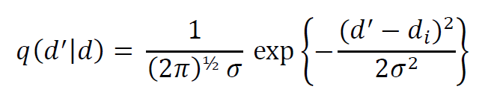
A commonly used choice for the conditional p.d.f. is
here σ is chosen to represent the sixe of the neighborhood, the typical distance of d_{i+1} from d_{i}

Slide 64
example exponential p.d.f.
p(d)=½c exp(-|d|/c)
Notes:
MatLab does not do this one (though it does do a one-sized exponential distributuon, at is, requiring d>0.

Slide 65
Histogram of 5000 realizations
Notes:
Fig. ?. Histograms (blue curves) of 5000 realizations of a random variable, d, for the probability density function (red curves), p(d)=½c exp(-|d|/c), with c=2. A) Realizations computed by transforming data drawn from a uniform distribution, and B) Realizations computed using the Metropolis algorithm. MatLab script gda02_?.

