Slide 1
Lecture 4 The L₂ Norm and Simple Least Squares
Notes:
In this lecture we will start solving inverse problems.

Slide 2
Syllabus
Lecture 01 Describing Inverse Problems Lecture 02 Probability and Measurement Error, Part 1 Lecture 03 Probability and Measurement Error, Part 2 Lecture 04 The L₂ Norm and Simple Least Squares Lecture 05 A Priori Information and Weighted Least Squared Lecture 06 Resolution and Generalized Inverses
Lecture 07 Backus-Gilbert Inverse and the Trade Off of Resolution and Variance Lecture 08 The Principle of Maximum Likelihood Lecture 09 Inexact Theories Lecture 10 Nonuniqueness and Localized Averages Lecture 11 Vector Spaces and Singular Value Decomposition
Lecture 12 Equality and Inequality Constraints Lecture 13 L₁ , L∞ Norm Problems and Linear Programming Lecture 14 Nonlinear Problems: Grid and Monte Carlo Searches Lecture 15 Nonlinear Problems: Newton’s Method Lecture 16 Nonlinear Problems: Simulated Annealing and Bootstrap Confidence Intervals Lecture 17 Factor Analysis Lecture 18 Varimax Factors, Empircal Orthogonal Functions Lecture 19 Backus-Gilbert Theory for Continuous Problems; Radon’s Problem Lecture 20 Linear Operators and Their Adjoints Lecture 21 Fréchet Derivatives Lecture 22 Exemplary Inverse Problems, incl. Filter Design Lecture 23 Exemplary Inverse Problems, incl. Earthquake Location Lecture 24 Exemplary Inverse Problems, incl. Vibrational Problems

Slide 3
Purpose of the Lecture
Introduce the concept of prediction error and the norms that quantify it
Develop the Least Squares Solution
Develop the Minimum Length Solution
Determine the covariance of these solutions

Slide 4
Part 1 prediction error and norms
Notes:
An estimate of a model parameter may incorrectly predict the data … but by how much?

Slide 5
The Linear Inverse Problem
Gm = d
Notes:
This is the simplest inverse problem … explicit and linear.
Explicit: model parameters on one side, data on the other.
Linear: a matrix G linking the data and model paraemeters.

Slide 6
The Linear Inverse Problem
Gm = d
model parameters
data
data kernel
Notes:
Lingo

Slide 7
an estimate of the model parameters can be used to predict the data
Gm^{est} = d^{pre}
but the prediction may not match the observed data
(e.g. due to observational error)
d^{pre} ≠ d^{obs}
Notes:
An estimate of m makes a prediction about d.
A prediction may not match the true d, because of observational error.

Slide 8
this mismatch leads us to define the prediction error
e = d^{obs} -d^{pre}
e = 0
when the model parameters exactly predict the data
Notes:
error: observed minus predicted, is only zero is the prediction is perfect.

Slide 9
example of prediction error
for line fit to data
A)
B)
d_{i}^{obs}
e_{i}
d_{i}^{pre}
z_{i}
Notes:
The error ei is the vertical distance of a datum (red circle) from the value predicted by the model parameters.
Fig ?. A) Least squares fitting of a straight line to (z, d) data. B) The error, e_{i}, for each observation is the difference between the observed and predicted datum: e_{i}=d_{i}^{obs}-d_{i}^{pre}. MatLab script gda03_??.

Slide 10
“norm” rule for quantifying the overall size of the error vector e
lot’s of possible ways to do it
Notes:
“Norm” is mathematical term for a rule that produces a single non-negative number from a vector.

Slide 11
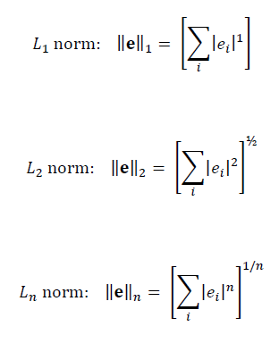
L_{n} family of norms
Notes:
Note that the L2 norm is the familiar Euclidean length. The others are generalizations of it using different powers.

Slide 12
L_{n} family of norms
Euclidian length
Notes:
Note that the L2 norm is the familiar Euclidean length. The others are generalizations of it using different powers.

Slide 13
higher norms give increaing weight to largest element of e
Notes:
The higher norms give preferential weight to the largest of the errors.
Fig ?. Hypothetical prediction error, e_{i}(z_{i}), and its absolute value, raised the powers, 1, 2 and 10. While most elements of |e_{i}| are numerically significant, only a few elements of |e_{i}|¹⁰ are. MatLab script gda03_??.

Slide 14

limiting case
Notes:
The limiting case say the norm of e is the absolute value of its largest element.

Slide 15
guiding principle for solving an inverse problem find the m^{est} that minimizes E=||e|| with e = d^{obs} –d^{pre} and d^{pre} = Gm^{est}
Notes:
The best estimate of the model parameters is the one that minimizes the norm of the error vector.
Note that E is interpreted as the overall or total error.

Slide 16
but which norm to use? it makes a difference!
Notes:
Different estimate of the model parameters for each norm.

Slide 17
L₁
L₂
L∞
outlier
Notes:
Straight line problem solved under three different norms.
This is a worst-case example, since the data have a horrible outlier (be sure to point it out).
Fig ?. Straight line fits to (z,d) pairs where the error is measured under the L₁, L₂ and L∞ norms. The L₁ norm gives the least weight to the one outlier. MatLab script gda03_??.

Slide 18
Answer is related to the distribution of the error. Are outliers common or rare?
A)
B)
long tails
outliers common
outliers unimportant
use low norm
gives low weight to outliers
short tails
outliers uncommon
outliers important
use high norm
gives high weight to outliers
Notes:
Use low norms for long-tailed p.d.f.’s, high norms for short tailed p.d.f.’s
Fig ?. A) Long-tailed probability density function. B) Short-tailed probability density function. MatLab script gda03_??.

Slide 19
as we will show later in the class … use L₂ norm when data has Gaussian-distributed error
Notes:
This is a very important correspondence. The corollary is that if the data are not Gaussian-distributed, all bets are off!

Slide 20
Part 2 Least Squares Solution to Gm=d
Notes:
Least-squares = L2 norm

Slide 21
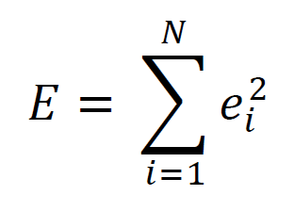
L₂ norm of error is its Euclidian length
= e^{T}e
so E is the square of the Euclidean length
mimimize E
Principle of Least Squares
Notes:
L2 norm

Slide 22
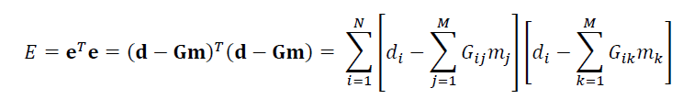
Least Squares Solution to Gm=d
minimize E with respect to m_{q}
∂E/∂m_{q} = 0
Notes:
Point out the need for a three different names (i, j and k in this case) for the dummy variables in the three summations. Else they will get confused when we multiply out the expression

Slide 23
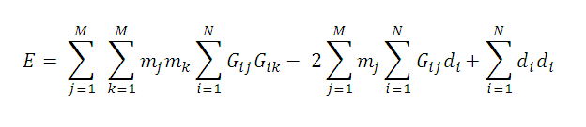
so, multiply out
Notes:
Note that the order of the summations have been reversed.

Slide 24
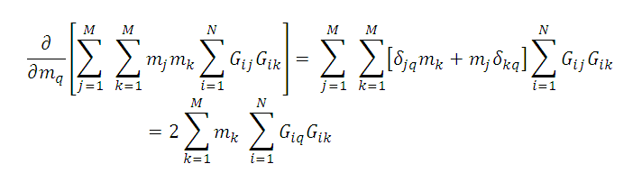
first term

Slide 25
first term
∂m_{j} /∂m_{q} = δ_{jq}
since m_{j} and m_{q} are independent variables
Notes:
All the model parameters are assumed to be independent of one another, so that the derivative one with respect to another is zero. The derivative of one with respect to itself is unity.

Slide 26
Kronecker delta (elements of identity matrix) [I]_{ij} = δ_{ij}
a = Ib = b
a_{i} = Σ_{j} δ_{ij} b_{j} = b_{i}
a_{i} = Σ_{j} δ_{ij} b_{j} = b_{i}
i
Notes:
Since the Kronecker delta is just the elements of the identity matrix, its algebra is simple:
Cross out the summation cross out the summation. Cross out the delta. Replace the summed over variaible name with the un-summed-over variable name.

Slide 27
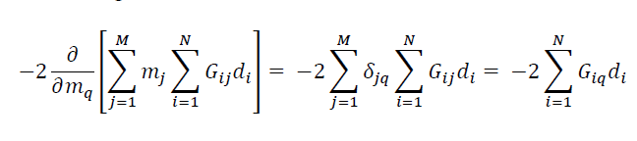
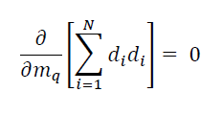
second term
third term
Notes:
You step through the Kronecker delta algebra here. The summed variable is j, the un-summed one is q.
so cross out the sum-j, cross out the delta-j-q, and change all remaining j’s to q’s.
The third term is zero since it is not a function of the model parameters.

Slide 28
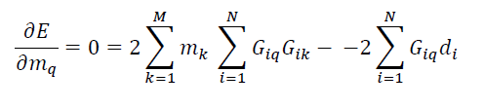

putting it all together
or
Notes:
You might work through the conversion of the summation notation to the matrix notation.

Slide 29
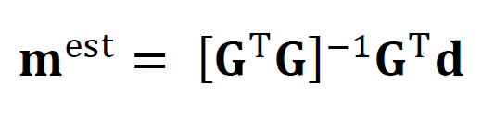
presuming [G^{T}G] has an inverse
Least Square Solution
Notes:
Mention that we will examine the cases when there is no inverse later in the lecture.

Slide 30
presuming [G^{T}G] has an inverse
Least Square Solution
memorize
Notes:
This is the most important formula in the course.
The second most important is the error propagtion formula.

Slide 31
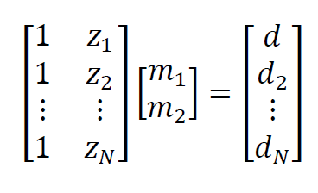
example
straight line problem
Gm = d

Slide 32
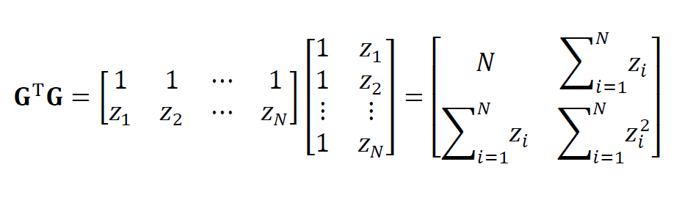

Slide 33
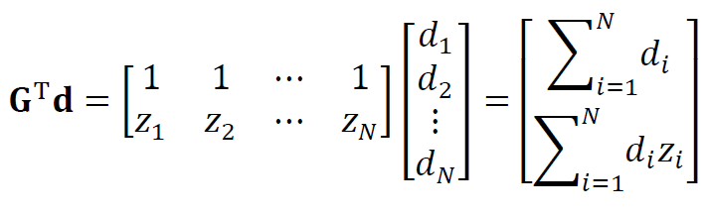

Slide 34
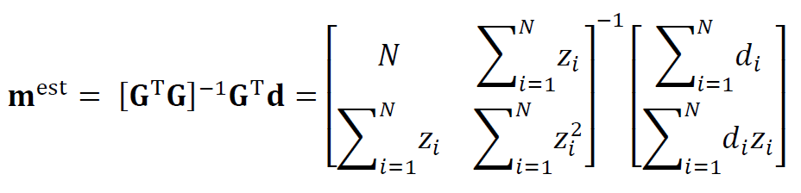

Slide 35
in practice, no need to multiply matrices analytically just use MatLab
mest = (G’*G)\(G’*d);
Notes:
Explain the use of the ‘backslash’ operator.

Slide 36
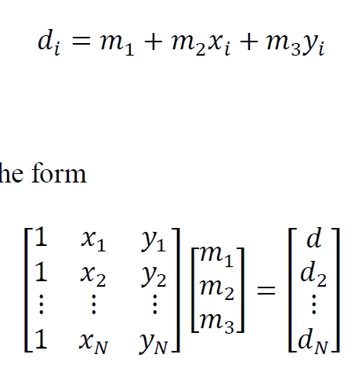
another example fitting a plane surface
Gm = d
Notes:
We just set the problem up. No need to multiply out the matrices to obtain an analytic
solution, because we are going to use MatLab to solve the problem.

Slide 37
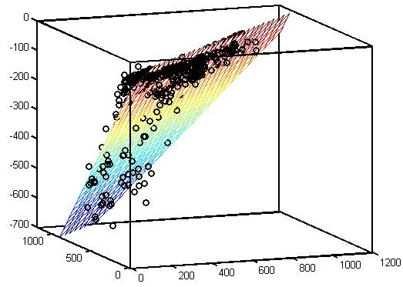
z, km
y, km
x, km
Notes:
Fig ? (circles) Earthquakes in the Kurile subduction zone, northwest Pacific ocean. The x-axis points north and the y-axis east. The earthquakes scatter about a dipping planar surface (colored grid), determine using least squares. Data courtesy of the US Geological Survey. MatLab script gda03_??.

Slide 38
Part 3 Minimum Length Solution

Slide 39
but Least Squares will fail when [G^{T}G] has no inverse
Notes:
SO the question is, when does it not have an inverse. We start by examining the straight line case.

Slide 40
example fitting line to a single point
?
?
d
?
z
Notes:
Fig ?. A) An infinity of different lines can pass through a single point. The prediction error for each is E=0.

Slide 41
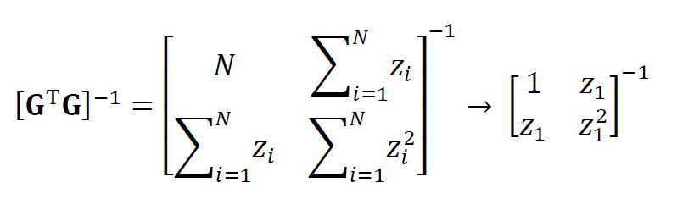
Notes:
The straight line case fails when there is only one data point. The determinant of G^{T}G is zero in this case, and
a matrix with zero determinant has no inverse.

Slide 42
zero determinant hence no inverse
Notes:
You might multiply this out on the board.

Slide 43
Least Squares will fail when more than one solution minimizes the error the inverse problem is “underdetermined”
Notes:
Underdetermined: not enough information to determine a unique solution.

Slide 44
simple example of an underdetermined problem
S
1
2
R
Notes:
Silly example. Want to know the properties of two blocks, but just make a single measurement that involves only the first.
Fig ?. An acoustic travel time experiment with source, S, and receiver, R, in a medium consisting of two discrete bricks. Because of poor experimental geometry, the acoustic waves (dashed line) pass only through brick 1. The slowness of brick 2 is completely underdetermined.

Slide 45
What to do? use another guiding principle “a priori” information about the solution
Notes:
“A priori information” = preconceptions about the world.

Slide 46
in the case choose a solution that is small minimize ||m||₂
Notes:
The solution is small = “close to zero”. This is not the most sophisticated type of a priori information,
but cases arise where it make sense. For instance, if the model parameters correspond to the velocities
of objects, the a solution that is small in the L2 sense has small kinetic energy.

Slide 47
simplest case “purely underdetermined” more than one solution has zero error
Notes:
The key point is that the data can be exactly satisfied. This is a special case. We will treat the
general case in the next lecture.

Slide 48
minimize L=||m||₂² with the constraint that e=0
Notes:
This is the formal mathematical definition of the problem: find the smallest set of model parameters that
have zero prediction error.

Slide 49
Method of Lagrange Multipliers minimize L with constraints C₁=0, C₂=0, … equivalent to minimize Φ=L+λ₁C₁+λ₂C₂+… with no constraints λs called “Lagrange Multipliers”
Notes:
The amount of time you spend on this one will depend on whether the class has seen Lagrange
Multipliers before.

Slide 50
e(x,y)=0
y
(x₀,y₀)
∇L (x,y)
x
Notes:
Fig. A1.1. Graphical interpretation of the method of Lagrange Multipliers, in which the function L(x,y) is minimized subject to the constraint that e(x,y)=0. The solution (bold dot) occurs at the point, (x₀,y₀), on the curve, e(x,y)=0, where the surface normal (gray arrows) is parallel to the gradient, ∇L(x,y) (white arrows). At this point, E can only be further minimized by moving the point, (x₀,y₀), off of the curve, which is disallowed by the constraint. MatLab script gdaap_??.

Slide 51
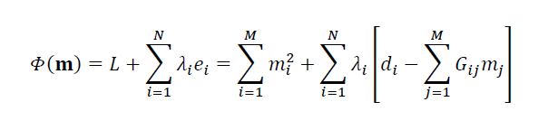
Notes:
Setup: first term is Euclidean length L of model parameter vector; second term is sum of constraints
(that error is zero), each multiplied by a Lagrange multiplier.

Slide 52
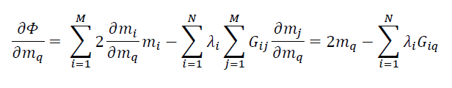
2m=G^{T} λ and Gm=d ½GG^{T} λ =d λ = 2[GG^{T} ]⁻¹d m=G^{T} [GG^{T} ]⁻¹d
Notes:
Top line: Taking the derivative.
Second line: First equation is the matrix form of the derivative equation in the first line; second is the statement that the error is zero.
Subsequent lines: The two equations on the second line are solved simultaneously by algebraic manipulation.
Insert the first into the second. Solve for λ. Insert λ back into the first.

Slide 53
presuming [GG^{T}] has an inverse
Minimum Length Solution
m^{est}=G^{T} [GG^{T} ]⁻¹d
Notes:
Again that presumption that an inverse exists.

Slide 54
presuming [GG^{T}] has an inverse
Minimum Length Solution
m^{est}=G^{T} [GG^{T} ]⁻¹d
memorize

Slide 55
Part 4 Covariance
Notes:
Here we examine the error of the model parameters.

Slide 56
Least Squares Solution
m^{est}= [G^{T}G ]⁻¹G^{T}d
Minimum Length Solution
m^{est}=G^{T} [GG^{T} ]⁻¹d
both have the linear form
m=Md
Notes:
Both solutions have a linear form.

Slide 57
but if
m=Md
then
[cov m] = M [cov d] M^{T}
when data are uncorrelated with uniform variance σ_{d}²
[cov d]=σ_{d}²I
so
Notes:
So we can use the standard formula for error propagation.
Assume that the data are uncorrelated with uniform variance …. a common case.

Slide 58
Least Squares Solution
[cov m] = [G^{T}G ]⁻¹G^{T}σ_{d}² G[G^{T}G ]⁻¹
[cov m] = σ_{d}² [G^{T}G ]⁻¹
Minimum Length Solution
[cov m] = G^{T} [GG^{T} ]⁻¹ σ_{d}² [GG^{T} ]⁻¹G
[cov m] = σ_{d}² G^{T} [GG^{T} ]⁻²G
Notes:
Get formulas for [cov m]

Slide 59
Least Squares Solution
[cov m] = [G^{T}G ]⁻¹G^{T}σ_{d}² G[G^{T}G ]⁻¹
[cov m] = σ_{d}² [G^{T}G ]⁻¹
Minimum Length Solution
[cov m] = G^{T} [GG^{T} ]⁻¹ σ_{d}² [GG^{T} ]⁻¹G
[cov m] = σ_{d}² G^{T} [GG^{T} ]⁻²G
memorize
Notes:
Covariance of least squares version is especially imporant.

Slide 60
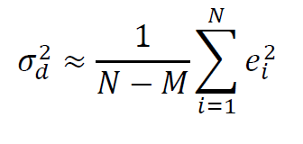
where to obtain the value of σ_{d}²
a priori value – based on knowledge of accuracy of measurement technique
my ruler has 1 mm divisions, so σ_{d}≈½mm
a posteriori value – based on prediction error
Notes:
Two sources of variance on data:
a priori: knowledge of technique
a posteriori: size of prediction errror. Presumes model is a good one; if not, its an over-estimate.

Slide 61
variance critically dependent on experiment design (structure of G)
4
3
3
2
2
2
2
3
4
1
1
1
1
…
1
1
2
3
…
which is the better way to weigh a set of boxes ?
Notes:
Two silly ways to weight a bunch of blocks. Of course, you could weight them individually,
but this is more fun!

Slide 62
A)
m_{i}^{est}
i
B)
σ_{mi}
i
Notes:
The first way is the better, because it has smaller variance, and because the variance does not grow with box number.
Fig 3.?. Two hypothetical experiments to measure the weight, m_{i}, of each of 100 bricks. In experiment 1 (red), the bricks are accumulated on a scale, so that observation, d_{i}, is the sum of the weight of the first i bricks. In experiment 2 (blue), the first brick is weighed, and then subsequently, pairs or bricks (the first and the second, the second and the third, and so forth). A) Least-squared solution for weights, m_{i}. B) Corresponding error, σ_{mi}. Note that the first experiment has the lower error. MatLab script gda03_??.

Slide 63
Relationship between
[cov m] and Error Surface
A)
B)
d
d
z
z
C)
4
D)
m₂
0
m₂
E
0
4
E
0
0
m₁
m₁
4
4
Notes:
These slides can be omitted if the lecture is running too long.
Note shape of error minimum different in two cases, even though scatter about the same.
Left: fairly uncorrelated; right: highly correlated, wider minimum in m1 direction.
Suggests some relationship between shape of error surface and [cov m]
Region of low error (within white ellipse) depends on location of measurement
(which is to say, on the structure of G). Any solution in region of low error
almost as good as minimum-error-solution. So this region must have some relationship
to covariance.
Fig ?. A) Least squares fitting of a straight line (blue) to (z, d) data (red). C) The best estimate of the model parameters, (m₁^{est}, m₂^{est}), (white circle) occurs at the minimum of the error surface, E(m₁, m₂), which is a function of model parameters, intercept, m₁, and slope, m₂. The minimum is surrounded by a region of low error (white ellipse) that correspond to lines that fit “almost as well” as the best estimate. The variance of the estimate is related to the size of the ellipse. In this example, the ellipse is narrowest in the m₂ direction, indicating that the slope, m₂, is determined more accurately than intercept, m₁. The geometry of the experiment, and not the overall level of observational error, determines the shape of the ellipse, as can be seen from the example in B, D). The tilt of the ellipse indicates that the intercept and slope are negatively correlated. MatLab script gda03_??.

Slide 64
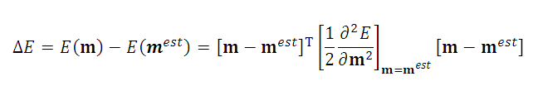
Taylor Series expansion of the error about its minimum
Notes:
The idea here is to establish a relationship between the shape of the error surface and the covariance of the model parameters.
The shape of the

Slide 65
Taylor Series expansion of the error about its minimum
curvature matrix
with elements
∂²E/ ∂m_{i}∂m_{j}
Notes:
Region of low error is related to the second derivative (curvature) of the error

Slide 66
for a linear problem curvature is related to G^{T}G E = (Gm-d)^{T}(Gm-d) = m^{T}[G^{T}G]m-d^{T}Gm-m^{T}G^{T}d+d^{T}d so ∂²E/ ∂m_{i}∂m_{j} = [G^{T}G] _{ij}
Notes:
So covariance of model parameters is related to inverse of second derivative matrix.

Slide 67

and since [cov m] = σ_{d}² [G^{T}G]⁻¹ we have
Notes:
So covariance of model parameters is related to inverse of second derivative matrix.

Slide 68
the sharper the minimum the higher the curvature the smaller the covariance
Notes:
Broad minimum in E corresponds to a small curvature and a large covariamce
Narrow minimum in E corresponds to a large curvature and a small covariacne

