Slide 1
Lecture 5 A Priori Information and Weighted Least Squared
Notes:
In this lecture we will develop a really useful method for solving inverse problems.

Slide 2
Syllabus
Lecture 01 Describing Inverse Problems Lecture 02 Probability and Measurement Error, Part 1 Lecture 03 Probability and Measurement Error, Part 2 Lecture 04 The L₂ Norm and Simple Least Squares Lecture 05 A Priori Information and Weighted Least Squared Lecture 06 Resolution and Generalized Inverses
Lecture 07 Backus-Gilbert Inverse and the Trade Off of Resolution and Variance Lecture 08 The Principle of Maximum Likelihood Lecture 09 Inexact Theories Lecture 10 Nonuniqueness and Localized Averages Lecture 11 Vector Spaces and Singular Value Decomposition
Lecture 12 Equality and Inequality Constraints Lecture 13 L₁ , L∞ Norm Problems and Linear Programming Lecture 14 Nonlinear Problems: Grid and Monte Carlo Searches Lecture 15 Nonlinear Problems: Newton’s Method Lecture 16 Nonlinear Problems: Simulated Annealing and Bootstrap Confidence Intervals Lecture 17 Factor Analysis Lecture 18 Varimax Factors, Empircal Orthogonal Functions Lecture 19 Backus-Gilbert Theory for Continuous Problems; Radon’s Problem Lecture 20 Linear Operators and Their Adjoints Lecture 21 Fréchet Derivatives Lecture 22 Exemplary Inverse Problems, incl. Filter Design Lecture 23 Exemplary Inverse Problems, incl. Earthquake Location Lecture 24 Exemplary Inverse Problems, incl. Vibrational Problems

Slide 3
Purpose of the Lecture
Classify Inverse Problems as Overdetermined, Underdetermined and Mixed-Determined
Further Develop the Notion of A Priori Information
Apply A Priori Information to Solving Inverse Problems

Slide 4
Part 1 Classification of Inverse Problems on the Basis of Information Content
Notes:
Is there enough data to determine a model parameters? Or is there too much?

Slide 5
“Even Determined”
Exactly enough data is available to determine the model parameters
E=0 and solution unique
(a rare case)
Notes:
Each block has one ray. All blocks sampled. Data can be exactly fit, so error is zero.

Slide 6
“Over Determined”
More than enough data is available to determine the model parameters
E>0 and solution unique
Notes:
All blocks sampled, but more than one ray per box, so that error is non-zero.

Slide 7
“Under Determined”
Insufficient data is available to determine all the model parameters
E=0 and solution non-unique
Notes:
Right hand block missed. Data does not constrain its value. The other block has one ray and is exactly
determines. So error is zero and solution is non-unique.

Slide 8
This configuration is also underdetermined
since only the mean is determined
Notes:
The mean value of the two blocks is determined, but the difference between the two bocks is not.

Slide 9
“Mixed Determined”
More than enough data is available to constrain some the model parameters
Insufficient data is available to constrain other model parameters
E>0 and solution non-unique
Notes:
Three rays sample the left block only. Its model parameter cannot be adjusted to all three rays, so the error is non-zero.
But the right block is unsampled and its model parameter is unconstrained.

Slide 10
this configuration is also mixed-determined
the average of the two blocks is over-determined
and
the difference between the two blocks is under-determined
Notes:
The mean value is over-determined, but the difference is undetermined

Slide 11
mixed-determined
some linear combinations of model parameters are not determined by the data
(very common)
Notes:
Note that the undetermined part can be a linear combination of model parameters. It doesn’t have to be
a specific set of model parameters.

Slide 12
what to do?
add a priori information that supplement observations
Notes:
A priori information = systematized preconceptions about the world.

Slide 13
Part 2 a priori information
Notes:
We used this “smallness” as a priori information during the last lecture in deriving the Minimum Length Solution.

Slide 14
a priori information preconceptions about the behavior of the model parameters
Notes:
Are preconceptions dangerous?

Slide 15
example of a priori information model parameters are: small near a given value have a known average value smoothly varying with position solve a known differential equation positive etc.
Notes:
You might discuss with the class cases where each of these types of prior information might potentially be relevant.

Slide 16
dangerous? perhaps … but we have a lot of experience about the world in general, so why not put that experience to work
Notes:
We are really using our knowledge of “similar cases in the past” help us.

Slide 17
one approach to solving a mixed-determined problem “of all the solutions that minimize E=||e||² choose the one with minimum L =||m||²”
Notes:
This is the obvious generalization of the principle used for Minimum Length Solution,
of all the solutions with zero error, find the one with minimum L

Slide 18
“of all the solutions that minimize E choose the one with minimum L” turns out to be hard to do, since you have to know how to divide up the model parameters into two groups one over-determined one under-determined
Notes:
Hard to so … so do something similar but not so hard. Actually, we will see in chapter 5
that the easy way makes good statistical sense.

Slide 19
next best thing “of all the solutions that minimize E choose the one with minimum L”
“choose the solutions that minimizes
E+ε²L”
Notes:
Note that both E and L are positive.
Minimize the sum, instead of minimize the two individually.

Slide 20

minimize
when ε² is chosen to be small,
the E will be approximately minimized and the solution will be small
Notes:
We will discuss the meaning of ε a few lectures form now.
Right now, treat it as a fudge factor that has to be determined by trial and error.

Slide 21


minimize
damped least-squares solution
Notes:
The math, omitted here, is very similar to the derivation of the least squares solution.

Slide 22
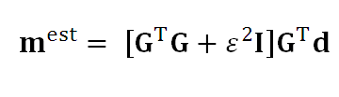

minimize
damped least-squares solution
Very similar to least-squares
Just add ε² to diagonal of G^{T}G
Notes:
Quick and dirty … and very useful.

Slide 23
Part 3 Using Prior Information to Solve Inverse Problems
Notes:
Prior information is used together with data to solve a mixed-determined inverse problem.

Slide 24
m is small
minimize
L=m^{T}m
Notes:
simplest kind of prior information

Slide 25

m is close to <m>
minimize
Notes:
Somewhat more complicated. The deviation about <m> is small.

Slide 26
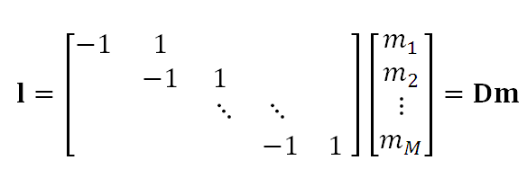
m varies slowly with position (m is flat)
characterize steepness with
first-difference
approximation for dm/dx
Notes:
The first difference is an approximation for the first derivative (up to a multiplicative factor of Δx)
Thus Dm is the slope (=steepness) of m

Slide 27
m varies smoothly with position (m is smooth)
characterize roughness with
second-difference
1 | -2 | 1
 | 1 | -2 | 1
 |  | ⋱ | ⋱ | ⋱
 |  |  | 1 | -2 | 1
approximation for d²m/dx²
Notes:
The second difference is an approximation for the second derivative (up to a multiplicative factor of Δx)
Thus Dm is the curvature (=roughness) of m

Slide 28

m varies slowly/smoothly with position
minimize
with W_{m} = D^{T}D
Notes:
Note that the D’s combine into a single ‘weight matrix’ Wm

Slide 29

Suppose that some data are more accurately determined than others
minimize
Notes:
We can also define a weight matrix We for the error. It weights some errors more than others.

Slide 30
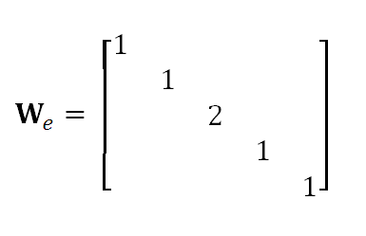
example when d₃ is more accurately measured than the other data
Notes:
Weighting different errors differently may make sense if one type of measurement is more
accurate than another. Weight the more accurate one more.

Slide 31

weighted damped least squares minimize E+ε²L with
and
Notes:
Three parameters
<m> a priori values of model parameters
Wm model parameter weight matrix, can represent derivatives
We error weight matrix, can represent one data type being more accurate than another
ε determines the relative weight gives to model error and deviation from the a priori values

Slide 32
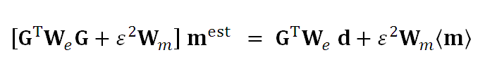
weighted damped least squares solution
Notes:
The derivation is again similar to the one for simple least squares.
Note that the form reduces to least squares in the case ε=0 (no weight given to prior information)

Slide 33
weighted damped least squares solution
a bit complicated, but …
Notes:
Still, easy to solvie this using MatLab

Slide 34
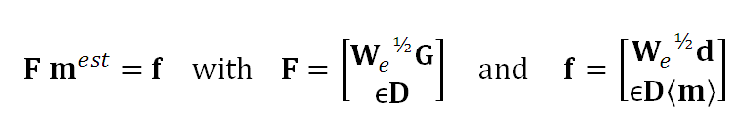
equivalent to solving
by simple least squares
Notes:
In other words, multiply of F^{T}Fm=F^{T}d and you get the same solution as in the previous slide.

Slide 35

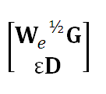
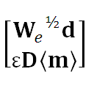
m =
Notes:
Structure is very simple

Slide 36
top rows data equation Gm=d weighted by W_{e}^{1/2}
m =

Slide 37
top rows a priori equation m=<m> weighted by ε D
m =

Slide 38
you can even use this equation to implement constraints just by making ε very large

Slide 39
example fill in missing data of discretized version of m(z)
d_{j}
m(z_{i})
0
z_{i}
100
Notes:
This is a variant of the interpolation problem.
Here we use a priori information of smoothness to fill in data gaps.
The major difference between this method and interpolation is that in this one
the curve will not pass exactly through the data points. But since with the right
choice of ε it can be made to pass very close to the points, the difference is more
philosophical than practical.

Slide 40
set up
M=100 model parameters
N<M data
data, when available, gives values of model parameter
d_{i} = m_{j}
associates datum with corresponding model parameter
each row has M-1 zeros and a single one
d = Gm
a priori information of
smoothness in interior x’s
flatness at ends
Notes:
The data is very sparse. It just aligns the data with the model parameterrs.

Slide 41
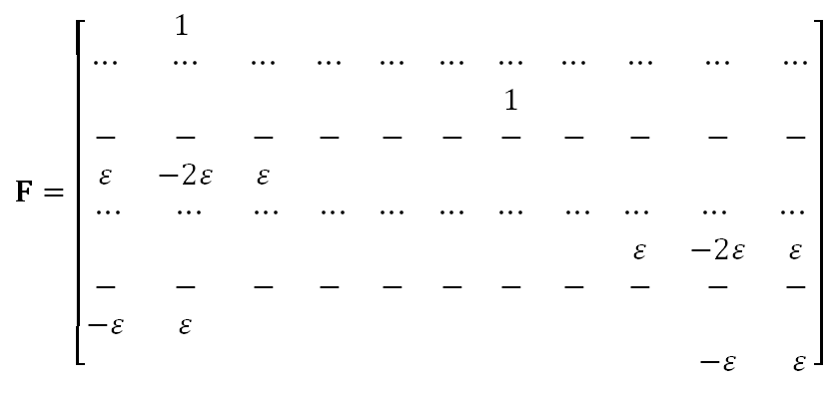
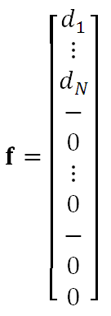
F m = f
Notes:
The matrix F

Slide 42
F m = f
associates datum with corresponding model parameter
Notes:
Top part is the equation Gm=d

Slide 43
F m = f
roughness in interior
Notes:
Middle part implements the smoothness prior information using 2nd differences.

Slide 44
F m = f
steepness at left
Notes:
Some question about what to do with the ends, where you cant compute a second difference.
One possibility is to use flatness, that is a first difference.
The curve is flat at the ends. This is the left end.

Slide 45
F m = f
steepness at right
Notes:
And this is the right end.

Slide 46
computational efficiency
Use sparse matrices
Use solver that does not require forming F^{T}F
Notes:
Because F is so sparse, using sparse matrices leads to big efficiencies.
Also, a matrix equation solution technique optimized for sparse matrices really can speed things up.

Slide 47
1. Sparse matrices
F = spalloc(N, M, 3*N);
Notes:
This allocates a N by M sparse matrix that can hold 3N nonzero values.
One so allocated, MatLab takes care of the rest.

Slide 48
2A. Use Biconjugate Gradient Algorithm (an iterative method to solve F^{T}Fm = F^{T}f)
clear F;
global F;
- - -
tol = 1e-6;
maxit = 3*M;
mest = bicg( @weightedleastsquaresfcn, F'*f, tol, maxit );
stop iterations
when solution is good enough
Notes:
tol : the error in the solution to F^{T}F m = F^{T}f.

Slide 49
2A. Use Biconjugate Gradient Algorithm (an iterative method to solve F^{T}Fm = F^{T}f)
clear F;
global F;
- - -
tol = 1e-6;
maxit = 3*M;
mest = bicg( @weightedleastsquaresfcn, F'*f, tol, maxit );
stop iterations after maximum iteration is reached, regardless of whether it is good enough
Notes:
This is an iterative method, so you need some way to ensure that you don’t iterate forever if something goes wrong.

Slide 50
2A. Use Biconjugate Gradient Algorithm (an iterative method to solve F^{T}Fm = F^{T}f)
clear F;
global F;
- - -
tol = 1e-6;
maxit = 3*M;
mest = bicg( @weightedleastsquaresfcn, F'*f, tol, maxit );
F^{T}f
Notes:
F^{T}f is just computed in the normal way.

Slide 51
2A. Use Biconjugate Gradient Algorithm (an iterative method to solve F^{T}Fm = F^{T}f)
clear F;
global F;
- - -
tol = 1e-6;
maxit = 3*M;
mest = bicg( @weightedleastsquaresfcn, F'*f, tol, maxit );
function that calculates F^{T}F times a vector v
Notes:
but F^{T}F is not explicitly calculated.
Instead, you supply a function that perform the multiplication F^{T}F v
where v is an arbitrary vector.

Slide 52
2B. Function to multiply a vector by F^{T}F do as y = F^{T}(Fv) so F^{T}F never calculated
function y = weightedleastsquaresfcn(v,transp_flag)
global F;
temp = F*v;
y = F'*temp;
return
Notes:
Here is the definition of the function.
Note that F^{T}F v is calculated as F^{T (}Fv), so that
the intermediate value is a vector, not a matrix.

Slide 53
m(z)
z
Notes:
Figure 3.10. Example of weighted damped least squares. (Red curve) The true model, sampled with Δz=1, is a sinusoid. (Red circles) The data are the model observed at just a few points. (Green curve) The estimated model is reconstructed from the data using the a priori information of smoothness in the interior of the (0,100) interval and flatness at its ends. MatLab script gda03_??.

