Slide 1
Lecture 6 Resolution and Generalized Inverses
Notes:
In this lecture we will view an inverse problem as being solved by a “generalized inverse” applied to the data.

Slide 2
Syllabus
Lecture 01 Describing Inverse Problems Lecture 02 Probability and Measurement Error, Part 1 Lecture 03 Probability and Measurement Error, Part 2 Lecture 04 The L₂ Norm and Simple Least Squares Lecture 05 A Priori Information and Weighted Least Squared Lecture 06 Resolution and Generalized Inverses
Lecture 07 Backus-Gilbert Inverse and the Trade Off of Resolution and Variance Lecture 08 The Principle of Maximum Likelihood Lecture 09 Inexact Theories Lecture 10 Nonuniqueness and Localized Averages Lecture 11 Vector Spaces and Singular Value Decomposition
Lecture 12 Equality and Inequality Constraints Lecture 13 L₁ , L∞ Norm Problems and Linear Programming Lecture 14 Nonlinear Problems: Grid and Monte Carlo Searches Lecture 15 Nonlinear Problems: Newton’s Method Lecture 16 Nonlinear Problems: Simulated Annealing and Bootstrap Confidence Intervals Lecture 17 Factor Analysis Lecture 18 Varimax Factors, Empircal Orthogonal Functions Lecture 19 Backus-Gilbert Theory for Continuous Problems; Radon’s Problem Lecture 20 Linear Operators and Their Adjoints Lecture 21 Fréchet Derivatives Lecture 22 Exemplary Inverse Problems, incl. Filter Design Lecture 23 Exemplary Inverse Problems, incl. Earthquake Location Lecture 24 Exemplary Inverse Problems, incl. Vibrational Problems

Slide 3
Purpose of the Lecture
Introduce the idea of a Generalized Inverse,
the Data and Model Resolution Matrices
and the Unit Covariance Matrix
Quantify the spread of resolution and the size of the covariance
Use the maximization of resolution and/or covariance as the guiding principle for solving inverse problems
Notes:
Our end goal is to find a solution to an inverse problem using a new type of minimization procedure.

Slide 4
Part 1 The Generalized Inverse, the Data and Model Resolution Matrices and the Unit Covariance Matrix
Notes:
The lingo here will be important throughout the course, so be sure to emphasize it.

Slide 5




all of the solutions
of the form
m^{est} = Md + v
Notes:
Name each solution, simple least squares, minimum length, damped least squares and weighted least squares

Slide 6
let’s focus on this matrix
m^{est} = Md + v
Notes:
All the solution have similar linear forms.

Slide 7
rename it the “generalized inverse” and use the symbol G^{-g}
m^{est} = G^{-g}d + v
Notes:
We will call the matrix the ‘generalized inverse’.

Slide 8
(let’s ignore the vector v for a moment) Generalized Inverse G^{-g} operates on the data to give an estimate of the model parameters if d^{pre} = Gm^{est} then m^{est} = G^{-g}d^{obs}
Notes:
The generalized inverse is a matrix. It operates on data to yield an estimate of the model parameters.
So it sort of ‘inverts’ the top equation.

Slide 9
Generalized Inverse G^{-g} if d^{pre} = Gm^{est} then m^{est} = G^{-g}d^{obs} sort of looks like a matrix inverse except M⨉N, not square and GG^{-g}≠I and G^{-g}G≠I
Notes:
But it does not have the properties expected of a real matrix inverse.

Slide 10
so actually the generalized inverse is not a matrix inverse at all
Notes:
And so is not a matrix inverse in the normal sense. hence the word “generalized”.

Slide 11

d^{pre} = Gm^{est} and m^{est} = G^{-g}d^{obs}
plug one equation into the other
d^{pre} = Nd^{obs} with N = GG^{-g}
“data resolution matrix”
Notes:
This procedure defines the data resolution matrix N

Slide 12
Data Resolution Matrix, N
d^{pre} = Nd^{obs}
How much does d_{i}^{obs} contribute to its own prediction?
Notes:
The predicted data vector is a function of the observed data vector. But how well does a particular datum contribute to its own prediction?

Slide 13
if N=I
d^{pre} = d^{obs}
d_{i}^{pre} = d_{i}^{obs}
d_{i}^{obs} completely controls its own prediction
Notes:
The correspondence is perfect when N+I. A particular predicted datum depends only on the corresponding observation.

Slide 14
(A)
d^{pre}
=
d^{obs}
The closer N is to I, the more d_{i}^{obs} controls its own prediction
Notes:
Graphical Interpretation of dpre=N dobs.
Fig 4.1. (A) Plots of selected rows of the data resolution matrix, N, indicate how well the data can be predicted. Narrow peaks occurring near the main diagonal of the matrix (dashed line) indicate that the resolution is good. (B) Actual N for the case of fitting a straight line to 100 data, equally spaced along the z-axis. Large values (red colors) occur only near the ends of the main diagonal (dashed line), indicating that the resolution is poor at intermediate values of z. MatLab script gda04_??.

Slide 15
straight line problem
Notes:
Straight line problem. The points at the end strongly influence the line, but the points
in the middle points don’t really have much effect.

Slide 16
d^{pre} = N d^{obs}
j
=
i
i
j
only the data at the ends control their own prediction
Notes:
Hence N has large values only at the top-left and bottom-right.
Fig 4.1. (A) Plots of selected rows of the data resolution matrix, N, indicate how well the data can be predicted. Narrow peaks occurring near the main diagonal of the matrix (dashed line) indicate that the resolution is good. (B) Actual N for the case of fitting a straight line to 100 data, equally spaced along the z-axis. Large values (red colors) occur only near the ends of the main diagonal (dashed line), indicating that the resolution is poor at intermediate values of z. MatLab script gda04_??.

Slide 17
d^{obs} = Gm^{true} and m^{est} = G^{-g}d^{obs}
plug one equation into the other
m^{est} = Rm^{true} with R = G^{-g}G
“model resolution matrix”
Notes:
This procedure defines the model resolution matrix, R

Slide 18
Model Resolution Matrix, R
m^{est} = Rm^{true}
How much does m_{i}^{true} contribute to its own estimated value?
Notes:
Same deal as with N.
The estimated model vector depends on the true model vector.
But how much does a particular model parameter contribute to its own estimated value?

Slide 19
if R=I
m^{est} = m^{true}
m_{i}^{est} = m_{i}^{true}
m_{i}^{est} reflects m_{i}^{true} only
Notes:
The correspondence is perfect when R is the identity matrix.

Slide 20
else if R≠I
m_{i}^{est} =
… + R_{i,i-1}m_{i-1}^{true} + R_{i,i}m_{i}^{true} + R_{i,i+1}m_{i+1}^{true}+ …
m_{i}^{est} is a weighted average
of all the elements of m^{true}
Notes:
A row of R can be considered the coefficients of a weighted average.
The i-th estimated model parameter is a weighted average of all the true model parameters

Slide 21
m^{est}
=
m^{true}
The closer R is to I, the more m_{i}^{est} reflects only m_{i}^{true}
Notes:
Graphical interpretation of mest=R mtrue.
Fig 4.2. (A) Plots of selected rows of the model resolution matrix, R, indicate how well the model parameters can be resolved. Narrow peaks occurring near the main diagonal of the matrix (dashed line) indicate that the resolution is good. (B) Actual R for the case where the model parameters, m_{j}(z_{j}), are related to the data through the kernel, G_{ij}=exp(-c_{i}z_{j}), where the c’s are constants. Large values (red colors) occur only near the top (small z) of the main diagonal (dashed line), indicating that the resolution is poor at larger values of z. MatLab script gda04_??.

Slide 22
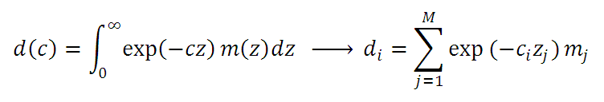
Discrete version of Laplace Transform
large c: d is “shallow” average of m(z)
small c: d is “deep” average of m(z)
Notes:
An example. Data represent an exponentially decaying weighted average of the model parameters,
here treated as a function m(z). The coefficient c of the exponential controls whether the weighted
average is sensitive to mainly shallow values of m, or whether it includes deep values

Slide 23
e^{-c}hi^{z}
⨉
m(z)
integrate
e^{-c}lo^{z}
d_{lo}
z
⨉
integrate
z
d_{hi}
z
Notes:
Graphical interpretation of deep (top) and shallow (bottom) weighted averages.

Slide 24
m^{est} = R m^{true}
j
=
i
i
j
the shallowest model parameters are “best resolved”
Notes:
Model resolution for this problem when it is solved by the minimum length method.
Note that the band on the main diagonal widens with depth.
Thus, resolution degrades with depth.
Fig 4.2. (A) Plots of selected rows of the model resolution matrix, R, indicate how well the model parameters can be resolved. Narrow peaks occurring near the main diagonal of the matrix (dashed line) indicate that the resolution is good. (B) Actual R for the case where the model parameters, m_{j}(z_{j}), are related to the data through the kernel, G_{ij}=exp(-c_{i}z_{j}), where the c’s are constants. Large values (red colors) occur only near the top (small z) of the main diagonal (dashed line), indicating that the resolution is poor at larger values of z. MatLab script gda04_??.

Slide 25

Covariance associated with the Generalized Inverse
“unit covariance matrix”
divide by σ² to remove effect of the
overall magnitude of the measurement error
Notes:
Thus is the normal rule for error propagation, but written so as to normalize away the
overall magnitude of the covariance of the data.

Slide 26
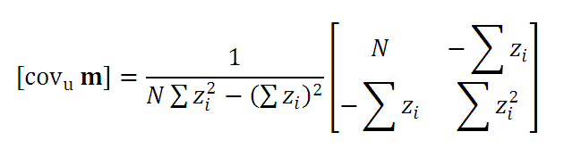
unit covariance for straight line problem
model parameters uncorrelated when this term zero
happens when data are centered about the origin
Notes:
The unit covariance matrix of the straight line problem, computed using the simple least squares
generalized inverse. Note that the model parameters are uncorrelated when the off diagonal element
is zero. This happens when the z’s straddle the origin.

Slide 27
Part 2 The spread of resolution and the size of the covariance
Notes:
Resolution is “good” when it is close to an identity matrix.
“Bad” when it is more “spread out”.
Let’’s quantify how good.

Slide 28
a resolution matrix has small spread if only its main diagonal has large elements it is close to the identity matrix
Notes:
Small spread means “amplitude is concentrated on the main diagonal”

Slide 29
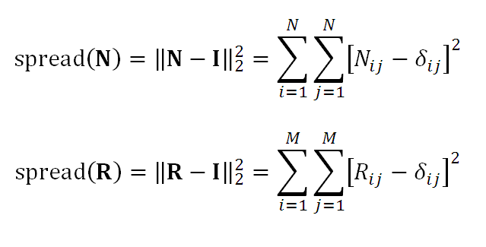
“Dirichlet” Spread Functions
Notes:
This is just the L2 norm of the resolution matrix minus the identity matrix.

Slide 30
a unit covariance matrix has small size if its diagonal elements are small error in the data corresponds to only small error in the model parameters (ignore correlations)
Notes:
Similarly, we can define the size of the unit covariance matrix.
It is small (“good”) if its diagonal elements are small.
Then error in the data propagates to small error in the model parameters.

Slide 31
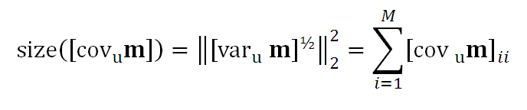
Notes:
The size function is just the sum of the diagonal elements of the matrix.

Slide 32
Part 3 minimization of spread of resolution and/or size of covariance as the guiding principle for creating a generalized inverse
Notes:
The idea is to use spread() and size() as the guiding principle for designing generalized inverses.

Slide 33
over-determined case note that for simple least squares
G^{-g} = [G^{T}G]⁻¹G^{T}
model resolution
R=G^{-g}G = [G^{T}G]⁻¹G^{T}G=I
always the identify matrix
Notes:
Simplest case is the over-determined case.
Note that simple least squares has “perfect” model resolution.

Slide 34
suggests that we try to minimize the spread of the data resolution matrix, N find G^{-g} that minimizes spread(N)
Notes:
So don’t bother with R in the over-determined case; just look at N

Slide 35
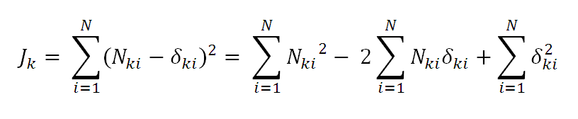
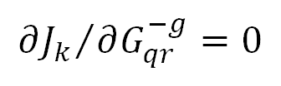
spread of the k-th row of N
now compute
Notes:
Now starts the algebra.
Note that the minimization can be done on each row of N separately, since
J is the sum of squares of values for each row, and each row represents a
weighted average for a different, independent observed model parameter.

Slide 36
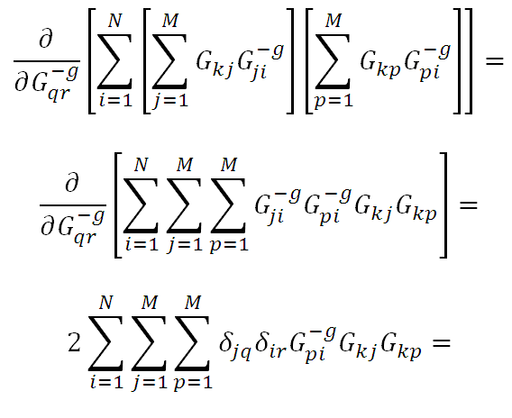
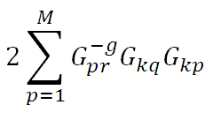
first term
Notes:
Note we have inserted R=G^{-g}G into the equation for J_{k}. Lots of algebra, but standard …

Slide 37
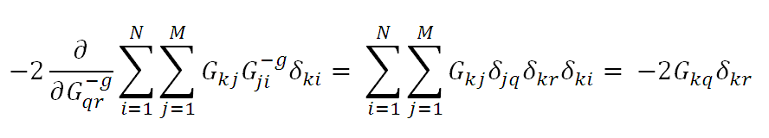
second term
third term is zero
Notes:
Other terms similar

Slide 38

which is just simple least squares
putting it all together
G^{-g} = [G^{T}G]⁻¹G^{T}
Notes:
Writing the result as a matrix equation returns simple least squares.

Slide 39
the simple least squares solution minimizes the spread of data resolution and has zero spread of the model resolution
Notes:
So we have not found a new solution, but rather have reinterpreted the knows simple least-squared solution

Slide 40
under-determined case note that for minimum length solution
G^{-g} = G^{T} [GG^{T}]⁻¹
data resolution
N=GG^{-g} = G G^{T} [GG^{T}]⁻¹ =I
always the identify matrix
Notes:
Similar deal of the under-determined case. Start by examining the minimum length solution.

Slide 41
suggests that we try to minimize the spread of the model resolution matrix, R find G^{-g} that minimizes spread(R)
Notes:
Similar minimization

Slide 42
which is just minimum length solution
minimization leads to
[GG^{T}]G^{-g} = G^{T}
G^{-g} = G^{T} [GG^{T}]⁻¹
Notes:
The solution (derivation not shown) is just the minimum length solution).

Slide 43
the minimum length solution minimizes the spread of model resolution and has zero spread of the data resolution
Notes:
Again, we have not found a new solution, just reinterpreted a known one.
Note that this interpretation does not require any discussion of a priori information.

Slide 44

general case
leads to
Notes:
The general case is straightforward: minimize a weighted sum of all three.
The resulting equation is straightforward, too.

Slide 45
a Sylvester Equation, so explicit solution in terms of matrices
general case
leads to
Notes:
However, although the solution is perfectly-well defined., it can’t be written in closed form.
The equation is a Sylvester equation, of the form Ax+xB=c where A and B are square NxN matrices. On the one hand,
these are just N linear equations in N unknowns, so the solution exists and is well-behaved. On the other hand, the
equation cannot be manipulated to yield an explicit solution of the form x = f(A,B,c).

Slide 46
1
special case #1
0
ε²
I
[G^{T}G+ε²I]G^{-g}=G^{T}
G^{-g}=[G^{T}G+ε²I]⁻¹G^{T}
damped least squares
Notes:
One special case is damped least squares. Note that it arrived out by including the size of the covariance
in the minimization. The link between damped least squares and the minimization of variance is an important
one we will further develop in a subsequent lecture.

Slide 47
0
special case #2
1
ε²
I
G^{-g}[GG^{T}+ε²I] =G^{T}
G^{-g}=G^{T} [GG^{T}+ε²I]⁻¹
damped minimum length
Notes:
One special case is damped least squares. Note that it arrived out by including the size of the covariance
in the minimization. The link between damped least squares and the minimization of variance is an important
one we will further develop in a subsequent lecture.

Slide 48
so
no new solutions have arisen …
… just a reinterpretation of previously-derived solutions
Notes:
Again, no new solution, just a reinterpretation.

Slide 49
reinterpretation
instead of solving for estimates of the model parameters
We are solving for estimates of weighted averages of the model parameters,
where the weights are given by the model resolution matrix
Notes:
This is a very important reinterpretation, especially for under-determined problems.
We don’t need a priori information to estimate a weighted average.
Except to the extent that we have a prior notion of what constitutes a good weighted average.

Slide 50
criticism of Direchlet spread() functions when m represents m(x) is that they don’t capture the sense of “being localized” very well
Notes:
Model resolution is localized when any large off-diaginal elements of R are near the main diagonal.

Slide 51
These two rows of the model resolution matrix have the same spread …
R_{ij}
R_{ij}
i
index, j
i
index, j
… but the left case is better “localized”
Notes:
(leftt) Near the main diagonal = localized
(right) far from the main diagonal = unlocalized.
Fig 4.4. (A) and (B). Resolution matrices have the same spread, when measured by the Dirichlet spread function. Nevertheless, if the model parameters possess a natural ordering, then A) is better resolved. The Backus-Gilbert spread function is designed to measure A) as having a smaller spread than B).

Slide 52
we will take up this issue in the next lecture
Notes:
Stay tuned!

