Slide 1
Lecture 7 Backus-Gilbert Generalized Inverse and the Trade Off of Resolution and Variance
Notes:
The Backus-Gilbert generalized inverse is especially important in cases where the model parameters
represent discritized versions of a continuous variable.

Slide 2
Syllabus
Lecture 01 Describing Inverse Problems Lecture 02 Probability and Measurement Error, Part 1 Lecture 03 Probability and Measurement Error, Part 2 Lecture 04 The L₂ Norm and Simple Least Squares Lecture 05 A Priori Information and Weighted Least Squared Lecture 06 Resolution and Generalized Inverses
Lecture 07 Backus-Gilbert Inverse and the Trade Off of Resolution and Variance Lecture 08 The Principle of Maximum Likelihood Lecture 09 Inexact Theories Lecture 10 Nonuniqueness and Localized Averages Lecture 11 Vector Spaces and Singular Value Decomposition
Lecture 12 Equality and Inequality Constraints Lecture 13 L₁ , L∞ Norm Problems and Linear Programming Lecture 14 Nonlinear Problems: Grid and Monte Carlo Searches Lecture 15 Nonlinear Problems: Newton’s Method Lecture 16 Nonlinear Problems: Simulated Annealing and Bootstrap Confidence Intervals Lecture 17 Factor Analysis Lecture 18 Varimax Factors, Empircal Orthogonal Functions Lecture 19 Backus-Gilbert Theory for Continuous Problems; Radon’s Problem Lecture 20 Linear Operators and Their Adjoints Lecture 21 Fréchet Derivatives Lecture 22 Exemplary Inverse Problems, incl. Filter Design Lecture 23 Exemplary Inverse Problems, incl. Earthquake Location Lecture 24 Exemplary Inverse Problems, incl. Vibrational Problems

Slide 3
Purpose of the Lecture
Introduce a new way to quantify the spread of resolution
Find the Generalized Inverse that minimizes this spread
Include minimization of the size of variance
Discuss how resolution and variance trade off
Notes:
The first three sections parallel the last lecture, the last, on trade-off, introduces a new result.

Slide 4
Part 1 A new way to quantify the spread of resolution
Notes:
As we noted at the end of the last lecture, the Direchlet spread function is not the greatest ..

Slide 5
criticism of Direchlet spread() functions when m represents m(x) is that they don’t capture the sense of “being localized” very well
Notes:
Model resolution is localized when any large off-diagonal elements of R are near the main diagonal.

Slide 6
These two rows of the model resolution matrix have the same Direchlet spread …
R_{ij}
R_{ij}
i
index, j
i
index, j
… but the left case is better “localized”
Notes:
(leftt) Near the main diagonal = localized
(right) far from the main diagonal = unlocalized.
Fig 4.4. (A) and (B). Resolution matrices have the same spread, when measured by the Dirichlet spread function. Nevertheless, if the model parameters possess a natural ordering, then A) is better resolved. The Backus-Gilbert spread function is designed to measure A) as having a smaller spread than B).

Slide 7
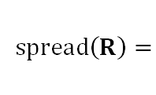
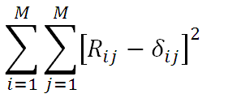
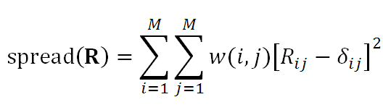
old way
new way
Notes:
The only new thing we’ve done is to introduce a weight function w(i,j)

Slide 8
old way
add this function
new way

Slide 9
old way
Backus-Gilbert Spread Function
new way
Notes:
This modification was first proposed by George Backus and Freeman Gilbert in the late 1960’s.

Slide 10
grows with physical distance between model parameters
zero when i=j
Notes:
The idea is to choose the weight function so that it grows with physical distance between
two model parameters. Then resolution is better when the average is “localized”

Slide 11
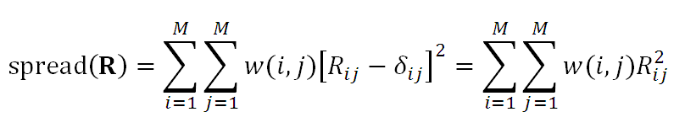
if w(i,i)=0 then
Notes:
Choosing the weight function so that it is zero or i=j simplifies the form of the spread function

Slide 12
for one spatial dimension m is discretized version of m(x) m = [m(Δx), m(2 Δx), … m(M Δx) ]^{T}
w(i,j) = (i-j)²
would work fine
Notes:
for a 1D function that is evenly sampled, (i-2)² is a good measure of the physical distance between model parameters
i and j. We could have put in a factor of (Δx)², so that it is exactly length, but it turns out that this is unnecessary.

Slide 13
for two spatial dimension m is discretized version of m(x,y) on K⨉L grid m = [m(x₁, y₁), m(x₁, y₂), … m(x_{K}, y_{L}) ]^{T}
w(i,j) = (x_{i}-x_{j}) ² + (y_{i}-y_{j}) ²
would work fine
Notes:
In 2D, what counts is not the distance of the model parameters from one another in their
arrangement in the vector of model parameters, but their physical arrangement in the real world.

Slide 14
Part 2 Constructing a Generalized Inverse
Notes:
This is almost exactly parallel to the procedure of the last lecture – with one catch.

Slide 15
under-determined problem
find G^{-g} that minimizes spread(R)
Notes:
This is what we did last time. It won’t work here though because the diagonal elements
of R do not affect the spread, which the weights are zero for them.

Slide 16
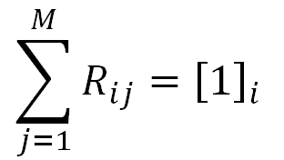
under-determined problem
find G^{-g} that minimizes spread(R)
with the constraint
Notes:
So we must add a constraint that limits the size of the diagonal of R.
Here we require that every row of R sum to unity.
Thus, since mest = R mtrue every mest is true weighted average
in the sense that the weights sum to unity.
Note however that a really good weighted average should have positive weights
and that this constraint is not implemented here.

Slide 17
under-determined problem
find G^{-g} that minimizes spread(R)
with the constraint
(since R_{ii} is not constrained by spread function)

Slide 18
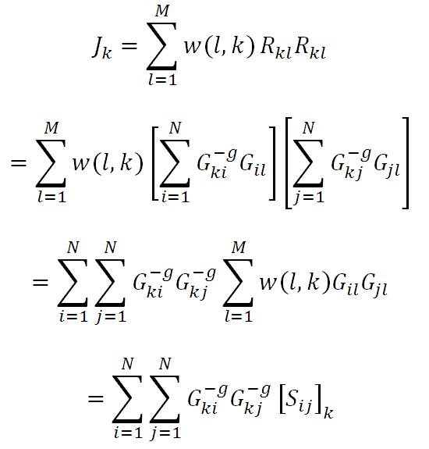
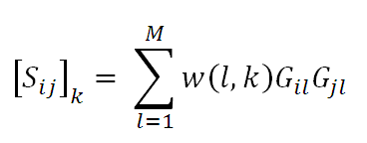
once again, solve for each row of G^{-g} separately spread of kth row of resolution matrix R
symmetric in i,j
with
Notes:
Each localized average is a separate thing, so quantify its spread with J.
Plug R=G^{-g}G into the formula for J.
Note that J depends on G through the matrix S

Slide 19
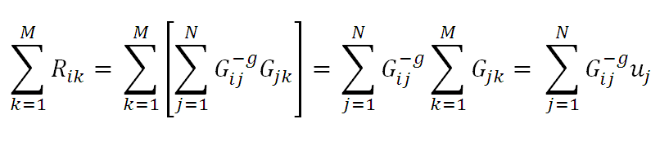
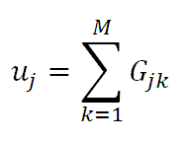
for the constraint
[1]_{k}=
with
Notes:
Same style of manipulation for the constraint.
G enters through the vector u.

Slide 20
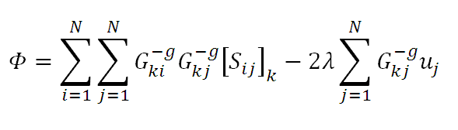
Lagrange Multiplier Equation
+
now set ∂Φ/∂G^{-g}_{kp}
Notes:
Now do a constrained minimization with Lagrane multipliers.
Factor of 2 thrown in to make result simpler.

Slide 21
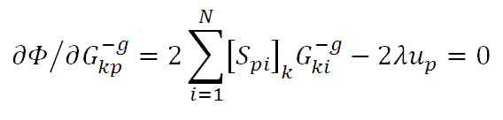
S g^{(k)} – λu = 0
with g^{(k)T} the kth row of G^{-g}
solve simultaneously with
u^{T} g^{(k)} = 1
Notes:
After much algebra, get Lagrange equation, written here involving a column-vector g
Note the transform of this column-vector is a row of the generalized inverse.
Lagrange equation must be solved simultaneously with the constraint equation.

Slide 22
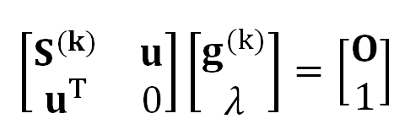
putting the two equations together
Notes:
Matrix form of the two equations.

Slide 23
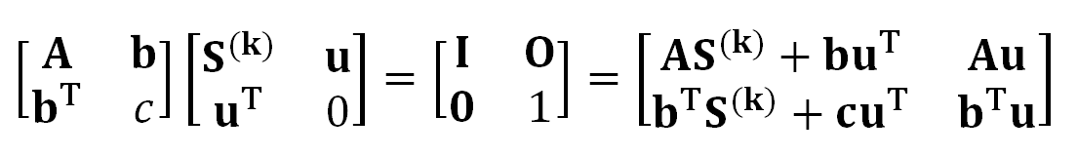
construct inverse
A, b, c unknown
Notes:
Now propose that an inverse exists.

Slide 24

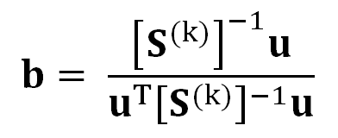
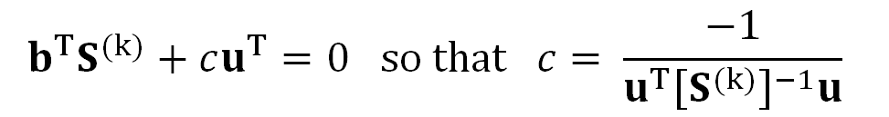
construct inverse
so
Notes:
Painfully solve or each of its component pieces.

Slide 25
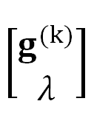
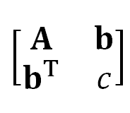



=
g^{(k)} =
u^{T}
g^{(k)T} =
kth row of G^{-g}
Notes:
Actually, all we need is the vector b. A row of the generalized inverse is given by b^{T}.

Slide 26
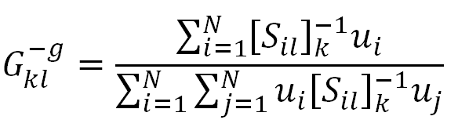
Backus-Gilbert Generalized Inverse
(analogous to Minimum Length Generalized Inverse)
written in terms of components
with
Notes:
Same thing, written component-wise.

Slide 27
(A)
(B)
j
i
(C)
(D)
j
i
Notes:
Laplace Transform problem. Top: Backus-Gilbert; Bottom Minimum Length
Note Backus-Gilbert is much more localized than Minimum Length.
But central peal is also wider than Minimum Length.
Hence one pays a price. It’s a trade off.
Fig 4.5. Comparison of the Backus-Gilbert and Dirichlet solutions of the inverse problem described in Figure 4.2. (A) The true model (red) contains a series of sharp spikes. The estimated model (blue) using the Backus-Gilbert spread function is much smoother, with the width of the smoothing increasing with z. (B) Corresponding model resolution matrix, R. (C) and (D) Same, but for a Dirichlet spread function. Note that the Backus-Gilbert resolution matrix has the lower intensity sidelobes, but a wider central band. MatLab scripts gda04_?? and gda04_??.

Slide 28
Part 3 Include minimization of the size of variance
Notes:
Same idea as last time. Throw size([cov m]) into inversion.

Slide 29
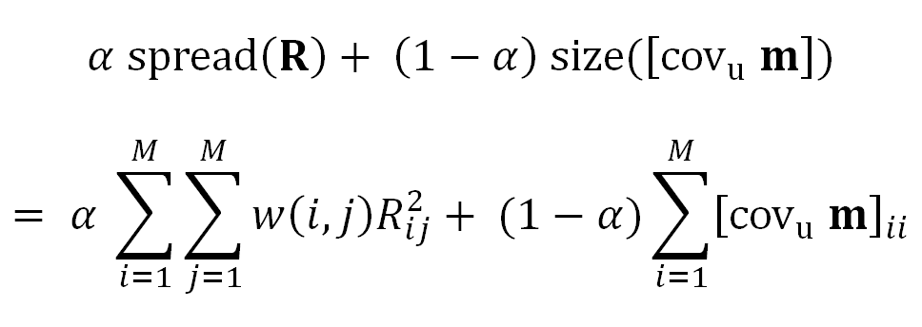
minimize
Notes:
Same size function as in last lecture.
α=1, only consider spread(R), same as result we just worked out.
α<1, given weight to size of covariance

Slide 30
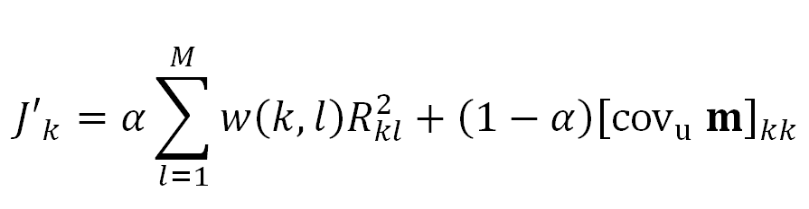
new version of J_{k}
Notes:
New version J.

Slide 31
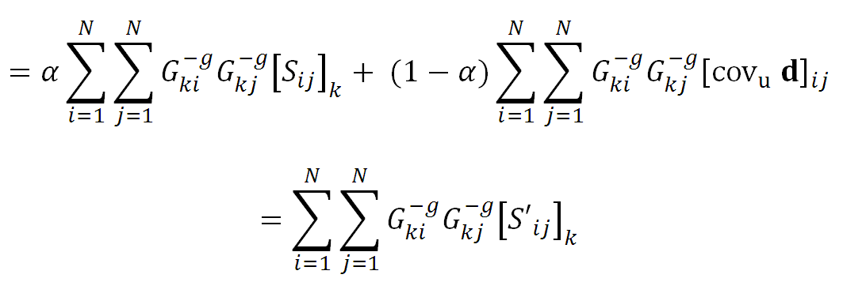

with
Notes:
After algebra, note that …

Slide 32
same
with
Notes:
After algebra, note that … two terms have the same summations, and can be grouped together.
That leads to a redefinition of the matrix S, here called S’

Slide 33
so adding size of variance is just a small modification to S
Notes:
So old derivation – with modified S - will work. No algebra necessary.

Slide 34
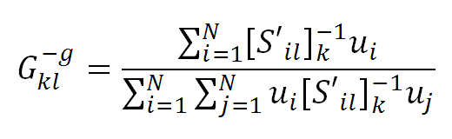
Backus-Gilbert Generalized Inverse
(analogous to Damped Minimum Length)
written in terms of components
with
Notes:
Putting it all together.

Slide 35
In MatLab
GMG = zeros(M,N);
u = G*ones(M,1);
for k = [1:M]
S = G * diag(([1:M]-k).^2) * G';
Sp = alpha*S + (1-alpha)*eye(N,N);
uSpinv = u'/Sp;
GMG(k,:) = uSpinv / (uSpinv*u);
end
Notes:
MatLab Code; not so bad.

Slide 36
$20 Reward! to the first person who sends me MatLab code that computes the BG generalized inverse without a for loop (but no creation of huge 3-indexed quantities, please. Memory requirements need to be similar to my code)
Notes:
The lingo here will be important throughout the course, so be sure to emphasize it.

Slide 37
The Direchlet analog of the Backus-Gilbert Generalized Inverse is the Damped Minimum Length Generalized Inverse

Slide 38

0
special case #2
1
ε²
I
G^{-g}[GG^{T}+ε²I] =G^{T}
G^{-g}=G^{T} [GG^{T}+ε²I]⁻¹
damped minimum length
Notes:
One special case is damped least squares. Note that it arrived out by including the size of the covariance
in the minimization. The link between damped least squares and the minimization of variance is an important
one we will further develop in a subsequent lecture.

Slide 39
Part 4 the trade-off of resolution and variance
Notes:
Extremely important concept in inverse theory.

Slide 40
the value of a localized average with small spread is controlled by few data and so has large variance
the value of a localized average with large spread is controlled by many data and so has small variance
Notes:
Key issue: how much is variance in the data “averaged away”.

Slide 41
(A)
(B)
Notes:
Left – big boxes correspond to poorly localized model parameters.
Lots of rays in a big box; opportunity for errors in the data to average out.
Right: Little boxes are better localized. But fewer rays pass through each one, so less opportunity for
errors in the data to average out.
Fig, 4.6. Hypothetical tomography experiment with (A) large voxels and (B) small voxels. MatLab Script The small voxel case has better spatial resolution, but also had higher variance, since fewer rays pass through each voxel, leaving less opportunity for measurement error to average out. gda04_??.

Slide 42
small spread large variance
large spread small variance
Notes:
Fundamental trade off in inverse theory.

Slide 43
α near 1 small spread large variance
α near 0
large spread small variance
Notes:
Trade off is parameterized by parameter alpha.

Slide 44
Trade-Off Curves
(A)
(B)
α=1
α=1
log₁₀ size of covariance
log₁₀ size of covariance
α=½
α=½
α=0
α=0
log₁₀ spread of model resolution
spread of model resolution
Notes:
Trade off curves for both Backus-Gilbert and Damped Minimim Length generalized inverses.
Note that the size of covariance varies by the huge factor of 10⁶.
Fig 4.7. Trade-off curves of resolution and variance for the inverse problem shown in Figure 4.2. (A) Backus-Gilbert solution, (B) Damped Minimum Length solution. The larger the parameter, α, the more weight resolution is given (relative to variance) when forming the generalized inverse. The details of the trade-off curve depend upon the parameterization. The resolution can be no better than the smallest element in the parameterization and no worse than the sum of all the elements. MatLab script gda04_??.

