Slide 1
Lecture 8 The Principle of Maximum Likelihood
Notes:
In this lecture, we introduce a new technique. But its application just leads to a reinterpretation of
formulas that we previously derived, not to new solutions.

Slide 2
Syllabus
Lecture 01 Describing Inverse Problems Lecture 02 Probability and Measurement Error, Part 1 Lecture 03 Probability and Measurement Error, Part 2 Lecture 04 The L₂ Norm and Simple Least Squares Lecture 05 A Priori Information and Weighted Least Squared Lecture 06 Resolution and Generalized Inverses
Lecture 07 Backus-Gilbert Inverse and the Trade Off of Resolution and Variance Lecture 08 The Principle of Maximum Likelihood Lecture 09 Inexact Theories Lecture 10 Nonuniqueness and Localized Averages Lecture 11 Vector Spaces and Singular Value Decomposition
Lecture 12 Equality and Inequality Constraints Lecture 13 L₁ , L∞ Norm Problems and Linear Programming Lecture 14 Nonlinear Problems: Grid and Monte Carlo Searches Lecture 15 Nonlinear Problems: Newton’s Method Lecture 16 Nonlinear Problems: Simulated Annealing and Bootstrap Confidence Intervals Lecture 17 Factor Analysis Lecture 18 Varimax Factors, Empircal Orthogonal Functions Lecture 19 Backus-Gilbert Theory for Continuous Problems; Radon’s Problem Lecture 20 Linear Operators and Their Adjoints Lecture 21 Fréchet Derivatives Lecture 22 Exemplary Inverse Problems, incl. Filter Design Lecture 23 Exemplary Inverse Problems, incl. Earthquake Location Lecture 24 Exemplary Inverse Problems, incl. Vibrational Problems

Slide 3
Purpose of the Lecture
Introduce the spaces of all possible data,
all possible models and the idea of likelihood
Use maximization of likelihood as a guiding principle for solving inverse problems
Notes:
The first three sections parallel the last lecture, the last, on trade-off, introduces a new result.

Slide 4
Part 1 The spaces of all possible data, all possible models and the idea of likelihood
Notes:
This sections draws heavily on ideas from probability theory.

Slide 5
viewpoint
the observed data is one point in the space of all possible observations
or
d^{obs} is a point in S(d)
Notes:
The space S(d) is of dimension N. In the following example, we use N=3, that is, just three measurements.

Slide 6
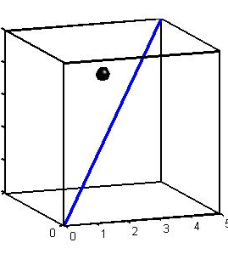
plot of d^{obs}
d₃
d₂
d₁
O
Notes:
This is a case of measuring just three data. A triplet of observations (d1, d2, d3) is just a point in the space.
Fig 5.1. The data are represented by a single point (black) in a space whose dimensions equals the number of observations (in this case, 3). These data are realizations of random variables with the same mean and variance. Nevertheless, they do not necessarily fall on the line d₁= d₂= d₃ (blue). MatLab script gda05_??.

Slide 7
plot of d^{obs}
d₃
d^{obs}
d₂
d₁
O
Notes:
The observed data are one point in the space.
Fig 5.1. The data are represented by a single point (black) in a space whose dimensions equals the number of observations (in this case, 3). These data are realizations of random variables with the same mean and variance. Nevertheless, they do not necessarily fall on the line d₁= d₂= d₃ (blue). MatLab script gda05_??.

Slide 8
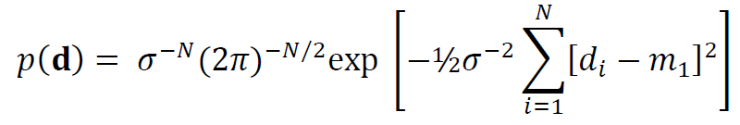
now suppose …
the data are independent
each is drawn from a Gaussian distribution
with the same mean m₁ and variance σ²
(but m₁ and σ unknown)
Notes:
Let’s assign a probability to each point in the space S(d), the probability of the
set of three observations coming out to that particular value. In this example,
we us a Gaussian distribution. But initially we don’t know its mean or variance;
we will want eventually to estimate them from the data.

Slide 9
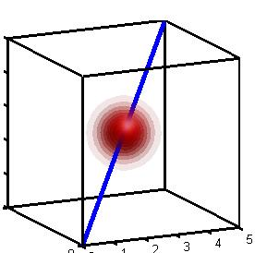
plot of p(d)
d₃
d₂
d₁
O
Notes:
The data having the same mean implies that the cloud of probability is centered on the blue line d1=d2=d3.
All the data having the same variance implies that the cloud is spherically symmetric.
Fig 5.2. If the data, d_{i}, are assumed to be uncorrelated with equal mean and uniform variance, their probability density function p(d) is a spherical cloud (red), centered on the line d₁= d₂= d₃ (blue). MatLab script gda05_??.

Slide 10
plot of p(d)
d₃
cloud centered on d₁=d₂=d₃
with radius proportional to σ
d₂
d₁
O
Notes:
Fig 5.2. If the data, d_{i}, are assumed to be uncorrelated with equal mean and uniform variance, their probability density function p(d) is a spherical cloud (red), centered on the line d₁= d₂= d₃ (blue). MatLab script gda05_??.

Slide 11
now interpret …
p(d^{obs})
as the probability that the observed data was in fact observed
L = log p(d^{obs})
called the likelihood
Notes:
This is the amplitude of the cloud at the point dobs.
We take the log because it facilitates math later in the section.

Slide 12
find parameters in the distribution
maximize
p(d^{obs})
with respect to m₁ and σ
maximize the probability that the observed data
were in fact observed
the
Principle of Maximum Likelihood
Notes:
In other words, slide the cloud up and down along the blue line, and adjust its radius, until its amplitude at
dobs is maximized.

Slide 13
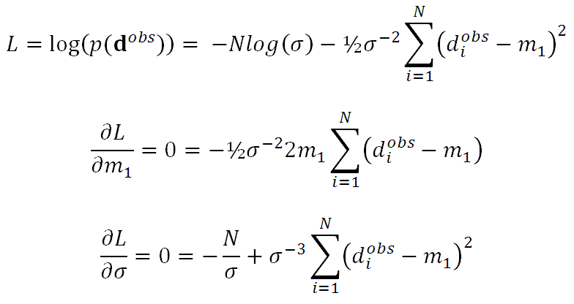
Example
Notes:
Note that taking the log gets rid of the exponential and changes products of variables into sums of variables.
The maximization is accomplished by setting derivatives to zero, as usual.

Slide 14
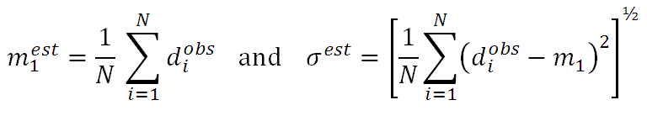
solving the two equations
Notes:
The two equations are easy to solve. The first can only be zero when the summation is zero, which
yields the formula for m1. Once m1 is known, solving the second is trivial.

Slide 15
solving the two equations
usual formula for the sample mean
almost the usual formula for the sample standard deviation
Notes:
I use the word almost, since the usual formula for standard deviation has a factor of (N-1) in it,
not the factor of N that appears above. However, this difference is insignificant when N is large.

Slide 16
these two estimates linked to the assumption of the data being Gaussian-distributed
might get a different formula for a different p.d.f.
Notes:
In fact, we will show later in the course that, when the data follow a two-sided exponential
p.d.f., as contrsted to a Gaussian p.d.f., the estimator of the mean is the sample median.

Slide 17
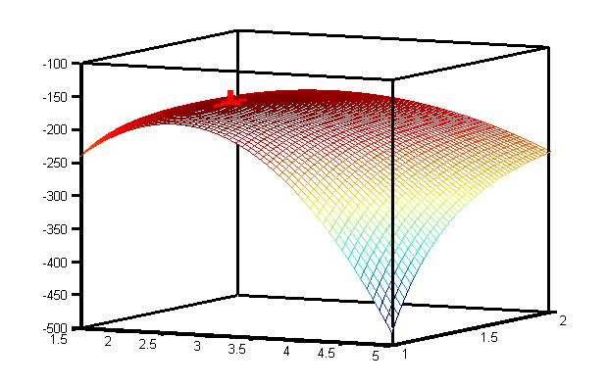
example of a likelihood surface
L(m₁, σ)
maximum
likelihood
point
σ
m₁
Notes:
Here is L(m1,sigma) for the case just discussed. The best estimate of (m1, sigma) is at the peak. Note that
L is curvier in the m direction than in the sigma direction, indicating that the error bounds on estimated mean are smaller
than those on estimated standard deviation.
Fig 5.3. Likelihood surface for 100 realizations of random variables with equal mean, m₁=2.5, and uniform variance, σ²=(1.5)². The curvature in the direction of the mean is greater than the maximum in the direction of the σ, indicating that the former can be determined to greater certainty. MatLab script gda05_??.

Slide 18
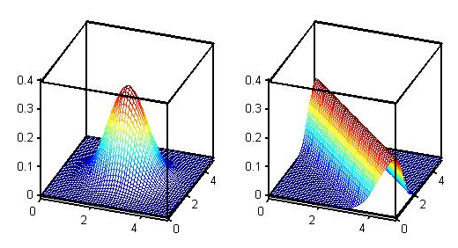
likelihood maximization process will fail if p.d.f. has no well-defined peak
(A)
(B)
p(d_{1,} ,d₁ )
p(d_{1,} ,d₁ )
d₂
d₂
d₁
d₁
Notes:
Maximum likelihood will fail when the distributions have ridges.
Fig 5.4. (A) Probability density function, p(d₁,d₂), with a well-defined peak. (B) Probability density function with a ridge. MatLab script gda05_??.

Slide 19
Part 2 Using the maximization of likelihood as a guiding principle for solving inverse problems
Notes:
We now extend this procedure to the Gm=d case.

Slide 20

linear inverse problem for with Gaussian-distibuted data with known covariance [cov d] assume Gm=d gives the mean d
T
Notes:
This is a Gaussian p.d.f. where the theory is assumed to predict the mean observation.

Slide 21

principle of maximum likelihood maximize L = log p(d^{obs}) minimize
T
with respect to m
Notes:
The log of the p.d.f. is just the argument of the exponential, plus some constants that don’t depend on m.

Slide 22
principle of maximum likelihood maximize L = log p(d^{obs}) minimize
E =
T
This is just weighted least squares

Slide 23

principle of maximum likelihood when data Gaussian-distributed solve Gm=d with weighted least squares with weighting of

Slide 24
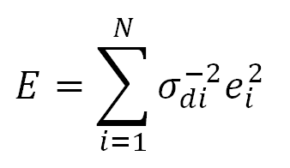
special case of uncorrelated data each datum with a different variance [cov d]_{ii} = σ_{di}² minimize

Slide 25
special case of uncorrelated data each datum with a different variance [cov d]_{ii} = σ_{di}² minimize
errors weighted by their certainty

Slide 26
but what about a priori information?
Notes:
We need to develop a way to include a priori information in the solution

Slide 27
probabilistic representation of a priori information
probability that the model parameters are
near m
given by p.d.f.
p_{A}(m)

Slide 28
probabilistic representation of a priori information
probability that the model parameters are
near m
given by p.d.f.
p_{A}(m)
centered at a priori value <m>

Slide 29
probabilistic representation of a priori information
probability that the model parameters are
near m
given by p.d.f.
p_{A}(m)
variance reflects uncertainty in a priori information

Slide 30
certain
uncertain
<m₂>
<m₂>
m₂
m₂
<m₁>
<m₁>
m₁
m₁
Notes:
The p.d.f. of the a priori model parameters.
It is centered on the a priori values <m>.
Its variance reflects the certainty we have about those values.
Fig 5.5. A priori information about model parameters, m₁ and m₂, represented with a probability density function, p(m₁,m₂). Most probable values are given by means <m₁> and <m₂>. Width of the probability density function reflects certainty of knowledge: (A) certain, (B) uncertain. MatLab script gda05_??.

Slide 31
<m₂>
m₂
<m₁>
m₁
Notes:
In this case our knowledge of m2 is more certain than our knowledge of m1.
Fig 5.6. A priori information about model parameters, m₁ and m₂, represented with a probability density function, p(m₁,m₂). The model parameters are thought to be near <m>, with the uncertainty in m₁ greater than the uncertainty of m₂. MatLab script gda05_??.

Slide 32
linear relationship
approximation with Gaussian
<m₂>
m₂
m₂
<m₁>
m₁
m₁
Notes:
Some non-Gaussian p.d.f.’s can be approximated with Gaussians.
Fig 5.7. A priori information about model parameters, m₁ and m₂, represented with a probability density function, p(m₁,m₂). (A) Case when the values of m₁ and m₁ are unnkown, but believed to be correlated. (B) Approximation of A) with a Normal probability density function with finite variance. MatLab script gda05_??.

Slide 33
m₂
p=constant
m₁
p=0
Notes:
But other p.d.f.’s can’t be approximated as Gaussian, such as this inequality relationship m1>m2.
Fig 5.8. A priori information about model parameters, m₁ and m₂, represented with a probability density function, p(m₁,m₂). The value of the model parameters are unknown, but the relationship, m₁≤m₂, is believed to hold exactly. This is a non-Normal probability density function. MatLab script gda05_??.

Slide 34
assessing the information content in p_{A}(m)
Do we know a little about m
or
a lot about m ?
Notes:
How much knowledge do we actually have about the model parameters?

Slide 35
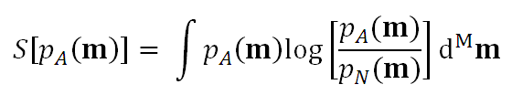
Information Gain, S
-S called Relative Entropy,
Notes:
We will need this in the next lecture. We will not really use it today.

Slide 36
Relative Entropy, S also called Information Gain
null p.d.f.
state of no knowledge
Notes:
Knowledge needs to be compared to the state of no knowledge, here represented
by the null p.d.f. pN(m). Note that S=0 when PA=PN; we no nothing.

Slide 37
Relative Entropy, S also called Information Gain
uniform p.d.f. might work for this
Notes:
A uniform p.d.f. might work in simple cases.

Slide 38
probabilistic representation of data
probability that the data are
near d
given by p.d.f.
p_{A}(d)
Notes:
Same idea here as with the a priori information.
Use a p.d.f. to describe our state of knowledge after making the observations.

Slide 39
probabilistic representation of data
probability that the data are
near d
given by p.d.f.
p(d)
centered at observed data d^{obs}
Notes:
The p.d.f. is centered on the observations.

Slide 40
probabilistic representation of data
probability that the data are
near d
given by p.d.f.
p(d)
variance reflects uncertainty in measurements
Notes:
The p.d.f. has a variance reflecting the uncertainty of the observations.

Slide 41

probabilistic representation of both prior information and observed data
assume observations and a priori information are uncorrelated
Notes:
Now combine the two to give the state of information about both the
data and the model parameters, taking into consideration both the observations
and the a priori information about the model parameters.

Slide 42
Example of
m_{ap}
model, m
d^{obs}
datum, d
Notes:
Fig 5.9. Joint probability density function, p_{A}(m, d), for model parameter, m, and datum, d. The distribution is peaked at mean values <m> and <d>. MatLab script gda05_??.

Slide 43
the theory d = g(m) is a surface in the combined space of data and model parameters on which the estimated model parameters and predicted data must lie

Slide 44
the theory d = g(m) is a surface in the combined space of data and model parameters on which the estimated model parameters and predicted data must lie for a linear theory the surface is planar
Notes:
all that is left is to make use of the theory, which is a relationship between
the data and the model parameters.

Slide 45
the principle of maximum likelihood says
maximize
on the surface d=g(m)
Notes:
The solution is the estimated model parameters.

Slide 46
(A)
model, m
d^{obs}
d_{pre}
d=g(m)
datum, d
m^{ap}
m^{est}
(B)
p(s)
s_{max}
position along curve, s
Notes:
Example. Top. p(d,m) with theory superimposed as white curve.
Bottom. p(d,m) evaluated along the curve.
The peak gives both the estimated model parameters and the predicted data.
Fig 5.10. (A) A priori joint probability density function, p(m, d), for model parameter, m, and datum, d, represents the idea that the model parametes is near it’s a priori value, m^{ap} and the datum is near its observed value, d^{obs} (white circle). The data and model parameters are believed to be related by an exact theory, d=g(m) (white curve). The estimated model parameter, m^{est}, and predicted datum, d^{pre}, fall on this curve at the point of maximum probability (black circle). (B) Probability density, p, evaluated along the curve. The MatLab script gda05_??.

Slide 47
model, m
d^{obs}
d_{pre}
d=g(m)
datum, d
m_{est}≈m_{ap}
p(s)
s_{max}
position along curve, s
Notes:
If the a priori information is very certain, then the estimated model parameters are close to the a priori information.
Fig 5.11. (A) If the a priori model parameter, m^{ap}, is much more certain than the observed datum, d^{obs} , the solution is close to m^{ap} but may be far from d^{obs}. (B) The probability density function, p, evaluated along the curve. MatLab script gda05_??.

Slide 48
(A)
model, m
d_{pre}≈d^{obs}
d=g(m)
datum, d
m_{ap}
(B)
m_{est}
p(s)
s_{max}
position along curve, s
Notes:
If the a priori information is very uncertain, then the estimated model parameters are close to the observations.
Fig 5.12. A) If the a priori model parameter, m^{ap}, is much less certain than the observed datum, d^{obs} , the solution is close tod^{obs} but may be far from m^{ap}. B) The probability density function, p, evaluated along the curve. MatLab script gda05_??.

Slide 49
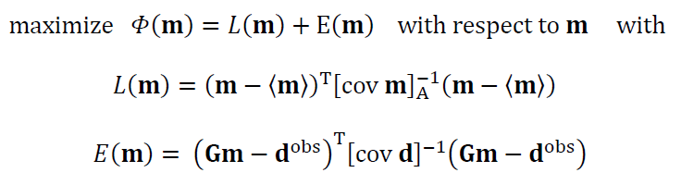
minimize
principle of maximum likelihood with Gaussian-distributed data Gaussian-distributed a priori information
Notes:
Since the data are a function of the model parameters in an explicit theory d=g(m), we can
avoid the use of Lagrange Multipliers. All we need to do is substitute d=Gm into p(m,d) and
perform the minimization. The log of the Gaussian p.d.f. for the a priori model parameters is the
function L(m), and the log of the Gaussian p.d.f. for the observations is the function E(m) (both
up to some additive terms which are not functions of m and therefore can be ignored).

Slide 50

this is just weighted least squares with
so we already know the solution
Notes:
We have already solved the weighted least square problem.

Slide 51
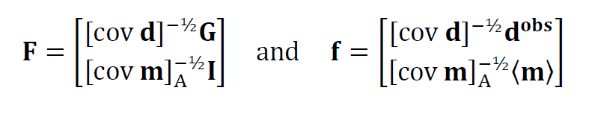
solve Fm=f with simple least squares
Notes:
Top row: Data equation Gm=dobs, weighted by its certainty.
Bottom row: A priori equation m=<m>, weighted by its certainty.
Now compute simple least squares solution m^{est} = (F^{T}F)⁻¹(F^{T}f).

Slide 52
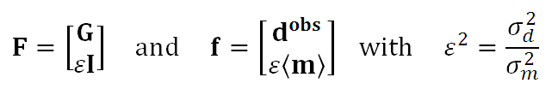
when [cov d]=σ_{d}²I and [cov m]=σ_{m}²I
Notes:
Here we simplify by assuming uncorrelated data and model parameters with uniform variance.
Note the substantial simplification: only one parameter, epsilon.

Slide 53
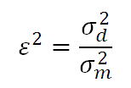
this provides and answer to the question What should be the value of ε² in damped least squares? The answer
it should be set to the ratio of variances of the data and the a priori model parameters
Notes:
So epsilon does not really need to be determined by trial and error, as long as one has a good
feel for how certain the a priori model parameters are.

Slide 54
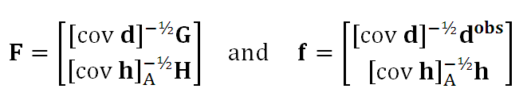
if the a priori information is Hm=h with covariance [cov h]_{A} then the Fm=f becomes
Notes:
This is the solution that arises when the a priori information is that a linear combination
of the model parameters have a prescribed value; that is, when Hm=h.

Slide 55
Gm=d^{obs} with covariance [cov d] Hm=h with covariance [cov h]_{A} m^{est} = (F^{T}F)⁻¹F^{T}d^{obs}
the most useful formula in inverse theory
with
Notes:
This solution is undoubtedly the most important “practical” solution in inverse theory.

