Slide 1
Lecture 9 Inexact Theories
Notes:
In this lecture, we introduce the idea of an inexact theory; that is, one that is only approximately correct.
However, only about the first two-thirds of the lecture is on this subject;
a few other miscellaneous topics will be thrown in.

Slide 2
Syllabus
Lecture 01 Describing Inverse Problems Lecture 02 Probability and Measurement Error, Part 1 Lecture 03 Probability and Measurement Error, Part 2 Lecture 04 The L₂ Norm and Simple Least Squares Lecture 05 A Priori Information and Weighted Least Squared Lecture 06 Resolution and Generalized Inverses
Lecture 07 Backus-Gilbert Inverse and the Trade Off of Resolution and Variance Lecture 08 The Principle of Maximum Likelihood Lecture 09 Inexact Theories Lecture 10 Nonuniqueness and Localized Averages Lecture 11 Vector Spaces and Singular Value Decomposition
Lecture 12 Equality and Inequality Constraints Lecture 13 L₁ , L∞ Norm Problems and Linear Programming Lecture 14 Nonlinear Problems: Grid and Monte Carlo Searches Lecture 15 Nonlinear Problems: Newton’s Method Lecture 16 Nonlinear Problems: Simulated Annealing and Bootstrap Confidence Intervals Lecture 17 Factor Analysis Lecture 18 Varimax Factors, Empirical Orthogonal Functions Lecture 19 Backus-Gilbert Theory for Continuous Problems; Radon’s Problem Lecture 20 Linear Operators and Their Adjoints Lecture 21 Fréchet Derivatives Lecture 22 Exemplary Inverse Problems, incl. Filter Design Lecture 23 Exemplary Inverse Problems, incl. Earthquake Location Lecture 24 Exemplary Inverse Problems, incl. Vibrational Problems

Slide 3
Purpose of the Lecture
Discuss how an inexact theory can be represented
Solve the inexact, linear Gaussian inverse problem
Use maximization of relative entropy as a guiding principle for solving inverse problems
Introduce F-test as way to determine whether one solution is “better” than another
Notes:
The first two sections are related; defining and inexact theory and then solving an inverse problem involving it.
The last two are two less-related topics thrown in.

Slide 4
Part 1 How Inexact Theories can be Represented
Notes:
An inexact theory is one that is only approximately correct.
For this approach to be helpful, we must have an a priori notion of how approximate it is.
For example, that it typically gives results that are incorrect by 5%.

Slide 5
How do we generalize the case of an exact theory to one that is inexact?
Notes:
Last lecture we developed a procedure for solving the exact theory problem that contained
both data and a priori information.

Slide 6
exact theory case
model, m
theory
d^{obs}
d_{pre}
datum, d
d=g(m)
m^{ap}
m^{est}
Notes:
The a priori information was represented by a p.d.f.
The theory was represented as a surface.
The solution was the point of maximum likelihood along the surface.

Slide 7
to make theory inexact ...
must make the theory probabilistic or fuzzy
model, m
d^{obs}
d_{pre}
datum, d
d=g(m)
m^{ap}
m^{est}
Notes:
We make the theory inexact by blurring it into a cloud.

Slide 8
a prior p.d.f.
theory
combination
model, m
model, m
model, m
d^{obs}
d^{obs}
d^{obs}
d^{pre}
datum, d
datum, d
datum, d
m^{ap}
m^{ap}
m^{ap}
m^{est}
Notes:
The a priori p.d.f. is the same as before.
The theory becomes a cloud.
The two combine somehow or other.
And then we select the maximum likelihood point of the result
as the solution to the inverse problem.
Fig 5.13. (A) The a priori probability density function, p_{A}(m,d), respresents the state of knowledge before the theory is applied. Its mean (white circle) is the a priori model parameter, m^{ap}, and observed data, d^{obs}. (B) An inexact theory is represented by the conditional probability density function, Pg(m|d), which is centered about the exact theory (dotted white curve). (C) The product, p_{T}(m,d) =p_{A}(m,d) p_{g}(m|d) combines the a prior information and theory. Its peak is at the estimated data, m^{est}, and predicted data, d^{pre}. MatLab script gda05_??.

Slide 9
how do you combine two probability density functions ?
Notes:
The key is combining the two p.d.f.’s in a sensible way.

Slide 10
how do you combine two probability density functions ?
so that the information in them is combined ...
Notes:
Sensible means that the information they represent is sensibly combined.

Slide 11
desirable properties
order shouldn’t matter
combining something with the null distribution should leave it unchanged
combination should be invariant under change of variables
Notes:
some obvious properties that the process of combining should possess

Slide 12

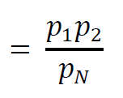
Answer
Notes:
The answer is simple. When the null p.d.f. is constant, the combination is just
multiplication.

Slide 13
a priori , p_{A}
theory, p_{g}
total, p_{T}
model, m
model, m
model, m
d^{obs}
d^{obs}
d^{obs}
d^{pre}
datum, d
datum, d
datum, d
m^{ap}
m^{ap}
m^{ap}
m^{est}
(D)
model, m
(E)
model, m
(F)
model, m
d^{obs}
d^{obs}
d^{obs}
d^{pre}
datum, d
datum, d
datum, d
m^{ap}
m^{ap}
m^{ap}
m^{est}
Notes:
Examples: (top) Very accurate theory: results are more or less the same as one would
get with a surface. The solution is very close to being on the surface. (botton) Very
innacurate theory. The theory adds nothing and the solution is very close to the a priori
values.
Fig 5.?. The rows of the figure have the same format as Fig. 5.?. If the theory is made more and more inexact (compare (A)-(C) with (D)-(F), the solution (black circle) moves towards the maximum likelihood point of the a priori distribution. MatLab script gda05_??.

Slide 14
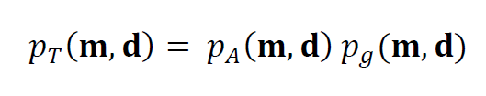
“solution to inverse problem” maximum likelihood point of
(with p_{N}∝constant)
simultaneously gives
m^{est} and d^{pre}
Notes:
So the solution process is: (A) Write down the p.d.f. for the theory;
(B) Multiply with the a priori distribution (C) find maximum likelihood point
of result.

Slide 15
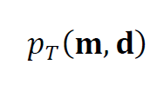
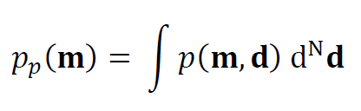
probability that the estimated model parameters are near m and the predicted data are near d
T
probability that the estimated model parameters are near m irrespective of the value of the predicted data
Notes:
Note the difference between these two p.d.f.’s

Slide 16
conceptual problem
and
T
do not necessarily have maximum likelihood points at the same value of m
Notes:
Unfortunately, they have different maximum likelihood points

Slide 17
model, m
d^{obs}
d^{pre}
datum, d
m^{est}
m^{ap}
p(m)
m^{est}’
model, m
Notes:
Graphical interpretation of difference.
Fig 5.15. (A) The joint probability density function, p_{T}(m,d), can be considered the solution to the inverse problem. Its maximum likelihood point (black circle) gives an estimate of the model parameter, m^{est}, and a prediction of the data, d^{pre}. (B) The function, p_{T}(m,d), is projected onto the m-axis, by integrating over d, to form the probability density function, p(m), of the model parameter irrespective of the datum. This function also has a maximum likelihood point, m^{est}’, which in general can be different than m^{est}. The distinction points out the difficulty of defining a unique “solution” to an inverse problem. MatLab script gda05_??.

Slide 18
illustrates the problem in defining a
definitive solution
to an inverse problem
Notes:
As always, the notion of a definitive solution to the inverse problem is a bit elusive.

Slide 19
illustrates the problem in defining a
definitive solution
to an inverse problem
fortunately
if all distributions are Gaussian
the two points are the same
Notes:
But the problem is unimportant for Gaussian p.d.f.’s, because
collapsing the distribution does not change the maximum likelihood point.

Slide 20
Part 2 Solution of the inexact linear Gaussian inverse problem
Notes:
Now apply these ideas.

Slide 21

Gaussian a priori information
Notes:
Represent a priori information about model parameters probabilistically.

Slide 22
Gaussian a priori information
a priori values of model parameters
their uncertainty
Notes:
Represent a priori information about model parameters probabilistically.

Slide 23
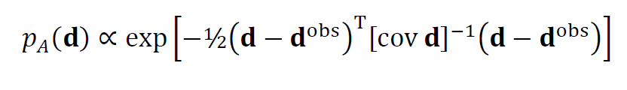
Gaussian observations
Notes:
Represent observations of the data probabilistically.

Slide 24
Gaussian observations
observed data
measurement error
Notes:
The data have an observed value dobs and a measurement error [cov d]

Slide 25
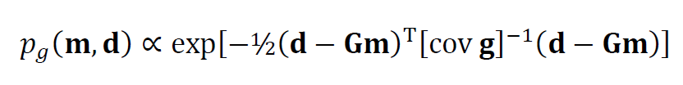
Gaussian theory
Notes:
Represent the theory probabilistically.

Slide 26
Gaussian theory
linear theory
uncertainty
in theory
Notes:
The theory embodies a relationship between d and m and an uncertainty of that relationship.
In this case, the relationship between d and m is linear.

Slide 27
mathematical statement of problem
find (m,d) that maximizes
p_{T}(m,d) = p_{A}(m) p_{A}(d) p_{g}(m,d)
and, along the way, work out the form of p_{T}(m,d)
Notes:
The product of Gaussian p.d.f.’s is Gaussian, so the overall form of the solution will turn out to be Gaussian.

Slide 28
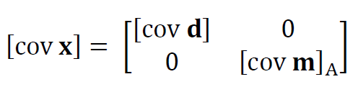
notational simplification
group m and d into single vector x = [d^{T}, m^{T}]^{T}
group [cov m]_{A} and [cov d]_{A} into single matrix
write d-Gm=0 as Fx=0 with F=[I, –G]
Notes:
We did this before ... write model and data in terms of a single vector x

Slide 29


after much algebra, we find p_{T}(x) is a Gaussian distribution with mean
and variance
Notes:
Nothing new in the derivation, just a lot of matrix manipulations.

Slide 30
after much algebra, we find p_{T}(x) is a Gaussian distribution with mean
and variance
solution to inverse problem
Notes:
x*, the mean of pT(x) is the solution. It contains dpre and mest.
[cov x*] is its covariance. Its contains [cov dpre] and [cov mest]

Slide 31
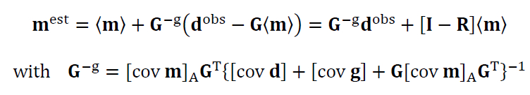
after pulling m^{est} out of x*
Notes:
This formula ought to look very familiar

Slide 32
after pulling m^{est} out of x*
reminiscent of G^{T}(GG^{T})⁻¹ minimum length solution
Notes:
It has the form of a minimum length type solution

Slide 33
after pulling m^{est} out of x*
error in theory adds to error in data
Notes:
Note that the uncertainty of the theory appears in only one place,
and is added to the uncertainty of the data.

Slide 34
after pulling m^{est} out of x*
solution depends on the values of the prior information only to the extent that the model resolution matrix is different from an identity matrix
Notes:
The solution can be rewritten to involve the model resolution matrix R.
The solution depends on the a priori values of the model parameters only to
the extent that R is not the identity matrix.

Slide 35
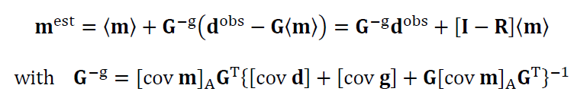
and after algebraic manipulation
which also equals
reminiscent of (G^{T}G)⁻¹ G^{T} least squares solution
Notes:
More algebra reveals that the solution can also be written as a
least squares type solution

Slide 36
interesting aside
weighted least squares solution
is equal to the
weighted minimum length solution
Notes:
So weighted least squares and weighted minimum length are very closely linked.

Slide 37
what did we learn?
for linear Gaussian inverse problem
inexactness of theory
just adds to
inexactness of data
Notes:
We did not learn much. An inexact theory just adds to the variance of the data.

Slide 38
Part 3 Use maximization of relative entropy as a guiding principle for solving inverse problems
Notes:
This sections is unrelated to the issue of inexact theories.
It concerns using the maximization of entropy as a guiding principle for solving inverse problems.

Slide 39
from last lecture
Notes:
We introduce informatiton gain / relative entropy in the last lecture.

Slide 40
assessing the information content in p_{A}(m)
Do we know a little about m
or
a lot about m ?
Notes:
Information gain is used to assess how much information is in one p.d.f. relative to another.
We originally stated it for the a priori p.d.f. pA(m) relative to the null p.d.f. pN(m).

Slide 41
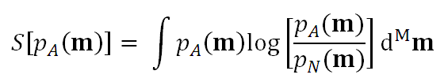
Information Gain, S
-S called Relative Entropy
Notes:
Here’s the definition

Slide 42
(A)
p_{A}(m)
p_{N}(m)
m
(B)
S(σ_{A})
σ_{A}
Notes:
Here’s and example. A narrow p.d.f. should have more information than a wide p.d.f.
That’s bourne out by the calculation.
Fig. 5.9. (A) In this example, a wide Gaussian (green, σ_{N}=5) is used for the null probability density function p_{N}(m) and a narrow Gaussian (red, σ_{N}=1) is used for the a priori probability density function p_{A}(m). (B) The information Gain S decreases as the width of p_{A}(m) is increased. The case in (A) is depicted with a red dot. MatLab script gda05_??.

Slide 43
Principle of Maximum Relative Entropy or if you prefer Principle of Minimum Information Gain
Notes:
Here’s how we use it.

Slide 44
find solution p.d.f. p_{T}(m) that has the largest relative entropy as compared to a priori p.d.f. p_{A}(m)
or if you prefer
find solution p.d.f. p_{T}(m) that has smallest possible new information as compared to a priori p.d.f. p_{A}(m)
Notes:
Note that we are measuring pT(m) with respect to pA(m).
Total with respect to a priori.
That’s different than a priori against null
that we looked at a moment ago.

Slide 45
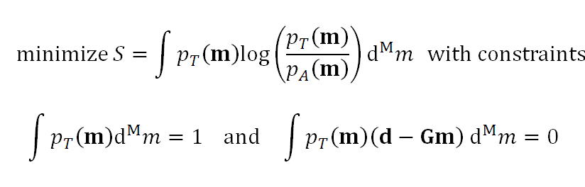
Notes:
If we just minimized S, we would get S=0 when pT(m)=pA(m).
So we have to add some constaints.
One constraint is that pT(m) is properly normalized.
For an underdetermined problem, it makes sense to require that the
prediction error e is ob average zero.

Slide 46
properly normalized
p.d.f.
data is satisfied in the mean
or
expected value of error is zero
Notes:
“The prediction error e is ob average zero”
“The data is satisfied in the mean”
“The expected value of the error is zero”
are all different ways of saying the same thing.
Here we are treating the underdetermined problem, which is simplest.

Slide 47

After minimization using Lagrange Multipliers process
p_{T}(m) is Gaussian with maximum likelihood point m^{est} satisfying
Notes:
The minimization is moderately messy.
The result is that the total p.d.f. is Gaussian
and that the solution ...

Slide 48
After minimization using Lagrane Multipliers process
p_{T}(m) is Gaussian with maximum likelihood point m^{est} satisfying
just the weighted minimum length solution
Notes:
Is just the weighted minimum length solution.

Slide 49
What did we learn?
Only that the
Principle of Maximum Entropy
is yet another way of deriving
the inverse problem solutions
we are already familiar with
Notes:
The only thing new is an expanded undertstading of solutions that we already have derived.

Slide 50
Part 4 F-test as way to determine whether one solution is “better” than another
Notes:
This is the most important statistical test in inverse theory.

Slide 51
Common Scenario two different theories solution m^{est}_{A} M_{A} model parameters prediction error E_{A} solution m^{est}_{B} M_{B} model parameters prediction error E_{B}
Notes:
Fit the data with two different theories.
Based on the fits, which is better?

Slide 52
Suppose E_{B} < E_{A} Is B really better than A ?
Notes:
Smaller error, better fit?

Slide 53
What if B has many more model parameters than A M_{B} >> M_{A} Is B fitting better any surprise?
Notes:
But with a lot of model parameters, you can always do better than with just a few.

Slide 54
Need to against Null Hypothesis The difference in error is due to random variation
Notes:
Null Hypothesis – “Random Variation did it”.

Slide 55
suppose error e has a Gaussian p.d.f. uncorrelated uniform variance σ_{d}
Notes:
Everything here assumes Gaussian statistics

Slide 56
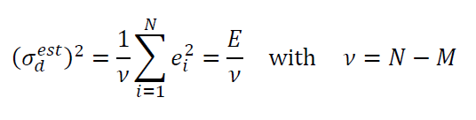
estimate variance
Notes:
The estimated variance involves the error E and the degrees of freedom nu.

Slide 57

want to known the probability density function of
Notes:
We need to examine this ratio. What is its p.d.f.

Slide 58
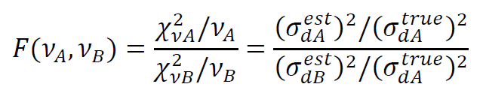
actually, we’ll use the quantity
which is the same, as long as the two theories that we’re testing is applied to the same data
Notes:
Actually, this ratio is a little more versatile, since it allows the numerator and
denominator to have different true variances. Thus we could test two theories
each with its own dataset (not that we’ll do that much).

Slide 59
p.d.f. of F is known
N=2
50
p(F_{N,2})
N=2
50
F
p(F_{N,5})
N=2
50
F
p(F_{N,25})
50
F
p(F_{N,50})
N=2
F
Notes:
The p.d.f. of F is known.
Fig. 11.4. F-probability density function, p(F_{N,M}), for selected values of M and N. MatLab script eda11_04.

Slide 60
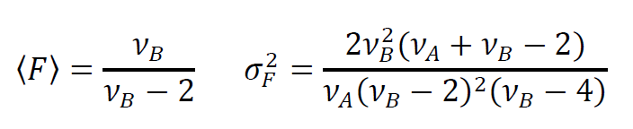
as is its mean and variance
Notes:
As is its mean and variance. Note that the mean is <F>=1 when vB is large.

Slide 61
example
same dataset fit with
a straight line
and
a cubic polynomial
Notes:
This is a typical example. The cubic fit has more parameters than a linear fit (4 vs 2),
so its no surprise that the error of the cubic is less than the error in the linear fit. But
is it “enough less” to justify saying that its better?

Slide 62
(A) Linear fit, N-M=9, E=0.030
d_{i}
z_{i}
(B) Cubic fit, N-M=7, E=0.006
d_{i}
z_{i}
Notes:
What do you think?
Fig 5.17. Hypothetical dataset (red circles) fit (blue curve) with (A) a straight line and (B) a cubic polynomial. Although the cubic fit appears superior, an F-test reveals that this level of improvement of fit will be obtained 6.4% under the Null Hypothesis that the improvement is due to random variation. The improvement of fit is not significant at the 95% level. MatLab script gda05_??.

Slide 63
(A) Linear fit, N-M=9, E=0.030
d_{i}
z_{i}
(B) Cubic fit, N-M=7, E=0.006
d_{i}
z_{i}
_{est}
F_{7,9} = 4.1
Notes:
Fig 5.17. Hypothetical dataset (red circles) fit (blue curve) with (A) a straight line and (B) a cubic polynomial. Although the cubic fit appears superior, an F-test reveals that this level of improvement of fit will be obtained 6.4% under the Null Hypothesis that the improvement is due to random variation. The improvement of fit is not significant at the 95% level. MatLab script gda05_??.

Slide 64
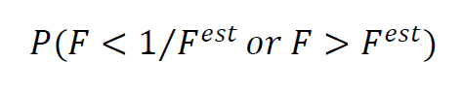
probability that F >F ^{est} (cubic fit seems better than linear fit) by random chance alone or F < 1/F ^{est} (linear fit seems better than cubic fit) by random chance alone
Notes:
I like the two-sided test above.
Typically, one has no reason to think that theory A is better or worse than theory B.
So one should compute the probability one seeming better than the other.

Slide 65
in MatLab P = 1 - (fcdf(Fobs,vA,vB)-fcdf(1/Fobs,vA,vB));
Notes:
The fcdf() function is the cumulative F distribution

Slide 66
answer: 6% The Null Hypothesis that the difference is due to random variation cannot be rejected to 95% confidence
Notes:
In this case, the Null Hypothesis cannot be rejected to 95% confidence.
(Even though the data really do scatterr about a cubic).

