Slide 1
Lecture 10 Nonuniqueness and Localized Averages
Notes:
Today’s is a short lecture. I recommend that left over time be used to review material
or to show some ‘live’ MatLab demos.

Slide 2
Syllabus
Lecture 01 Describing Inverse Problems Lecture 02 Probability and Measurement Error, Part 1 Lecture 03 Probability and Measurement Error, Part 2 Lecture 04 The L₂ Norm and Simple Least Squares Lecture 05 A Priori Information and Weighted Least Squared Lecture 06 Resolution and Generalized Inverses
Lecture 07 Backus-Gilbert Inverse and the Trade Off of Resolution and Variance Lecture 08 The Principle of Maximum Likelihood Lecture 09 Inexact Theories Lecture 10 Nonuniqueness and Localized Averages Lecture 11 Vector Spaces and Singular Value Decomposition
Lecture 12 Equality and Inequality Constraints Lecture 13 L₁ , L∞ Norm Problems and Linear Programming Lecture 14 Nonlinear Problems: Grid and Monte Carlo Searches Lecture 15 Nonlinear Problems: Newton’s Method Lecture 16 Nonlinear Problems: Simulated Annealing and Bootstrap Confidence Intervals Lecture 17 Factor Analysis Lecture 18 Varimax Factors, Empirical Orthogonal Functions Lecture 19 Backus-Gilbert Theory for Continuous Problems; Radon’s Problem Lecture 20 Linear Operators and Their Adjoints Lecture 21 Fréchet Derivatives Lecture 22 Exemplary Inverse Problems, incl. Filter Design Lecture 23 Exemplary Inverse Problems, incl. Earthquake Location Lecture 24 Exemplary Inverse Problems, incl. Vibrational Problems

Slide 3
Purpose of the Lecture
Show that null vectors are the source of nonuniqueness
Show why some localized averages of model parameters are unique while others aren’t
Show how nonunique averages can be bounded using prior information on the bounds of the underlying model parameters
Introduce the Linear Programming Problem
Notes:
Broadly, today’s lecture further develops the idea of localized averages as a type of ‘solution’ to
an inverse problem. The key new quantity developed is called the ‘null vector’.

Slide 4
Part 1 null vectors as the source of nonuniqueness in linear inverse problems
Notes:
As we will see, a linear inverse problem is nonunique if it has null vectors.

Slide 5
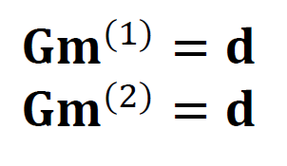
suppose two different solutions exactly satisfy the same data
since there are two
the solution is nonunique
Notes:
Suppose an inverse problem is nonunique, with two solutions that satisfy the same data.

Slide 6
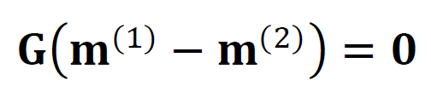
then the difference between the solutions satisfies
Notes:
Then the difference between the solutions satisfies G times the difference is zero.
But the difference itself is not zero, because the two solutions are presumed to be different.

Slide 7
the quantity m^{null} = m⁽¹⁾ – m⁽²⁾
is called a null vector
it satisfies
G m^{null} = 0
Notes:
The difference is called a null vector.
Any m satisfying Gm=0 is a null vector.

Slide 8
an inverse problem can have more than one null vector m^{null(1)} m^{null(2)} m^{null(3)}...
any linear combination of null vectors is a null vector
αm^{null(1)} + βm^{null(2)} +γm^{null(3)}
is a null vector for any α, β, γ
Notes:
Any linear combination of null vectors is a null vector.

Slide 9
suppose that a particular choice of model parameters m^{par} satisfies G m^{par}=d^{obs} with error E
Notes:
Here’s a solution to an inverse problem that has error E.

Slide 10
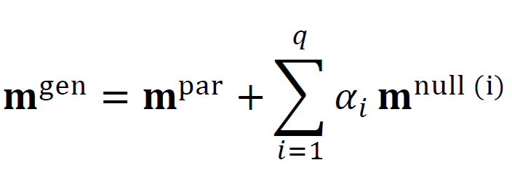
then has the same error E for any choice of α_{i}
Notes:
If you add to it any amount of null vectors, the solution still has error E.

Slide 11
since e = d^{obs}-Gm^{gen} = d^{obs}-Gm^{par} + Σ_{i} α_{i} 0
Notes:
Since G times mnull is zero.

Slide 12
since since α_{i} is arbitrary the solution is nonunique
Notes:
So the general solution to the Gm=d involves an arbitrary amount of null vectors, and hence is nonunique.

Slide 13
hence an inverse problem is nonunique if it has null vectors
Notes:
so the presence of null vectors implies nonuniqueness and vice versa.

Slide 14
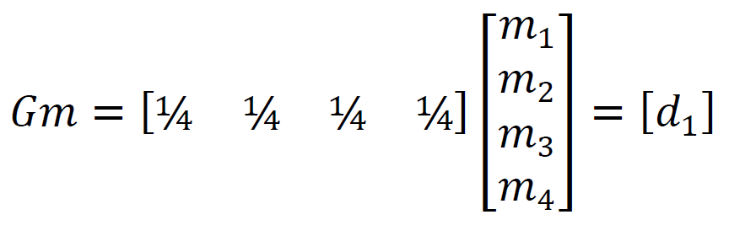
Gm
example
consider the inverse problem
a solution with zero error is
m^{par}=[d₁, d₁, d₁, d₁]^{T}
Notes:
Only one datum here, the average of 4 model parameters is known.
The solution cited above is in fact the minimum length solution.

Slide 15
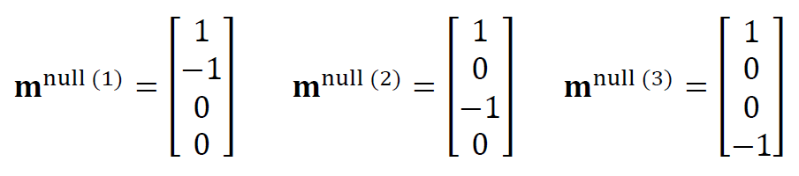
the null vectors are easy to work out
note that
times any
of these vectors is zero
Notes:
We can easily guess the null vectors.
Right now, we will not discuss how many there may be, but later in the course we
will discover that there can be no more than M of them.

Slide 16
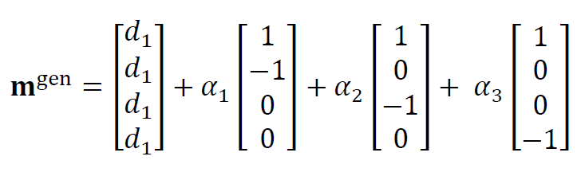
the general solution to the inverse problem is
Notes:
The general solution to the simple problem.

Slide 17
Part 2 Why some localized averages are unique while others aren’t
Notes:
Knowing the value of a unique average is of course more useful than knowing a
possible value of one that is not unique.

Slide 18
let’s denote a weighted average of the model parameters as <m> = a^{T} m where a is the vector of weights
Notes:
“a” for average.

Slide 19
let’s denote a weighted average of the model parameters as <m> = a^{T} m where a is the vector of weights
a may or may not be “localized”
Notes:
An inexact theory is one that is only approximately correct.
For this approach to be helpful, we must have an a priori notion of how approximate it is.
For example, that it typically gives results that are incorrect by 5%.

Slide 20
a = [0.25, 0.25, 0.25, 0.25]^{T} a = [0. 90, 0.07, 0.02, 0.01]^{T}
examples
not localized
localized near m₁
Notes:
An average might be localized, or it might not.
The question of an average being uniqueness is different from the question of its being localized.

Slide 21
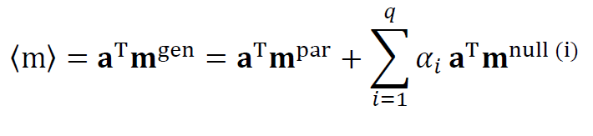
now compute the average of the general solution
Notes:
Just dot the general solution with the vector a.

Slide 22
now compute the average of the general solution
if this term is zero for all i,
then <m> does not depend on α_{i},
so average is unique

Slide 23
an average <m>=a^{T}m is unique if the average of all the null vectors is zero

Slide 24
if we just pick an average
out of the hat
because we like it ... its nicely localized
chances are that it will not zero all the null vectors
so the average will not be unique
Notes:
Most averages are nin-unique.

Slide 25
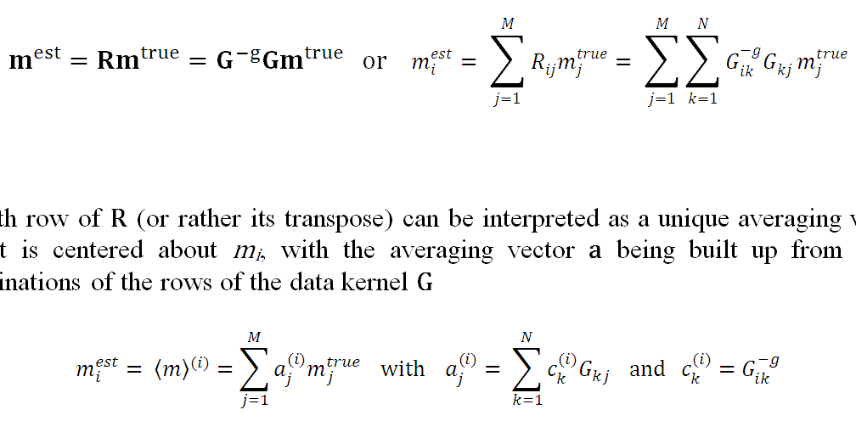
relationship to model resolution R
Notes:
All this sounds like it has something to do with the resolution matrix.
What’s the relationship?
Top equation: Definition of the resolution matrix.
Bottom -left equation: Definition of the average.
Can make them look the same by defining the average to be a row of R.

Slide 26
relationship to model resolution R
a^{T} is a linear combination of the rows of the data kernel G
Notes:
All this sounds like it has something to do with the resolution matrix.
What’s the relationship?
Top equation: Definition of the resolution matrix.
Bottom -left equation: Definition of the average.
Can make them look the same by defining the average to be a row of R.

Slide 27
if we just pick an average
out of the hat
because we like it ... its nicely localized
its not likely that it can be built out of the rows of G
so it will not be unique
Notes:
Most averages are not unique, because unless we’re lucky, they won’t
be composed of a linear combination of the rows of G

Slide 28
suppose we pick a
average that is not unique
is it of any use?
Notes:
Is an nonunique average any good? Maybe, with the addition of the right kind of a priori information.

Slide 29
Part 3 bounding localized averages even though they are nonunique
Notes:
“Bounding” means that we can be sure its value lies between an lower and upper limit.

Slide 30
we will now show
if we can put weak bounds on m
they may translate into stronger bounds on <m>
Notes:
This is only useful when the bounds on <m> are tighter than the bounds on mi.

Slide 31

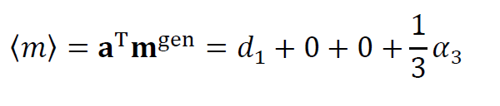
example
with
so
Notes:
We can do the simple case by hand. The average depends on one arbitrary parameter, alpha 3.

Slide 32
example
with
so
nonunique
Notes:
So the average is nonunique.

Slide 33
but suppose m_{i} is bounded
0 > m_{i} > 2d₁
smallest α₃= -d₁
largest α₃= +d₁
Notes:
Since m is presumed to be bounded, alpha 3 not be so big or small as to violate those bounds.
If alpha 3 less than –d1, then m4>2d1, which violates the upper bound
If alpha 3 greater than d1, then m4<0, which violates the lower bound.
So alpha 3 must be between –d1 and + d1.

Slide 34
smallest α₃= -d₁
largest α₃= +d₁
(2/3) d₁ > <m> > (4/3)d₁

Slide 35
smallest α₃= -d₁
largest α₃= +d₁
(2/3) d₁ > <m> > (4/3)d₁
bounds on <m> tighter than bounds on m_{i}
Notes:
But then <m> must be between two-thirds d1 and four-thirds d1.
We’ve learned something potentially useful.

Slide 36
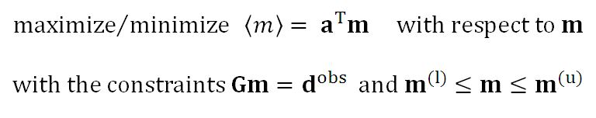
the question is how to do this in more complicated cases
Notes:
Here’s the formal statement of the problem we need to solve for the general case.
Note that we must solve both a minimization and a maximazation problem separately.
This problem is a variant of the “Linear Programming Problem”

Slide 37
Part 4 The Linear Programming Problem
Notes:
I well-understood problem in applied mathematics.

Slide 38
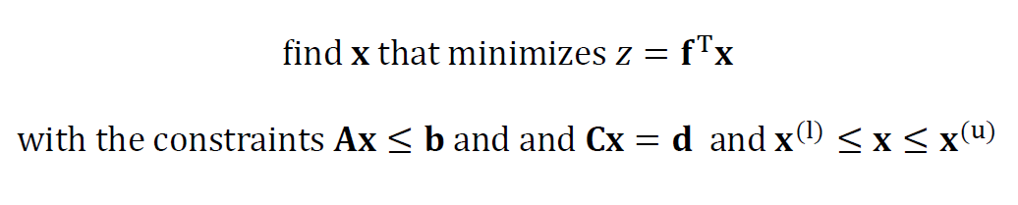
the Linear Programming problem
Notes:
Here’s the formal statement.

Slide 39
the Linear Programming problem
flipping sign switches minimization to maximization
flipping signs of A and b
switches to ≥
Notes:
Two useful things to remember:
Flipping sign of f switches minimization to maximization.
Multiplying inequality equation by minus-one flips the sense of the inequality.

Slide 40
in Business
quantity of each product
unit profit
profit
maximizes
no negative production
physical limitations of factory
government regulations
etc
care about both profit z and product quantities x
Notes:
Linear programming very useful in business.
Explain the interpretation of each of the quantities.

Slide 41
in our case
first minimize
then
maximize
a
m
<m>
not needed
Gm=d
bounds on m
care only about <m>, not m
Notes:
equate x with m
equate z with <m>
equate f with a
equate Cx=d with Gm=d
and we’re done.
Note that we usually won’t care about the m that leads to the biggest/smallest <m>
But rather just want to know the value of the biggest/smallest <m>

Slide 42
In MatLab
Notes:
Easy to solve in MatLab, since there’s a predefined function to do it!

Slide 43
Example 1 simple data kernel one datum sum of m_{i} is zero bounds |m_{i}| ≤ 1 average unweighted average of K model parameters
Notes:
Really simple example.

Slide 44
bounds on absolute value of weighted average
K
Notes:
Bounds on |<m<| as a function of the width of the average.
Fig. 6.1. Bounds on weighted averages of model parameters, m_{i}, in a problem in which the only datum is that the sum of all model parameters is zero. When this observation is combined with the a priori information that each model parameter must satisfy |m_{i}|≤1, bounds can be placed on the weighted averages of the model parameter. The bounds shown here are for averages of K neighboring model parameters. Note that the bounds are tighter than the a priori bounds only when K>10. MatLab script gda06_??.

Slide 45
bounds on absolute value of weighted average
K
if you know that the sum of 20 things is zero
and
if you know that the things are bounded by ±1
then you know
the sum of 19 of the things is bounded by about ±0.1
Notes:
Knowing this is sort of useful, isn’t it?
Fig. 6.1. Bounds on weighted averages of model parameters, m_{i}, in a problem in which the only datum is that the sum of all model parameters is zero. When this observation is combined with the a priori information that each model parameter must satisfy |m_{i}|≤1, bounds can be placed on the weighted averages of the model parameter. The bounds shown here are for averages of K neighboring model parameters. Note that the bounds are tighter than the a priori bounds only when K>10. MatLab script gda06_??.

Slide 46
bounds on absolute value of weighted average
K
for K>10
<m> has tigher bounds
than m_{i}
Notes:
Bounds contain no useful information for small K, but start to
provide useful info when K>10.
Fig. 6.1. Bounds on weighted averages of model parameters, m_{i}, in a problem in which the only datum is that the sum of all model parameters is zero. When this observation is combined with the a priori information that each model parameter must satisfy |m_{i}|≤1, bounds can be placed on the weighted averages of the model parameter. The bounds shown here are for averages of K neighboring model parameters. Note that the bounds are tighter than the a priori bounds only when K>10. MatLab script gda06_??.

Slide 47
Example 2 more complicated data kernel d_{k} weighted average of first 5k/2 m’s bounds 0 ≤ m_{i} ≤ 1 average localized average of 5 neighboring model parameters
Notes:
The kernel is a bit reminiscent of the Laplace Transform kernel we examined in Chapter 4.

Slide 48
(A)
(B)
m_{i} (z_{i})
d^{obs}
G
j
m^{true}
≈
width, w
depth, z_{i}
i
i
j
Notes:
Left: graphical representation of the equation Gm=d
Right: plot of the solution and bounds on localized averages of the solution.
Fig. 6.2. (A) This underdetermined inverse problem, d=Gm, has M=100 model parameters, m_{i}, and N=40 data, d_{i}. The data are weighted averages of the model parameters, from the surface down to a depth, z, that increase with index, i.. The observed data, d_{i}^{est}, include additive noise. (B) The true model parameters (red curve) increase linearly with depth, z. The estimated model parameters (blue curve), computed using the minimum length method, scatter about the true model at shallow depths (z<6), but decline towards zero at deeper depths due to poor resolution. Bounds on localized averages of the model parameters, with an averaging width, w=2, (black curves) are for a priori information, 0<m_{i}<1 (grey dotted lines). MatLab script gda06_??.

Slide 49
(A)
(B)
m_{i} (z_{i})
d^{obs}
G
j
m^{true}
≈
width, w
depth, z_{i}
i
i
complicated G
but
reminiscent of Laplace Transform kernel
j
Notes:
Kernel complicated, but reminiscent of Laplace Transform kernel.
Fig. 6.2. (A) This underdetermined inverse problem, d=Gm, has M=100 model parameters, m_{i}, and N=40 data, d_{i}. The data are weighted averages of the model parameters, from the surface down to a depth, z, that increase with index, i.. The observed data, d_{i}^{est}, include additive noise. (B) The true model parameters (red curve) increase linearly with depth, z. The estimated model parameters (blue curve), computed using the minimum length method, scatter about the true model at shallow depths (z<6), but decline towards zero at deeper depths due to poor resolution. Bounds on localized averages of the model parameters, with an averaging width, w=2, (black curves) are for a priori information, 0<m_{i}<1 (grey dotted lines). MatLab script gda06_??.

Slide 50
(A)
(B)
m_{i} (z_{i})
d^{obs}
G
j
m^{true}
≈
width, w
depth, z_{i}
i
i
j
true m_{i} increased with depth z_{i}
Notes:
Simple true solution. Linear with depth.
Fig. 6.2. (A) This underdetermined inverse problem, d=Gm, has M=100 model parameters, m_{i}, and N=40 data, d_{i}. The data are weighted averages of the model parameters, from the surface down to a depth, z, that increase with index, i.. The observed data, d_{i}^{est}, include additive noise. (B) The true model parameters (red curve) increase linearly with depth, z. The estimated model parameters (blue curve), computed using the minimum length method, scatter about the true model at shallow depths (z<6), but decline towards zero at deeper depths due to poor resolution. Bounds on localized averages of the model parameters, with an averaging width, w=2, (black curves) are for a priori information, 0<m_{i}<1 (grey dotted lines). MatLab script gda06_??.

Slide 51
(A)
(B)
m_{i} (z_{i})
d^{obs}
G
j
m^{true}
≈
width, w
depth, z_{i}
i
i
j
minimum length solution
Notes:
Minimum length solution vaguely close to true solution,
but much rougher.
Fig. 6.2. (A) This underdetermined inverse problem, d=Gm, has M=100 model parameters, m_{i}, and N=40 data, d_{i}. The data are weighted averages of the model parameters, from the surface down to a depth, z, that increase with index, i.. The observed data, d_{i}^{est}, include additive noise. (B) The true model parameters (red curve) increase linearly with depth, z. The estimated model parameters (blue curve), computed using the minimum length method, scatter about the true model at shallow depths (z<6), but decline towards zero at deeper depths due to poor resolution. Bounds on localized averages of the model parameters, with an averaging width, w=2, (black curves) are for a priori information, 0<m_{i}<1 (grey dotted lines). MatLab script gda06_??.

Slide 52
(A)
(B)
m_{i} (z_{i})
d^{obs}
G
j
m^{true}
≈
width, w
upper
bound
on solution
depth, z_{i}
i
i
lower bound
on solution
j
Notes:
A priori upper/lower bounds on solution.
Fig. 6.2. (A) This underdetermined inverse problem, d=Gm, has M=100 model parameters, m_{i}, and N=40 data, d_{i}. The data are weighted averages of the model parameters, from the surface down to a depth, z, that increase with index, i.. The observed data, d_{i}^{est}, include additive noise. (B) The true model parameters (red curve) increase linearly with depth, z. The estimated model parameters (blue curve), computed using the minimum length method, scatter about the true model at shallow depths (z<6), but decline towards zero at deeper depths due to poor resolution. Bounds on localized averages of the model parameters, with an averaging width, w=2, (black curves) are for a priori information, 0<m_{i}<1 (grey dotted lines). MatLab script gda06_??.

Slide 53
(A)
(B)
m_{i} (z_{i})
d^{obs}
G
j
m^{true}
≈
width, w
depth, z_{i}
i
i
upper
bound
on
average
lower bound
on average
j
Notes:
Upper/lower bounds on localized average, calculated by solving the linear programming
problem, are tighter than the a priori bounds on the solution, at least for shallow depths.
Fig. 6.2. (A) This underdetermined inverse problem, d=Gm, has M=100 model parameters, m_{i}, and N=40 data, d_{i}. The data are weighted averages of the model parameters, from the surface down to a depth, z, that increase with index, i.. The observed data, d_{i}^{est}, include additive noise. (B) The true model parameters (red curve) increase linearly with depth, z. The estimated model parameters (blue curve), computed using the minimum length method, scatter about the true model at shallow depths (z<6), but decline towards zero at deeper depths due to poor resolution. Bounds on localized averages of the model parameters, with an averaging width, w=2, (black curves) are for a priori information, 0<m_{i}<1 (grey dotted lines). MatLab script gda06_??.

