Slide 1
Lecture 11 Vector Spaces and Singular Value Decomposition
Notes:
One of the primary results of today’s is a general technique to determine the
null vectors of a linear inverse problem, something that we recognized was
important (and missing) in the last lecture.

Slide 2
Syllabus
Lecture 01 Describing Inverse Problems Lecture 02 Probability and Measurement Error, Part 1 Lecture 03 Probability and Measurement Error, Part 2 Lecture 04 The L₂ Norm and Simple Least Squares Lecture 05 A Priori Information and Weighted Least Squared Lecture 06 Resolution and Generalized Inverses
Lecture 07 Backus-Gilbert Inverse and the Trade Off of Resolution and Variance Lecture 08 The Principle of Maximum Likelihood Lecture 09 Inexact Theories Lecture 10 Nonuniqueness and Localized Averages Lecture 11 Vector Spaces and Singular Value Decomposition
Lecture 12 Equality and Inequality Constraints Lecture 13 L₁ , L∞ Norm Problems and Linear Programming Lecture 14 Nonlinear Problems: Grid and Monte Carlo Searches Lecture 15 Nonlinear Problems: Newton’s Method Lecture 16 Nonlinear Problems: Simulated Annealing and Bootstrap Confidence Intervals Lecture 17 Factor Analysis Lecture 18 Varimax Factors, Empirical Orthogonal Functions Lecture 19 Backus-Gilbert Theory for Continuous Problems; Radon’s Problem Lecture 20 Linear Operators and Their Adjoints Lecture 21 Fréchet Derivatives Lecture 22 Exemplary Inverse Problems, incl. Filter Design Lecture 23 Exemplary Inverse Problems, incl. Earthquake Location Lecture 24 Exemplary Inverse Problems, incl. Vibrational Problems

Slide 3
Purpose of the Lecture
View m and d as points in the
space of model parameters and data
Develop the idea of transformations of coordinate axes
Show how transformations can be used to convert a weighted problem into an unweighted one
Introduce the Natural Solution and the Singular Value Decomposition
Notes:
Broadly, today’s lecture further develops the idea of observed data and estimated model
parameters being one “point” in spaces of all possible data and all possible model parameters.
We develop the ramifications of this idea.

Slide 4
Part 1 the spaces of model parameters and data
Notes:
We have encountered this idea in the context of maximum likelihood analysis. The
data and model parameters one “points” in a high-dimensioanl spaces of possibilities.

Slide 5
what is a vector?
algebraic viewpoint
a vector is a quantity that is manipulated
(especially, multiplied)
via a specific set of rules
geometric viewpoint
a vector is a direction and length
in space
Notes:
The word “vector” is used both in the contect of algebra and geometry.
Hitherto fore we have been mostly taking an algebraic viewpoint. Now we
move onto a geometric viewpoint.

Slide 6
what is a vector?
algebraic viewpoint
a vector is a quantity that is manipulated
(especially, multiplied)
via a specific set of rules
geometric viewpoint
a vector is a direction and length
in space
column-
in our case, a space of very high dimension
Notes:
In fact, maybe it’s better to use the term “column-vector” to distinguish the algebraic
viewpoint from the geometric one, where we will retain the word vector. Note that the
spaces we are considering here are NOT three-dimensional, but rather of a much
higher dimension.

Slide 7
S(m)
S(d)
d
m
m₃
d₃
m₂
d₂
m₁
d₁
Notes:
Graphical representation of space of all possible model parameters, S(m),
and space of all possible data S(d). The former is M-dimensional, the latter
N-dimensional.
Fig. 7.1. (A) The model parameters represented as a vector, m, in the M-dimensional space, S(m), of all possible model parameters. (B) The data represented as a vector, d, in the N-dimensional space, S(d), of all possible data. MatLab script, gda07_??.

Slide 8
forward problem
d = Gm
maps an m onto a d
maps a point in S(m) to a point in S(d)
Notes:
One way of looking at a forward problem.

Slide 9
Forward Problem: Maps S(m) onto S(d)
d
m
m₃
d₃
m₂
d₂
m₁
d₁
Notes:
Graphical representation. As you move m around, you move d around. But there is no
guarantee that the mapping is one-to-one. There may be holes; there may be duplications.
Fig. 7.1. (A) The model parameters represented as a vector, m, in the M-dimensional space, S(m), of all possible model parameters. (B) The data represented as a vector, d, in the N-dimensional space, S(d), of all possible data. MatLab script, gda07_??.

Slide 10
inverse problem
m = G^{-g}d
maps a d onto an m
maps a point in S(m) to a point in S(d)
Notes:
One way of looking at an inverse problem.

Slide 11
Inverse Problem: Maps S(d) onto S(m)
d
m
m₃
d₃
m₂
d₂
m₁
d₁
Notes:
Graphical representation. As you move d around, you move m around. But there is no
guarantee that the mapping is one-to-one. There may be holes; there may be duplications.
Fig. 7.1. (A) The model parameters represented as a vector, m, in the M-dimensional space, S(m), of all possible model parameters. (B) The data represented as a vector, d, in the N-dimensional space, S(d), of all possible data. MatLab script, gda07_??.

Slide 12
Part 2 Transformations of coordinate axes
Notes:
The axes of a space are arbitrary.

Slide 13
coordinate axes are arbitrary given M linearly-independent basis vectors m^{(i)} we can write any vector m* as ...
Notes:
You can always define new axes, as long as you have enough linearly-independent vectors.
Normally, we use mutually-perpendicular unit vectors, but this is not required.
However, they must span the space.

Slide 14
span space
don’t span space
d
m₃
m₃
m₂
m₂
m₂
m₁
m₁
Notes:
Basis vectors must span the whole space.
Fig. 7.2. (A) These three vectors span the three-dimensional space, S(m). (B) These three vectors do not span the space since they all lie on the same plane. MatLab script, gda07_??.

Slide 15
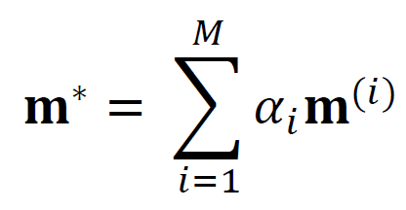
... as a linear combination of these basis vectors
Notes:
Here we construct m* by adding together the right amount of the basis vectors.
The coefficients alpha(i) specify the amounts.

Slide 16
... as a linear combination of these basis vectors
components of m* in new coordinate system
m_{i}*’ = α_{i}
Notes:
The component of a vector merely give the amount of the each basis vector
that must be added together so that they sum to the desired vector, in this case
m*.

Slide 17
might it be fair to say that the components of a vector are a column-vector ?
Notes:
In the geometrical view, it’s the same vector, regardless of what coordinate system
its being represented in. But its components change from coordinate system to
coordinate system. So its probably better to reserve the word ‘vector’ for the
unchanging geometrical duantity, and the word ‘column-vector’ for the list
of components, which does change.

Slide 18
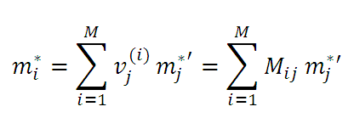
matrix formed from basis vectors
M_{ij} = v_{j}^{(i)}
Notes:
The top equation says that a vector m* is represented as a sum of basis vectors.
The bottom equation says that the components of the vector in the unprimed
(original) coordinate system are related to the components of the vector in
the primed (new) coordinate system by a matrix multiplication.

Slide 19
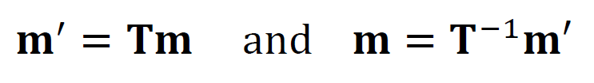
transformation matrix T
Notes:
We write the linear relationship between primed and unprimed components in terms
of a transformation matrix T. M from the previous slide is T-inverse.

Slide 20
transformation matrix T
same vector
different components
Notes:
Again, what’s changing is the axes and components, not the vector itself.

Slide 21

Q: does T preserve “length” ? (in the sense that m^{T}m = m’^{T}m’)
A: only when T^{T}= T⁻¹
Notes:
A transformation preserved “length” when T-inverse = T-traspose, that
is, T is a unary matrix. The word length is in quotes, because there is
only one vector under consideration, so of course its geometric length
doesn’t change. What we really mean is that in the new coordinate system
the formula for squared length is the usual “sum of squared compinents” and
not something else.

Slide 22
transformation of the model space axes
d = Gm = GIm = [GT_{m}⁻¹] [T_{m}m] = G’m’
d = Gm
d = G’m’
same equation
different coordinate system for m
Notes:
Given a transformation Tm, we can transform the equation to a new set of model parameter axes.

Slide 23
transformation of the data space axes
d’ = T_{d}d = [T_{d}G] m = G’’m
d = Gm
d’ = G’’m
same equation
different coordinate system for d
Notes:
Similarly, given a transformation Te, we can transform the equation to a new set of data axes.

Slide 24
transformation of both data space and model space axes
d’ = T_{d}d = [T_{d}GT_{m}⁻¹] [T_{m}m] = G’’’m’
d = Gm
d’ = G’’’m’
same equation
different coordinate systems for d and m
Notes:
We can even do both.

Slide 25
Part 3 how transformations can be used to convert a weighted problem into an unweighted one
Notes:
The trick is to pick transformation matrices Tm and Te that do something useful.

Slide 26

when are transformations useful ?
remember this?
Notes:
Let’s try to get rid of the weights by transfomring them away.

Slide 27
when are transformations useful ?
remember this?
massage this into a pair of transformations
Notes:
Start with the model parameters.

Slide 28
m^{T}W_{m}m
W_{m}=D^{T}D or W_{m}=W_{m}^{½}W_{m}^{½}=W_{m}^{½T}W_{m}^{½}
OK since W_{m} symmetric
m^{T}W_{m}m = m^{T}D^{T}Dm = [Dm] ^{T}[Dm]
T_{m}
Notes:
The idea is to manipulate the quadratic form until it looks like the unweighted
length of two transformed model parameter vectors. This happens when Tm=D.

Slide 29
when are transformations useful ?
remember this?
massage this into a pair of transformations
Notes:
Now the error.

Slide 30
e^{T}W_{e}e
W_{e}=W_{e}^{½}W_{e}^{½}=W_{e}^{½T}W_{e}^{½}
OK since W_{e} symmetric
e^{T}W_{e}e = e^{T}W_{e}^{½T}W_{e}^{½}e = [W_{e}^{½}m] ^{T}[W_{e}^{½}m]
T_{d}
Notes:
The transformation is the square root of the weight matrix. This is easy
to compute of the weight matrix is diagonal. If not, one must compute the
eigenvalue deomposition We=V LAMBDA VT and compute its sqrt as
sqrt We=V (sqrt LAMBDA) VT

Slide 31
we have converted weighted least-squares
into unweighted least-squares
minimize: E’ + L’ = e’^{T}e’ +m’^{T}m’
Notes:
So with these transformations, a weighted least squares problem into an unweighted one.
That could be handy.

Slide 32
steps
1: Compute Transformations
T_{m}=D=W_{m}^{½} and T_{e}=W_{e}^{½}
2: Transform data kernel and data to new coordinate system
G’’’=[T_{e}GT_{m}⁻¹] and d’=T_{e}d
3: solve G’’’ m’ = d’ for m’ using unweighted method
4: Transform m’ back to original coordinate system
m=T_{m}⁻¹m’

Slide 33
steps
extra work
1: Compute Transformations
T_{m}=D=W_{m}^{½} and T_{e}=W_{e}^{½}
2: Transform data kernel and data to new coordinate system
G’’’=[T_{e}GT_{m}⁻¹] and d’=T_{e}d
3: solve G’’’ m’ = d’ for m’ using unweighted method
4: Transform m’ back to original coordinate system
m=T_{m}⁻¹m’

Slide 34
steps
to allow simpler solution method
1: Compute Transformations
T_{m}=D=W_{m}^{½} and T_{e}=W_{e}^{½}
2: Transform data kernel and data to new coordinate system
G’’’=[T_{e}GT_{m}⁻¹] and d’=T_{e}d
3: solve G’’’ m’ = d’ for m’ using unweighted method
4: Transform m’ back to original coordinate system
m=T_{m}⁻¹m’

Slide 35
Part 4 The Natural Solution and the Singular Value Decomposition (SVD)
Notes:
Two different things here.
The Natural solution is one possible solution to a linear inverse problem.
SVD is a methof for computing it. SVD has many other uses as well, so it’s
important in its own right.

Slide 36
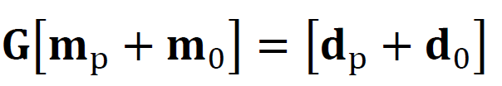
Gm = d
suppose that we could divide up the problem like this ...
Notes:
suppose that we could divide a linear inverse the problem like this ...

Slide 37
Gm = d
only m_{p} can affect d
since Gm₀ =0
Notes:
We want to divide up m so that only mp can effect the predicted data.
The other part of the solution, mp, lies in the null space of the model
parameters and cannot affect the prediction of the data, regardless of its value.

Slide 38
Gm = d
Gm_{p} can only affect d_{p}
since no m can lead to a d₀
Notes:
We also want to divie up the data into a part that can be matched
by some corresponding value of m, and a part d0 that cannot be
matched no matter what m is used. The part of the data in d0
leads to ‘unavoidable error’ and is in the null space of the data.

Slide 39

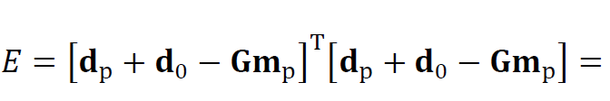
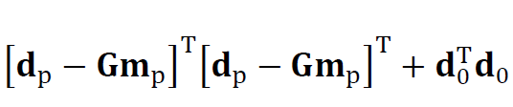
Notes:
Since mp and m0 are in different subspaces of the model parameter space,
and since dp and d0 are in different subspaces of the data space.
the cross terms are zero. Dot products of mutually-orthogonal
vectors are zero.

Slide 40
determined by a priori information
determined by data
determined by m_{p}
not possible to reduce
Notes:
Only mp can be determined by the data.
mo must be determined by the prior information.
the smallest error is when dp-Gmp=0
that leaves do, which cannot be satisfied at all.
It is an irreducible residual of error.

Slide 41
natural solution determine m_{p} by solving d_{p}-Gm_{p}=0 set m₀=0
Notes:
Natural solution. Smallest error, just ||d0||^2. Smallest model parameter length, just ||m0||2.

Slide 42
what we need is a way to do
Gm = d
Notes:
So to pull it off, we need to identify the spaces. We use SVD for this.

Slide 43






Singular Value Decomposition (SVD)
Notes:
SVD: any matrix can be represented as the product of
the eigenvalue matric U
the singular value matrix LAMBDA
and and eigenvalue matrix U.

Slide 44
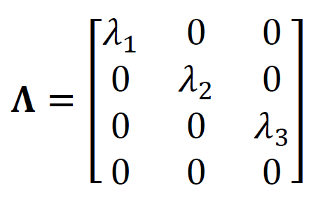
singular value decomposition
U^{T}U=I and V^{T}V=I
Notes:
Note the two eigenvalue matrices are orthonormal.
The lambdas are called singular values.

Slide 45
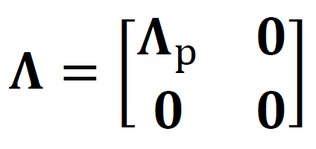
suppose only p λ’s are non-zero
Notes:
Note that if some lambdas are zero, then the matric LAMBDA looks like this. It has a block of zeros at the bottom.

Slide 46

suppose only p λ’s are non-zero
only first p columns of U
only first p columns of V
Notes:
When the three matrices are multiplied, the block of zeros cancels out some of the eigenvectors.
The remaining eigenvectors form smaller matrices Up and Vp.

Slide 47
U_{p}^{T}U_{p}=I and V_{p}^{T}V_{p}=I since vectors mutually pependicular and of unit length
U_{p}U_{p}^{T}≠I and V_{p}V_{p}^{T}≠I since vectors do not span entire space
Notes:
When the three matrices are multiplied, the block of zeros cancels out some of the eigenvectors.
The remaining eigenvectors form smaller matrices Up and Vp.

Slide 48

The part of m that lies in V₀ cannot effect d
since V_{p}^{T}V₀=0
so V₀ is the model null space
Notes:
Vo really is the null space of G, since no part of m that lies in V0 can affect the data.

Slide 49
The part of d that lies in U₀ cannot be affected by m
since Λ_{p}V_{p}^{T}m is multiplied by U_{p}
and U₀ U_{p}^{T} =0
so U₀ is the data null space
Notes:
Similarly, the part of d that lies in U0 cannot be fit, regardless of the choice of m.

Slide 50
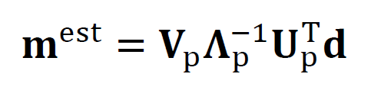
The Natural Solution
Notes:
Here’s the way to calculate the natural solution.

Slide 51
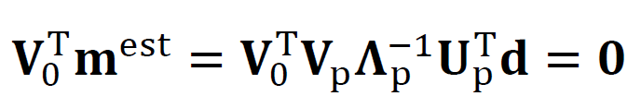
The part of m^{est} in V₀ has zero length
Notes:
It really has no part of mest in m9.

Slide 52
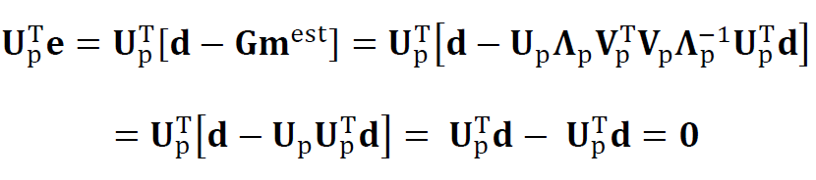
The error has no component in U_{p}
Notes:
And the error really has no component in Up.

Slide 53

computing the SVD
Notes:
Its easy to calculate in MatLab.

Slide 54
determining p use plot of λ_{i} vs. i
however
case of a clear division between
λ_{i}>0 and λ_{i}=0
rare
Notes:
The value of p should be easy to determine,
except that in practice there is rarely a clear distinction
between non-zero singular values and zero singular-values.
(Often that’s due to measurement noise).
So some judgment is required.

Slide 55
(A)
j
(B)
i
λ_{i}
λ_{i}
j
index number, i
p
(C)
(D)
i
λ_{i}
p?
index number, i
Notes:
Example:
Top: Data kernel with clear-cut p
Bottom: Data kernel where p is not so clear.
Fig. 7.3. (A) Hypothetical data kernel, G_{ij}, for an inverse problem with M=20 model parameters and N=20 observations. (B) Corresponding singular values, λ_{i}, have a clear cutoff at p=16. (C) Another hypothetical data kernel, also with N=20 and M=20. (D) Corresponding singular values do not have a clear cutoff, so the parameter, p, must be chosen in a more arbitrary fashion near p≈7.

Slide 56
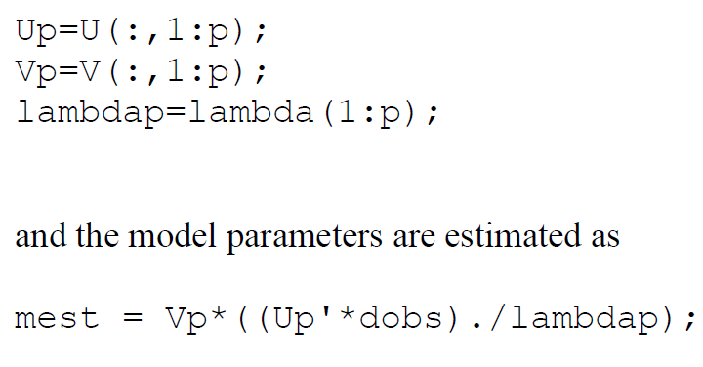
Natural Solution
Notes:
Computing natural solution in MatLab.
Top: constructing the reduced-size martices.
Bottom: multiplying them together.
Note that grouping favors multiplying a matrix times a vector
over multiplying two matrices (which is computationally more
intensive).

Slide 57
(A)
(B)
G
m
d^{obs}
m^{true}
(m^{est})_{DML}
(m^{est})_{N}
Notes:
Example. Comparison of the natural and damped least squares solution.
Fig. 7.4. (A) Same linear problem as in Fig. 7.3A, where d^{obs}=Gm^{true}+n, with n uncorrelated Gaussian noise. (B) Corresponding solutions, true solutions m^{true}, Natural solution (m^{est})_{N} and Damped Minimum Length solution (m^{est})_{DML}. MatLab Script gda07_??.

Slide 58




resolution and covariance

Slide 59
resolution and covariance
large covariance if any λ_{p} are small

Slide 60
Is the Natural Solution the best solution?
Why restrict a priori information to the null space
when the data are known to be in error?
A solution that has slightly worse error but fits the a priori information better might be preferred ...
Notes:
As always, answers in inverse theory are not clear-cut.

