Slide 1
Lecture 14 Nonlinear Problems Grid Search and Monte Carlo Methods
Notes:
This is the first of three lectures on solving non-linear problems

Slide 2
Syllabus
Lecture 01 Describing Inverse Problems Lecture 02 Probability and Measurement Error, Part 1 Lecture 03 Probability and Measurement Error, Part 2 Lecture 04 The L₂ Norm and Simple Least Squares Lecture 05 A Priori Information and Weighted Least Squared Lecture 06 Resolution and Generalized Inverses
Lecture 07 Backus-Gilbert Inverse and the Trade Off of Resolution and Variance Lecture 08 The Principle of Maximum Likelihood Lecture 09 Inexact Theories Lecture 10 Nonuniqueness and Localized Averages Lecture 11 Vector Spaces and Singular Value Decomposition
Lecture 12 Equality and Inequality Constraints Lecture 13 L₁ , L∞ Norm Problems and Linear Programming Lecture 14 Nonlinear Problems: Grid and Monte Carlo Searches Lecture 15 Nonlinear Problems: Newton’s Method Lecture 16 Nonlinear Problems: Simulated Annealing and Bootstrap Confidence Intervals Lecture 17 Factor Analysis Lecture 18 Varimax Factors, Empircal Orthogonal Functions Lecture 19 Backus-Gilbert Theory for Continuous Problems; Radon’s Problem Lecture 20 Linear Operators and Their Adjoints Lecture 21 Fréchet Derivatives Lecture 22 Exemplary Inverse Problems, incl. Filter Design Lecture 23 Exemplary Inverse Problems, incl. Earthquake Location Lecture 24 Exemplary Inverse Problems, incl. Vibrational Problems

Slide 3
Purpose of the Lecture
Discuss two important issues related to probability
Introduce linearizing transformations
Introduce the Grid Search Method
Introduce the Monte Carlo Method
Notes:
The first section emphasizes issues that arise because the data and model parameters are random variables.
The rest of the lecture discusses methods for solving non-linear problems.

Slide 4
Part 1 two issue related to probability not limited to nonlinear problems but they tend to arise there a lot
Notes:
Non-linear problems involve complicated functions of the model and the data.
But whenever you take a function of a random variable, you change its p.d.f.
That has consequences.

Slide 5
issue #1 distribution of the data matters
Notes:
We need to pay attention to the p.d.f. of the noise.
If you don’t, you can easily do inconsistent things,
which lead to incorrect results.

Slide 6
d(z) vs. z(d)
d(z)
z(d)
d(z)
not quite the same
intercept -0.500000 slope 1.300000
intercept -0.615385 slope 1.346154
Notes:
Example.
Fitting d against z does not give the same result as fitting z against d.
Left: d against z.
Middle z against d.
Right: red is d against z, green is z against d inverted back to d(z).
The results differ by about 4%.

Slide 7
d(z) d are Gaussian distributed z are error free
z(d) z are Gaussian distributed d are error free
Notes:
The results differ because we made different assumptions about the p.d.f. of the noise.

Slide 8
d(z) d are Gaussian distributed z are error free
not the same
z(d) z are Gaussian distributed d are error free

Slide 9
lesson learned
you must properly account for how the noise is distributed

Slide 10
issue #2 mean and maximum likelihood point can change under reparameterization
Notes:
This is bad news, because we tend to use quantities like the mean or the
maximum likelihood point as the “answer” to an inverse problem. But they
do not really have the properties that we might want in an “answer”.
We now give and example.

Slide 11
consider the non-linear transformation
m’=m²
with
p(m) uniform on (0,1)
Notes:
We’ve solved this problem back in the lecture on probability.

Slide 12
p(m)=1
p(m’)=½(m’)^{-½}
p(m)
p(m’)
m
m’
Notes:
The transformed model parameter has a pd.f. with a maximum likelihood point at zero.
The untransformed p.d.f. has no maximum likelihood point. However, if we bowed it
up or down a little, we could put the maximum likelihood point anywhere we wanted,
but the modification, as long as ity was small, would not change the maximum likelihood
point of m’ being at zero.
We now examine the means of the two distributions.
Fig. 9.1. (A) A probability density function, p(m), that is uniform on the interval 0<x<1. (B) The corresponding probability distribution, p(m’), for the transformation, m’=m². The mean (expectation) of each probability density function is indicated with a triangle. MatLab script gda09_02.

Slide 13
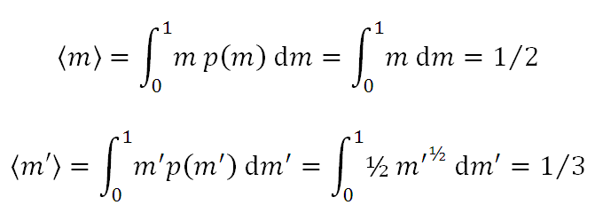

Calculation of Expectations
Notes:
This is just a standard calculation of the expected value of the two distributions.

Slide 14
although
m’=m²
<m’> ≠ <m>²
Notes:
Unfortunately, the means do not obey the transformation.
“Means are not invariant under non-linear transformations of the model space”
(They are invariant for linear transformations, as we showed when we discussed probability0.
That’s bad, because in nonlinear problems its often hard to settle upon an authoritative parameterization.
The “answer”, if that answer is a mean or maximum likelihood point, will be dependent upon the parameterization.

Slide 15
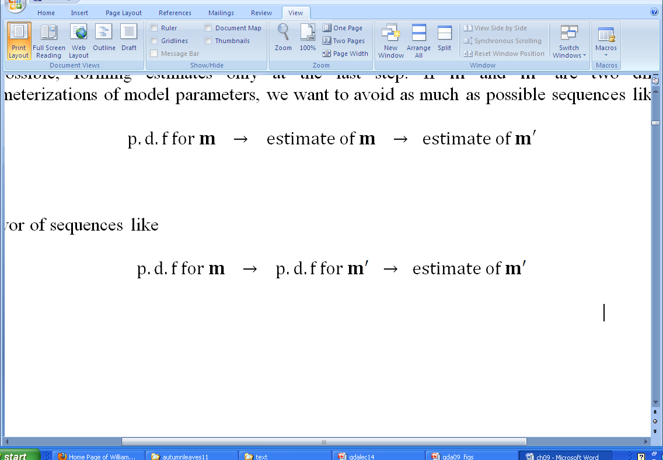
right way
wrong way
Notes:
At the very least, we should try to leave the calculation of “estimates” (mean, maximum likelihood points) to last.

Slide 16
Part 2 linearizing transformations
Notes:
A linearizing transformation turns a nonlinear problem into a linear one.

Slide 17
Non-Linear Inverse Problem
d = g(m)
transformation
d→d’
m→m’
Linear Inverse Problem
d’ = Gm’
solve with least-squares
Notes:
In general, we must transform both the data and model parameters
(though occasionally we can get by with just transforming one or the other).
The resulting problem is linear and can be solved with least squares.

Slide 18
Non-Linear Inverse Problem
d = g(m)
transformation
d→d’
m→m’
rarely possible, of course
Linear Inverse Problem
d’ = Gm’
solve with least-squares
Notes:
In practice, linearizing transformations can be found only occasionally.
A few important ones are known, though ...

Slide 19
an example
d_{i} = m₁ exp ( m₂ z_{i} )
d’_{i}=log(d_{i})
m’₁=log(m₁)
m’₂=m₂
log(d_{i}) = log(m₁) + m₂ z_{i}
d_{i}’ =m’₁+ m’₂ z_{i}
Notes:
The most important is the transformation of an exponential by the taking of a logarithm.

Slide 20
(A)
(B)
d
log10(d)
z
z
true
minimize E=||d^{obs} – d^{pre}||²
minimize E’=||d’^{obs} – d’^{pre}||²
Notes:
Example:
Left: linear plot; Right log-linear plot of the same data.
The problem is that the solution that minimizes E (green) is not the same one as minimizes E’ (blue)
Fig. 9.2. (A) Least-squares fit to the exponential function, d_{i}=m₁*exp(m₂z_{i}). (Red curve) The true function, d(z), for (m₁, m₂)=(0.7, 1.0). (Red circles) Data that includes Normally-distributed random noise with zero mean and variance, σ_{d}²=(0.1)². (Green curve) Non-linear least squares solution using Newton’s method. (Blue curve) Least-squares solution using the linearizing transformation, ln(d_{i})=ln(m₁)+m₂z_{i}. Note that the two solutions are different. (B) Log-linear version of the graph in A). Note that the scatter of the data increases with z, and that the solution based on the linearizing transformation is strongly affected by outliers associate with it. MatLab script gda09_03.

Slide 21
again measurement error is being treated inconsistently if d is Gaussian-distributed then d’ is not so why are we using least-squares?
Notes:
This is because of the p.d.f. of the data changing. Presuming that d is Gaussian-distributed,
Quantifying error via the L2 norm is correct for d(z) but is incorrect for log(d) against z,
which has a different p.d.f.
Note that the transformation doesn’t work is a datum is negative.
If the error is Gaussian-distributed, then there can be negative data,
especially at large z, when the true curve is close to zero.
This should be a hint that something is fundamentally wrong with what’s being done.
A patch is to imagine that the error have whatever p.d.f. is necessary for log(d) to be Gaussian-distributed.
That distribution will turn out to be defined on the interval (0, infinity), so that negative z’s are impossible.
But in most cases this is wishful thinking.

Slide 22
we should really use a technique appropriate for the new error ... ... but then a linearizing transformation is not really much of a simplification
Notes:
So the morale is that a linearizing transfomation is not as useful as one might hope ...
If d (or m) is Gaussian-distributed, its better to keep it that way, and not transform to some
other variables that introduce a less familiar p.d.f.

Slide 23
non-uniqueness
Notes:
Nonlinear problems can be nonunique.

Slide 24
consider d_{i} = m₁² + m₁m₂ z_{i}
Notes:
Take a look at this non-linear problem.
It’s easy to cook up a transformation that linearizes it.

Slide 25
linearizing transformation m’₁= m₁² and m’₂=m₁m₂ d_{i} = m’₁ + m’₂ z_{i}
consider d_{i} = m₁² + m₁m₂ z_{i}
Notes:
The transformation does not even effect the data, and hence does not change the
p.d.f. of the data.

Slide 26
linearizing transformation m’₁= m₁² and m’₂=m₁m₂ d_{i} = m’₁ + m’₂ z_{i}
consider d_{i} = m₁² + m₁m₂ z_{i}
but actually the problem is nonunique
if m is a solution, so is –m
a fact that can easily be overlooked when focusing on
the transformed problem
Notes:
But was it obviuous that the non-linear problem has a non-uniquess?
Did the transformation make it mode of less obvious?

Slide 27
linear Gaussian problems have well-understood non-uniqueness
The error E(m) is always a multi-dimensioanl quadratic
But E(m) can be constant in some directions in model space (the null space). Then the problem is non-unique.
If non-unique, there are an infinite number of solutions, each with a different combination of null vectors.
Notes:
In a linear problem, non-uniqueness is due to the existence of Null Vector, which solve
Gm=0. They span a sub-space of model space called the Null Space. You can add any
amount of any null vector to the problem, and it still minimizes the error.
Hence there are an infinitie number of solutions and they are bounded in size.
No hint here of the type of nonuniqueness we just encountered in the simple nonlinear problem,
where there were exactly two solutions.

Slide 28
E(m)
m^{est}
m
Notes:
Linear problem has a quadratic error surface.
Fig. 9.3. L₂ prediction error, E(m), as a function of model parameter, m, for a typical linear inverse problem. The solution, m^{est}, minimizes the error. In the linear case, E(m) is always a paraboloid. MatLab script gda09_04.

Slide 29
a nonlinear Gaussian problems can be non-unique in a variety of ways
Notes:
We will give example in the next slide/

Slide 30
(B)
(E)
m₂
(A)
E(m)
E(m)
m₁
m
m
(C)
(D)
(F)
m₂
E(m)
E(m)
m₁
m
m
Notes:
(A) error surface is “nearly quadratic” and has a single minimum, so the solution is unique.
(B) Two solution, similar to the case we doscussed a moment ago.
(C) Infinitely many solutions, well separted from one another.
(D) Finite range of solutions.
(E) Unique solution, but in a curved valley of low-error. If the valley floor is
exactly flay, then the solution has an infinite number of closely-spaced solutions.
(F) Two D version of C.
Fig. 9.4.(A)-(D) Prediction error, E, as a function of a single model parameter, m. (A) A single minimum (red circle) correspond to an inverse problem with a unique solution. (B) Two solutions. (C) Many well-separated solutions. (D) Finite range of solutions (red arrow). (E)-(F) Error (colors) as a function of two model parameters, m₁ and m₂ . (E) A single solution, with the minimum occurring within a nearly flat valley. (F) Many well-separated solutions. MatLab scripts gda09_05 and gda09_06.

Slide 31
Part 3 the grid search method
Notes:
Now we move on to a very simple way of solving a non-linear inverse problem
All we need to do is to be able to compute an appropriate error E given a trial vector of model parameters.
In the example, we will assume that the data are Gaussian-distributed so that E is based on an L2 norm.
But in principle, we could use a measure of total error appropriate for some other p.d.f.

Slide 32
sample inverse problem
d_{i}(x_{i}) = sin(ω₀m₁x_{i}) + m₁m₂
with ω₀=20
true solution
m₁= 1.21, m₂ =1.54
N=40 noisy data
Notes:
This is the simple non-linear inverse problem that we will solve by a variety of ways.

Slide 33
strategy
compute the error on a multi-dimensional grid in model space
choose the grid point with the smallest error as the estimate of the solution
Notes:
Grid search – exhaustive testing of “every possible solution”

Slide 34
(A)
(B)
Notes:
Note that the error surface is fairly complicated, even though the inverse problem looks fairly simple.
Note that the estimated solution is very close to the true solution, discrepancy due to grid spacing.
Fig. 9.5. A grid search is used to solve the non-linear curve fitting problem, d_{i}(x_{i}) = sin(ω₀m₁x_{i}) + m₁m₂, . (A) The true data (black curve) are for m₁= 1.21, m₂ =1.54. The observed data (black circles) have additive noise with variance, s²_{d}=(0.4)². The predicted data (red curve) are based results of the grid search. (B) Error surface (colors), showing true solution (green circle) and estimated solution (white circle) MatLab script gda09_07.

Slide 35
to be effective
The total number of model parameters are small, say M<7. The grid is M-dimensional, so the number of trial solution is proportional to L^{M}, where L is the number of trial solutions along each dimension of the grid.
The solution is known to lie within a specific range of values, which can be used to define the limits of the grid.
The forward problem d=g(m) can be computed rapidly enough that the time needed to compute L^{M} of them is not prohibitive.
The error function E(m) is smooth over the scale of the grid spacing, Δm, so that the minimum is not missed through the grid spacing being too coarse.
Notes:
Two key questions:
Can you define a box that you’re confident encloses the solution?
Can you evaluate the error on enough points within the box to find the solution.
Note that if the error oscillates very rapidly, you might need a rather fine grid spacing.

Slide 36
MatLab
% 2D grid of m’s
L = 101;
Dm = 0.02;
m1min=0;
m2min=0;
m1a = m1min+Dm*[0:L-1]';
m2a = m2min+Dm*[0:L-1]';
m1max = m1a(L);
m2max = m2a(L);
Notes:
Define the grid

Slide 37
% grid search, compute error, E
E = zeros(L,L);
for j = [1:L]
for k = [1:L]
dpre=sin(w0*m1a(j)*x)+m1a(j)*m2a(k);
E(j,k) = (dobs-dpre)'*(dobs-dpre);
end
end
Notes:
Evaluate the error at every point on the grid

Slide 38
% find the minimum value of E
[Erowmins, rowindices] = min(E);
[Emin, colindex] = min(Erowmins);
rowindex = rowindices(colindex);
m1est = m1min+Dm*(rowindex-1);
m2est = m2min+Dm*(colindex-1);
Notes:
Find the minimum.
Note that min() returns two argiments, the minimum value and the array index at which the minimum occurs.
Two calls to min() are necessary, since E is a matrix

Slide 39
Definition of Error for non-Gaussian statistcis
Gaussian p.d.f.: E=σ_{d}⁻²||e||₂²
but since
p(d) ∝ exp(-½E)
and
L=log(p(d))=c-½E
E = 2(c – L) → -2L
since constant does not affect location
of minimum
in non-Gaussian cases:
define the error in terms of the likelihood L E =– 2L

Slide 40
Part 4 the Monte Carlo method
Notes:
Simple variant of a grid search, based on random sampling of the model space.
New key issue: can you randomly generate points in the model space quickly enough?

Slide 41
strategy
compute the error at randomly generated points in model space
choose the point with the smallest error as the estimate of the solution
Notes:
Strategy is very similar to the grid search, except no systematic search, just random “poking around” in model space.

Slide 42
(A)
(B)
(C)
B)
Notes:
Pattern shows only the solutions that decrease the error, not the hundreds of trial in between that didn’t.
The graphs at the right show the error “stepping down” every time a better solutuion is found.
Note that the estimated soluition is not all that near the true solution, because the region of
low error is pretty wide.
Fig. 9.6. A Monte Carlo search is used to solve the same non-linear curve fitting problem as in Figure 9.5. (A) The observed data (black circles) are computed from the true data (black curve) by adding random noise. The predicted data (red curve) are based on the results of the method. (B) Error surface (colors), showing true solution (green circle), and a series of improved solutions (white circles connected by red lines) determined by the method. (C) Plot of error, E, and model parameters, m₁ and m₂ as a function of iteration number. MatLab script gda09_08.

Slide 43
advantages over a grid search
doesn’t require a specific decision about grid
model space interrogated uniformly so
process can be stopped when acceptable
error is encountered
process is open ended, can be continued
as long as desired
Notes:
An important question is whether you really need the true solution, or merely one with some
acceptably low error. If the latter, a Mone Carlo search can sometimes get you there fast.

Slide 44
disadvantages
might require more time to generate a point in model space
results different every time; subject to “bad luck”

Slide 45
MatLab
% initial guess and corresponding error
mg=[1,1]';
dg = sin(w0*mg(1)*x) + mg(1)*mg(2);
Eg = (dobs-dg)'*(dobs-dg);
Notes:
generate an initial guess and its error

Slide 46
ma = zeros(2,1);
for k = [1:Niter]
% randomly generate a solution
ma(1) = random('unif',m1min,m1max);
ma(2) = random('unif',m2min,m2max);
% compute its error
da = sin(w0*ma(1)*x) + ma(1)*ma(2);
Ea = (dobs-da)'*(dobs-da);
% adopt it if its better
if( Ea < Eg )
mg=ma;
Eg=Ea;
end
end
Notes:
each iteration of the loop computes one random trial solution, computes its error and adobts it if
the error has decreased.
we could add a test to terminate the loop if the error is acceptably low.

